Slide 1


Slide 2

If something is not clear, ask!!
There is nothing like a stupid question. Its just that I have made the mistake before and hence I know how to avoid it.
Practice makes perfect!
Don’t wait for a opportunity to practice what you learnt, create the opportunity.
The last time someone taught you something was in the tenth grade. After that you have been learning.
Trainings are ONLY EYE OPENERS. They are not spoon feeding sessions.

Slide 3

To familiarize ones self with Java Language concepts
To gain knowledge about how Java can be used.
www.v2solutions.com

Slide 4
Last Day Covered
  Sample Approaches of doing one program in multiple ways
  Java Loaders
  Static & Dynamic Loading
  Static initializer
Focus on Today
  Object Characteristic
  Abstract/Interface
  Overloading/Overriding
  Pass by Value Pass by Reference
www.v2solutions.com

Slide 5
Encapsulation
Inheritance
Abstraction
Polymorphism
www.v2solutions.com

Slide 6
Inhertitance
is the inclusion of behaviour (i.e. methods) and state (i.e. variables) of a base class in a derived class so that they are accessible in that derived class
is uni-directional
In Java, you can only inherit from one superclas
Inheritance is two types
    Implementation Inheritance
    Interface Inheritance
www.v2solutions.com

Slide 7
Implementation Inhertitance
Implementation inheritance promotes reusability but improper use of class inheritance can cause programming nightmares by breaking encapsulation and making future changes a problem
make sure that the subclasses depend only on the behaviour of the superclass, not on the actual implementation
Interface Inhertitance
This is also known as subtyping
Interfaces provide a mechanism for specifying a relationship between otherwise unrelated classes
Interface inheritance promotes the design concept of program to interfaces not to implementations
This is more flexible than implementation inheritance because it won’t lock you into specific implementations which make subclasses difficult to maintain
www.v2solutions.com

Slide 8
Prefer interface inheritance to implementation inheritance because it promotes the design concept of coding to an interface and reduces coupling
Interface inheritance can achieve code reuse with the help of object composition
inheritance should be only used when subclass ‘is a’ superclass
If there is no ‘is a’ relationship and all you want is polymorphism then use interface inheritance with composition, which gives you code reuse
www.v2solutions.com

Slide 9
Implementation Inhertitance Java Code
Let’s assume that savings account and term deposit
account have a similar behaviour in terms of depositing
and withdrawing money, so we will get the super class to
implement this behaviour and get the subclasses to reuse
this behaviour. But saving account and term deposit
account have specific behaviour in calculating the interest.
public abstract class Account {
www.v2solutions.com

Slide 10
Implementation Inhertitance Java Code
public abstract class Account { public void deposit(double amount) { //deposit logic } public void withdraw(double amount) { //withdraw logic } public abstract double calculateInterest(double amount); } public class SavingsAccount extends Account { public double calculateInterest(double amount) { //calculate interest for SavingsAccount } } | public class TermDepositAccount extends Account { public double calculateInterest(double amount) { //calculate interest for TermDeposit } } The calling code can be defined as follows for illustration purpose only: public class Test { public static void main(String[] args) { Account acc1 = new SavingsAccount(); acc1.deposit(5.0); acc1.withdraw(2.0); Account acc2 = new TermDepositAccount(); acc2.deposit(10.0); acc2.withdraw(3.0); acc1.calculateInterest(500.00); acc2.calculateInterest(500.00); } }
www.v2solutions.com

Slide 11
Interface Inhertitance Java Code
Let’s look at an interface inheritance code sample, which makes
use of composition for reusability. In the following example the
methods deposit(…) and withdraw(…) share the same piece of code
in AccountHelper class. The method calculateInterest(…) has its
specific implementation in its own class.
www.v2solutions.com

Slide 12
Interface Inhertitance Java Code
public interface Account { public abstract void deposit(double amount); public abstract void withdraw(double amount); public abstract int getAccountType(); } public interface SavingsAccount extends Account{ public abstract double calculateInterest(double amount); } public interface TermDepositAccount extends Account{ public abstract double calculateInterest(double amount); } The classes SavingsAccountImpl,should implement the methods declared in its interfaces. The class AccountHelper implements the methods deposit(…) and withdraw(…) public class SavingsAccountImpl implements SavingsAccount{ private int accountType = 1; //helper class which promotes code reuse through composition AccountHelper helper = new AccountHelper(); public void deposit(double amount) { helper.deposit(amount, getAccountType()); } public void withdraw(double amount) { } helper.withdraw(amount, getAccountType()); public double calculateInterest(double amount) { } //calculate interest for SavingsAccount public int getAccountType(){ return accountType; }} | public class TermDepositAccountImpl implements TermDepositAccount { private int accountType = 2; //helper class which promotes code reuse through composition AccountHelper helper = new AccountHelper(); public void deposit(double amount) { } helper.deposit(amount, getAccountType()); public void withdraw(double amount) { } helper.withdraw(amount, getAccountType()); public double calculateInterest(double amount) { } //calculate interest for TermDeposit public int getAccountType() { } return accountType; } The calling code can be defined as follows for illustration purpose only: public class Test { public static void main(String[] args) { Account acc1 = new SavingsAccountImpl(); acc1.deposit(5.0); Account acc2 = new TermDepositAccountImpl(); acc2.deposit(10.0); if (acc1.getAccountType() == 1) { ((SavingsAccount) acc1).calculateInterest(500.00); } if (acc2.getAccountType() == 2) { ((TermDepositAccount) acc2).calculateInterest(500.00); } } }
www.v2solutions.com

Slide 13
means the ability of a single variable of a given type to be used to reference objects of different types
The benefit of polymorphism is that it is very easy to add new classes of derived objects without breaking the calling code
When you send a message to an object even though you don’t know what specific type it is, and the right thing happens, that’s called polymorphism.
The process used by object-oriented programming languages to implement polymorphism is called dynamic binding. Let us look at some sample code to demonstrate polymorphism
www.v2solutions.com

Slide 14
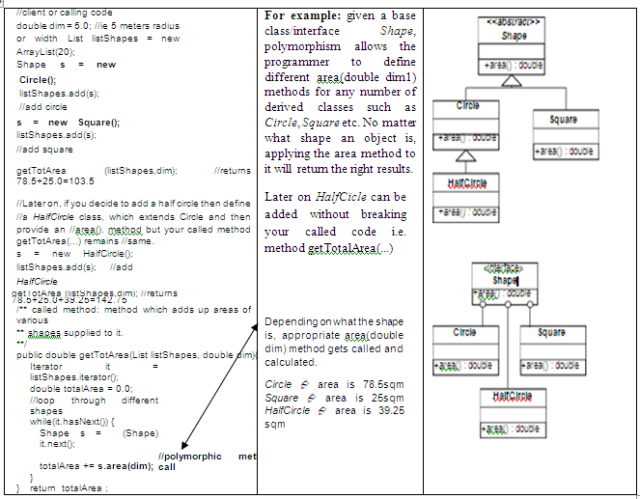
www.v2solutions.com

Slide 15
//client or calling code
double dim = 5.0; //ie 5 meters radius or width List listShapes = new ArrayList(20);
Shape s = new Circle(); listShapes.add(s); //add circle
s = new Square(); listShapes.add(s);
//add square
getTotArea (listShapes,dim); //returns 78.5+25.0=103.5
//Later on, if you decide to add a half circle then define
//a HalfCircle class, which extends Circle and then provide an //area(). method but your called method getTotArea(...) remains //same.
s = new HalfCircle(); listShapes.add(s); //add HalfCircle
getTotArea (listShapes,dim); //returns 78.5+25.0+39.25=142.75
/** called method: method which adds up areas of various shapes supplied to it. **/
public double getTotArea(List listShapes, double dim){
Iterator it = listShapes.iterator();
double totalArea = 0.0;
//loop through different shapes
while(it.hasNext()) {
Shape s = (Shape) it.next();
totalArea += s.area(dim);
//polymorphic method call
}}
return totalArea ;
www.v2solutions.com

Slide 16
refers to keeping all the related members (variables and methods) together in an object. Specifying members as private can hide the variables and methods.
Being able to encapsulate members of a class is important for security and integrity. We can protect variables from unacceptable values.
www.v2solutions.com

Slide 17
In design, you want the base class to present only an interface for its derived classes.
This means, you don’t want anyone to actually instantiate an object of the base class. You only want to upcast to it (implicit upcasting, which gives you polymorphic behaviour), so that its interface can be used.
This is accomplished by making that class abstract using the abstract keyword. If anyone tries to make an object of an abstract class, the compiler prevents it.
The interface keyword takes this concept of an abstract class a step further by preventing any method or function implementation at all
You can only declare a method or function but not provide the implementation.
The class, which is implementing the interface, should provide the actual implementation.
as it provides the separation of interface and implementation and enables you to Capture similarities among unrelated classes without artificially forcing a class relationship
www.v2solutions.com

Slide 18
Have executable methods and abstract methods. | Have no implementation code. All methods are abstract
Can only subclass one abstract class | A class can implement any number of interfaces.
Can have instance variables, constructors and any visibility: public, private, protected | Cannot have instance variables, constructors and can have only public
www.v2solutions.com

Slide 19
When to use an abstract class?: In case where you want to use implementation inheritance then it is usually provided by an abstract base class.
Abstract classes are excellent candidates inside of application frameworks.
Abstract classes let you define some default behaviour and force subclasses to provide any specific behaviour.
When to use an interface?: For polymorphic interface inheritance, where the client wants to only deal with a type and does not care about the actual implementation use interfaces.
For frequent design changes , you should prefer using interface to abstract.
Coding to an interface reduces coupling and interface inheritance can achieve code reuse with the help of object composition.
Interface solve the ‘diamond problem’
www.v2solutions.com

Slide 20
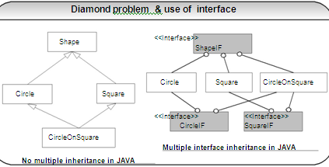
www.v2solutions.com

Slide 21
Overloading deals with multiple methods in the same class
with the same name but different method signatures.
class MyClass {
public void getInvestAmount(int rate) {…}
public void getInvestAmount(int rate, long principal)
{ … }
}
Both the above methods have the same method names
but different method signatures, which mean the methods
are overloaded.
Overloading lets you define the same operation in different ways for different data.
www.v2solutions.com

Slide 22
Overriding deals with two methods, one in the parent class and
the other one in the child class and has the same name and
signatures.
class BaseClass{
public void getInvestAmount(int rate) {…}
}
class MyClass extends BaseClass {
public void getInvestAmount(int rate) { …}
}
Both the above methods have the same method names and
the signatures but the method in the subclass MyClass
overrides the method in the superclass BaseClass.
Overriding lets you define the same operation in different
ways for different object types.
www.v2solutions.com

Slide 23
Everything in Java is pass by Value
public void first(){ int i= 10; int x = second(i); //A t this point //value of i is still 10 //value of x is 11 } public int second(int k) { k++; return k ; } | public void first(){ C ar c = new C ar("red") //A t this point //color is R ed second(c); //A t this point //color is B lue } public void second(C ar d) { d.setC olor(blue); //color is blue }
www.v2solutions.com

Slide 24
Public class Test Animals { public static void main(String ar[] ) { Animal a = new Animal ( ); Animal b = new Horse ( ); // Animal ref. but Horse object a. eat ( ); // Runs the animal version of eat. b. eat ( ); //, Runs the Horse version of eat. }} Class Animal { public void eat ( ) { System.out.println (“ Hi “); }} Class Horse extends Animal { public void eat ( ) { System.out.println (“ Horse eating hay”);}} public void buck ( ){ }} | Class Animal {void makeNoise () { System.out.println (“Generic Noise”);}} Class Dog extends Animal { Void makeNoise () { System.out.println (“Bark”); } Void play Dead () { System.out.println (“roll over”); } } Class CastTest2 { public static void main(string ar[]){ Animal [] a = { new Animal (), new Dog”), new Animal ()}; For (Animal animal :a) { Animal.makeNoise (); If (animal instance of Dog) { Animal playDead (); // try to do a Dog behavior }}}
www.v2solutions.com

Slide 25

Please feel free to send your suggestion / feedback

