Slide 1


Slide 2

If something is not clear, ask!!
There is nothing like a stupid question. Its just that I have made the mistake before and hence I know how to avoid it.
Practice makes perfect!
Don’t wait for a opportunity to practice what you learnt, create the opportunity.
The last time someone taught you something was in the tenth grade. After that you have been learning.
Trainings are ONLY EYE OPENERS. They are not spoon feeding sessions.

Slide 3

To familiarize ones self with Java Language concepts
To gain knowledge about how Java can be used.
www.v2solutions.com

Slide 4
Last Day Covered
  Object Characteristic
  Abstract/Interface
  Overloading/Overriding
  Pass by Value Pass by Reference
Focus on Today
  Object Casting
  File Handling
    What is File? & Handling Mechanism
  Serialization
www.v2solutions.com

Slide 5
Invoking Overloaded Methods –
  For Primitive- Deciding which of the matching methods to invoke is based on the arguments
  For Object References- overloaded version of the method to call is based on the reference type of the argument passed at Compile time
Invoking Overridden Methods
  Which overridden version of the method to call is decided at runtime based on object type
www.v2solutions.com

Slide 6
What is File
  File is concept or mechanism to store data permanently into secondary storage device.
File Handling mechanism.
    Character based
    Binary based.
www.v2solutions.com

Slide 7
For Binary Mode
    FileReader=FileInputStream
    FileWriter= FileOutputStream
    BufferedReader =DataInputStream
    BufferedWriter =DataOutputStream
We can read text file in binary mode (English language which supports ASCII)
But when we have different language like Chinese, Japanese , we cannot read this in binary mode because text will corrupted.
When we will read binary file like Image, video etc in character mode File will be corrupted.
www.v2solutions.com

Slide 8
So binary file must be read in Binary mode.
Character in Java, is of two bytes while in in C and C++ , it is of one byte?
Because java has support of multilingual and all languages character cannot represent into one byte. So it is of two byte.
In binary mode we can read one byte at a time and in one byte we can store all ascii characters. So when we are reading text file using binary mode data is not corrupted.
www.v2solutions.com

Slide 9
Serialization?
Object:-object is real entity in the world which can uniquely identify on the basis of it’s attributes and behaviors.
Serialization involves saving the current state of an object to a stream, and restoring an equivalent object from that stream.
Serialization is mechanism through which we can persist state of an object into the file system or database.
It supports light weight persistence.
www.v2solutions.com

Slide 10
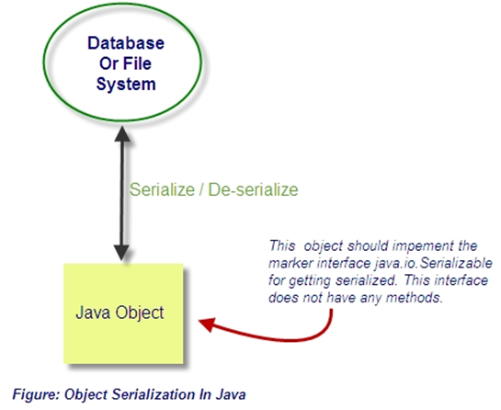
www.v2solutions.com

Slide 11
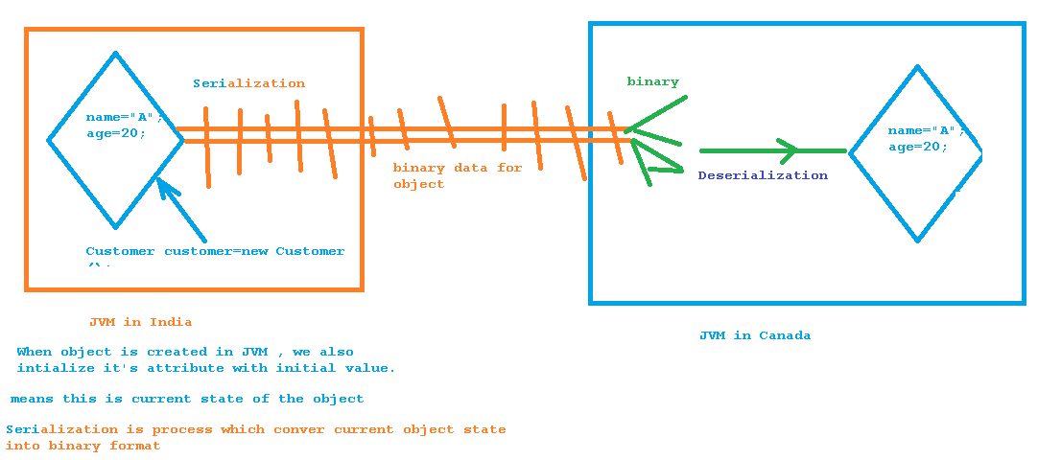
www.v2solutions.com

Slide 12
De-serializable: Restoring the state of the object from file/database into original object inside JVM.
Serializability of a class is enabled by the class implementing the java.io.Serializable interface.
Classes that do not implement this interface will not have any of their state serialized or deserialized.
All subtypes of a serializable class are themselves serializable.
The serialization interface has no methods or fields and serves only to identify the semantics of being serializable.
www.v2solutions.com

Slide 13
public interface Serializable {
}
Serializable is marker or tag interface.
Other example : Clonable, Remote, EventListener.EJBObject
Note: When we will not implement serializable interface for an object and trying to serialize it ,we will get java.io.NotSerializableException
www.v2solutions.com

Slide 14
this is property of object but we do not want to serialize
transient private String password1;
//static is not state of the object ,it is state of the class
static private String password2;
serialVersionUID?
During object serialization, the default Java serialization mechanism writes the metadata about the object, which includes the class name, field names and types, and superclass. This class definition is stored as a part of the serialized object. This stored metadata enables the deserialization process to reconstitute the objects and map the stream data into the class attributes with the appropriate type.
www.v2solutions.com

Slide 15
Everytime an object is serialized the java serialization mechanism automatically computes a hash value. ObjectStreamClass's computeSerialVersionUID() method passes the class name, sorted member names, modifiers, and interfaces to the secure hash algorithm (SHA), which returns a hash value.The serialVersionUID is also called suid.
So when the serilaize object is retrieved , the JVM first evaluates the suid of the serialized class and compares the suid value with the one of the object. If the suid values match then the object is said to be compatible with the class and hence it is de-serialized. If not InvalidClassException exception is thrown.
www.v2solutions.com

Slide 16
Changes to a serializable class can be compatible or incompatible.
Following is the list of changes which are compatible:
Add fields
Change a field from static to non-static
Change a field from transient to non-transient
Add classes to the object tree
List of incompatible changes:
Delete fields
Change class hierarchy
Change non-static to static
Change non-transient to transient
Change type of a primitive field
www.v2solutions.com

Slide 17
At the time of de-serialization if class implements Serializable interface Then it’s default constructor will not be called . Because we are storing object from bits to it’s original state.
UseCases
Use Case : How we make parent class serializable which is written by third party
Question : Is default constructor of parent class will be invoked? Yes
If one class(outer) implements Serializable interface and it contains another object Which does not implements the Serializable interface, then which kind of exception do we get?
www.v2solutions.com

Slide 18
What is Externalizable?
The writeExternal and readExternal methods of the Externalizable interface are implemented by a class to give the class complete control over the format and contents of the stream for an object and its supertypes.
These methods must explicitly coordinate with the supertype to save its state. These methods supersede customized implementations of writeObject and readObject methods
Note : we can change encoding and decoding mechanism here because we have full control because of these two methods.
www.v2solutions.com

Slide 19
public interface Externalizable extends java.io.Serializable {
void writeExternal(ObjectOutput out) throws IOException;
void readExternal(ObjectInput in) throws IOException, ClassNotFoundException;
}
What is difference between Serializable and Externalizable interface
Is Externalizable marker interface? No
www.v2solutions.com

Slide 20
What is Externalizable?
The writeExternal and readExternal methods of the Externalizable interface are implemented by a class to give the class complete control over the format and contents of the stream for an object and its supertypes.
These methods must explicitly coordinate with the supertype to save its state. These methods supersede customized implementations of writeObject and readObject methods
Note : we can change encoding and decoding mechanism here because we have full control because of these two methods.
www.v2solutions.com

Slide 21

Please feel free to send your suggestion / feedback

