Slide 1
DEPARTMENT OF COMPUTER SCIENCE AND SOFTWARE ENGINEERING
CONCORDIA UNIVERSITY
Multithreading
(Java, C#, C++)
by Emil Vassev & Joey Paquet
Multithreading
2007, 2009

Slide 2
Outline
Process versus Thread
Synchronization
Multithreading with Java
Multithreading with C#
Multithreading with C++
Multithreading

Slide 3
Topic
Process versus Thread.
Synchronization
Multithreading

Slide 4
Process Model
A process is a sequential program in execution.
A process is a unit of computation.
Process components:
  The program (code) to be executed.
  The data on which the program will execute.
  Resources required by the program.
  The status of the process execution.
A process runs in an abstract machine environment (could be OS) that manages the sharing and isolation of resources among the community of processes.
Code
Data
Process Status
Resource
Abstract Machine Environment
Multithreading

Slide 5
Program and Process
Program and process – distinction?
A program is a static entity made up of program statements. The latter define the run-time behavior.
A process is a dynamic entity that executes a program on a particular set of data.
Two or more processes could execute the same program, each using their own data and resources.
Multithreading

Slide 6
Thread Model
A thread is an alternative form (to the process) of schedulable unit of computation.
In the thread model:
  Each thread is associated with a process.
  A thread is an entity that executes by relying on the code and resources, holding by the associated process.
  Several threads could be associated with a single process. Those threads share the code and resources of the process.
  A thread allocates part of the process’s resources for its needs.
  A thread has its own data and status.
Resource
Process
Thread
Data
Code
Data
Process Status
Thread Status
Multithreading

Slide 7
Thread Model
Control in a normal program usually follows a single thread of execution.
What differentiates threads from normal processes is the shared memory (objects), which is visible to all threads in a multi-threaded program.
A thread has much less overhead than a process so is sometimes called as light-weight process.
Multithreading allows an application to have multiple threads of execution running concurrently.
Multithreading

Slide 8
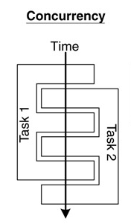
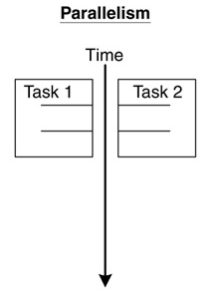
Concurrency and Parallelism
  Concurrent multithreading systems give the appearance of several tasks executing at once, but these tasks are actually split up into chunks that share the processor with chunks from other tasks.
  In parallel systems, two tasks are actually performed simultaneously. Parallelism requires a multi-CPU system.
Multithreading

Slide 9
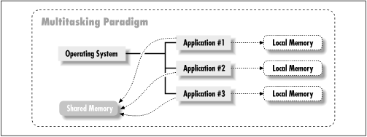
Multitasking
Multitasking operating systems run multiple programs simultaneously.
Each of these programs has at least one thread within it - single-threaded process:
  The process begins execution at a well-known point. In Java, C# or C++, the process begins execution at the first statement of the function called main().
  Execution of the statements follows in a completely ordered, predefined sequence for a given set of inputs.
  While executing, the process has access to certain data – local, global, static etc.
Multithreading

Slide 10
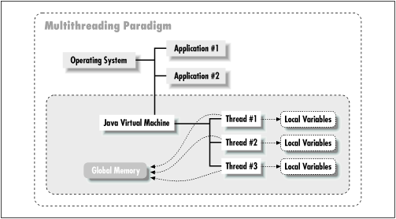
Multithreading
A program with multiple threads running within a single instance could be considered as a multitasking system within an OS.
In a multithreading program, threads have the following properties:
  A thread begin execution at a predefined, well-known location. For one of the threads in the program, that location is the main() method; for the rest of the threads, it is a particular location the programmer decides on when the code is written.
  A thread executes code in an ordered, predefined sequence.
  A thread executes its code independently of the other threads.
  The threads appear to have a certain degree of simultaneous execution.
Multithreading

Slide 11
Threading Models
There are typically two threading models supported by OS:
Cooperative Threading Model;
Preemptive Threading Model.
Cooperative Threading Model
  In a cooperative system, a thread retains control of the processor until it decides to give it up (which might be never).
  Supporting OS – Windows 3.x, Solaris, Mac OS.
  The various threads have to cooperate with each other. If not, some of them will be starving (never given a chance to run).
  Scheduling in most cooperative systems is done strictly by priority level - when the current thread gives up control, the highest-priority waiting thread gets control.
Multithreading

Slide 12
Threading Models
Preemptive Threading Model
  In a preemptive system, some sort of timer is used by the operating system itself to cause a context swap.
  Supporting OS – Windows 9x, XP, NT (2000), Solaris, Linux.
  When the timer "ticks" the OS can abruptly take control away from the running thread and give control to another thread.
  The interval between timer ticks is called a time slice.
  To get to concurrency, the OS must do the thread scheduling.
  Preemptive systems are less efficient than cooperative ones because the thread management must be done by the OS’ kernel, but they are easier to program (except their synchronization).
Multithreading

Slide 13
Synchronization
  Background
  Concurrent access to shared data may result in data inconsistency.
  Maintaining data consistency requires mechanisms to ensure the
  orderly execution of cooperating processes (or threads).
  When do we need synchronization?
  When two or more processes (or threads) work on the same data simultaneously.
Multithreading

Slide 14
Synchronization
  Example:
  Two threads are trying to update the same shared variable simultaneously:
    The result is unpredictable.
    The result depends on which of the two threads was the last one to change the value.
    The competition of the threads for the variable is called race condition.
    The first thread is the one who wins the race to update the variable.
Multithreading

Slide 15
Classical Synchronization Problems
  Mutual exclusion
  Only one process executes a piece of code (critical section) at any time.
  OS examples: access to shared resources, e.g., a printer.
  Sequencing
  A process waits for another process to finish executing some code.
  OS examples: waiting for an event, e.g., ls (dir) command suspends until there is some data to read from the file system.
Multithreading

Slide 16
Classical Synchronization Problems
  Bounded-buffer
  (also referred to as the Producer-Consumer problem)
  A pool of n buffers.
  Producer processes put items into the pool.
  Consumer processes take items out of the pool.
  Issues: mutual exclusion, empty pool, and full pool.
  OS examples: buffering for pipes, file caches, etc.
Multithreading

Slide 17
Classical Synchronization Problems
  Readers-Writers
  Multiple processes access a shared data object X.
  Any number of readers can access X at the same time.
  No writer can access it at the same time as a reader or another writer.
  Mutual exclusion is too constraining. Why?
  Variations:
    reader-priority: a reader must not wait for a writer;
    writer-priority: a writer must not wait for a reader,
  OS examples: file locks.
Multithreading

Slide 18
Classical Synchronization Problems
  Dining Philosophers
  5 philosophers with 5 chopsticks placed between them.
  To eat requires two chopsticks.
  Philosophers alternate between thinking and eating.
  OS examples: simultaneous use of multiple resources.
  Many examples, along with Java code
  http://www.doc.ic.ac.uk/~jnm/book/book_applets/concurrency.html
Multithreading

Slide 19
The Critical Section Problem
  Definition:
  A critical section is a piece of code that accesses a shared resource (data structure or device) that must not be concurrently accessed by more than one thread of execution.
  Conditions:
  n processes (or threads) all competing to use some shared data.
  Each process has a code segment, called critical section, in which the shared data is accessed.
  Problem:
  How to ensure that when one process is executing in its critical section, no other process is allowed to execute in its critical section?
Multithreading

Slide 20
The Critical Section Problem - Example
  Suppose that two processes are trying to increment the same variable. They both execute the statement
x := x + 1;
  To execute this statement each process reads the variable x, then adds one to the value, then write it back.
  Suppose the value of x is 3.
    If both processes read x at the same time then they would get the same value 3.
    If they then both added 1 to it then they would both have the value 4.
    They would then both write 4 back to x.
    The result is that both processes incremented x, but its value is only 4, instead of 5.
Multithreading

Slide 21
The Critical Section Problem
  Solution – three requirements:
  Only one process is allowed to be in its critical section at a time. Hence, the execution of critical sections is mutually exclusive.
  If there is no process in its critical section, but some processes are waiting to enter their critical sections, only the waiting processes may compete for getting in. Ultimately, there must be progress in the resolution and one process must be allowed to enter.
  Processes waiting to enter their critical sections must be allowed to do so in a bounded timeframe. Hence, processes have bounded waiting.
Multithreading

Slide 22
The Critical Section Problem
  Critical sections are General Framework for process (thread) synchronization:
  ENTRY SECTION
  CRITICAL SECTION CODE
  EXIT SECTION
    The ENTRY SECTION controls access to make sure no more than one process Pi gets to access the critical section at any given time. It acts as a guard.
    The EXIT SECTION does bookkeeping to make sure that other processes that are waiting know that Pi has exited.
Multithreading

Slide 23
Semaphores
  The Semaphores are a solution to the Critical Section Problem.
  Help in making the Critical Section atomic.
  A semaphores is:
  a single integer variable S;
  accessed via two atomic operations:
    WAIT (sometimes denoted by P)
    while S <= 0 do wait();
    S := S-1;
    SIGNAL (sometimes denoted by V)
    S := S+1;
    wake up a waiting process (if any);
  WAITing processes cannot “lock out” a SIGNALing process.
  Binary semaphores - S is restricted to take on only the values 0 and 1.
  Mutual Exclusion Semaphore
  //**** initially S = 1
  P( S ) //**** WAIT
  CRITICAL SECTION
  V( S ) //**** SIGNAL
Multithreading

Slide 24
Topic
Multithreading with Java
Multithreading

Slide 25
Threads in Java
There are two ways to create a java thread:
  By extending the java.lang.Thread class.
  By implementing the java.lang.Runnable interface.
The run() method is where the action of a thread takes place.
The execution of a thread starts by calling its start() method.
class PrimeThread extends Thread {
long minPrime;
PrimeThread(long minPrime) {
this.minPrime = minPrime; }
public void run() {
// compute primes larger than minPrime . . .
}
}
The following code would then create a thread and start it running:
PrimeThread p = new PrimeThread(143);
p.start();
Multithreading

Slide 26
Implementing the Runnable Interface
In order to create a new thread we may also provide a class that implements the java.lang.Runnable interface.
Preferred way in case our class has to subclass some other class.
A Runnable object can be wrapped up into a Thread object:
  Thread(Runnable target)
  Thread(Runnable target, String name)
The thread’s logic is included inside the run() method of the runnable object.
class ExClass
extends ExSupClass
implements Runnable {
  …
  public ExClass (String name) {
  }
  public void run() {
  …
  }
}
class A {
  …
  main(String[] args) {
    …
    Thread mt1 = new Thread(new ExClass("thread1”));
    Thread mt2 = new Thread(new ExClass("thread2”));
    mt1.start();
    mt2.start();
  }
}
Multithreading

Slide 27
Implementing the Runnable Interface
  Constructs a new thread object associated with the given Runnable object.
  The new Thread object's start() method is called to begin execution of the new thread of control.
  The reason we need to pass the runnable object to the thread object's constructor is that the thread must have some way to get to the run() method we want the thread to execute. Since we are no longer overriding the run() method of the Thread class, the default run() method of the Thread class is executed:
  public void run() {
  if (target != null) {
  target.run();
  }
  }
  Here, target is the runnable object we passed to the thread's constructor. So the thread begins execution with the run() method of the Thread class, which immediately calls the run() method of our runnable object.
Multithreading

Slide 28
Sleep, Yield, Notify & Wait Thread’s Functions
sleep(long millis) - causes the currently executing thread to sleep (temporarily cease execution) for the specified number of milliseconds.
yield() - causes the currently executing thread object to temporarily pause and allow other threads to execute.
wait() - causes current thread to wait for a condition to occur (another thread invokes the notify() method or the notifyAll() method for this object). This is a method of the Object class and must be called from within a synchronized method or block.
notify() - notifies a thread that is waiting for a condition that the condition has occurred. This is a method of the Object class and must be called from within a synchronized method or block.
notifyAll() – like the notify() method, but notifies all the threads that are waiting for a condition that the condition has occurred.
Multithreading

Slide 29
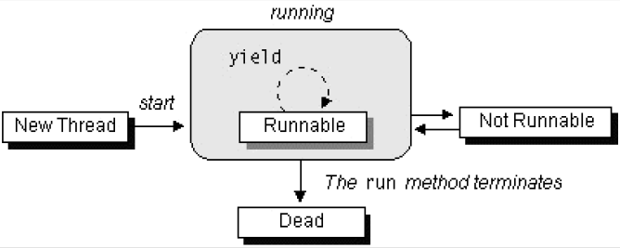
The Lifecycle of a Thread
The start() method creates the system resources necessary to run the thread, schedules the thread to run, and calls the thread's run() method.
A thread becomes Not Runnable when one of these events occurs:
  Its sleep() method is invoked.
  The thread calls the wait() method.
  The thread is blocked on I/O operations.
A thread dies naturally when the run() method exits.
Multithreading

Slide 30
Thread Priority
On a single CPU, threads actually run one at a time in such a way as to provide an illusion of concurrency.
Execution of multiple threads on a single CPU, in some order, is called scheduling.
The Java runtime supports a very simple scheduling algorithm (fixed priority scheduling). This algorithm schedules threads based on their priority relative to other runnable threads.
The runtime system chooses the runnable thread with the highest priority for execution.
Multithreading

Slide 31
Thread Priority
If two threads of the same priority are waiting for the CPU, the scheduler chooses one of them to run in a round-robin fashion - each process is guaranteed to get its turn at the CPU at every system-specified time interval.
The chosen thread will run until:
  A higher priority thread becomes runnable.
  It yields (calls its yield() method), or its run() method exits.
  On systems that support time-slicing, its time allotment has elapsed.
You can modify a thread's priority at any time after its creation by using the setPriority() method.
Multithreading

Slide 32
Synchronization of Java Threads
In many cases concurrently running threads share data and must consider the state and activities of other threads.
If two threads can both execute a method that modifies the state of an object then the method should be declared to be synchronized, those allowing only one thread to execute the method at a time.
If a class has at least one synchronized method, each instance of it has a monitor. A monitor is an object that can block threads and notify them when the method is available.
Example:
public synchronized void updateRecord() {
//**** critical code goes here …
}
Only one thread may be inside the body of this function. A second call will be blocked until the first call returns or wait() is called inside the synchronized method.
Multithreading

Slide 33
Synchronization of Java Threads
If you don’t need to protect an entire method, you can synchronize on an object:
  public void foo() {
      synchronized (this) {
      //critical code goes here …
      }
      …
  }
There are two syntactic forms based on the synchronized keyword - blocks and methods.
Block synchronization takes an argument of which object to lock. This allows any method to lock any object.
The most common argument to synchronized blocks is this.
Block synchronization is considered more fundamental than method synchronization.
Multithreading

Slide 34
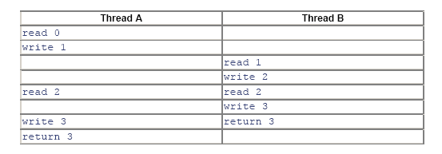
Applying Synchronization (Example)
Consider the following class:
class Even {
  private int n = 0;
  public int next(){
  ++n;
  ++n;
  return n; //**** next is always even
  }
}
Without synchronizing, the desired postcondition may fail due to a storage conflict when two or more threads execute the next method of the same Even object.
Here is one possible execution trace:
Declaring the next method as synchronized would resolve such conflicting problems.
synchronized
Multithreading

Slide 35
Synchronization of Java Threads
To program the synchronization behavior we use the Object class’ methods wait(), notify() and notifyAll().
With these methods we allow objects to wait until another object notifies them:
  synchronized( waitForThis ) {
    try { waitForThis.wait();}
    catch (InterruptedException ie) {}
  }
To wait on an object, you must first synchronize on it.
InterruptedException is thrown when a thread is waiting, sleeping, or otherwise paused for a long time and another thread interrupts it using the interrupt method in class Thread.
Multithreading

Slide 36
Synchronization of Java Threads
A thread may call wait() inside a synchronized method. A timeout may be provided. If missing or zero then the thread waits until either notify() or notifyAll() is called, otherwise until the timeout period expires.
wait() is called by the thread owning the lock associated with a particular object.
notify() or notifyAll() are only called from a synchronized method. One or all waiting threads are notified, respectively. It’s probably better (safer) to use notifyAll(). These methods don't release the lock. The threads awakened will not return from their wait() call immediately, but only when the thread that called notify() or notifyAll() finally relinquishes ownership of the lock.
Multithreading

Slide 37
Synchronization of Java Threads
The wait() method releases the lock prior to waiting, and reacquires the lock prior to returning from the wait() method.
It is possible a synchronized method to make a self-call to another synchronized method on the same object without freezing up.
Methods that are not synchronized may still execute at any time, even if a synchronized method is in progress. In other words, synchronized is not equivalent to atomic, but synchronization can be used to achieve atomicity.
Multithreading

Slide 38
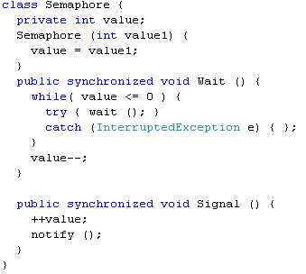
Java Semaphore - Example
Multithreading

Slide 39
Protecting Static Fields
Locking an object does not automatically protect access to the static fields of that object's class or any of its superclasses.
Access to static fields is instead protected via static synchronized methods and blocks.
Consider the following class:
class Even {
  public static int n = 0;
  public static synchronized int next(){ //**** will lock n as well and
  ++n;
  ++n;
  return n; //**** next is always even
  }
}
Will prevent outer access on n, until the end of the next() method.
Multithreading

Slide 40
Java Threading API
:: Stopping Threads
The Thread class does contain a stop() method that allows you to stop a thread immediately: no matter what the thread is doing, it will be terminated.
However, the stop() method is very dangerous. In Java 2, the stop() method is deprecated.
Why?
If a thread holds a lock at the time it is stopped, the lock will be released when the thread stops.
But if the thread that is being stopped is in the middle of updating a linked list, for example, the links in the list will be left in an inconsistent state.
Hence, if we were able to interrupt a thread in the middle of this operation, we would lose the benefit of its obtaining the lock.
The reason we needed to obtain a lock on the list in the first place was to ensure that the list would not be found by another thread in an inconsistent state.
Multithreading

Slide 41
Java Threading API
:: The suspend() and resume() Methods
The suspend() and resume() methods are very dangerous and they became deprecated.
The problem with using the suspend() method is that it can conceivably lead to cases of lock starvation - including cases where the starvation shuts down the entire virtual machine.
If a thread is suspended while it is holding a lock, that lock remains held by the suspended thread. As long as that thread is suspended, no other thread can obtain the lock.
There is no danger in the resume() method itself, but since the resume() method is useful only with the suspend() method, it too has been deprecated.
Java Thread primitives deprecation: http://java.sun.com/j2se/1.5.0/docs/guide/misc/threadPrimitiveDeprecation.html
Multithreading

Slide 42
Java Threading API
:: Thread Naming
  It is possible to assign a String name to the Thread object itself:
  void setName(String name) //assigns a name to the Thread instance
  String getName() //gets the name of the Thread instance
  The system does not use this string for any specific purpose.
  We can use it for debugging. With an assigned name, the debugger and the toString() method display thread information in terms of a “logical" name instead of a number.
  The naming support is also available as a constructor of the Thread class:
    Thread(String name) constructs a thread object with a name that is already assigned. This constructor is used when threading by inheritance.
    Thread(Runnable target, String name) constructs a thread object that is associated with the given Runnable object and is created with a name that is already assigned. This constructor is used when threading by interfaces.
Multithreading

Slide 43
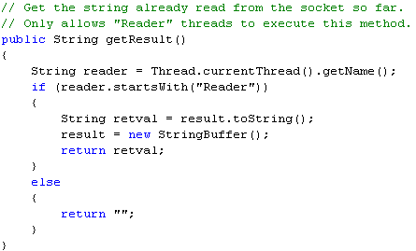
Java Threading API
:: Thread Access – The currentThread() Method
  static Thread currentThread() gets the Thread object that represents the current thread of execution. The method is static and may be called through the Thread class name.
  Why is this method important?
  The Thread object for the current thread may not be saved anywhere, and even if it is, it may not be accessible to the called method.
  In this code we are assuming that reader threads are threads whose names start with "Reader." This name could have been assigned by the setName() method earlier or when the threads were constructed.
  To obtain a name, we need simply to call the getName() method. However, since we do not have the Thread object reference of the caller, we must call the currentThread() method to obtain the reference.
Multithreading

Slide 44
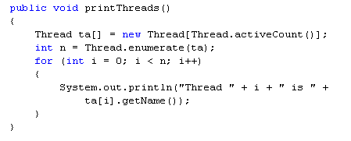
Java Threading API
:: Thread Access – Enumerating Threads in JVM
  The Thread class provides methods that allow you to obtain a list of all the threads in the program:
  static int enumerate(Thread threadArray[]) gets all the thread objects of the program and stores the result into the thread array. The value returned is the number of thread objects stored into the array. The method is static and may be called through the Thread class name.
  static int activeCount() returns the number of threads in the program. The method is static and may be called through the Thread class name.
Multithreading

Slide 45
Topic
Multithreading with C#
Multithreading

Slide 46
C# Namespace System.Threading
Sytem.Threading is a powerful namespace for:
  programming Threads in C#;
  thread Synchronization in C#.
The most important class inside this namespace for manipulating threads is the class Sytem.Threading.Thread.
  It can run other thread in our application process.
Threads in C# does not require a run() method;
A thread in C# is not considered as an object;
C# provides similar to Java set of primitives for operating on threads.
Multithreading

Slide 47
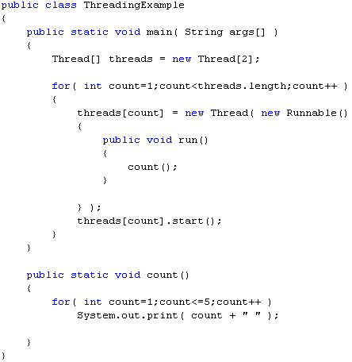
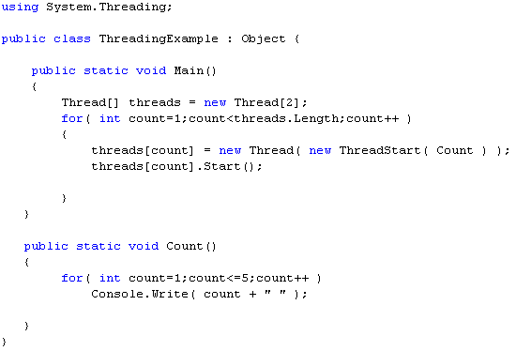
Java versus C#
Java Code
C# Code
Multithreading

Slide 48
Java’s java.lang.Thread – C#’s System.Threading.Thread
Java | C#
setDaemon( boolean on) method | IsBackground set property
isDaemon() method | IsBackground get property
isAlive() method | IsAlive get property
yield() method | Interrupt() method
isInterrupted() method | n/a
sleep( long millis ) and sleep( long millis, int nanos ) | Sleep( int millisecondTimeout ) and Sleep( System.TimeSpan ) methods
join(), and join( long millis ), and join( long millis, int nanos ) methods | Join(), Join( int millisecondTimeout ), and Join( System.TimeSpan ) methods
suspend() method | Suspend() method
resume() method | Resume() method
stop() method | Abort() method
Multithreading

Slide 49
Thread Synchronization
Java | C#
synchronized | lock
Object.wait() method | Monitor.Wait( object obj ) method
Object.notify() method | Monitor.Pulse( object obj ) method
Object.notifyAll() method | Monitor.PulseAll( object obj ) method
In addition to the lock construct, C# has provided access to its internal methods to acquire and release locks:
  Monitor.Enter( object obj );
  Monitor.Exit( object obj ).
Using these methods can buy a programmer the same benefits as using the lock construct, but it can also provide more elaborate locking abilities, such as being able to lock variables in one method and have them released at different times or different points in the code, depending on the code path.
Multithreading

Slide 50
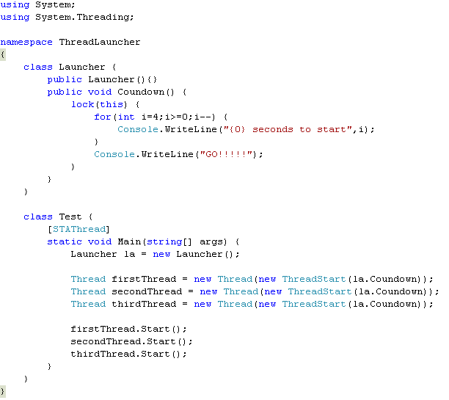
Example: Thread Synchronization
Multithreading

Slide 51
Topic
Multithreading with C++
Multithreading

Slide 52
C++ Has No Build-in Multithreading
C++ does not contain any built-in support for multithreaded applications. Instead, it relies entirely upon the operating system to provide this feature.
Using operating system functions to support multithreading gives you access to the full range of control offered by the execution environment.
Consider Windows. It defines a rich set of thread-related functions that enable finely grained control over the creation and management of a thread.
Example: Windows has several ways to control access to a shared resource - semaphores, mutexes, event objects, waitable timers, and critical sections.
Multithreading

Slide 53
Windows Thread Functions - CreateThread
Windows offers a wide array of Application Programming Interface (API) functions that support multithreading.
To use Windows’ multithreading functions, you must include <windows.h> in your program.
To create a thread, use the Windows API CreateThread() function. Its prototype is shown here:
HANDLE CreateThread(
LPSECURITY_ATTRIBUTES secAttr,
SIZE_T stackSize,
LPTHREAD_START_ROUTINE threadFunc,
LPVOID param,
DWORD flags,
LPDWORD threadID);
Multithreading

Slide 54
Windows Thread Functions - CreateThread
secAttr - a pointer to a set of security attributes pertaining to the thread. If secAttr is NULL, then the default security descriptor is used.
Each thread has its own stack – the stackSize parameter. If this integer value is zero, then the thread will be given a stack that is the same size as the creating thread.
Each thread of execution begins with a call to a function, called the thread function, within the creating process (like in C#).
Execution of the thread continues until the thread function returns.
The address of this function (that is, the entry point to the thread) is specified in threadFunc.
DWORD WINAPI threadfunc(LPVOID param);
Multithreading

Slide 55
Windows Thread Functions - CreateThread
param – specifies any argument that you need to pass to the new thread.
flags - determines the execution state of the thread:
  If it is zero, the thread begins execution immediately.
  If it is CREATE_SUSPEND, the thread is created in a suspended state, awaiting execution.
  It may be started using a call to ResumeThread().
threadID - the identifier associated with a thread is returned in this long integer pointer.
The function returns a handle to the thread if successful or NULL if a failure occurs.
The thread handle can be destroyed:
  manually by calling CloseHandle();
  automatically when the parent process ends.
Multithreading

Slide 56
Windows Thread Functions – TerminateThread
A thread terminates when its entry function returns.
We can also terminate threads manually:
  TerminateThread( );
  ExitThread( );
BOOL TerminateThread(HANDLE thread, DWORD status);
VOID ExitThread(DWORD status);
thread - the handle of the thread to be terminated.
status - the termination status.
ExitThread() - terminates the thread that calls ExitThread().
TerminateThread() returns nonzero if successful and zero otherwise.
Multithreading

Slide 57
Visual C++ Threading Model
The Visual C++ alternatives to CreateThread() and ExitThread() are listed below. Both require the header file <process.h>.
  _beginthreadex( );
  _endthreadex( );
uintptr_t _beginthreadex(
void *secAttr,
unsigned stackSize,
unsigned (__stdcall *threadFunc)(void *),
void *param,
unsigned flags,
unsigned *threadID);
void _endthreadex(unsigned status);
Multithreading

Slide 58
Suspending and Resuming Threads
A thread of execution can be suspended by calling SuspendThread().
It can be resumed by calling ResumeThread().
DWORD SuspendThread(HANDLE hThread);
DWORD ResumeThread(HANDLE hThread);
Multithreading

Slide 59
Windows Synchronization Objects
classic semaphore - when using a semaphore, the access to a resource can be completely synchronized.
mutex semaphore (mutex) - synchronizes a resource such that one and only one thread or process can access it at any one time.
event object - can be used to block access to a resource until some other thread or process signals that it can be used. An event object signals that a specified event has occurred.
waitable timer - blocks a thread’s execution until a specific time.
timer queues - lists of timers.
critical section - prevents a section of code from being used by more than one thread at a time.
Multithreading

Slide 60
Using Mutex
CreateMutex() – creates a mutex object.
HANDLE CreateMutex(
LPSECURITY_ATTRIBUTES secAttr,
BOOL acquire,
LPCSTR name);
Once you have created a semaphore, you use it by calling two related functions: WaitForSingleObject() and ReleaseMutex().
To use a mutex to control access to a shared resource, wrap the code that accesses that resource between a call to WaitForSingleObject() and ReleaseMutex().
If (WaitForSingleObject(hMutex, 10000)==WAIT_TIMEOUT)
{ //**** handle time-out error }
//**** access the resource
ReleaseMutex(hMutex);
Multithreading

Slide 61
References
Scott Oaks and Henry Wong, “Java Threads”, 2nd edition, O’Reilly
Bruce Eckel, "Thinking in Java", 3^{d} edition
Sun Microsystems, “The Java Tutorial, http://java.sun.com/docs/books/tutorial/essential/threads/
Sun Microsystems, JavaTM 2 Platform, Standard Edition, v 1.3.1
API Specification, http://java.sun.com/j2se/1.3/docs/api/overview-summary.html
Mike Gold October , Introduction to Multithreading in C#, C# Corner, June 2005
Multithreading in C++, Contributed by McGraw-Hill/Osborne,
http://www.devarticles.com/c/a/Cplusplus/Multithreading-in-C/
Multithreading

