Slide 1
Agile Methodology
Project on E-Commerce

Slide 2
Introduction To Agile methodology
Agile is a flexible and collaborative way of getting work done, especially in software development. Instead of doing all the work in one big chunk, Agile breaks it into smaller parts called sprints. After each sprint, a usable piece of the project is delivered. It's like building a puzzle one piece at a time while being open to changes and feedback. Agile encourages teamwork, regular communication, and making sure what's being built meets the needs of the people using it. The goal is to be adaptable and create a better product through continuous improvement.

Slide 3
Phases of Agile
Requirement Gathering:
Understand what needs to be done. Talk to people who will use the product to gather their needs and expectations. Create a list of all the things the product should do.
2. Design the Requirement:
Plan how to build the things you gathered in the first step. Think about the best way to make the product, considering how it will look and how people will use it.
3. Construction and Iteration:
Start building the product based on your plans. Instead of doing everything at once, break the work into smaller parts and build one part at a time. After each part, check if it's working well and make improvements if needed.

Slide 4
Phases of Agile
4. Testing:
Make sure everything works correctly. Test each part to catch any mistakes or problems. This ensures the product is reliable and does what it's supposed to do.
5. Deployment:
Share the product with the people who will use it. Make it available to them. This can be a small release to a limited group or a full release to everyone, depending on the project.
6. Feedback:
Listen to what people think about the product. Get their opinions and suggestions. Use this feedback to make the product better. This step helps in adapting and improving based on the actual experience of users.

Slide 5
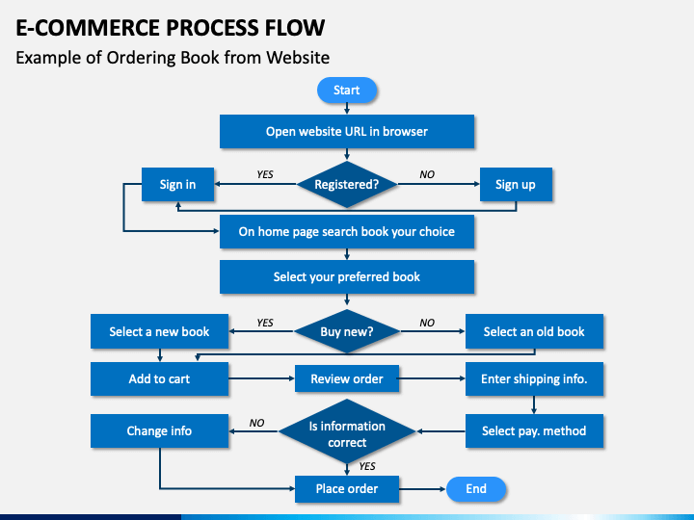
Designing The Flowchart

Slide 6
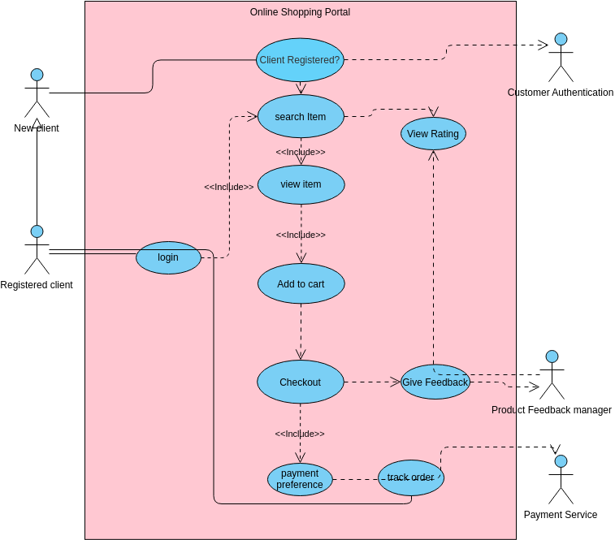
Use case Diagram

Slide 7
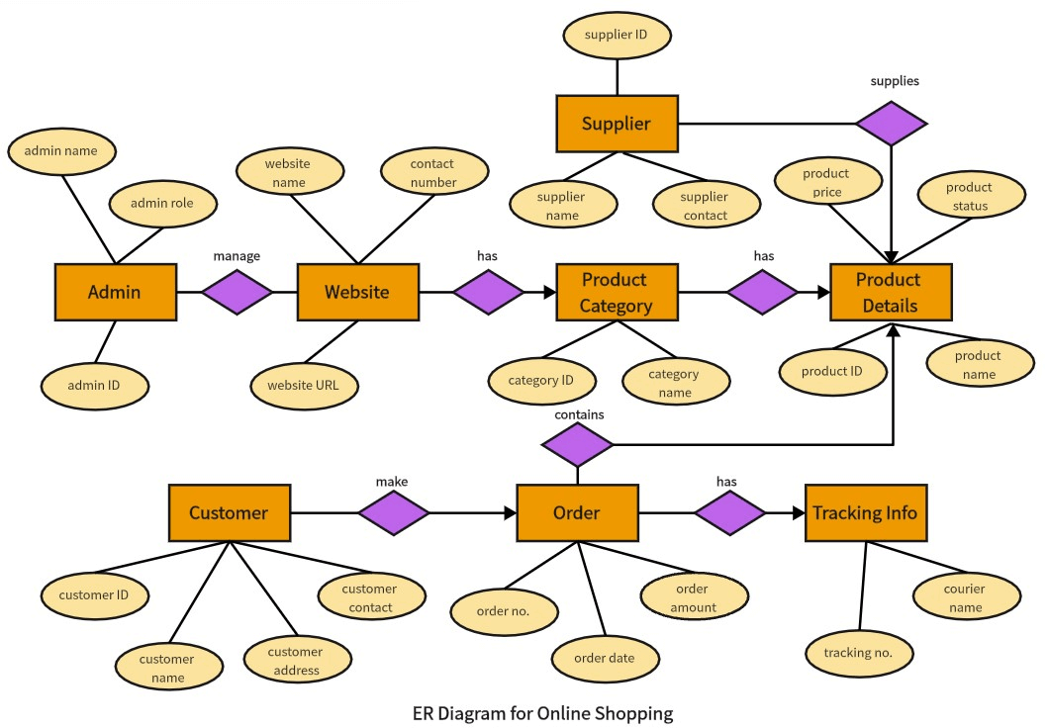
ER Diagram

