Slide 1
YouTube Content Success Analytics
What drives engagement across ~36,500 unique trending videos?
Capstone Analytics Team | July 2026

Slide 2
Problem & Objective
• Brief: analyze video engagement drivers and content-performance trends.
• Data: ~450,000 trending rows -> ~36,540 UNIQUE videos after dedup.
• Goal: turn engagement patterns into concrete content recommendations.
• Pipeline: cleaning + dedup -> EDA -> 16 visualizations -> stats -> strategy.

Slide 3
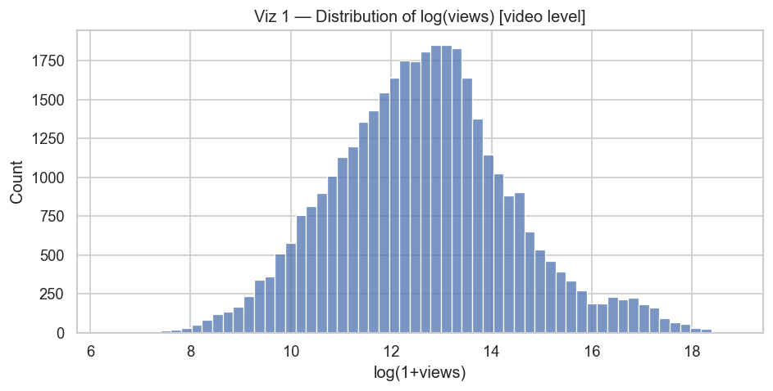
Data Quality & Unit of Analysis
• One row per (video, country, trending-day); ~92% of rows repeat a video.
• Deduplicated to one row per video (max-views snapshot) for driver analysis.
• Appearance grain kept only for geographic spread.
• ~442k appearances -> ~36,540 unique videos; engagement heavily right-skewed.
Dedup prevents over-counting widely-trending videos

Slide 4
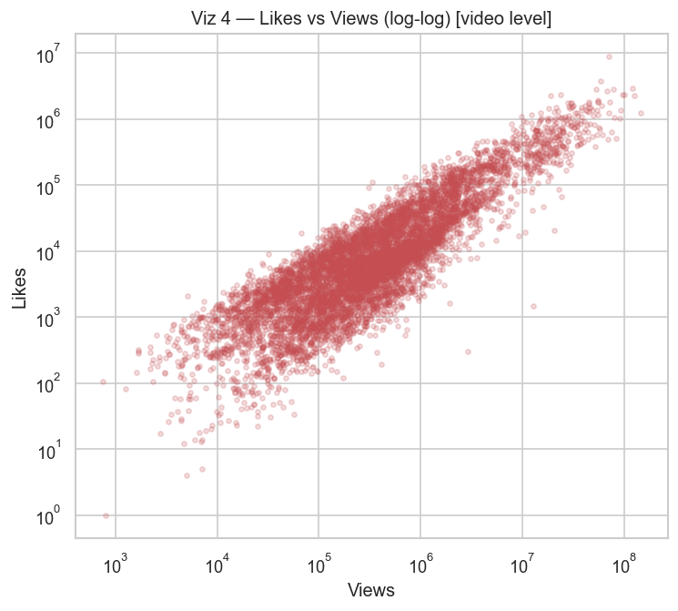
Engagement Is Real & Correlated
• Likes and views move together tightly: r = 0.87 (log scale), p ~ 0.
• Comments also track engagement.
• Only genuine relationships appear in the correlation heatmap.
Genuine engagement signal to analyze

Slide 5
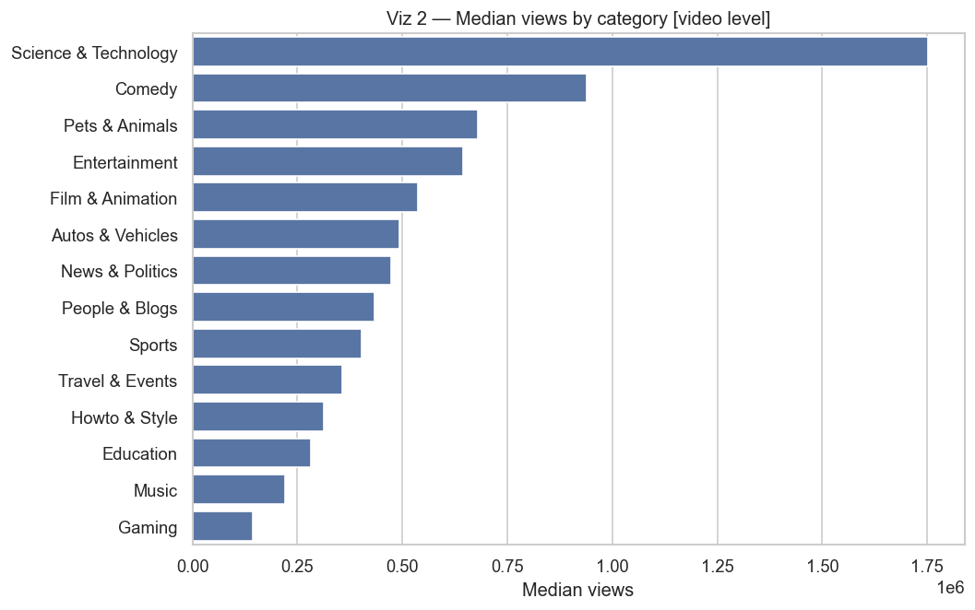
Driver 1 — Category Matters
• Median views vary widely across categories.
• Leaders: Science & Tech (~1.75M), Comedy, Pets & Animals.
• Laggards: Education, Music, Gaming (~0.14M).
• ANOVA F = 535 (log views), p ~ 0 — highly significant.
Weight the calendar toward high-reach categories

Slide 6
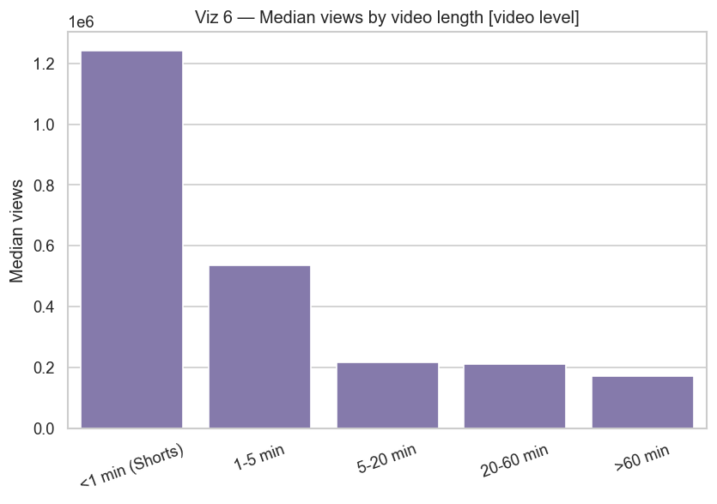
Driver 2 — Video Length (Reach vs Engagement)
• Shorts (<1 min): ~1.24M median views — ~6x the 5-20 min band.
• But like-rate PEAKS at 20-60 min (~3.9%) vs Shorts (~3.0%).
• Trade-off: Shorts win reach, long-form wins loyalty.
Barbell strategy: Shorts for reach + long-form for engagement

Slide 7
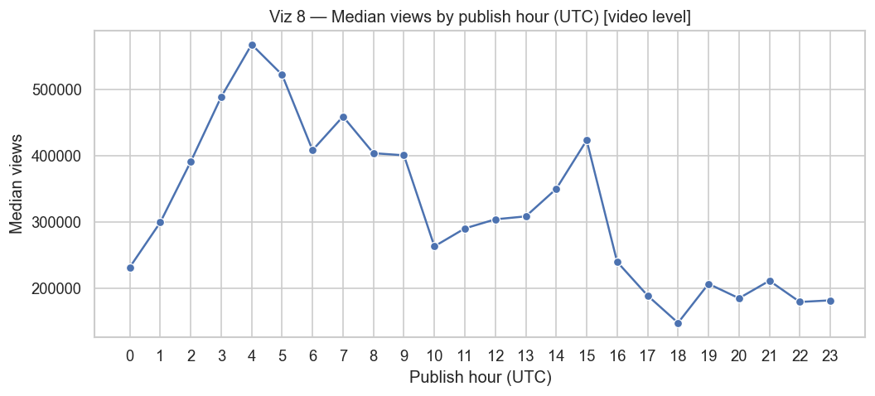
Driver 3 — Publish Timing
• Median views peak for uploads around 03:00-05:00 UTC.
• Like-rate varies modestly by weekday (ANOVA p ~ 3e-14).
• Align uploads to the audience's prime-time in this window.
Schedule uploads to the early-UTC peak window

Slide 8
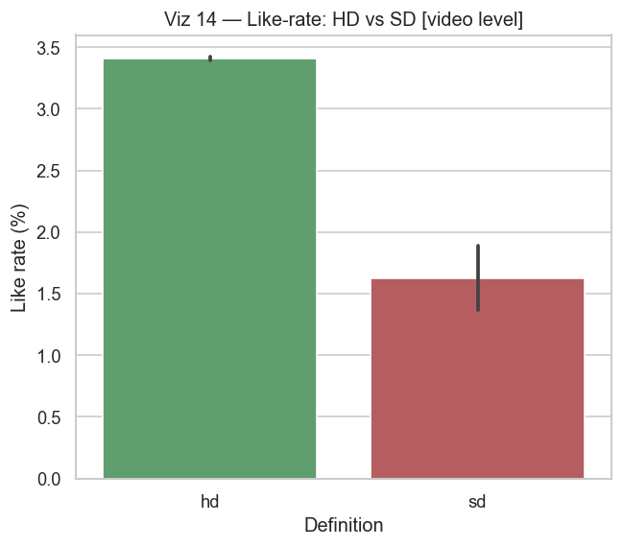
Driver 4 — Quality & Metadata
• HD like-rate 3.4% vs SD 1.6% (t-test p ~ 4e-10) — always ship HD.
• Shorter titles correlate with higher like-rate (r = -0.22).
• More tags do not raise views — don't over-tag.
HD + concise titles + focused tags

Slide 9
Statistical Evidence (summary)
Driver | Evidence | Result
Unit of analysis | Rows vs unique videos | 442,459 appearances -> 36,540 videos
Shorts reach | Median views <1min vs 5-20min | 1.24M vs 0.22M (~5.7x)
Length vs like-rate | Mean like-rate 20-60min vs Shorts | 3.88% vs 3.03%
Category spread | Median views top vs bottom | Sci&Tech 1.75M vs Gaming 0.14M
Best publish window | Top median-view hours (UTC) | 03:00-05:00
HD vs SD | Like-rate (t-test p~4e-10) | 3.41% vs 1.63%
Engagement realness | corr log(views)~log(likes) | r=0.87, p~0
Geographic spread | Videos trending in 1 country only | 69% (median 1, max 81)
All ANOVA/correlation tests significant (p < 1e-13).

Slide 10
Business Recommendations
• 1. Lead with Shorts for reach (~6x the mid-length band).
• 2. Use mid-to-long videos to deepen engagement (higher like-rate).
• 3. Prioritise high-value categories (Sci&Tech, Comedy, Pets).
• 4. Publish in the early-UTC window (03:00-05:00).
• 5. Always ship HD; keep titles concise.
• 6. Don't over-tag — a focused tag set is enough.
Actionable content strategy grounded in ~36,540 unique videos

Slide 11
Next Steps
• 1. A/B test the Shorts-first + long-form barbell on a live channel.
• 2. Validate timing against the channel's own audience analytics.
• 3. Extend with thumbnail/title NLP features for a richer model.
• 4. Deploy the Streamlit dashboard for ongoing content decisions.

