Slide 1





IPS Academy, Indore
Institute of Engineering & Science · Dept. of Computer Science & Information Technology
Session 2026-27
Capture
Score
LeadGen
AI-Powered Lead Management System
Assign
GUIDED BY
Mrs. Poonam Mishra
SUBMITTED BY · GROUP NO. 52
Trisha Mishra (0808CI231214)
Ratnesh Ranve (0808CI231162)
Convert
Notes:
~10 s. Introduce the team and guide. This is the master cumulative deck: slides 1–8 recap Presentation 1 (under 60 s total), slides 9–15 are the final deliverables.

Slide 2



Problem, Objectives & Expected Outcome
Problem Statement
Objectives
Expected Outcome
Leads come from websites, emails, ad platforms and other apps. When they are handled by hand, the same customer gets saved twice, follow-ups are late and nobody knows which lead to call first, so good customers are lost.
Collect leads from every source in one place and catch duplicates
Score each lead with ML as High, Medium or Low
Give each lead to the right salesperson automatically
Give teams dashboards, reports and AI-drafted replies
Faster first response to every new lead
No two salespeople calling the same customer
Time spent on the leads most likely to buy
Decisions based on live reports
Research gap addressed: earlier studies look at lead scoring, lead handling and collecting leads separately. LeadGen does all of it in one automatic flow (collect → duplicate check → ML score → assign → AI-assisted reply) and the model keeps learning from results.
Notes:
30-second recap. Problem → four objectives → outcome. Close on the research gap, which the final system addresses end to end.

Slide 3
Literature Review Matrix
# | Study (authors, title, venue, year) | Method | Key contribution | Gap LeadGen fills
1 | Espadinha-Cruz, Fernandes & Grilo, "Lead management optimization using data mining: A case in the telecommunications sector," Computers & Industrial Engineering (Elsevier), 2021 | Data mining to sort leads | Predicts which leads will convert | No automatic handling; one lead source only
2 | Ohiomah et al., "The role of lead management systems in inside sales performance," Journal of Business Research (Elsevier), 2019 | Survey of 108 sales staff | Lead systems improve follow-ups and selling | No AI scoring; no automatic assignment
3 | Das & Datta, "Application of UTAUT2 on adopting AI-powered lead management system (AI-LMS) in passenger car sales," Technological Forecasting and Social Change (Elsevier), 2024 | Survey on adopting AI tools | Why sales teams accept AI lead tools | Studies adoption; no system built
4 | Nygård & Mezei, "Automating lead scoring with machine learning: An experimental study," Proc. HICSS, 2020 | ML models on CRM data | ML lead scoring from past results | Scoring only; no collection, assignment or follow-up
5 | Wu, Andreev & Benyoucef, "The state of lead scoring models and their impact on sales performance," Information Technology and Management (Springer), 2024 | Review of lead scoring models | Compares scoring methods and their effect on sales | Review only; no working system
Common gap: no single system collects leads from many sources, removes duplicates, scores with ML, assigns automatically and shows reports.
Notes:
Skim in ~10 s. Five papers: three Elsevier journals, one HICSS conference paper, one Springer journal. All five checked against OpenAlex / publisher listings.

Slide 4
System Architecture
[UPDATED]
Users & lead sources
Website visitor
Salesperson
Admin / Manager
Meta Ads (webhook)
Excel / CSV import
HTTPS
Frontend
React web app
Lead form
Admin dashboard
Sales dashboard
Reports & analytics
REST API + login token (JWT)
Backend
Node.js + Express
Login & roles
Lead processing
Duplicate check
Auto assignment
AI reply drafts
Reminders & alerts
read / write, score request, API calls
Data & services
MongoDB (data)
Cloudinary (files)
ML service (lead score)
Google Gemini (AI replies)
Firebase + SMS (alerts)
Notes:
Under 10 s. Four layers: who uses the system, the React web app, the Node.js backend that does the work, and the data and outside services it uses. The ML service (highlighted) scores every new lead.

Slide 5

UML System Design
[UPDATED]
Use Case Diagram
Sequence Diagram
Submit enquiry
Process lead
Visitor
LeadGen
ML Service
Salesperson
Admin
Visitor
«include» duplicate check,
ML score, auto assign
1. Submit enquiry
Send leads (API)
2. Check + score
Ad platform
3. High / Med / Low
View my leads
Manage leads
Salesperson
4. Assign lead
Assign leads
5. Open lead
Update lead status
Admin
Manage team
6. Thank-you
Use AI reply
View reports
7. View reports
LeadGen system
Activity Diagram: lead intake
Class Diagram: core domain
Receive lead (form / webhook)
Duplicate?
no
Save lead + ML score
Assign salesperson + notify
User
Lead
FollowUp
Activity
+name
+role
+maxActiveLeads
1 *
+phone, email
+score, priority
+status
1 *
+scheduledAt
+status
+type
+actionType
+title
+metadata
yes
Merge as interaction
1 Lead — * Activity
Notes:
Under 10 s. All four diagrams the blueprint asks for. Use case: who does what. Sequence: order of steps when a lead arrives. Activity: lead intake path with duplicate branch. Class: User 1–* Lead 1–* FollowUp, Lead 1–* Activity.

Slide 6
Database Schema & API Contracts
[UPDATED]
User
Lead
Activity
Method | Endpoint (/api/v1) | Who can use it → what it does
POST | /auth/login | Anyone → login tokens (15 min, renewed for 7 days)
POST | /ingest/public | Anyone, limited per IP → website form lead
POST | /ingest/webhook/:sourceCode | Ad platform, signed → same request saved once
GET | /leads | Logged-in user, by role → list & filter leads
POST | /leads/:id/interactions | Logged-in → log a call/reply, re-score lead
POST | /leads/:id/ai-draft | Logged-in → Gemini writes a reply draft
GET | /dashboard/stats, /reports/* | Admin / Manager → numbers & reports
POST | ML /predict | Backend only (API key) → score + High/Med/Low
_id PK
name, email, phone
role (Admin/Manager/Sales)
maxActiveLeads
specializations → Category
fcmTokens
1 : N
_id PK
customLeadId UK
name, email, phone, company
status, estimatedValue
score, priority, scoreHistory
interactions[ ]
assignedTo FK → User
sourceId FK → LeadSource
categoryId FK → LeadCategory
stageId FK → PipelineStage
1 : N
_id PK
leadId FK
userId FK
actionType, title
old/newValue
FollowUp
Lookup collections
N : 1
1 : N
_id PK
leadId FK
assignedTo FK
scheduledAt, status
reminderSentAt
LeadSource
LeadCategory
PipelineStage
Product
1 : 1
IngestEvent
idempotencyKey UK
sourceCode, status
rawPayload
leadId FK → Lead
MongoDB Atlas · Mongoose 8 · 17 collections in total (also Task, Notification, AuditLog, OtpVerification, Setting, CustomField, RolePermission)
Notes:
~10 s. ER: Lead is the hub; User assigns, Activity/FollowUp hang off Lead, IngestEvent makes sure a repeated webhook does not create a second lead. API: REST /api/v1, JSON envelopes, JWT + role-based access; ML service is a separate contract.

Slide 7
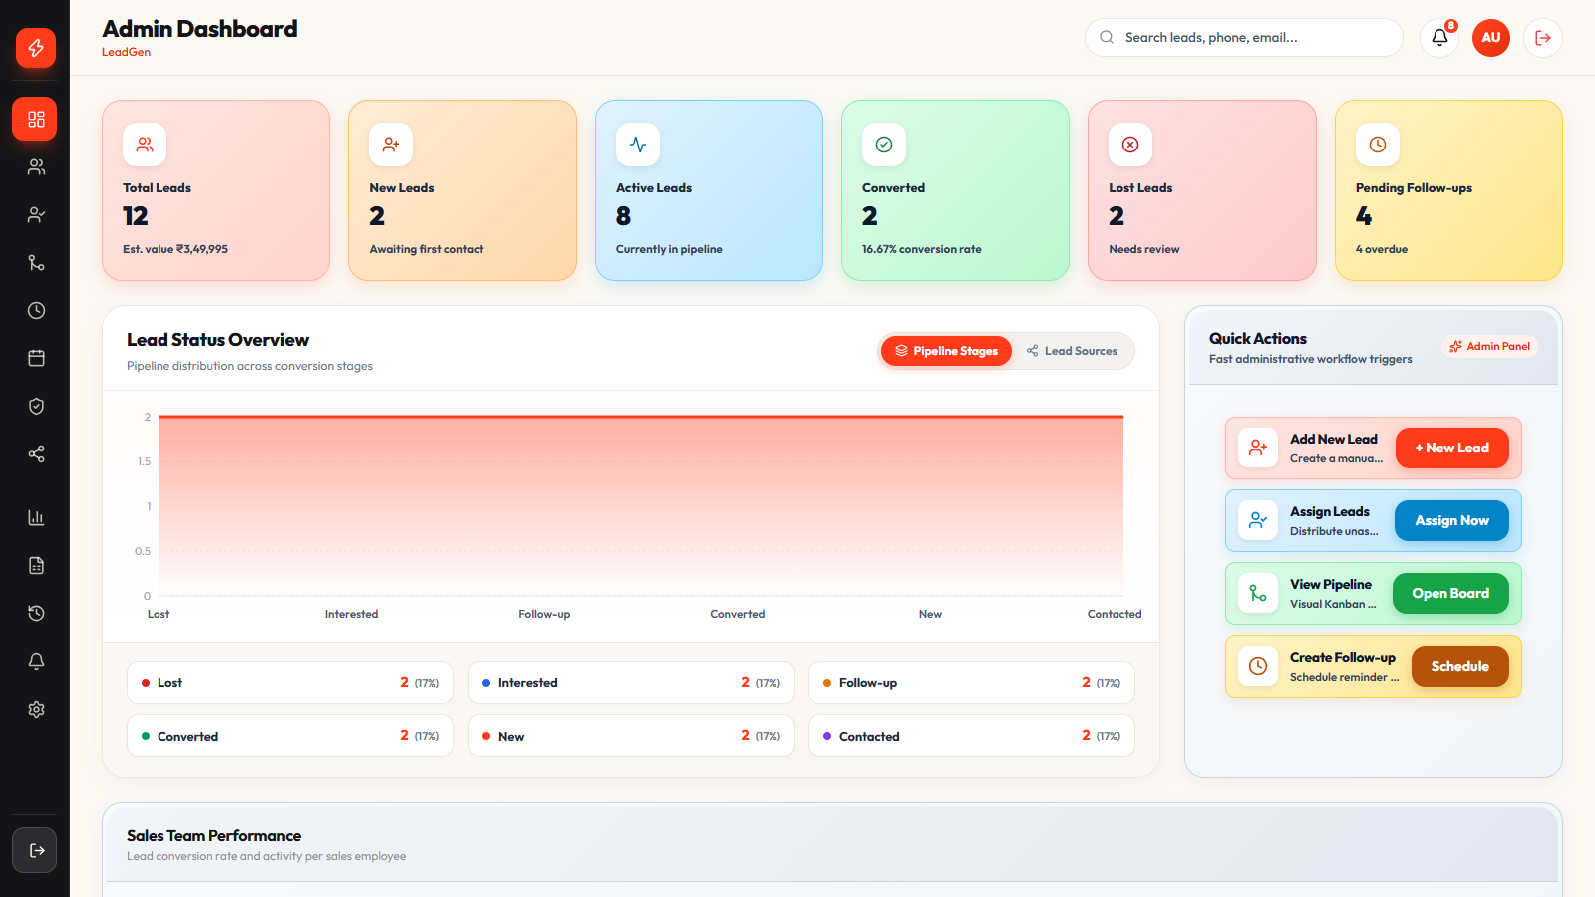
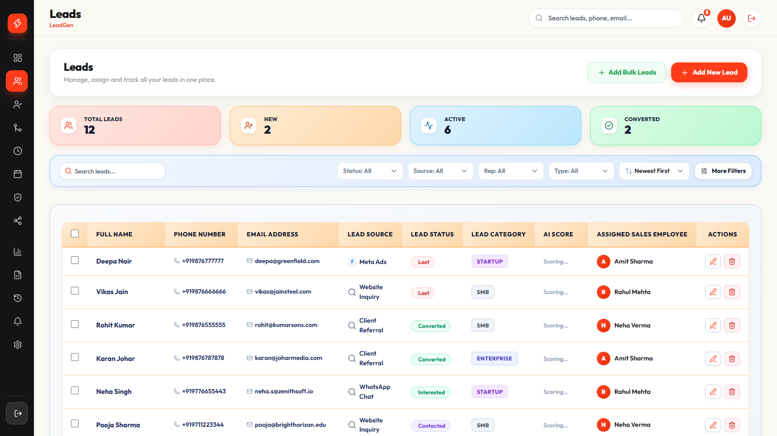
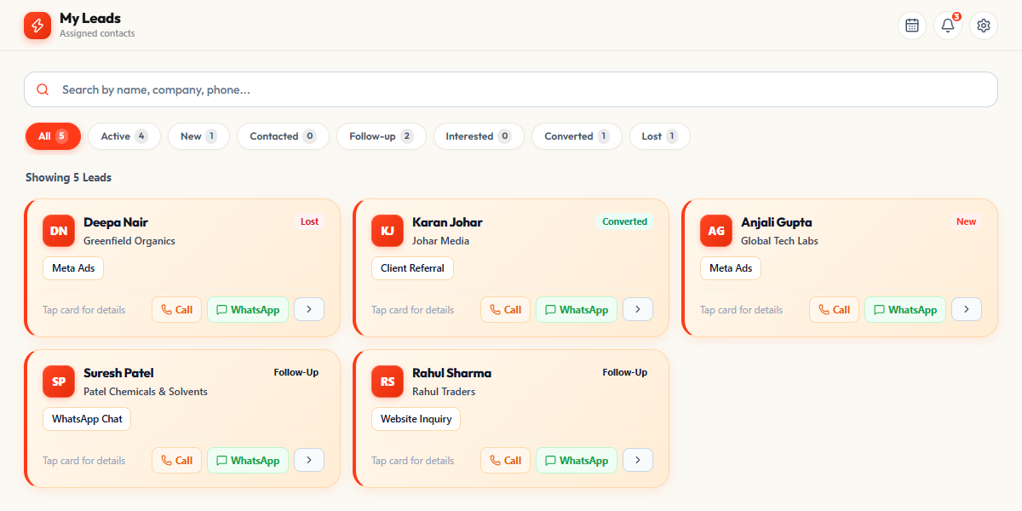
Phase-1 Code Screenshots
Admin dashboard: lead counts and pipeline chart
Leads table: source, status, AI score, assigned salesperson
// leadAssignment.service.js: give the lead to the least busy salesperson
let eligible = reps
.map((rep) => ({ rep, workload: workloadMap.get(rep._id.toString()) || 0 }))
.filter(({ rep, workload }) => workload < (rep.maxActiveLeads || 20));
// prefer salespeople who specialise in this lead's category
eligible.sort((a, b) => a.workload - b.workload);
await leadService.assignLead(leadId, eligible[0].rep._id, systemUser);
Sales panel: My Leads
Code: automatic lead assignment
Notes:
Recap only, ~10 s. Screenshots taken from the running app. The code is the core of automatic assignment: skip salespeople who are full, prefer category specialists, then pick the one with the fewest open leads.

Slide 8
Team Work Division & Timeline
Project timeline
TM
Trisha Mishra
0808CI231214
01
02
03
04
Frontend: React web app, admin and sales panels
ML model training (together)
Requirement & Planning
Workflow, features, tech stack
Phase-1 Development
React UI, Node APIs, MongoDB, ~50% code
Phase-2 Final Sprint
ML scoring, auto assignment, AI replies, testing
Deployment & Defense
Vercel + Render + Atlas, final viva
RR
Ratnesh Ranve
0808CI231162
August 2026
September 2026
September 2026
October 2026 (by 6th)
Backend: Node.js APIs, database, lead flow
ML model training (together)
Notes:
~10 s. Trisha built the frontend, Ratnesh built the backend, and both trained the ML model. Planning in August, development and the final sprint in September, deployment in October before the 6th.

Slide 9
Final Deployed Architecture & Cloud Integration
Facebook / Instagram ads
ONLINE SERVICES
sends new leads
MongoDB Atlas
stores all the data
USERS
Frontend · Vercel
the website people open
Backend · Render
does all the work
Admin / Manager
sees reports, manages team
ML Service · Render
gives each lead a score
Admin pages
Login
Salesperson
works on own leads
Sales pages
sends &
gets data
Save leads, skip duplicates
Google Gemini
writes reply drafts
Reports
Score every new lead
Give lead to a salesperson
Cloudinary
stores photos and files
Website Visitor
fills the enquiry form
Enquiry form
Follow-up reminders
Firebase · SMS Hub India
app alerts and SMS
Keep data safe
How a lead moves: form or ad → duplicate check → saved → scored → given to a salesperson → alert sent
Notes:
~45 s. Left to right: users open the React app hosted on Vercel; it calls the Node.js backend on Render over HTTPS with a login token. Ad platforms send leads straight to the backend through a secure webhook. The backend talks to MongoDB Atlas for data, the Python ML service (also on Render) for scores, Gemini for reply drafts, Cloudinary for files, and Firebase/SMS for alerts.

Slide 10
UML Deployment Diagram
«device»
User's browser
«cloud node»
Vercel
«database»
MongoDB Atlas
«external»
Online services
loads site
«artifact» Website files
«artifact» Built React website
«artifact» All app data
«artifact» Gemini
«artifact» Cloudinary
«artifact» Firebase
reads & saves data
«artifact» SMS Hub India
«execution env»
Render: Backend
«execution env»
Render: ML Service
sends & gets data
«artifact» Backend code (Node.js)
«artifact» Scoring code (Python)
«artifact» Reminder jobs
asks for
a score
«artifact» Trained ML model
«artifact» Hidden keys & passwords
«artifact» Web server (Uvicorn)
uses online services
Notes:
~30 s. Each 3D box is a place where part of the app runs (a node). The small boxes inside are what we put there (artifacts). Lines show who talks to whom. Website on Vercel, backend and ML service on Render, data on MongoDB Atlas, plus Gemini, Cloudinary, Firebase and SMS Hub India.

Slide 11
100% Working Live System Demo
Notes:
3–4 minutes, the core of the defense. Follow steps 1–8 in order (PROJECT_GUIDE.md §9). Open the backend and ML service URLs on Render a minute before you start so they are awake; pre-open the public form in a second tab. Step 8 is optional for a technical panel: run node backend/src/scripts/demoWebhookPing.js twice with the same key.

Slide 12
Testing, Benchmarking & Performance
4.0 ms
≈270 / s
120 ms
0.83
time to score one lead (ML)
leads scored per second, 1 worker
to load the leads list (typical)
ROC-AUC (model ranking score)
Backend response time
Request | Typical | Slowest 5%
Leads list | 120 ms | 180 ms
Dashboard numbers | 438 ms | 656 ms
1 user, server → MongoDB Atlas
Test scripts
Login & OTP · leads · master data · follow-ups, tasks, calendar · file upload · push alerts · full API test suite
Notes:
~45 s. All numbers were measured on the real system. ML service: 400 requests at each load level on one worker; one lead is scored in about 4.0 ms and it handles about 270 scores per second. More users at once only make requests wait in line, so the fix is more workers (slide 14). Backend: loading the leads list takes 120 ms normally (180 ms in the slowest 5%), most of it the trip to MongoDB Atlas. Model: Logistic Regression was chosen over Random Forest because its ROC-AUC is higher (0.83 vs 0.79), meaning it is better at putting the likely buyers on top. It was trained on 1,500 generated leads.

Slide 13






Innovation, Domain Impact & Originality
What is new
Domain impact
From form to salesperson in seconds
Each new lead is checked for duplicates, scored by ML and given to the least busy salesperson. No manual sorting.
For small and mid-size sales teams in education, real estate, cars and software:
Plagiarism check
AI replies checked by a person
Gemini writes replies using only real company facts; the salesperson edits and approves before sending.
No two salespeople calling the same customer
Work shared fairly across the team
Best leads are called first
Every action on a lead is recorded
A model that learns from results
Every won or lost lead is saved, so the model can be retrained and get better.
Easy to add new lead sources
A new platform needs one small file; secure webhooks block fake and repeated leads.
Attach the report to the project file
Notes:
~40 s. Lead with the four innovations; each maps to a demo step. Then impact for real sales teams. Read the plagiarism percentage and tool name aloud.

Slide 14
Cloud Deployment Specs & Scalability Roadmap
Component | Platform | Spec / configuration
Frontend | Vercel | React 19 + Vite build, served from a global CDN
Backend API | Render | Node.js 18+, Express 4 web service
ML service | Render | Python, FastAPI + Uvicorn, scikit-learn model
Database | MongoDB Atlas | Cloud MongoDB cluster, Mongoose 8
File storage | Cloudinary | Profile photos and lead attachments
Notifications | Firebase · SMS Hub India | App alerts, SMS and OTP login
Generative AI | Google Gemini API | Reply drafts from real company facts
Scalability roadmap
NOW
More backend copies can run side by side
Scoring runs in the background
≈270 scores per second per ML worker
NEXT
More ML workers and backend servers
Job queue (Redis) for scoring and alerts
Database indexes and auto-scaling
LATER
Google Ads, LinkedIn, WhatsApp sources
Retrain on real sales results
Many companies on one system
Security: login tokens expire in 15 min (renewed for 7 days) · each role sees only its pages · max 300 requests per 15 min per IP (20 for login) · signed webhooks · unsafe input is cleaned
Notes:
~30 s. Frontend on Vercel, backend and ML service on Render, database on MongoDB Atlas. Roadmap: slide 12 shows one ML worker tops out around 270 scores per second, so the next step is more workers and a job queue.

Slide 15
IEEE References & Viva Defense
[1] P. Espadinha-Cruz, A. Fernandes, and A. Grilo, "Lead management optimization using data mining: A case in the telecommunications sector," Computers & Industrial Engineering, vol. 154, Art. no. 107122, 2021.
[2] A. A. Ohiomah et al., "The role of lead management systems in inside sales performance," Journal of Business Research, vol. 102, pp. 163–177, 2019.
[3] S. Das and B. Datta, "Application of UTAUT2 on adopting artificial intelligence powered lead management system (AI-LMS) in passenger car sales," Technological Forecasting and Social Change, vol. 201, Art. no. 123241, 2024.
[4] R. Nygård and J. Mezei, "Automating lead scoring with machine learning: An experimental study," in Proc. 53rd Hawaii Int. Conf. System Sciences (HICSS), 2020.
[5] M. Wu, P. Andreev, and M. Benyoucef, "The state of lead scoring models and their impact on sales performance," Information Technology and Management, vol. 25, no. 1, pp. 69–98, 2024.
[6] F. Pedregosa et al., "Scikit-learn: Machine learning in Python," J. Mach. Learn. Res., vol. 12, pp. 2825–2830, 2011.
[7] L. Breiman, "Random forests," Machine Learning, vol. 45, no. 1, pp. 5–32, 2001.
[8] T. Fawcett, "An introduction to ROC analysis," Pattern Recognition Letters, vol. 27, no. 8, pp. 861–874, 2006.
Design decisions we defend
Why Logistic Regression?
Higher ROC-AUC (0.83 vs 0.79): it is better at putting likely buyers on top.
Why generated training data?
No real sales history yet; real results are added as they come in.
Why assign by workload?
It looks at how busy each salesperson is right now; taking turns does not.
Why must a person approve AI replies?
So wrong prices or false promises never reach a customer.
Notes:
~20 s, then open for viva. References [1]–[5] are the five papers from the literature table; [6]–[8] back the ML methods. The four design decisions are the questions the panel is most likely to ask; each member should be ready to answer for their own modules.

