Slide 1
SQL for Data Analysis (Assignment )
Conduct a comprehensive sales performance analysis for a pizza sale using SQL queries.
Ratnesh Satyarthi

Slide 2
Business Objective : -
The objective is to gain insights into sales trends, revenue distribution, and top performing products to inform strategic decision-making and optimize sales strategies.
Extract and aggregate sales data from the pizza sales dataset to calculate key metrics such as total sales revenue, average order value, Total Orders.
Analyse sales trends over time (hourly, daily, monthly) to identify peak sales periods and seasonal variations.
Calculate sales performance metrics for individual products, including best-selling pizzas, popular pizza sizes, and revenue contribution by product category.

Slide 3
1. Orders Trend: -
To measure and analyze various aspects of pizza sales data to assess sales performance.
Total no. of orders placed?
Distribution of orders per month or per day or per hour?
Total Quantity of all pizzas ordered based on size?
Maximum quantity of pizzas ordered based on size.
How much pizzas were ordered from each category?
During which time most no of pizza sales happened?
Aggregated sales Hour wise.
Group the orders by date and calculate the average number of pizzas ordered per day.

Slide 4
2. Sales Trend: -
To analyze how sales of pizza products vary seasonally or over specific time period.
Total revenue generated from pizza sales?
Revenue based on each pizza type/ size ordered
Total Revenue generated per hour or per day
For which date the pizza sales were maximum ?
Top 3 most ordered pizza types based on revenue
How much Revenue was generated from sales of pizzas from each category
Total Revenue generated per month by sales of all pizzas
TOP 5 months which generated the most revenue by sales of pizza

Slide 5
3. Product Popularity: -
To measure the popularity and demand for different pizza products.
Most expensive and Least expensive pizza ?
Total Quantity of each pizza type ordered based on size ?
Type of pizza based on size which was ordered the most ?
Most ordered pizza and how much quantity ?
Find How many pizzas which have price above than average price or below than average price ?
Percentage contribution of each pizza type to Revenue ?

Slide 6
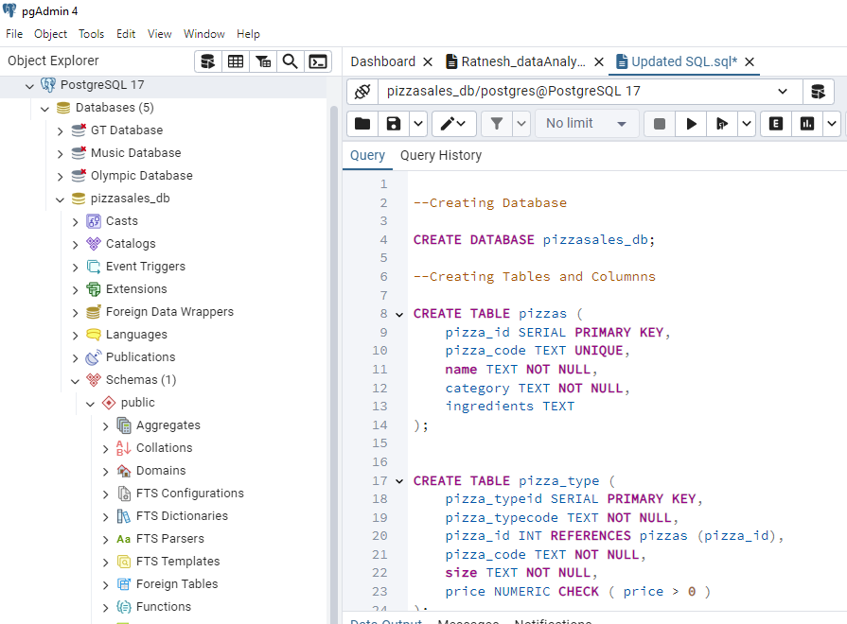
Database used: -
Postrgess SQL – version 8.11

Slide 7
Tables: -
Pizzas
Pizza id (PK)
Pizza type id (PK)
Order Details
Order details id (PK)
Order id (PK)
Pizza code
Name
Category
Ingredient
Pizza Types
Pizza type code
Pizza id (FK)
Pizza code
Size
Price
Orders
Date
Time
Order id (FK)
Pizza type code
Quantity
Pizza type id
PK – Primary Key
FK – Foreign Key

Slide 8
DDL Queries used: -
CREATE: Creates a new table or database.
Eg. - CREATE DATABASE pizzasales_db;
ALTER: Modifies an existing database object.
Eg. - ALTER TABLE pizza_type ADD COLUMN pizza_id INT REFERENCES pizzas (pizza_id);
DROP: Deletes an entire table, database, or other objects.
Eg. - DROP TABLE pizza_types;
TRUNCATE: Removes all records from a table, deleting the space allocated for the records.
Eg. - TRUNCATE TABLE order_details;

Slide 9
DML Queries used: -
SELECT: Retrieves data from the database.
Eg. - SELECT * FROM pizzas;
INSERT: Adds new data to a table.
Eg. - INSERT INTO pizzas ( pizza_code, name, category, ingredients) VALUES('bbq_ckn', 'The Barbecue Chicken Pizza', 'Chicken', 'Barbecued Chicken, Red Peppers, Green Peppers, Tomatoes, Red Onions, Barbecue Sauce’);
UPDATE: Modifies existing data within a table.
Eg. - UPDATE pizza_type SET pizza_id = 32 WHERE pizza_code = 'veggie_veg';
DELETE: Removes data from a table.
Eg. - DELETE pizza_type WHERE pizza_code = 'veggie_veg';

Slide 10

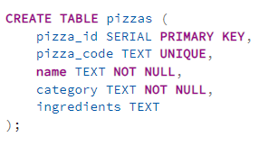
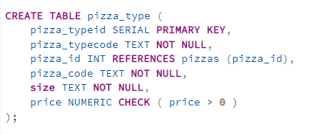
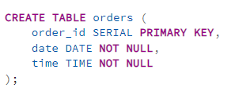
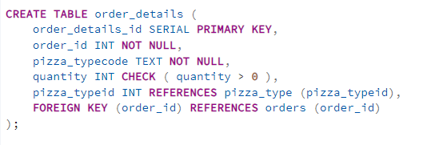
Create Database & Table structure: -

Slide 11
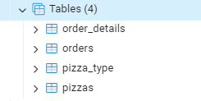
Tables & Database: -

Slide 12
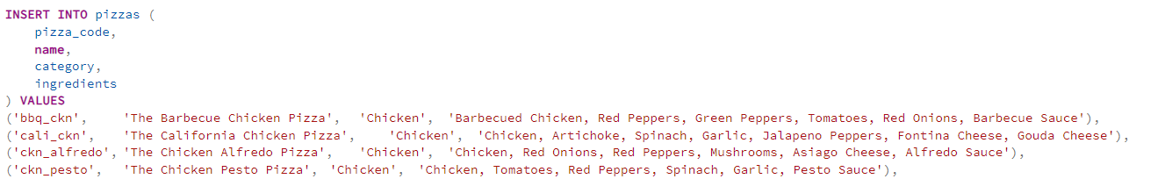
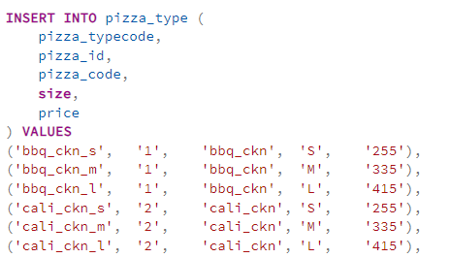
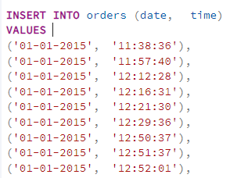
Insert Records in Tables: -

Slide 13
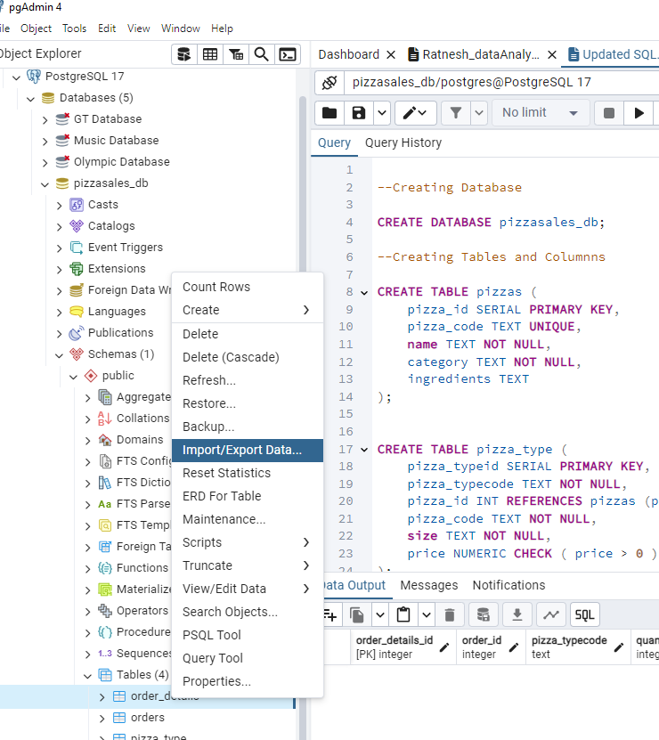
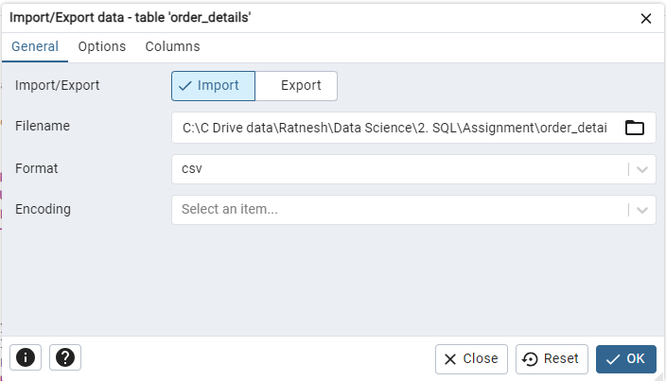
Importing Records in Tables: -

Slide 14
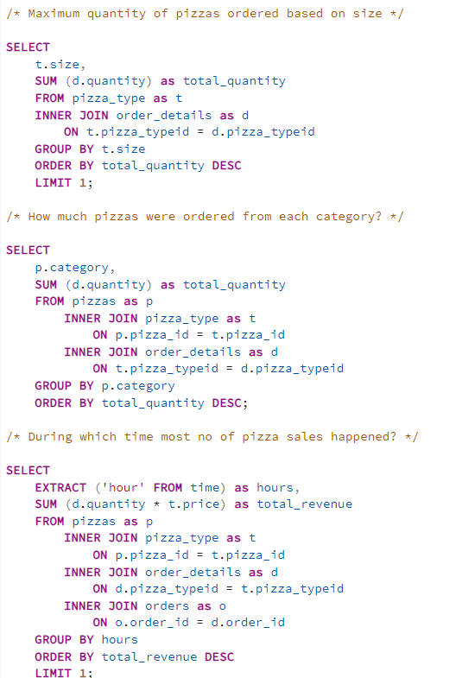
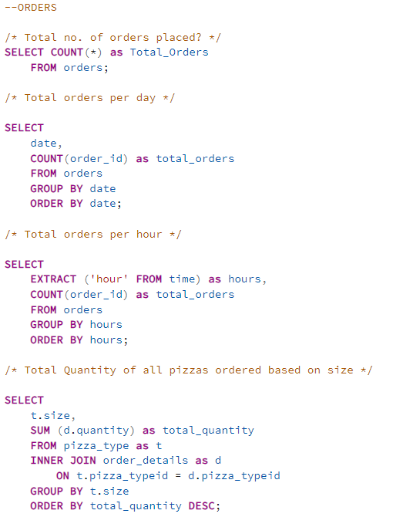
Orders queris: -

Slide 15
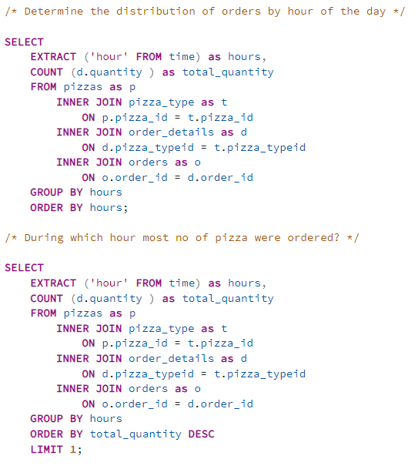
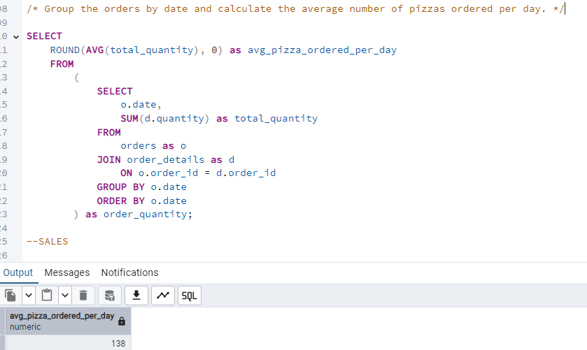
Orders queries: -

Slide 16
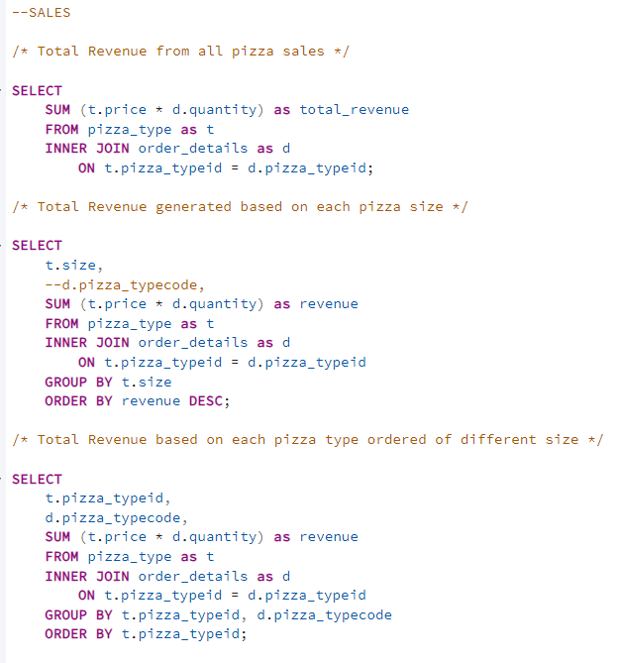
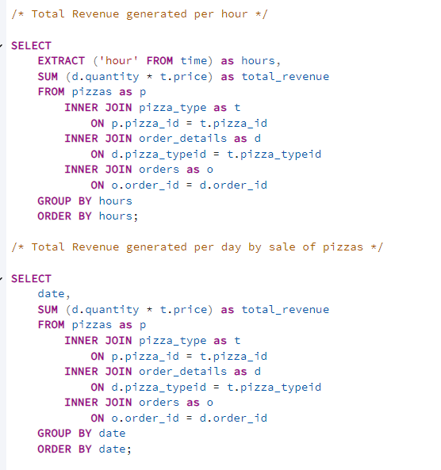
Sales queries: -

Slide 17
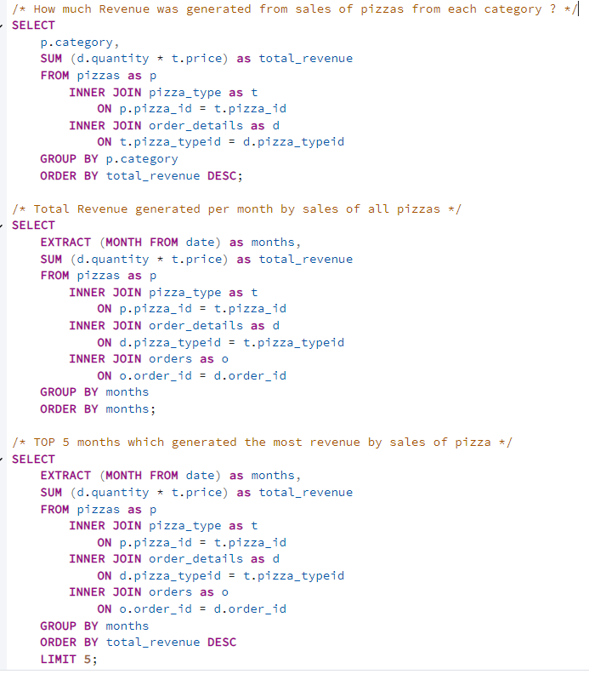
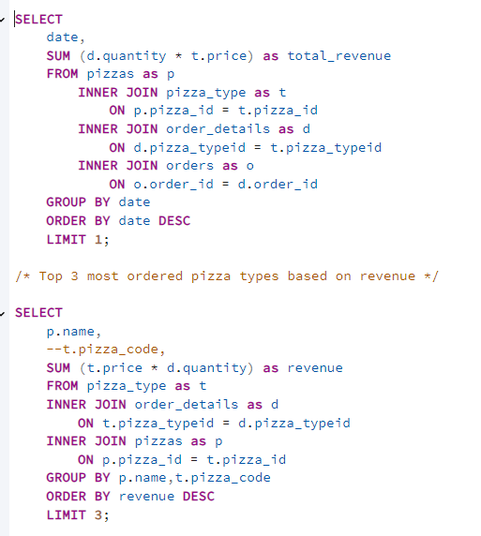
Sales queries: -

Slide 18
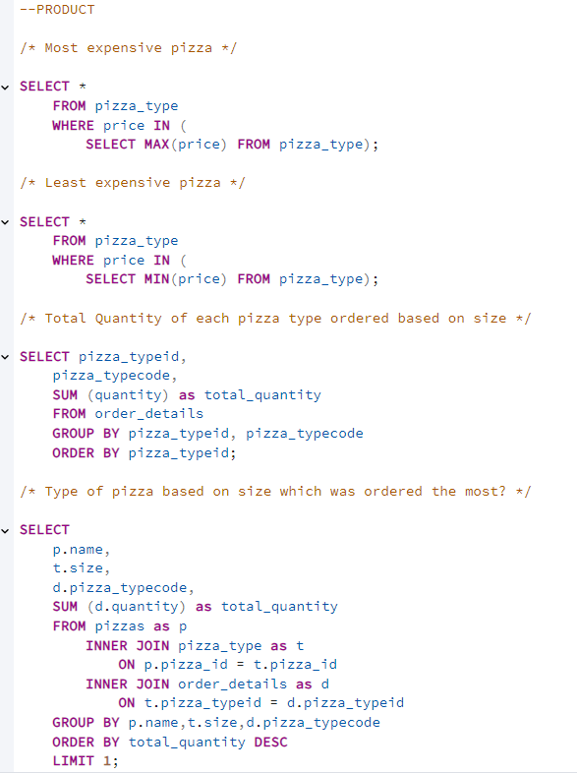
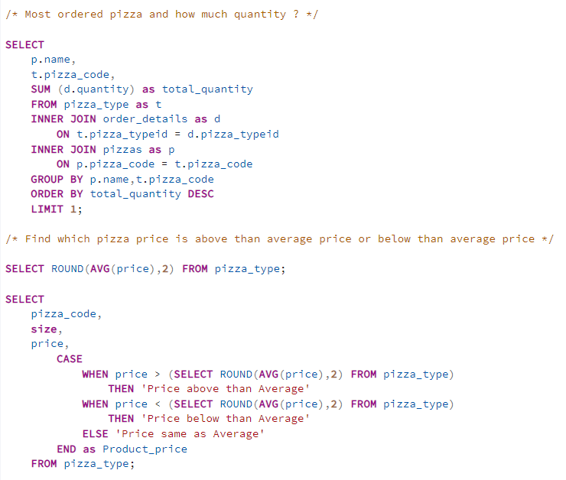
Product queries: -

Slide 19
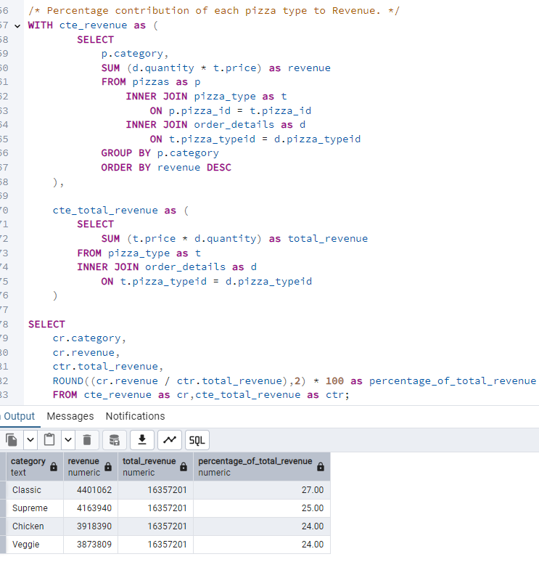
Output: -

Slide 20
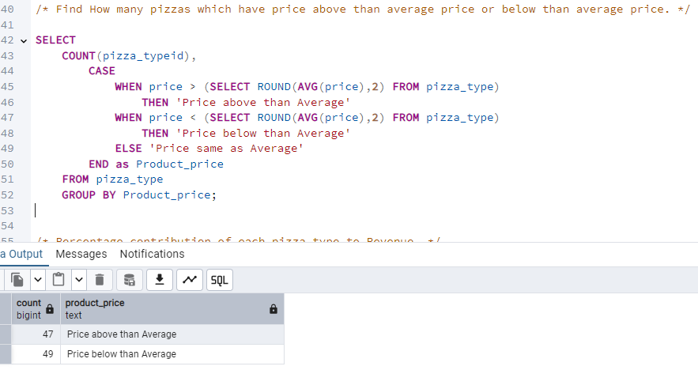
Output: -

Slide 21
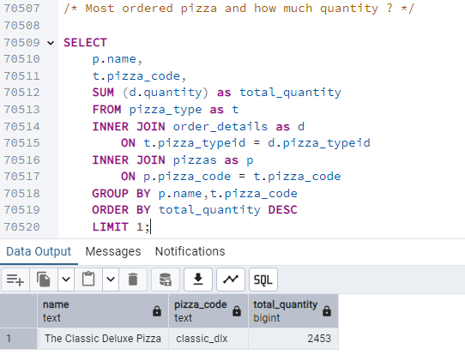
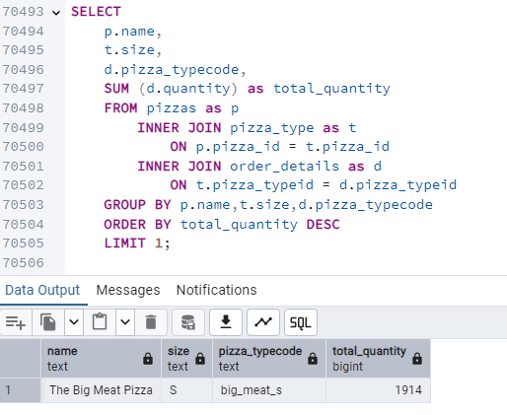
Output: -

Slide 22
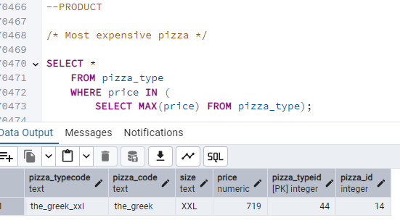
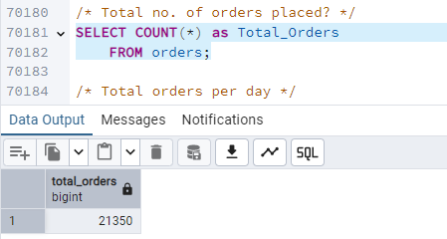
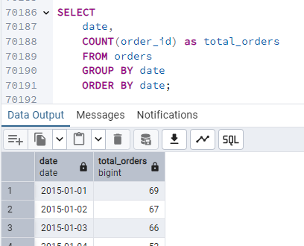
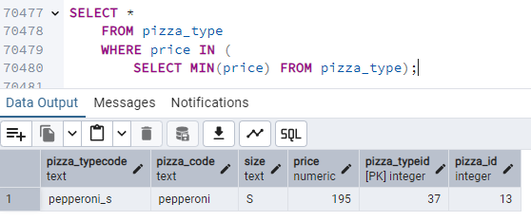
Output: -

Slide 23
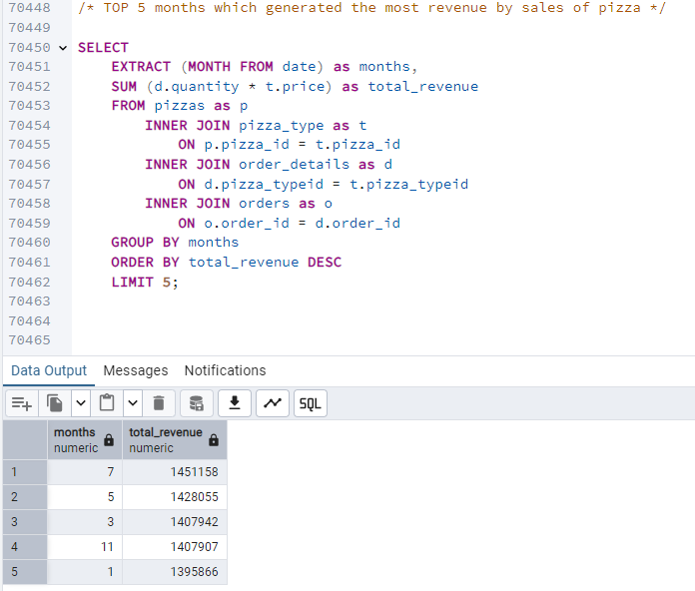
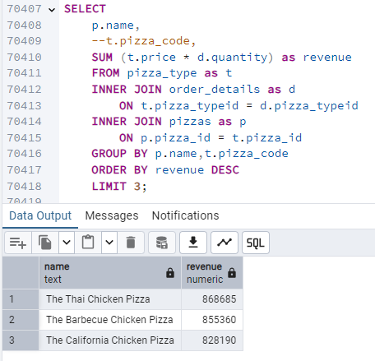
Output: -

Slide 24
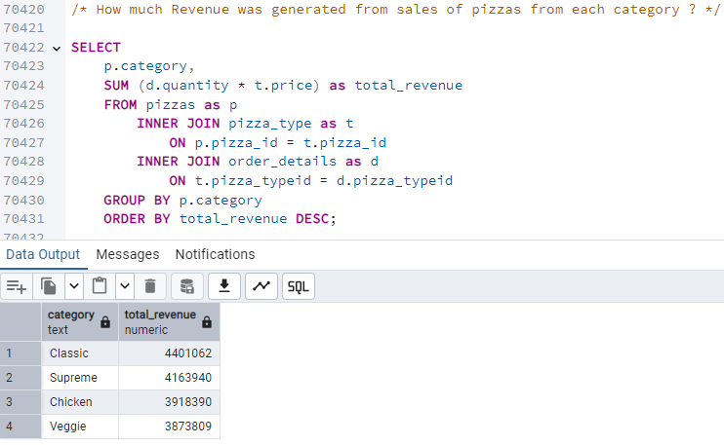
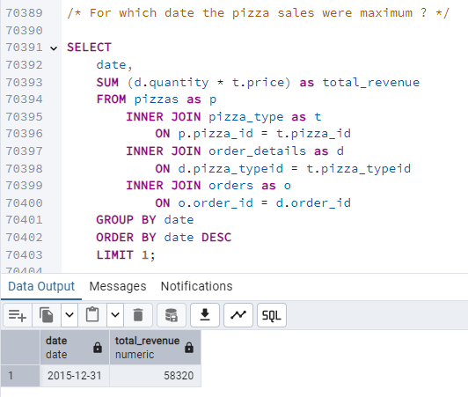
Output: -

Slide 25
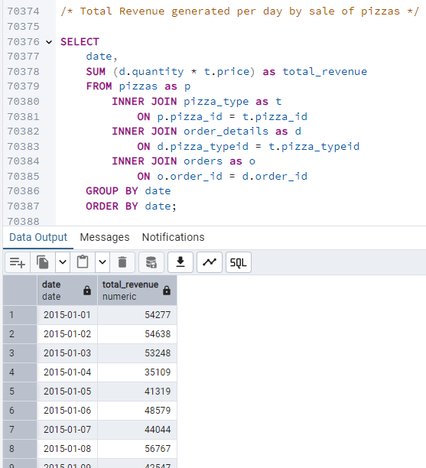
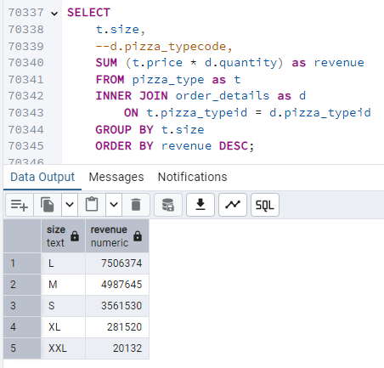
Output: -

Slide 26
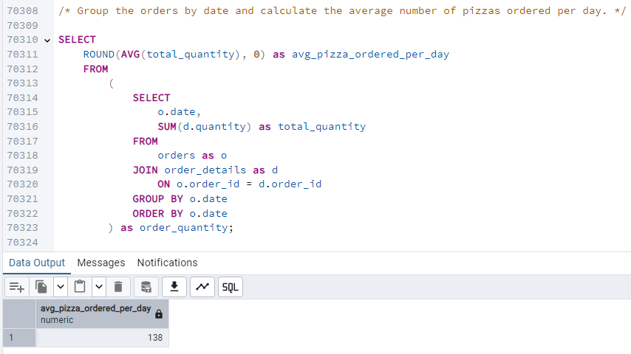
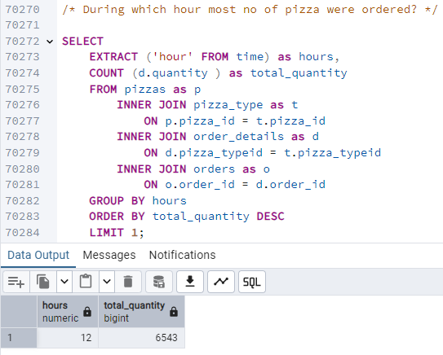
Output: -

Slide 27
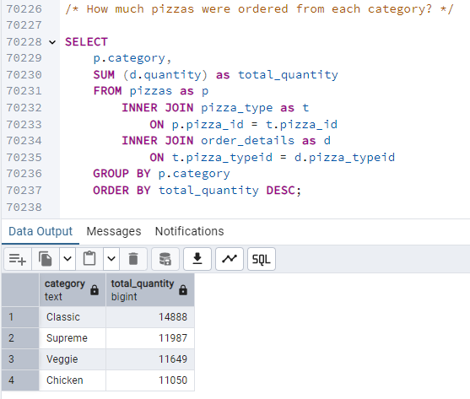
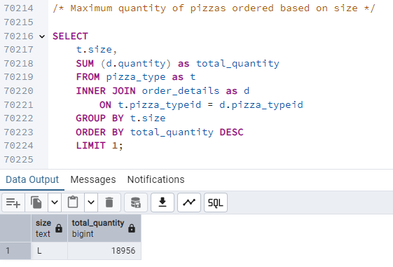
Output: -

Slide 28
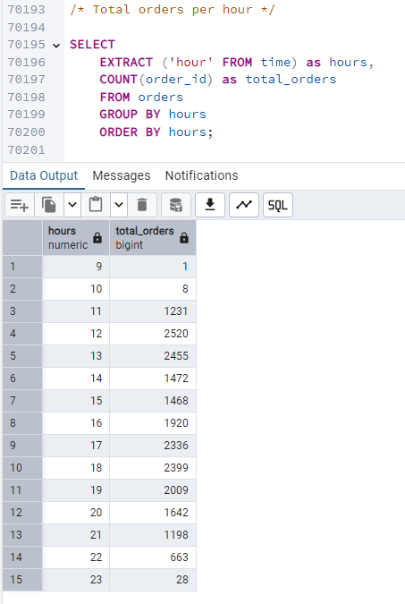
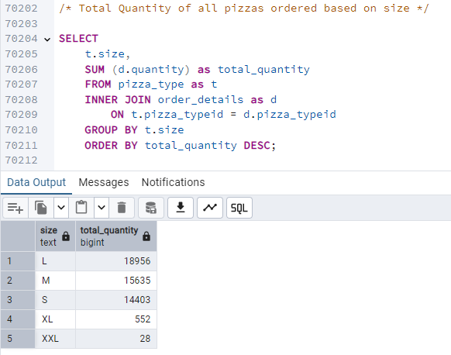
Output: -

Slide 29
Business Insights: -
Percentage share of total sales by all four Pizza Categories are almost same with CLASSIC category being the highest (27%) followed by SUPREME category (25%).
Among pizzas, THAI CHICKEN PIZZA contributes to maximum sales while CLASSIC DELUXE PIZZA was the most ordered one among the customers and BRIE CARRE PIZZA holds the position of least favoured pizza.
Most Expensive was The Greek Pizza (Rs 719) while Least expensive was The Pepperoni Pizza (Rs 195)
JULY month generated the highest revenue whereas MAXIMUM pizza sale was on 31 December.
Average pizza ordered per day was 138.
The busiest hours for pizza orders are between 12:00 PM to 1:00 PM and 5:00 PM to 6:00 PM, indicating high demand during lunch time and evening time.
LARGE-sized pizzas are the most popular choice among customers followed by MEDIUM and then SMALL sizes.

Slide 30
Recommendations: -
VEG category pizzas should be promoted with discounts and variety option to increase their sales similar to THAI CHICKEN PIZZA .
Some Ingredients of CLASSIC DELUXE PIZZA can be mixed with BRIE CARRE PIZZA sales to make it more tasty.
Discounts should be reduced during June-July season to tap more revenue, whereas offer heavy discounts for other months.
Since people prefer pizzas to celebrate days like 31 Dec so for other occasions promotional offers should be increased.
Sales Target should be set to increase the Average pizza ordered per day from 138 to 160.
More manpower should be deployed to handle the busiest hours for pizza orders between 12:00 PM to 1:00 PM and 5:00 PM to 6:00 PM so that maximum sales can be generated.
More variety options should be increased for SMALL and MEDIUM pizzas to attract more customers.
Rates of pizzas can also be optimized and gap between maximum and minimum pizzas can be reduced to tap more customers.

Slide 31
Thank You

