Slide 1
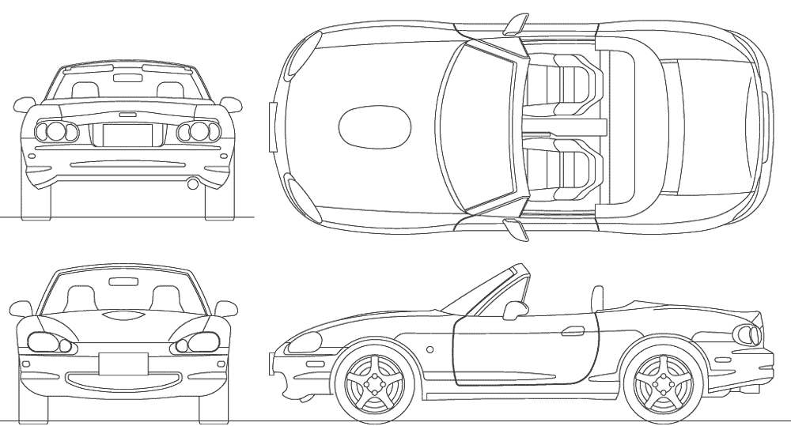

Battery
13.3V
Oil temp
70 ⁰C
14
34
Water temp
50 ⁰C
⁰C
16
20
psi
RATNICK RACING
36
46
x
x
20
25
x
x
Last data
14:44:23
Wifi strength
-56 dB
Wifi SSID
MX-5

Slide 2
http://car-blueprints.narod.ru/images/mazda/mazda-mx-5.gif

