Slide 1
Python
Useful Tools and Resources
Ryan Trent
2024

Slide 2
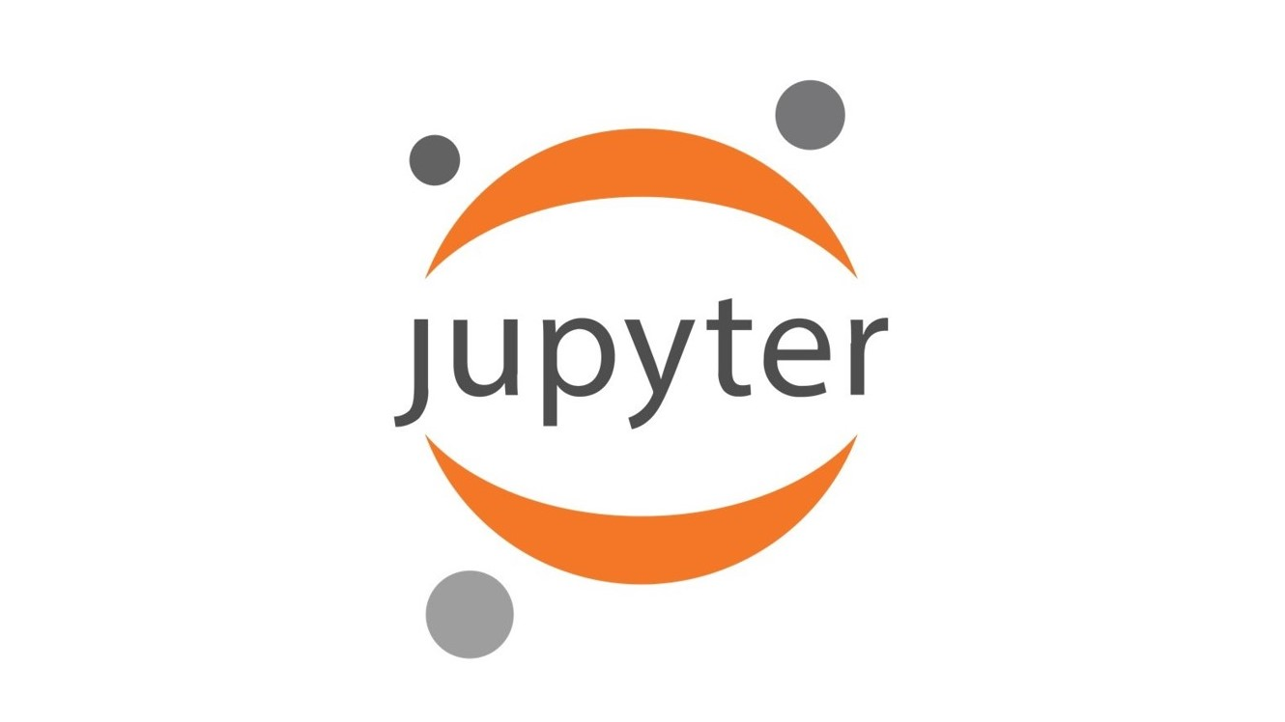
Jupyter Notebook
Purpose:
Interactive environment for writing and executing code. Perfect for exploratory data analysis, model development, and sharing results.
Best Used for:
Creating a sharing documents that contain live code, equations, visualization, and explanatory text.
Developing and iterating on machine learning models
Collaborating with others by sharing notebooks that can be executed independently.

Slide 3

Pandas
Purpose:
Data manipulation and analysis library.
Best Used for:
Handling and processing large datasets
Data cleaning, transforming, and exploration.
Merging and joining datasets, similar to SQL operations

Slide 4
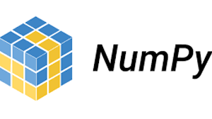
Numpy
Purpose:
A fundamental package for numerical computing in python.
Best Used for:
Handling arrays and matrices.
Performing mathematical operations on large datasets, such as linear algebra, Fourier transforms, and random number generation.

Slide 5

Scipy
Purpose:
A library for scientific and technical computing.
Best Used for:
Performing advanced computations, such as optimization, integration, interpolation, curve fitting, eigenvalue problems, and statistics.
Building custom simulations and solving differential equations

Slide 6



Matplotlib & Seaborn
Purpose:
A comprehensive library for creating static, animated, and interactive visualizations in python .
Best Used for:
Creating a vast array of plots for data visualization (e.g. scatterplots, heatmaps, line plots etc.)
Customized plots with control over every aspect of a figure.
Honorable Mention:
Plotly: Makes plots interactive

Slide 7

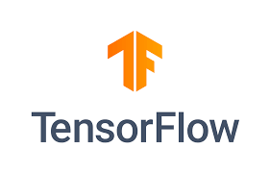

Scikit-learn & TensorFlow
Purpose:
Machine learning libraries.
Best Used for (Scikit-learn):
Building, training, and evaluating machine learning models for tasks such as classification, regression, clustering, and dimensionality reduction.
Performing model selection, feature selection, and validation.
Best Used for (TensorFlow):
Deep learning such as training neural networks.
Handling large scale machine learning tasks.
Deploying machine learning tasks to production.
Deep learning/ neural networks but easier to use than TensorFlow.

Slide 8
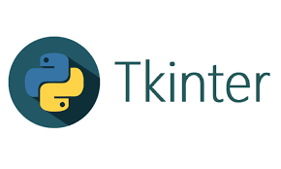
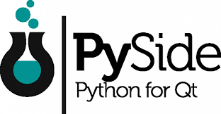
Tkinter & PySide
Purpose:
Developing graphical user interfaces (GUIs).
Best Used for:
Tkinter: Devoping lightweight, simple desktop applications.
PySide: Creating more complex, cross-platform desktop applications. Integrates with python libraries to create interactive tools.

Slide 9
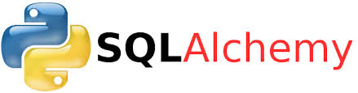
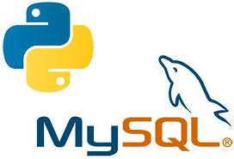
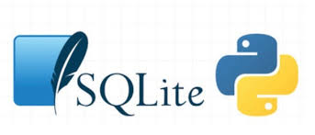
Database management SQLite, PyMySQL, SQLAlchemy
Purpose:
Building and interacting with SQL databases.
Best Used for:
SQLite3: Python module for creating and interacting with disk-based databases
When you don’t need a server powered database system
SQLAlchemy: SQL toolkit and Object-Relational Mapping (ORM) library.
Simplifies SQL queries and database management by working with Python classes and objects.
PyMySQL: Connecting to SQL databases directly from Python. Executing SQL queries.
For working with or connecting to databases on a server.

Slide 10
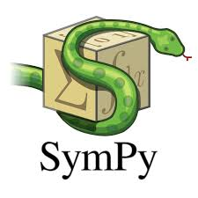
SymPy
Purpose:
A library for symbolic mathematics.
Best Used for:
Algebraic manipulation and symbolic computation.
Solving equations, performing calculus operations (hessians, Jacobians, differentiation, integration etc.), and handling symbolic matrices.
Useful in deriving analytical solutions before applying numerical methods.

Slide 11
Resources
scikit-learn: machine learning in Python — documentation
NumPy
TensorFlow
SymPy documentation
Matplotlib — Visualization with Python
seaborn: statistical data visualization — documentation
Jupyter Documentation
pandas documentation
Markdown for Jupyter notebooks cheatsheet - IBM Documentation
Best Practices - Scientific Python Development Guide (scientific-python.org)
All the mentioned tools have great documentation
Introduction to Statistical Learning - Gareth James (pdf)
Python for Data Analysis -- Wes McKinney

