Slide 1


SQL Server Tutorial For Beginners and Professionals

Slide 2
Overview of Course
Audience
This Course is design for beginners as well as professionals' developers who want to learn SQL Server step by step from the very basics to the advanced level concepts of SQL Server. This Course provides a hands-on approach to learn SQL programming step-by-step with example.
What is SQL Server
The SQL Server is a relational database management system (RDBMS) which is developed by Microsoft. SQL Server is built on top of SQL, a standard programming language for interacting with the relational databases. This product is built on the basic function of storing, retrieving data as required by other applications. It can be run either on the same computer or on another across a network.
Prerequisites
There are no prerequisites required to learn SQL Server as we are going to start from the very basics

Slide 3
Course Content
Getting Started with SQL Server
SQL Server Basics
SQL Server Views
SQL Server Stored Procedures
SQL Server User-defined Functions
SQL Server Triggers
SQL Functions
SQL Server Aggregate Functions
SQL Server Date Functions
SQL Server String Functions
SQL Server System Functions
SQL Server Window Functions
SQL Server Indexes

Slide 4
Getting Started with SQL Server
Download SQL Server 2019 and SQL Server Management Studio
Install the SQL Server
What is SQL Server
Connect to the SQL Server
SQL Server Sample Database

Slide 5
Download SQL Server 2019 and SQL Server Management Studio
1- SQL Server 2019 Developer Edition
To download SQL Server 2019, you click the following link:
Download the SQL Server
Microsoft provides you with some SQL Server editions. For learning purposes, you can download the Developer edition.
2- Microsoft SQL Server Management Studio
To interact with SQL Server, you need to have a SQL Server client tool. Install Microsoft SQL Server Management Studio
First, download the SSMS from the Microsoft website via the following link:
Download SQL Server Management Studio

Slide 6
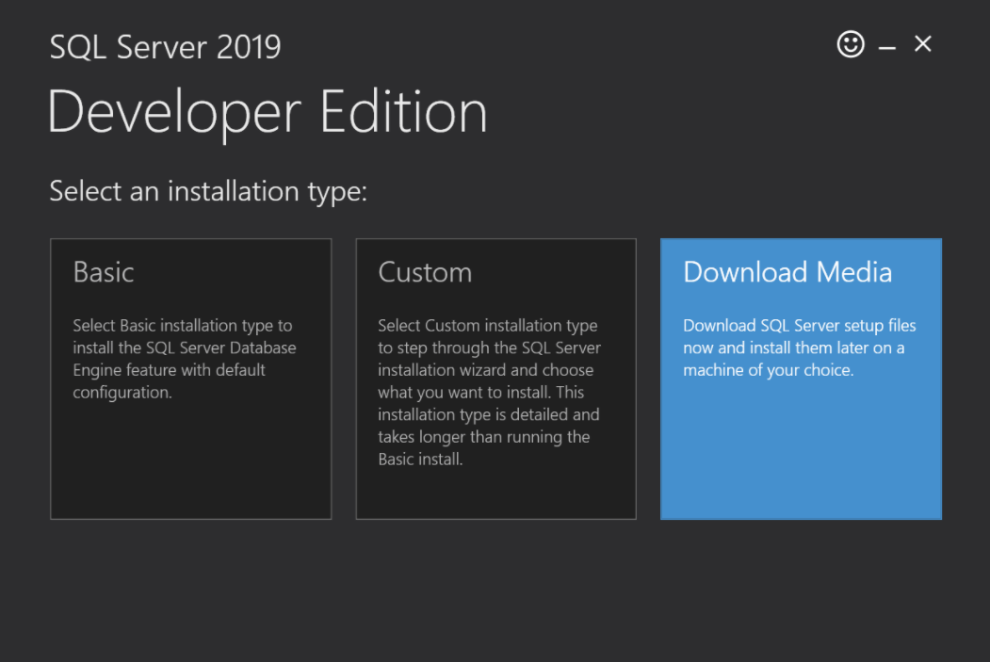
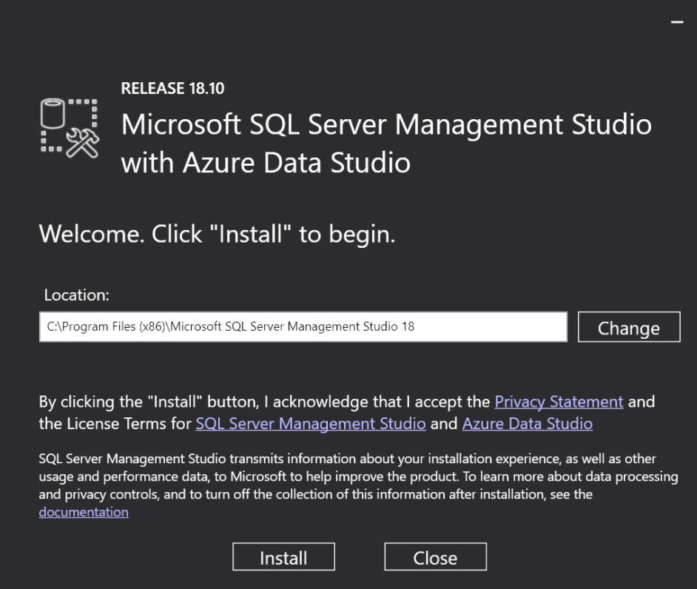
Install the SQL Server
Install SQL Server 2019 Developer Edition
Install Microsoft SQL Server Management Studio

Slide 7
What is SQL Server
The SQL Server is a relational database management system (RDBMS) which is developed by Microsoft. SQL Server is built on top of SQL, a standard programming language for interacting with the relational databases. This product is built on the basic function of storing, retrieving data as required by other applications. It can be run either on the same computer or on another across a network.
External Protocol
TCP/IP , Name Pipe
Database Engine
Storage Engine
Query Processor
Storage Engine
Query Processor
SQLOS
architecture of the SQL Server

Slide 8
1-Database Engine
SQL Server is the Database Engine. The Database Engine consists of a relational engine that processes queries and a storage engine that manages database files, pages, pages, index, etc. The database objects such as stored procedures, views, and triggers are also created and executed by the Database Engine.
Relational Engine
The Relational Engine contains the components that determine the best way to execute a query. The relational engine is also known as the query processor.
The relational engine requests data from the storage engine based on the input query and processed the results.
Some tasks of the relational engine include querying processing, memory management, thread and task management, buffer management, and distributed query processing.
Storage Engine
The storage engine is in charge of storage and retrieval of data from the storage systems such as disks and SAN.
2.SQLOS
Under the relational engine and storage engine is the SQL Server Operating System or SQLOS.
SQLOS provides many operating system services such as memory and I/O management. Other services include exception handling and synchronization services.

Slide 9
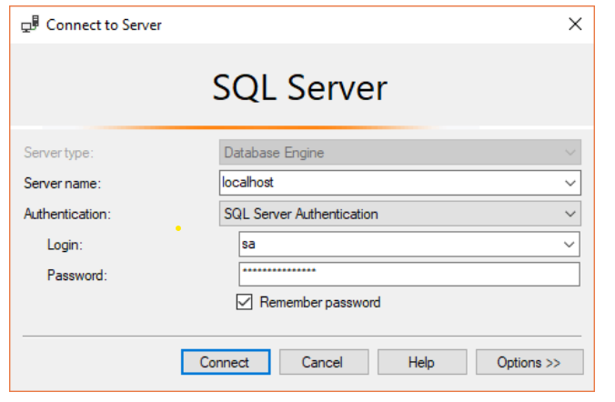
Connect to the SQL Server using SSMS
To connect to the SQL Server using the Microsoft SQL Server Management Studio

Slide 10
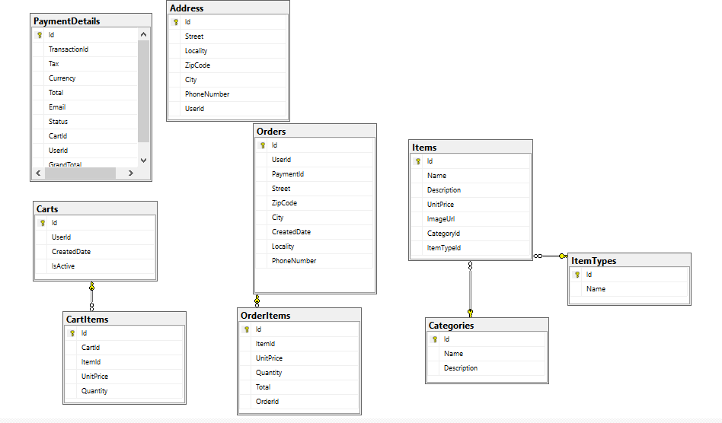
SQL Server Sample Database

