Slide 1
Partial Classes and Partial Methods in C#

Slide 2
What are Partial Classes in C#?
allows us to define a class on multiple files. we can physically split the content of the class into different files but even physically they are divided but logically it is one single unit only. A class in which code can be written in two or more files is known as a partial class. To make any class partial we need to use the keyword partial.
Partial classes allow us to split a class definition into 2 or more files. It is also possible to split the definition of a struct or an interface over two or more source files. Each source file will contain a section of the class definition, and all parts are combined into a single class when the application is compiled.
Rules to follow when working with Partial Classes in C#:
All the parts spread across different class files, must use the partial keyword. Otherwise, a compiler error is raised. Missing partial modifier. Another partial declaration of this type exists.
All the parts spread across different files, must have the same access specifiers. Otherwise, a compiler error is raised. Partial declarations have conflicting accessibility modifiers.
If any of the parts are declared as abstract, then the entire type is considered as abstract or if any of the parts are declared as sealed, then the entire type is considered as sealed or if any of the parts inherit a class, then the entire type inherits that class.
C# does not support multiple class inheritance. Different parts of the partial class must not specify different base classes. The following code will raise a compiler error stating – Partial declarations must not specify different base classes.

Slide 3

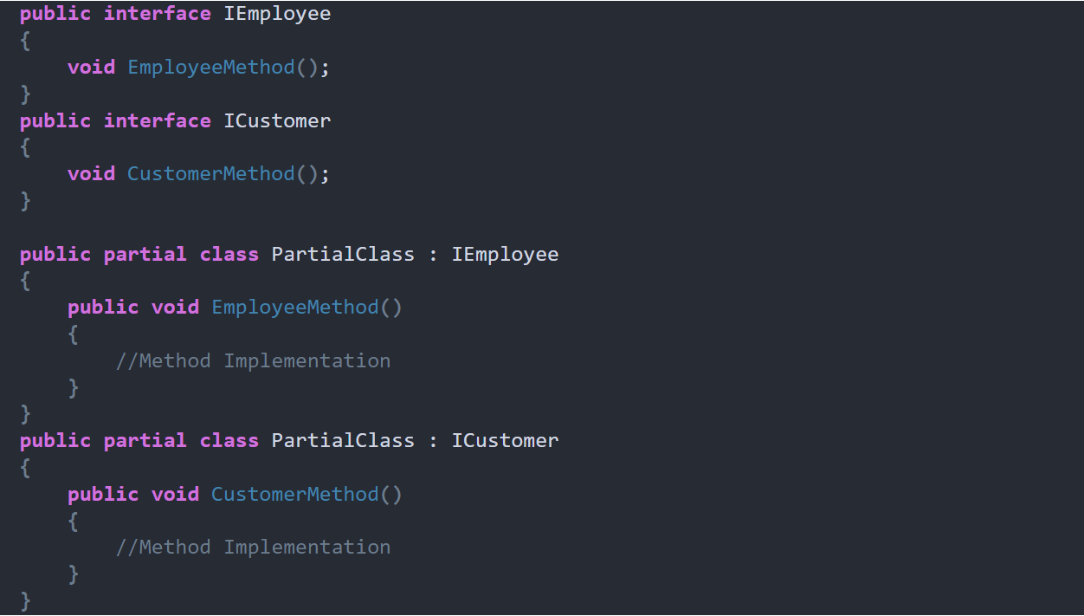
Different parts of the partial class can specify different base interfaces and the final type implements all of the interfaces listed by all of the partial declarations. In the example below PartialClass needs to provide the implementation for both IEmployee and ICustomer interface methods.

Slide 4
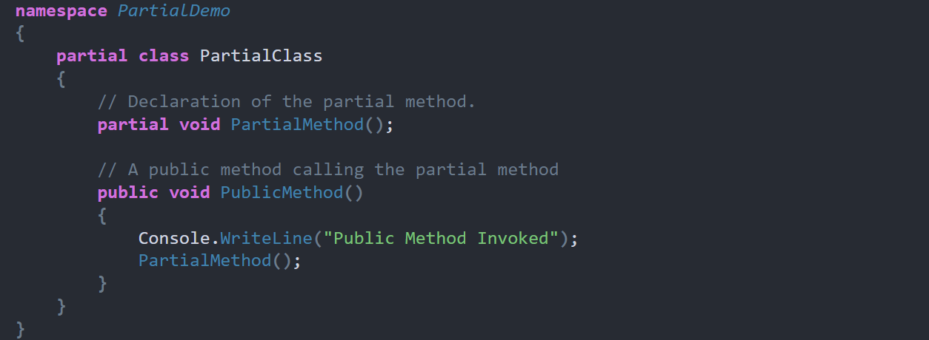
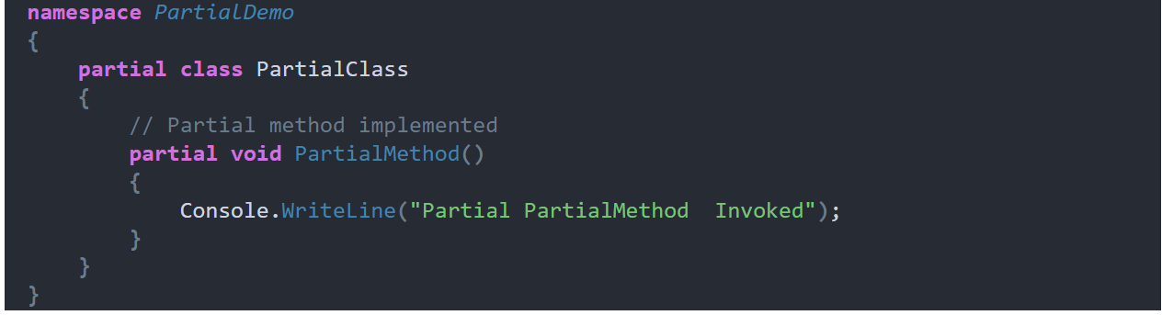
What are Partial Methods in C#?
A partial class or a struct can contain partial methods. A partial method is created using the same partial keyword.

Slide 5
Sealed Class in C#
A class from which it is not possible to create/derive a new class is known as a sealed class. In simple words, we can also define the class that is declared using the sealed modifier is known as the sealed class and a sealed class cannot be inherited by any other class. For example:
sealed class Class1 {} class class2 : Class1{} //invalid
Points to Remember while working with Sealed Class
A sealed class is completely opposite to an abstract class.
This sealed class cannot contain abstract methods.
It should be the bottom-most class within the inheritance hierarchy.
A sealed class can never be used as a base class.
The sealed class is specially used to avoid further inheritance.
The keyword sealed can be used with classes, instance methods, and properties.
Sealed Methods in C#
The method that is defined in a parent class, if that method cannot be overridden under a child class, we call it a sealed method. By default, every method is a sealed method because overriding is not possible unless the method is not declared as virtual in the parent class. If a method is declared as virtual in a class, any child class of it can have the right to override that method.

Slide 6
