Slide 1
What is Encapsulation in C#?
The process of binding the data and functions together into a single unit (i.e. class) is called encapsulation in C#. Or you can say that the process of defining a class by hiding its internal data members from outside the class and accessing those internal data members only through publicly exposed methods (setter and getter methods) or properties with proper validations is called encapsulation.
How can we implement Encapsulation in C#?
In C# Encapsulation is implemented
By declaring the variables as private (to restrict its direct access from outside the class)
By defining one pair of public setter and getter methods or properties to access private variables.
We declare variables as private to stop accessing them directly from outside the class. The public setter and getter methods or properties are used to access the private variables from outside the class with proper validations. If we provide direct access to variables then we cannot validate the data before storing it in the variable.
What is the problem if we don’t follow encapsulation in C# while designing a class?
If we don’t the encapsulation principle while designing the class, then we cannot validate the user-given data according to our business requirement as well as it is very difficult to handle future changes.
Let us understand this with an example. Assume in the initial project requirement, the client did not mention that the application should not allow the negative number to store in that variable. So, we give direct access to the variable

Slide 2
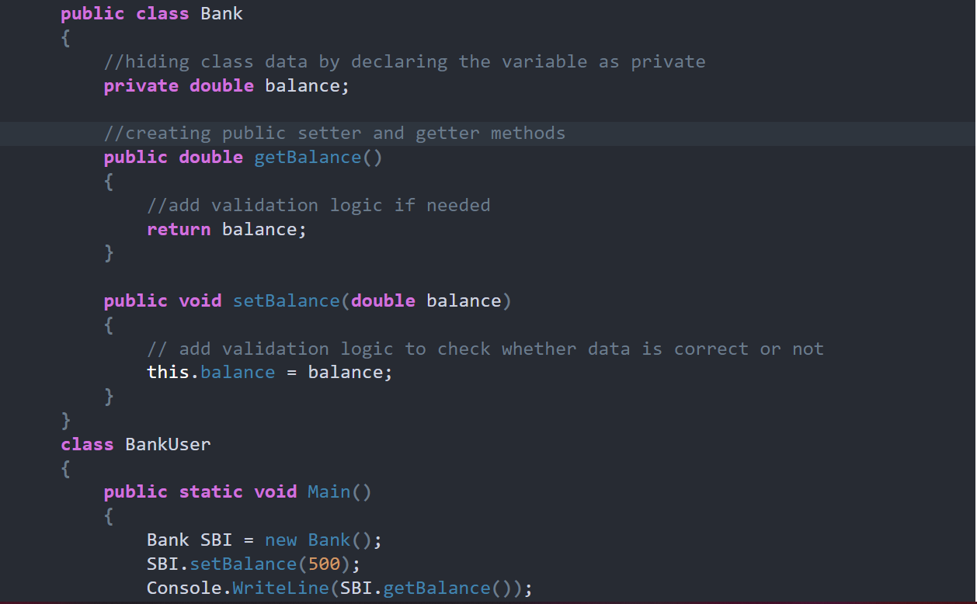
Let us see an example to understand this concept. In the following example, we declare the balance variable as private in the Bank class, and hence it can not be accessed directly outside of the Bank class. In order to access this balance variable, we have exposed two public methods i.e. getBalance and setBalance. The getBalance method (Accessors) is used to fetch the value store in the balance variable whereas the setBalance method (Mutator) is used to set the value in the balance variable.

Slide 3
What is Abstraction in C#?
The process of representing the essential features without including the background details is called Abstraction. In simple words, we can say that it is a process of defining a class by providing necessary details to call the object operations (i.e. methods) by hiding or removing its implementation details is called abstraction in C#. It means we need to expose what is necessary and compulsory and we need to hide the unnecessary things from the outside world. In C# we can hide the member of a class by using private access modifiers.
As we know a car is made of many things, such as the name of the car, the color of the car, gear, breaks, steering, silencer, the battery of the car, engine of the car, etc. Now you want to ride a car. So to ride a car what are the things you should know. The things a car driver should know are as follows.
Name of the Car
The color of the Car
Gear
Break
Steering
So these are the things that should be exposed and know by the car driver before riding the car. The things which should be hidden to a Car rider as are follows
The engine of the car
Diesel Engine
Silencer

Slide 4
What is inheritance in C#?
The process of creating a new class from an existing class such that the new class acquires all the properties and behaviors of the existing class is called inheritance. The properties (or behaviors) are transferred from which class is called the superclass or parent class or base class whereas the class which derives the properties or behaviors from the superclass is known as a subclass or child class or derived class. In simple words, inheritance means to take something that is already made (or available).
C#.NET classified the inheritance into two categories, such as
Implementation inheritance.
Interface inheritance
Implementation inheritance: This is the commonly used inheritance. Whenever a class is derived from another class then it is known as implementation inheritance.
Interface inheritance: This type of inheritance is taken from Java. Whenever a class is derived from an interface then it is known as interface inheritance.
Single Inheritance: When a class is derived from a single base class then the inheritance is called single inheritance.
Multilevel Inheritance: When a derived class is created from another derived class, then that type of inheritance is called multilevel inheritance.
Hierarchical Inheritance: When more than one derived class is created from a single base class then it is called Hierarchical inheritance.
Hybrid Inheritance: Hybrid Inheritance is the inheritance that is the combination of any single, hierarchical, and multilevel inheritances.
Multiple Inheritance: When a derived class is created from more than one base class then such type of inheritance is called multiple inheritances. But multiple inheritances are not supported by .net using classes and can be done using interfaces.

Slide 5
Rules to be considered while working with inheritance in C#
Rule1: In inheritance, the constructor of the parent class must be accessible to its child class otherwise the inheritance will not possible because when we create the child class object first it goes and calls the parent class constructor so that the parent class variable will be initialized and we can consume them under the child class.
NOTE: The reason why a child class internally calls its parent class constructor is to initialize parent class and can consume them under child class.
Rule2: In inheritance, the child classes can consume the parent class members but the parent class does not consume child class members that are purely defined in the child class.
Rule3: Just like the object of a class can be assigned to a variable of the same class to make it as a reference, it can also be assigned a variable of its parent to make it as a reference so that the reference starts consuming memory of the object assigned to it, but now also using that we control access child class pure members.
NOTE: A parent class object can never be assigned to a child class variable. A parent class reference i.e. created by using a child class object can be converted back into a child class reference if required by performing an explicit conversion.

Slide 6

Why do we need inheritance in C#?
inheritance in C# with one real-time example. Suppose we are developing an application for school the attributes of the entity will be as following

Slide 7
What is an interface in C#?
The Interface in C# is a fully un-implemented class used for declaring a set of operations of an object. So, we can define an interface as a pure abstract class which allows us to define only abstract methods. The abstract method means a method without body or implementation.
Why do we need an interface in C#?
We know the concept of multiple inheritances where one class is derived from more than one superclasses. For example a definition likes
Class A:B,C
{
}
How to declare an interface in C#?
By using the keyword interface we can declare an interface.
// SYNTAX:
public interface InterfaceName
{
//only abstract methods
}
// For example
public interface Example
{
void show();
}

Slide 8
Here the keyword interface tells that Example is an interface containing one abstract method i.e. show(). By default, the members of an interface are public and abstract. An interface can contain
Abstract methods
Properties
Indexes
Events
Rules to follow while working with the interface
While working with an interface, we must follow the below rules.
The interface cannot have concrete methods, violation leads to CE: interface methods cannot have a body.
We cannot declare interface members as private or protected members violation leads to CE:” modifier is not allowed here”.
An interface cannot be instantiated but its reference variable can be created for storing its subclass object reference.
We cannot declare the interface as sealed it leads to CE: “illegal combination of modifier interface and final”.
The class derived from the interface should implement all abstract methods of the interface otherwise it should be declared as abstract else it leads to a compile-time error.
The subclass should implement the interface method with public keyword because interface methods default accessibility modifier is public.
In an interface, we cannot create fields variable violation leads to a compile-time error.

Slide 9
What is the ambiguity problem in C#?
In the above case, class 3 is inheriting from class 1 and class 2 and both these two classes contain a method with the same name and same signature so while consuming the method ambiguity arises to understand which class method has to be executed. But, if a class is inheriting from interfaces we don’t have any ambiguity problem because the class is not consuming the members of its parent interfaces but only implementing the parent’s members.
In the above case, the class is not consuming the interface members. It is only implementing the interface members so if we face any ambiguity with interface members that can be resolved in child class in two different ways.
If the method is implemented for a single time under the class both the interface will assume that the implemented method belongs to them and executes and there will not be any ambiguity.
What is Explicit Interface Implementation in C#?
When each interface method is implemented separately under the child class by providing the method name along with the interface name then it is called Explicit Interface Implementation. But in this case, while calling the method we should compulsorily use the interface reference that is created using the object of a class. Let see an example to understand explicit interface implementation in C#. While implementing the Interface methods explicitly, it is not allowed us to use the public access specifiers.

