Slide 1
Face Mask Detection Using AI
UP2036456

Slide 2
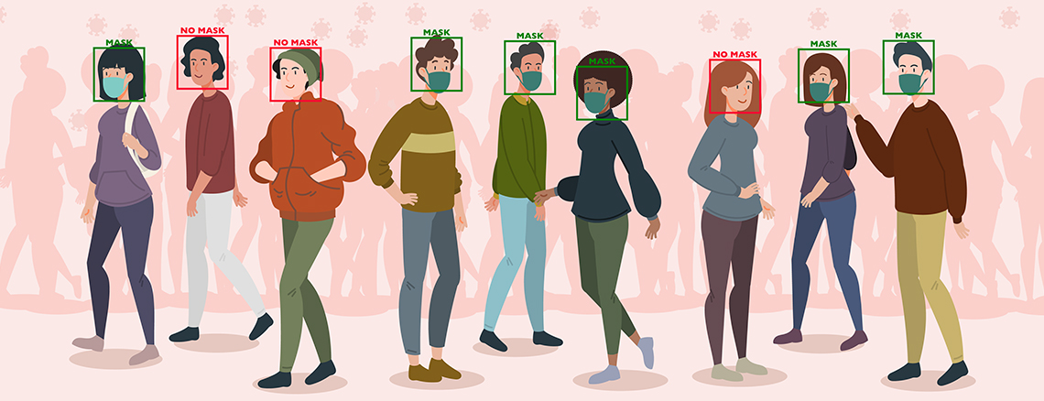
About Project Idea

Slide 3
Project Analysis
Install Dependencies
Train Data Set
Prepare Data Set
Data Preprocessing
Run and View Accuracy
Apply model in camera

Slide 4
Step 1
Install The Dependencies all the library and packages which are required to complete the project.
Tensor Flow
Keras
Imutils
Numpy
Open Cv
Matplotlib
Argparse
scipy

Slide 5
Step 2: Data Set
With Mask
Without mask
Source: Kaggle, Few from open source image libraries and google images

Slide 6
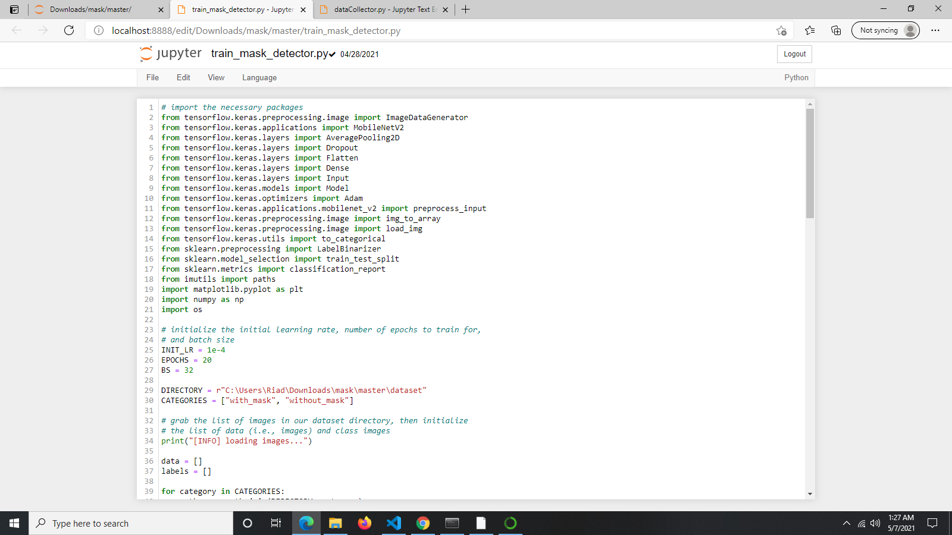
Step 3: Data Preprocessing

Slide 7
Step 4: Training Data set
Using Neural Network
Input>Mobile-Net>Max-pooling> Fully-connected>output
Train Data Set
(trainX, testX, trainY, testY) = train_test_split(data, labels,
test_size=0.20, stratify=labels, random_state=42)

Slide 8
After Training
I will get a dataset based on loss and accuracy if I get low loss dataset then my model will be good.

Slide 9
Last Step
Its time for applying model in front of camera.
open the web cam showing face it will be detected a face with mask or without with a green or red alert.

Slide 10
Wearing Mask Stay Safe

