Slide 1
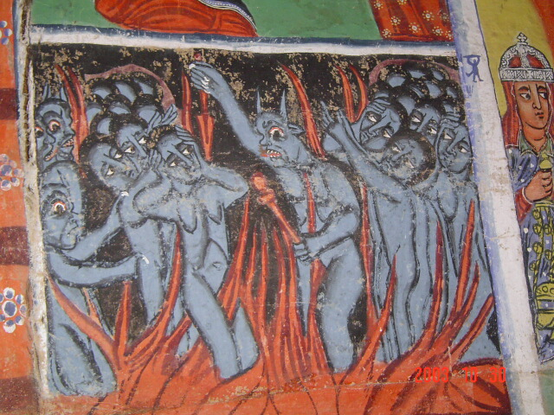
Visibility Data &
AIPS++ Measurement Sets

Slide 2
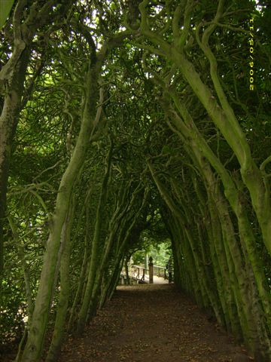

Slide 3
AIPS++...
2. AIPS++...
  [5] heard of it
  [2] tried to run it once
  [9] succeeded in running it once
  [5] have used it in anger
  [0] invented it
AIPS++ is making great progress: at the previous workshop we had “tried” ≈ “succeeded”
  (and one inventor that owned up to it all)

Slide 4
Working With
Visibility Data
MeqTrees interface with AIPS++ Measurement Sets
  other formats can be supported as necessary
An “empty” MS has to be pre-fabricated using external tools:
  you can use the AIPS++ “simulator”, see Workshop2006/demo_sim.g (and ask Tony)
  there's also a “makems” tool floating around (ask Ronald Nijboer)

Slide 5
Meet Our Guinea Pig Skeleton
I have prepared Workshop2007/demo.MS; this will serve most of our whims this week.
There is a pristine backup copy available, so if you screw up, restore it with:
$ cd ~/Workshop2007
$ rm -fr demo.MS
$ cp -a (/net/birch)/data/oms/workshop/demo.MS . (/apps/Timba/data/oms/workshop, if on jop01)

Slide 6
VLA In Space
(About demo.MS)
This contains 27 antennas in VLA-C configuration...
  ...but blown up by a factor of 10
So the max baseline is ~30km
8 hours observation, 5 minute sampling, 96 timeslots
32 frequency channels of 16MHz each, from 800MHz to 1.31GHz
Four polarizations: XX XY YX YY
One pointing

Slide 7
A Simple MS Tree
Load Intro2/demo1-sink.py
Under “TDL Exec”, select Tile size: 5
Load up the “MS Grids” bookmark
Run “test forest”
...note the “history” slider in the visualizer

Slide 8
Why “Skeleton”?
An MS provides a time/frequency grid (e.g., for use in simulations)
  thus, “skeleton”: we ignore the data in the MS (and write our own)
Sink nodes turn this grid into a request and send it up the tree.
  one Sink per interferometer
When a result comes back, this can be written out to a visibility column in the MS.
MSs are processed in chunks of time called “tiles”.

Slide 9
The VisDataMux
A VisDataMux node was created for us automatically.
The VDM is responsible for interfacing with the MS, reading data, and activating its child Sinks as appropriate.
To start the process, we give a specially-formed request to the VDM, containing input and output records telling it what and how to read (or write).

Slide 10
We Can Read, Too!
Load Intro2/demo2-spigot.py
Under “TDL Exec”, select Tile size: 10
Load up the “Spigots” bookmark, and the “Inspector” bookmark
Run “test forest”
...note the “history” slider in the visualizer

Slide 11
Sinks And Spigots
A Spigot node reads the visibility data from an MS, and returns it as a visibility matrix
Check visibilities using the history slider.
  You're looking at XX data, use the “Change selected Vells” option to look at the other correlations
You can probably guess what kind of observation demo.MS contains...

Slide 12
Inspector (Collections) Plot
The last script introduced a “Collections” plotter (the ns.inspector node)
A Meq.Composer node collects results from all its children into a single huge Result, which is plotted as a function of time.
This plotter expects one data point per timeslot, so we use a Meq.Mean() node to take the mean in frequency.
The inspector is attached as a special child to the VisDataMux node, labelled “post”. This makes it execute after (i.e., post) all the Sinks have fired. The result is published to the viewer (if active), then discarded.

Slide 13
Matrices And Tensors
Visibility data comes out as a
2x2 matrix
In MeqTrees, this is represented by a Result with 4 VellSets, and a dims=[2,2] field:
  no dims implies a 4-vector
  and remember that each element can be
  its own function of frequency/time/etc.
This can be generalized to tensors of arbitrary rank
  e.g., the “inspector” node collects its children into a 351x2x2 tensor

Slide 14
On MS Columns
An AIPS++ MS has three standard “columns” for visibility data: DATA, MODEL_DATA, CORRECTED_DATA.
MeqTrees can “attach” to any column, or even create new columns.
Tools like the AIPS++ imager assign specific meanings to these columns though, and do not support other names...
Speaking of the imager, run this script:
$ glish -l make_image.g DATA ms=demo.MS

Slide 15
Let's Modify Some Data
Load Intro3/demo3-mod-vis.py
Here we apply a gain term:
Under “TDL Exec”, select Tile size: 30 (the “go faster” option)
Load up the “Inspector” bookmark
Run “test forest”
Switch inspectors to display complex phases (via right-click)
Make an image:
$ glish -l make_image.g MODEL_DATA ms=demo.MS

Slide 16
More Inspectors
Here we have created two inspector nodes
A Meq.ReqMux() node is used to feed a request to multiple children, we need it since we can only have one “post” child on a VisDataMux.

Slide 17
Exercise 1:
Freq-Dependent Gains
Start with Intro2/demo3-mod-vis.py
Apply a frequency-dependent gain to the data:
Make a per-channel image using:
$ glish -l make_image.g MODEL_DATA ms=demo.MS mode=channel

