Slide 1
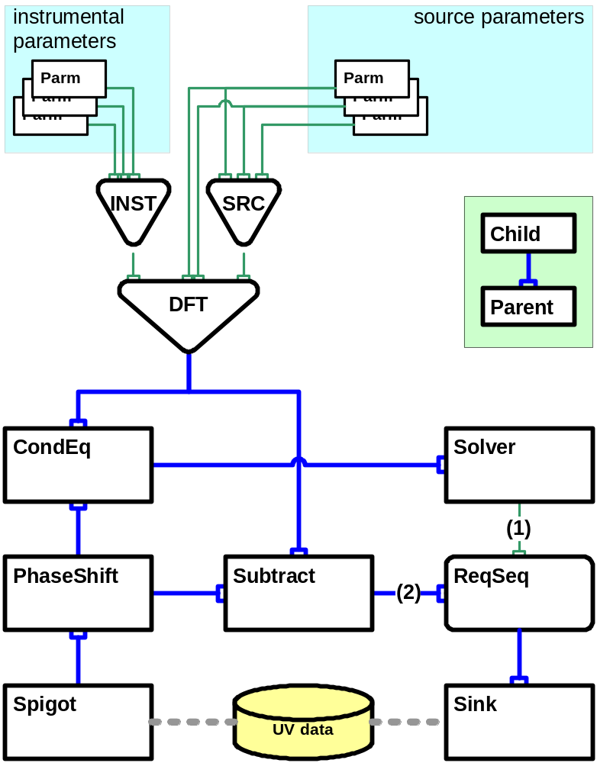
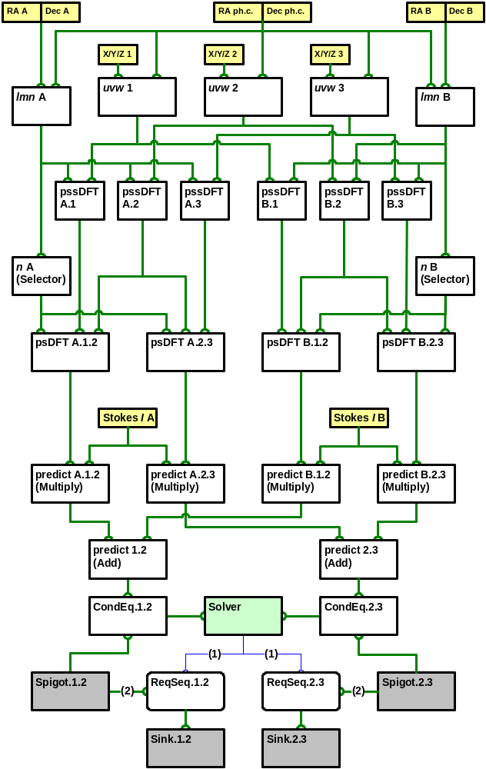
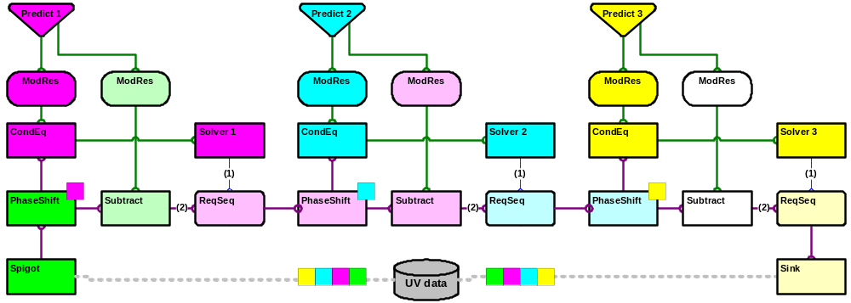



Taming the Measurement Equation With MeqTrees
O.M. Smirnov & J.E. Noordam
A Measurement Equation predicts data measured with a particular instrument
• A combined model of the instrument and observed objects
• Crucial for calibration of, e.g., radioastronomical measurements
Calibration with a M.E.
• Implement model in software
• Use apriori guesses to set model parameters
• Compare measured data to predicted values
• Adjust parameters of model for best fit
Where’s the catch?
• New instruments (LOFAR, SKA) require very sophisticated models with many M.E. parameters
• Existing calibration packages implicitly incorporate some fixed form of the M.E.
• A fixed M.E. makes it impossible to calibrate for effects unaccounted for by the software author
WANTED:
a model construction and parameter fitting kit!
predicted
measured
The basic structure of a predict-solve tree
Build a model of your choice by constructing a MeqTree
• MeqNodes perform operations on results of children, pass them on to parents
• Models of arbitrary complexity may be constructed
Just put a solver on the bottom, and you’re off!
• Model parameters: smooth functions (polynomials) of, e.g., frequency and time. Any subset may be solved for.
• Multiple solvers may be “chained” to accomodate different solving strategies -- naturally parallelizable
Kernel implemented in C++; controlled from Python/Glish
• Very little policy in kernel
• Policy (and, thus, problem domain) imposed from scripting side
A simple predict-solve tree for two point sources and two interferometers
A “rippling” tree: parallelization by source/time domain
smirnov@astron.nl
noordam@astron.nl
www.astron.nl
NETHERLANDS FOUNDATION FOR RESEARCH IN ASTRONOMY

