Slide 1
LSM:
The Local Sky Model
All scripts up till now had essentially “hard-wired” sky sources within the script body itself, usually expressed in lm coordinates.
This is convenient for testing and simulation of instrumental effects, but not convenient at all when we want to simulate a “real” field.
Also, we'd sometimes like to make “one size fits all” scripts, where different source models are simply swapped in.
Source structure encoded in the tree, so decisions need to be taken at compile time.

Slide 2
A Solution:
The LSM
Demo follows... (Adv1/demo1-lsm.py)
The LSM is a database of sources for a specific field of view.
Can be generated from existing catalogues (NVSS in this example).
Main body of code (Timba/LSM) is indepent of rest of system, as it may also be used by the LOFAR KSGs for, e.g., source extraction.
A simple loop (Adv1/lsm_model.py) reads an LSM at turns it into a list of Meow components.
Source type is encoded in the LSM.

Slide 3
LSM & LOFAR
For LOFAR, we're developing a Global Sky Model (GSM), containing all known radio sources (to some depth...)
This will be a huge database.
To calibrate a specific observation, we then extract an LSM by selecting a subset of the GSM for that specific field of view, plus the brightest sources in the far sidelobes.
LOFAR will incorporate a source extraction and GSM update cycle.

Slide 4
LSM Future
LSM to be redesigned in the near future, as the current codebase shows “growth rings”.
Will not affect the basic principles.
Will add seamless support for shapelets, patch images, etc.
  need a vocabulary of “source categories”, for which corresponding Meow component classes will be provided.
Underlying DB will change (and change and change), but this should not affect the TDL interface.

Slide 5
LSM & SKA Simulations
Can be an suitable format for exchanging “SKA Skies”
Has a number of advantages over plain images:
  frequency dependence is naturally represented (as, e.g., spectral indices, incl. variable spectral indices), without resorting to hi-res frequency cubes.
  same for time dependence.
  accurate morphologies for extended sources, using patch images, shapelets, or plain Gaussians.
  better trade off btw. spatial resolution and data size.
  can be directly plugged into a MeqTree, no need to decompose image into sources.
  can be easily decomposed into subsets (e.g. by flux, source type, etc.)

Slide 6
Inburgering Cursus:
A subversion primer
subversion is a version control system, basically an improvement on CVS
  most “svn” commands compatible
  some important differences w.r.t. tagging, branching, and “sticky” state.
Please see “The Subversion Book” (online).
You need to use svn to keep an up-to-date version of Timba.
Currently requires firewall holes into lofar9.

Slide 7
A subversion primer, 2
The subversion repository is on
  lofar9.astron.nl/var/svn/repos/trunk/Timba
  (“trunk” refers to main version).
Anonymous access is read-only
To contribute changes/scripts, an account on lofar9 is required.
To check out anonymously:
  svn checkout svn://lofar9.astron.nl/....
  (see path above)
Only need to do this the first time.

Slide 8
A subversion primer, 3
To check out with r/w access:
  svn checkout svn+ssh://lofar9.astron.nl/....
  (see path above)
This will ask for your lofar9 password (if username on lofar9 is different, supply via
--username option).
You may configure ssh to let you in w/o a password, by putting your public key on lofar9 and using ssh-add.

Slide 9
A subversion primer, 3
To check out with r/w access:
  svn checkout svn+ssh://lofar9.astron.nl/....
  (see path above)
This will ask for your lofar9 password (if username on lofar9 is different, supply via
--username option).
You may configure ssh to let you in w/o a password, by putting your public key on lofar9 and using ssh-add.

Slide 10
A subversion primer, 4
Once you have checked out, updating to the latest version is easy:
  cd ~/Timba
  svn up
svn “remembers” --username, repository path, etc.
Will ask for your lofar9 password each time, unless you do the public key thing.

Slide 11
Commiting Code Changes
For Dummies
No such thing:
  If you don't know how to commit code, you probably shouldn't be doing it.
Before you commit, at least skim the Subversion Book, and be careful your changes don't break other things.
Obvious bugfixes are encouraged, but any nontrivial changes ought to be discussed with the code author.
That said...

Slide 12
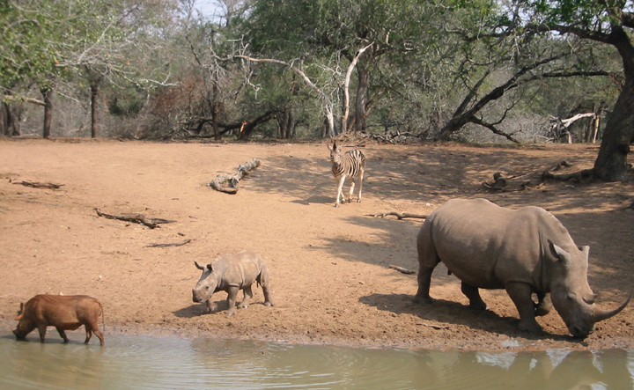
The Watering Hole!

Slide 13

...Another View
Of a Watering Hole...

Slide 14
The Watering Hole!
The Watering Hole is a place for everybody to play and share scripts, etc.
Your own corner of the WH is called:
  Timba/WH/contrib/XYZ (XYZ = your initials)
You may commit anything Timba-related, within reason:
  scripts, documentation, presentations
  NO large data files please, NO MSs

Slide 15
Building The System
Walk-through follows...
The whole process is documented on the Timba Wiki:
  http://lofar9.astron.nl/meqwiki
  (see the BuildingTimba pages)
If you see any inaccuracies in the Wiki, please feel free to correct, that's what a Wiki is for.

Slide 16
Reporting Bugs
Use our Bugzilla system to report bugs and file enhancement requests
  http://lofar9.astron.nl/bugzilla
You can create yourself a Bugzilla account on the front page,
Bugs reports submitted via conversation in the corridors have a half-life of 27.3 minutes before they vanish from the average developer's mental stack. USE Bugzilla and win valuable prizes!

Slide 17
Bugzilla
Bugzilla walk-through follows...
Do a quick Bugzilla search before reporting (you may find something interesting, e.g. a known workaround).
But don't waste too much time, we'd rather deal with duplicate reports (which are eventually merged anyway) than having bugs go unreported.

Slide 18
The Wiki http://lofar9.astron.nl/meqwiki
Source of all documentation, news, etc.
Feel free to sign up and correct pages or edit your own, the structuring is minimal.
You're free to place any relevant material of your own.
Your personal pages (accessed via YourName) are a handy way to keep a “logbook”.

Slide 19
Mailing List
Announcements, any questions, discussion.
Good to follow it if you become an active user, as things like “current svn version is broken, please don't update until I fix it” are broadcast via the list.
To sign up, send an e-mail with “subscribe” in the subject or body to:
  timba-developers-subscribe@astron.nl

Slide 20
Weekly Videocon:
If you just simply miss us too much
Really dedicated users can join in the videocon.
Every Wednesday at 15:30 Dwingeloo time.
Jan posts the program to the mailing list.

