Slide 1
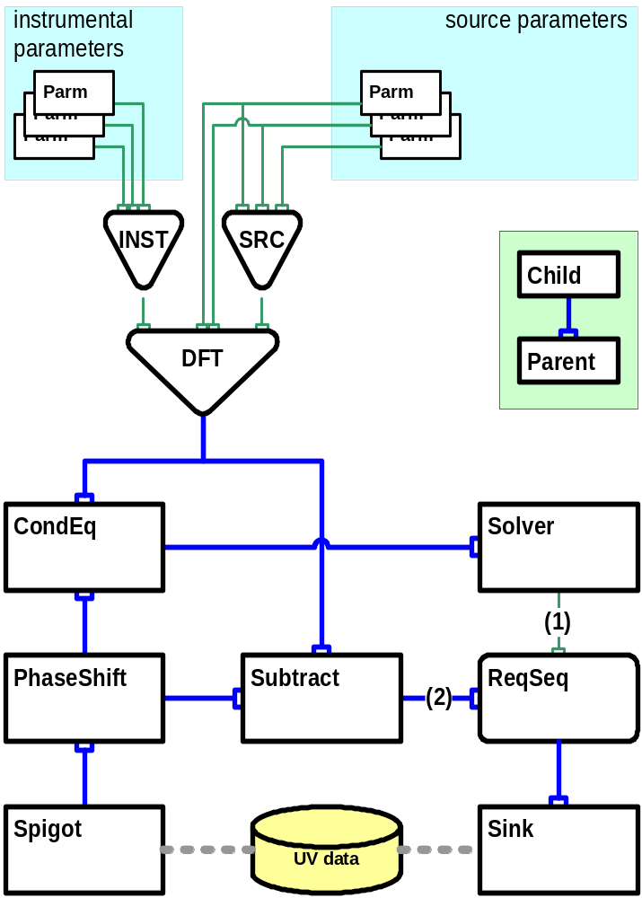
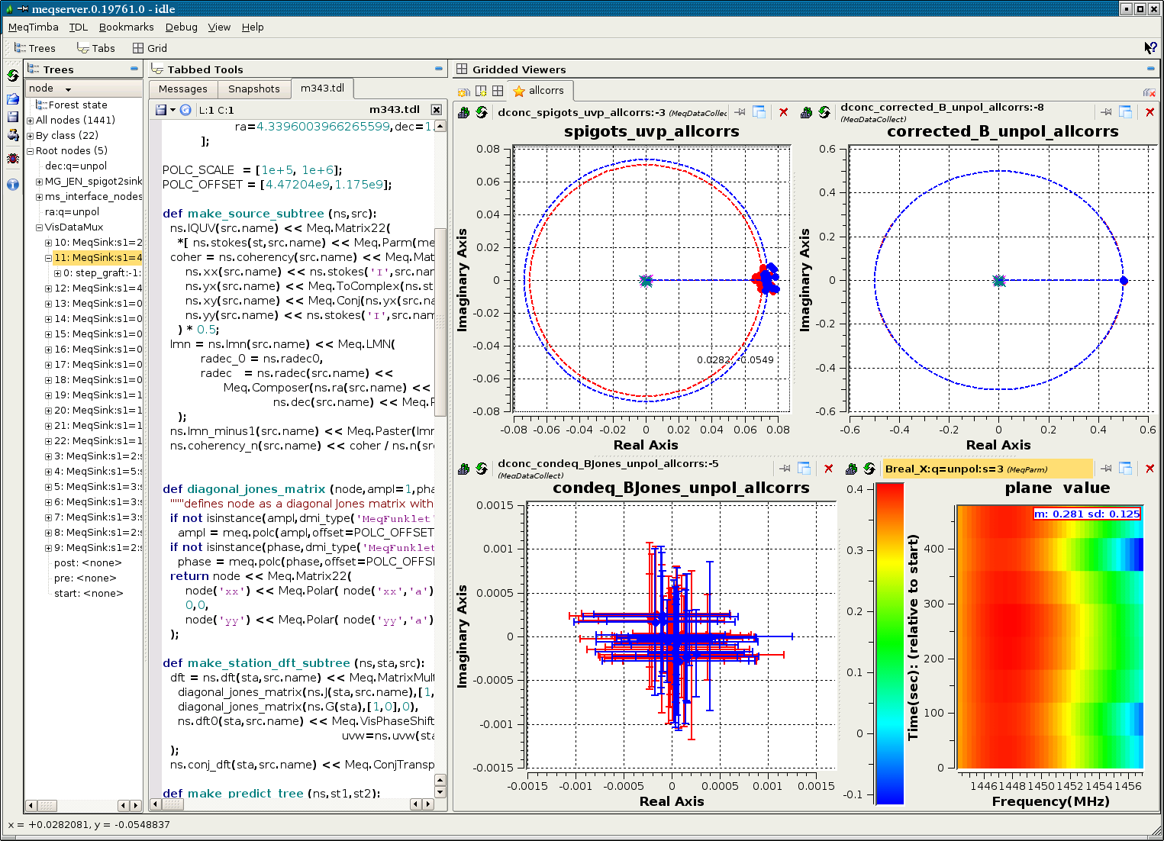
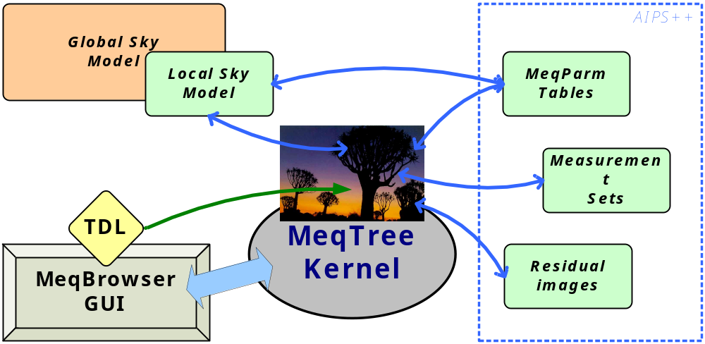


Implementing Arbitrary Measurement Equations
With The MeqTree Module
O.M. Smirnov & J.E. Noordam ASTRON
A Measurement Equation predicts data measured with a particular instrument
• A combined model of the instrument and observed objects
• Crucial for calibration of, e.g., radioastronomical measurements
Calibration with a M.E.
• Implement model in software
• Use apriori guesses to set model parameters
• Compare measured data to predicted values
• Adjust parameters of model for best fit
Where’s the catch?
• New instruments (LOFAR, SKA) require very sophisticated models with many M.E. parameters
• Existing calibration packages implicitly incorporate some fixed form of the M.E.
• A fixed M.E. makes it impossible to calibrate for effects unaccounted for by the software authors
WANTED:
a model construction and parameter fitting kit!
predicted
measured
The basic structure of a predict-solve tree
Build a model of your choice by constructing a MeqTree
• MeqNodes perform operations on results of children, pass them on to parents
• Models of arbitrary complexity may be constructed
Just put a solver on the bottom, and you’re off!
• Model parameters: arbitrary smooth functions (polynomials, gaussians, etc.) of, e.g., frequency, time, position, etc. Any subset may be solved for (see Mevius et al., Poster 78 this conference)
MeqTree Module Components
• C++ computational kernel. Fast and almost policy-free.
• Python-based Tree Definition Language.
• PyQt GUI: the MeqBrowser. Provides tree visualization, process control, debugging and profiling.
Policy defined from the scripting side
• Policy = problem domain
Applies to other domains/instruments, not just radioastronomy!
MeqTrees In The Context Of LOFAR Calibration (see also Nijboer et al., Poster 57 this conference)
smirnov@astron.nl
noordam@astron.nl
www.astron.nl
NETHERLANDS FOUNDATION FOR RESEARCH IN ASTRONOMY

