Slide 1
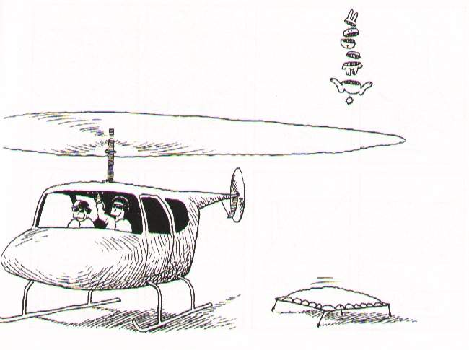
Day 4: Perils Of The Ionosphere

Slide 2
Before we start...
$ cd ~/Workshop2008
$ svn up

Slide 3
The Full-Sky ME

Slide 4
The Full-Sky ME

Slide 5
Image-plane vs. uv-plane

Slide 6
And Back To The ME....

Slide 7
The Fourier Transform
The integral then becomes a 2D Fourier transform of the “apparent sky”.

Slide 8
The Fourier Transform 2
This is essentially the van Cittert-Zernike theorem
  ...as a simple consequence of the M.E. and our K Jones term.
Note that the original M.E. (Hamaker-Bregman-Sault Paper I) was formulated purely in terms of cohaerency:
...and here we extend the M.E. into the image plane.

Slide 9
Apparent Skies & Apparent Cohaerencies
In other words, each antenna pair p-q measures an apparent cohaerency distribution Xpq(u,v) that corresponds to a 2D Fourier Transform of its own apparent projected sky Bpq.
...at a single point in time!

Slide 10
Time Is Not On Our Side
Cohaerencies are sampled along a “uv track” over some period of time:
The true sky B is probably constant(?) in time
Image-plane effects (beam shapes, ionosphere) will vary:
  ...both in time
  ...and across antennas
All this is especially relevant with low-frequency and/or wide-field observations.

Slide 11
The “Classic” Assumptions
Only under these assumptions can we consider a single F.T. of the sky as being an accurate representation of what an interferometer sees.

Slide 12
Conclusions
Under the “classic” assumptions, the visibilities measured by an array correspond to ONE cohaerency distribution X that is in an F.T. relationship with ONE apparent sky.
In the presence of non-trivial image plane effects – such as the ionosphere -- each interferometer p-q measures its “own” cohaerency Xpq(t), corresponding to its “own” apparent sky Bpq(t) -- variable in time!

Slide 13
Ionosphere In The M.E.

Slide 14
Some Ballpark Numbers

Slide 15
The Famous Four Modes: the trivial...

Slide 16
The Famous Four Modes: the simple, and the nasty

Slide 17
Building An Ionosphere
Let's make a tree to model an ionosphere.
Assume a “flat world” model, and a two-dimensional ionospheric “blanket”, i.e. Total Electron Content is then just TEC(x,y,t).
A number of sine waves to model Travelling Ionospheric Distrubances (TIDs).

Slide 18
Ionosphere 1
cd Day4; Load up demo1_iono.py
Run “test forest” and look at bookmarks.
  this gives us TECs at two x,y points
Lots to be learned from this script, so take it home to study if you want to write your own trees eventually:
  passing nodes in and out of functions
  using qualifiers (“rate”) on top of existing nodes to avoid naming conflicts
  making vectors, using matrix multiplication
  ...and generally making your code assumption-free

Slide 19
Ionosphere 2
Let's get a more elaborate picture...
Load up demo2-iono.py
Run “test forest” and look at “tec:grid”
More to be learned from this script:
  we import the TID function from demo1
  the “xy” nodes can be functions of anything, our tree doesn't care
  so we can form up a request in t,l,m
Bonus question: why is “tec:grid” only two-dimensional?

Slide 20
Ionosphere 3
OK, let's make a truly 3D picture...
Load up demo3-iono.py
  this adds a second sine wave moving in a different direction
  note the use of another qualifier
Run “test forest” and look at “tec:grid”
If you're lucky, you can access the “Warped surface” and “3D display” options via right-click.

Slide 21
Exercise:
Ionospheric Phase
Start with demo3-iono.py
Add nodes to compute ionospheric phase delays (see below)
Add a frequency axis of 30-200MHz to the domain.
  use 30 points per each axis, or you WILL run us out of memory!!!
Display the “phase screen” in l,m, as a function of frequency.
Ponder on the joys of LOFAR calibration

Slide 22
And Now, Into Siamese...

Slide 23
First, A Different MS...
We'll use a different MS:
  30-190 MHz in steps of 5 MHz
  more LOFAResque
Make demo-30-190.MS by running:
  glish -l demo_sim_30-190.g

Slide 24
Exercise: An Ionospheric Sim
Set compile-time options as follows:
  Rotate ionosphere with sky: True
  TID X amplitudes: 0.01 at t=0 and t=1hr
  Size 50km, speed 200 km/h
  TID Y amplitudes: 0
  Grid size 3, grid step 5'
  Noise: 0 Jy
Run tree and make a per-channel map
Make a time-slice movie:
  glish -l make_movie.g DATA ms=demo.MS channel=32 npix=300 cell=3arcsec
  (or whatever output column you used)

Slide 25
Calibrating The Ionosphere
Let's try to calibrate for the simulated ionosphere we produced before
We'll pretend we know the source fluxes and positions
  this what the LOFAR GSM is for...
We'll pretend we know nothing about the ionosphere, and model it by a flat blanket, with a polynomial TEC distribution
We'll then solve for the coefficients

Slide 26
Slightly More
Exotic Calibration
In principle anything in the tree can be a solvable parameter
...and can be attempted to be solved for (given enough data)
Instead of calibrating individual Jones matrix elements, we can make them functions of something else, and calibrate that “something else”
E.g., a Minimum Ionospheric Model

Slide 27
The Gory Details...

Slide 28
First, Simulate...
We'll use a different MS:
  100-103.1 MHz, 10 kHz channels
  more LOFAResque, and easier to fit phase when it doesn't wrap channel to channel!
We'll simulate TIDs in x and y
Starting with zero amplitude at t=0, and gradually increasing
  This is because we need “phase lock”, which least-squares (usually) struggles with

Slide 29
Running The Simulation
You can just copy a pre-fabbed MS from here:
  cp -a (/net/birch)/data/oms/
      Workshop2007/demo-lofar.MS .
      (/apps/Timba/data on jop0x)
I'll demo the simulation step to show what ionosphere we're putting in

Slide 30
Running The Solution
Load up ME3/example6-iono-cal.py
(use “Load TDL script” or Ctrl+L)
Set the following options:
  Grid size: 1, step: 5'
  Ionospheric model: mim_poly
  Subtract sources in output
  MIM options | Polc degree in X/Y: 2
  MIM options | Polc degree in time: 1
  MIM options | Base TEC value: 10
Compile and run with a tile size of 2, watch the bookmarks

Slide 31
Comments On The Tree
Note how the script is extremely similar to the 3C343 script
  just a different Jones term
  that's the power of frameworks
Details of the MIM are hidden inside mims.py, we could in principle add other models there
MIM parameters are found through node.search()

Slide 32
Ionospheres Are Hard...
This is obviously a hard problem for a least-squares solver
  and our model is not the best
  although it fits better if we bump up the polynomial order
  though not always...
Other approaches needed...
  orthogonal polynomials
  non-parametric models, subspace decomposition?
  Solvers based on Kalman-type filters

Slide 33
Optional Exercise:
What About Faraday Rotation?

