Slide 1

Visibility Data &
AIPS++ Measurement Sets

Slide 2
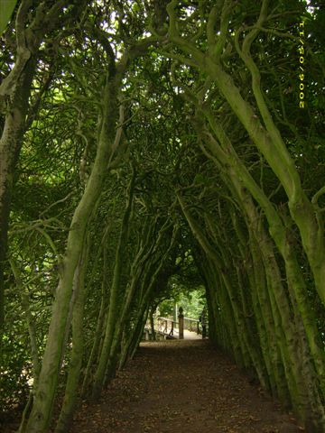

Slide 3
AIPS++...
14
2. AIPS++...
  [1] heard of it
  [2] tried to run it once
  [1] succeeded in running it once
  [2] have used it in anger
  [1] invented it
All the ingredients of a successful project are on hand here...

Slide 4
Working With
Visibility Data
14
MeqTrees interface with AIPS++ Measurement Sets
  other formats can be supported as necessary
An “empty” MS has to be pre-fabricated using external tools:
  you can use the AIPS++ “simulator”, see Workshop2006/demo_sim.g (and ask Tony)
  there's also a “makems” tool floating around (ask Ronald Nijboer)

Slide 5
Meet Our Guinea Pig Skeleton
14
I have prepared Workshop2006/demo.MS; this will serve our whims for this week.
There is a pristine backup copy available, so if you screw up, restore it with:
$ cd ~/Workshop2006
$ rm -fr demo.MS
$ cp -a /net/birch/home/timba/demo.MS .

Slide 6
VLA In Space
(About demo.MS)
14
This contains 27 antennas in VLA-C configuration...
  ...but blown up by a factor of 10
So the max baseline is ~30km
8 hours observation, 5 minute sampling, 96 timeslots
32 frequency channels of 16MHz each, from 800MHz to 1.31GHz
Four polarizations: XX XY YX YY
One pointing

Slide 7
A Simple MS Tree
14
Load Day1/demo50-sink.py
Under “TDL Exec”, select Tile size: 5
Load up the “MS Grids” bookmark
Run “test forest”
...note the “history” slider in the visualizer

Slide 8
Why “Skeleton”?
14
An MS provides a time/frequency grid (e.g., for use in simulations)
  thus, “skeleton”: we ignore the data in the MS (and write our own)
Sink nodes turn this grid into a request and send it up the tree.
  one Sink per interferometer
When a result comes back, this can be written out to a visibility column in the MS.
MSs are processed in chunks of time called “tiles”.

Slide 9
The VisDataMux
14
A VisDataMux node was created for us automatically.
The VDM is responsible for interfacing with the MS, reading data, and activating its child Sinks as appropriate.
To start the process, we give a specially-formed request to the VDM, containing input and output records telling it what and how to read (or write).

Slide 10
We Can Read, Too!
14
Load Day1/demo51-spigot.py
Under “TDL Exec”, select Tile size: 5
Load up the “Spigots” bookmark
Run “test forest”
...note the “history” slider in the visualizer

Slide 11
Sinks And Spigots
14
A Spigot node reads the visibility data from an MS, and returns it as a visibility matrix
Check visibilities using the history slider.
  You're looking at XX data, use the “Change selected Vells” option to look at the other 3
You can probably guess what kind of observation demo.MS contains...

Slide 12
On MS Columns
14
An AIPS++ MS has three standard “columns” for visibility data: DATA, MODEL_DATA, CORRECTED_DATA.
MeqTrees can “attach” to any column, or even create new columns.
Tools like the AIPS++ imager assign specific meanings to these columns though, and do not support other names...
Speaking of the imager, run this script:
$ glish -l make_image.g DATA ms=demo.MS

Slide 13
Let's Modify Some Data...
14
Load Day1/demo52-mod-vis.py
Here we apply a gain term:
Under “TDL Exec”, select Tile size: 30 (just to go faster...)
Load up the “Spigots” bookmark
Run “test forest”
Make an image:
$ glish -l make_image.g MODEL_DATA ms=demo.MS

Slide 14
Exercise 50:
Freq-dependent gains...
14
Start with Day1/demo52-mod-vis.py
Apply a frequency-dependent gain to the data:
Make a per-channel image using:
$ glish -l make_image.g MODEL_DATA ms=demo.MS mode=channel

