Slide 1
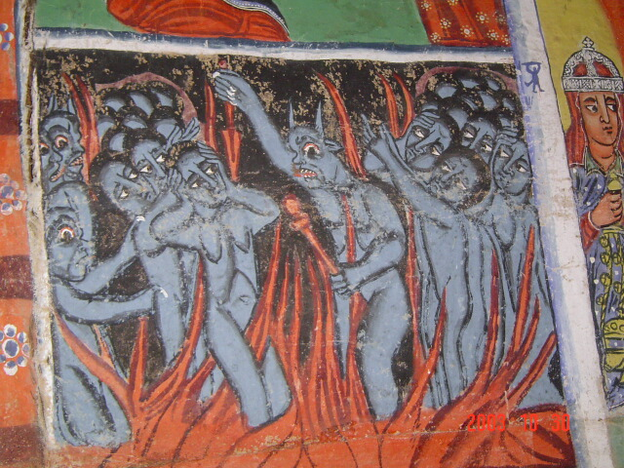
Visibility Data & AIPS++ Measurement Sets

Slide 2
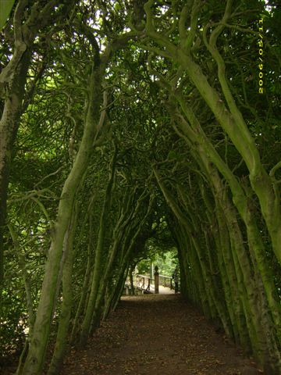

Slide 3
AIPS++...
2. AIPS++...
  [1] heard of it
  [2] tried to run it once
  [1] succeeded in running it once
  [2] have used it in anger
  [1] invented it

Slide 4
Working With
Visibility Data
MeqTrees interface with AIPS++ Measurement Sets
  other formats possible in the future
The MS has to be pre-fabricated using other tools
  e.g. Workshop2006/demo_sim.g (ask Tony)
  there's also a “makems” tool floating around (ask Ronald Nijboer)
I have prepared demo.MS for you
  demo-sim.MS is a backup copy (“rm -fr demo.MS; cp -a demo-sim.MS demo.MS” if you screw up)

Slide 5
Meet Our Guinea Pig
I have prepared demo.MS; this will serve all our whims for this week.
There is a pristine backup copy
rm -fr demo.MS
cp -a /net/birch/home/timba/demo.MS .

Slide 6
A Simple MS Tree
Load Day1/demo50-sink.py
Under “TDL Exec”, select Tile size: 5
Load up the “MS Grids” bookmark
Run “test forest”

