Slide 1
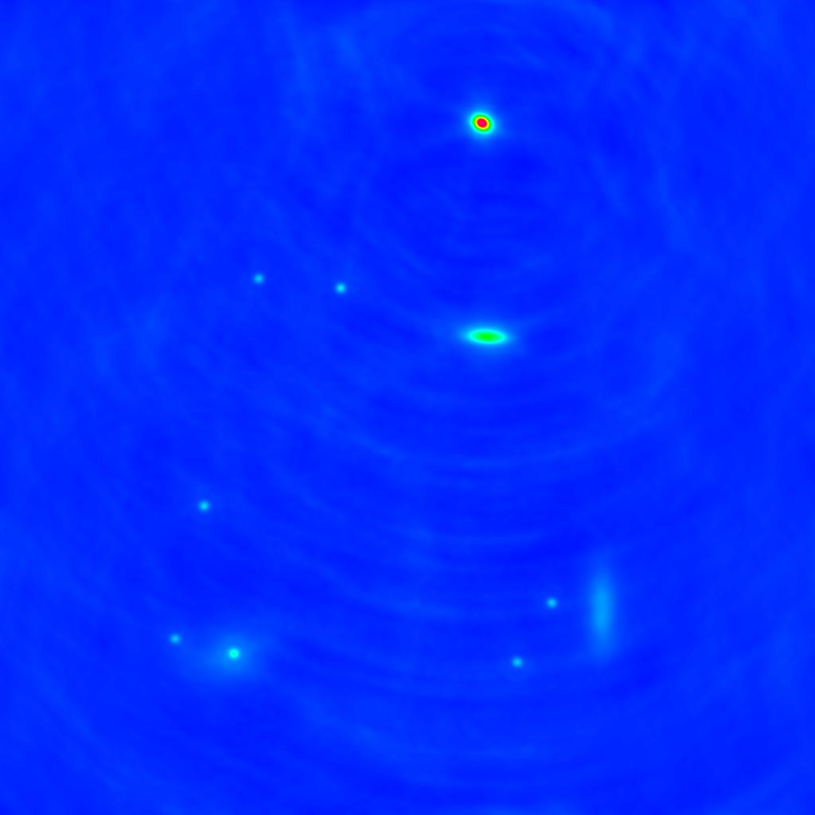
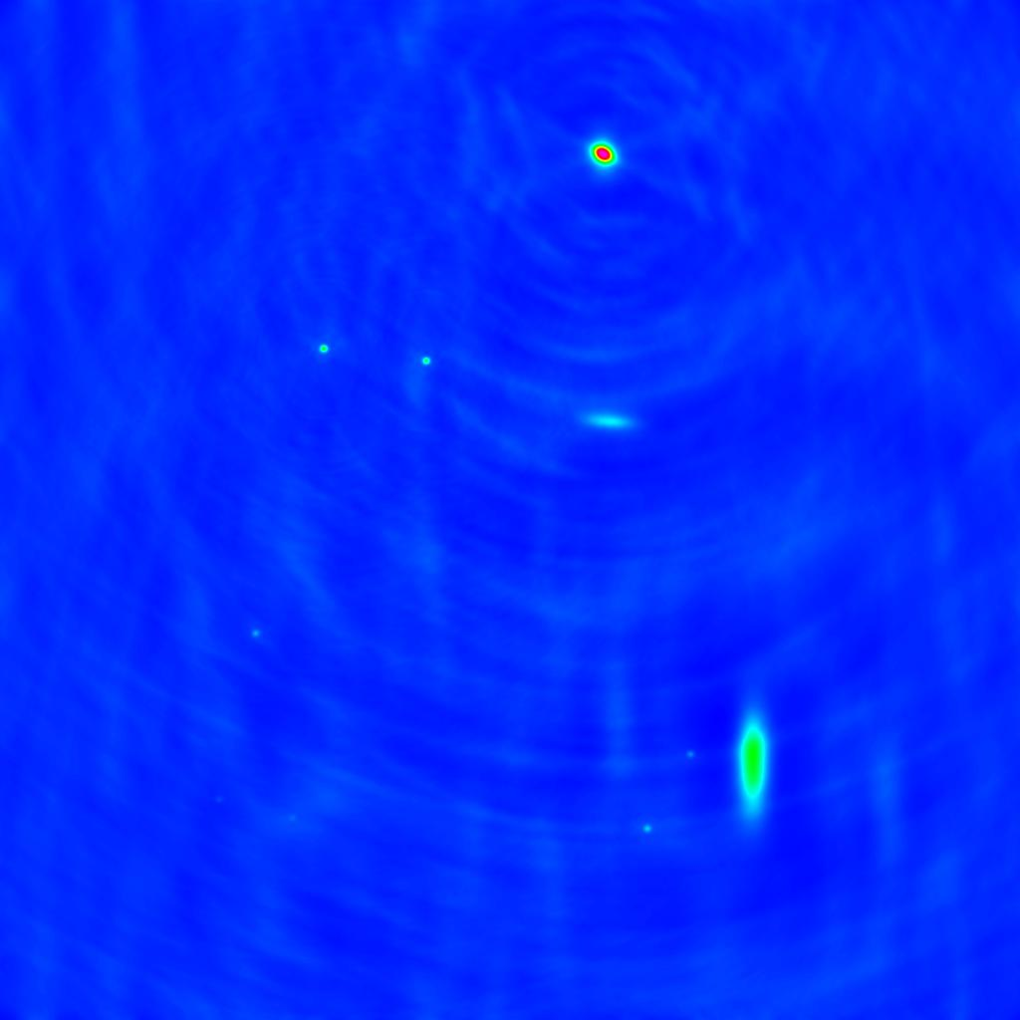
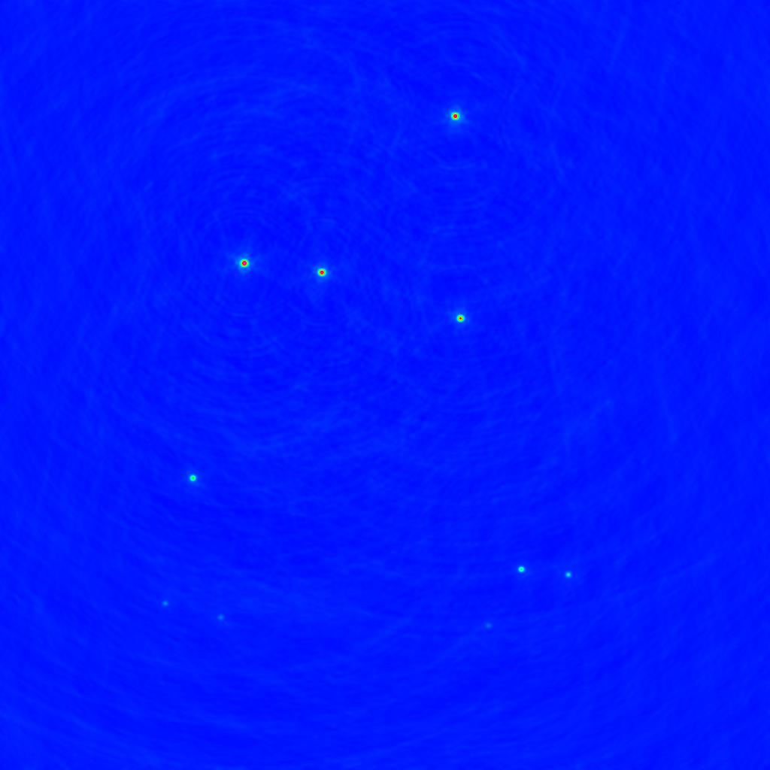
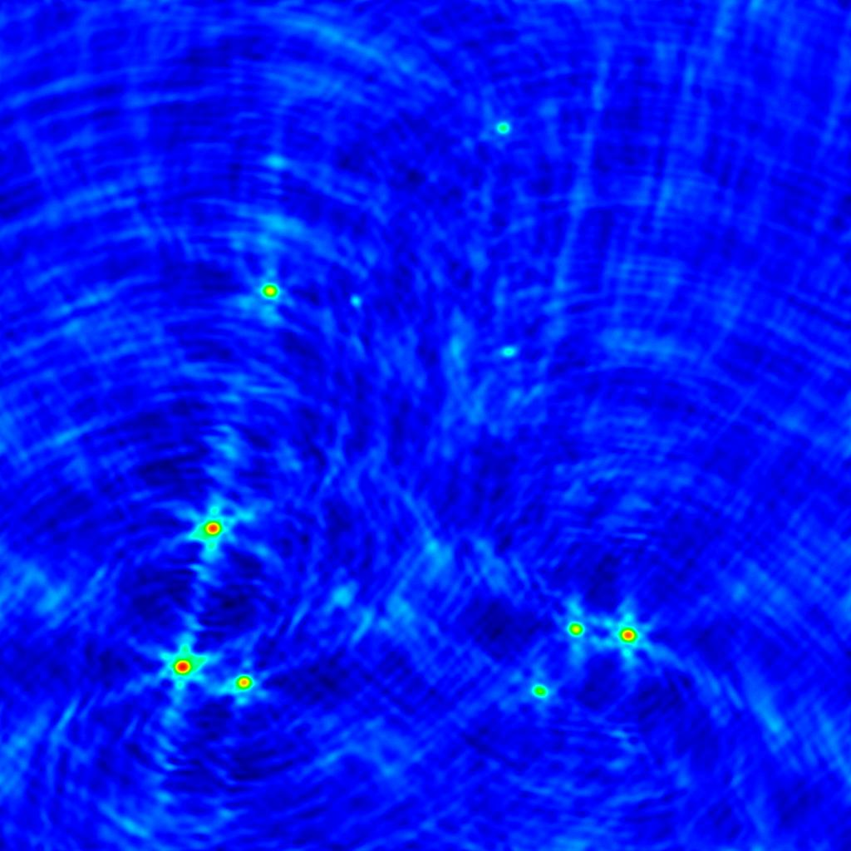
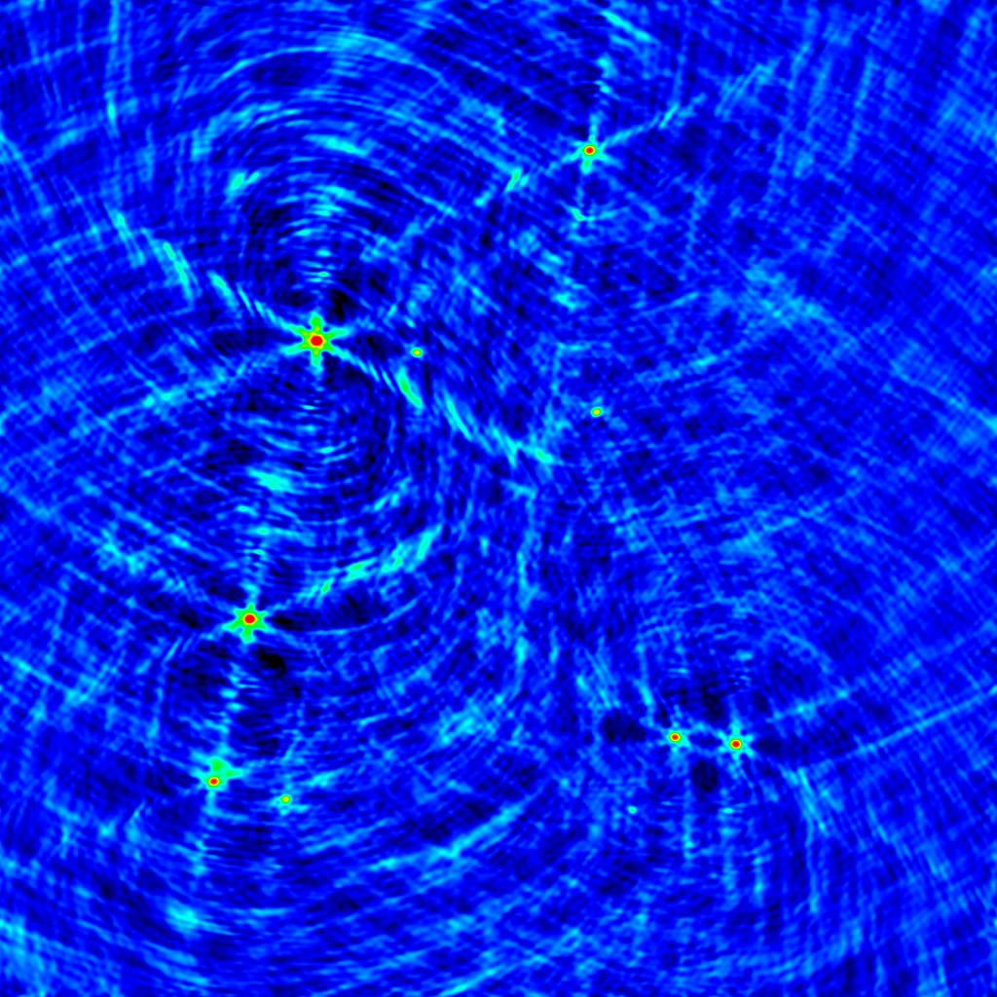
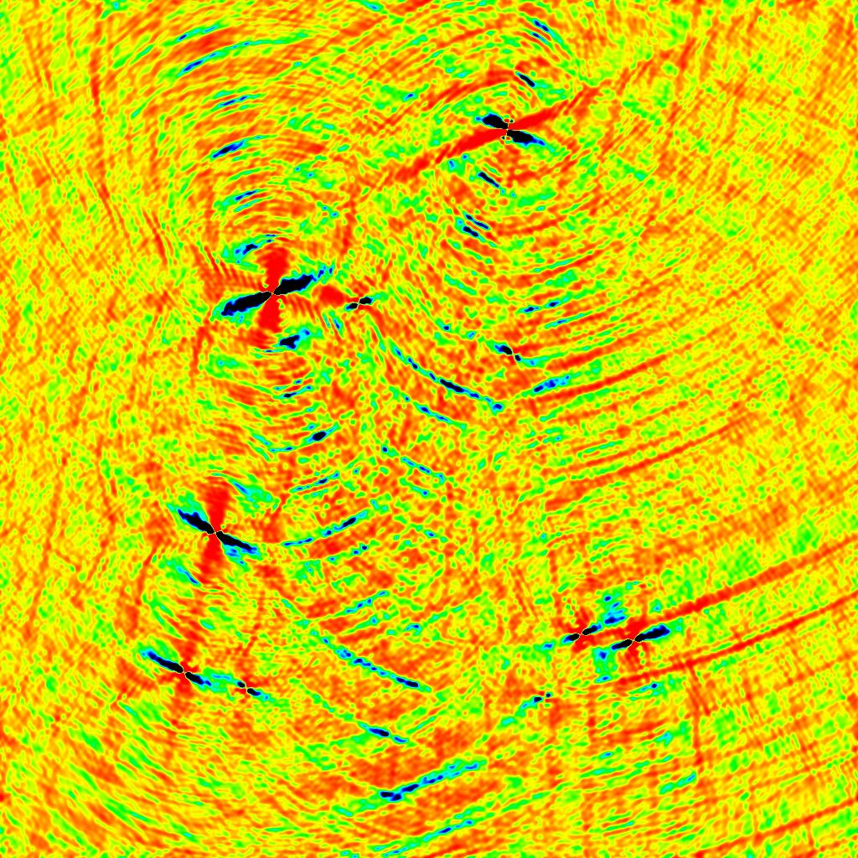
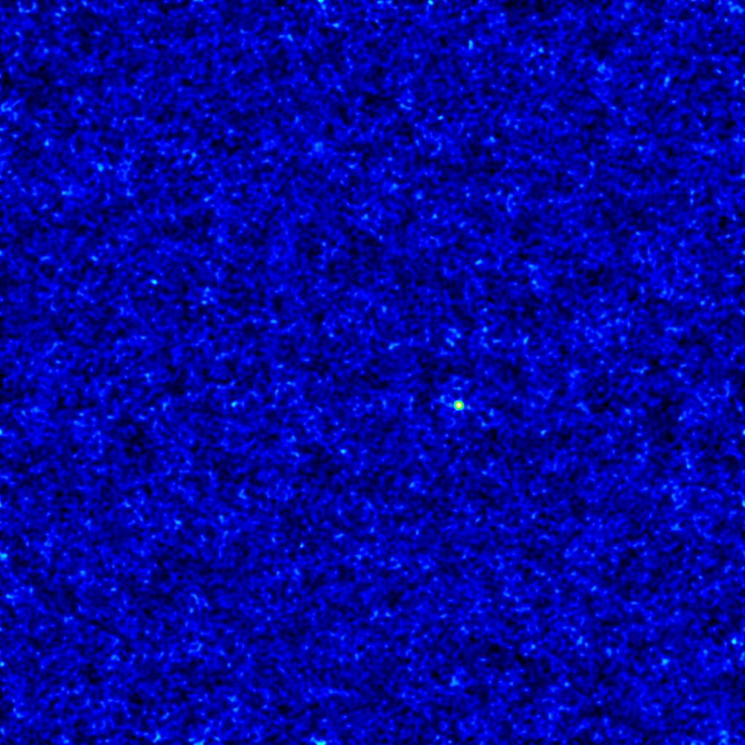
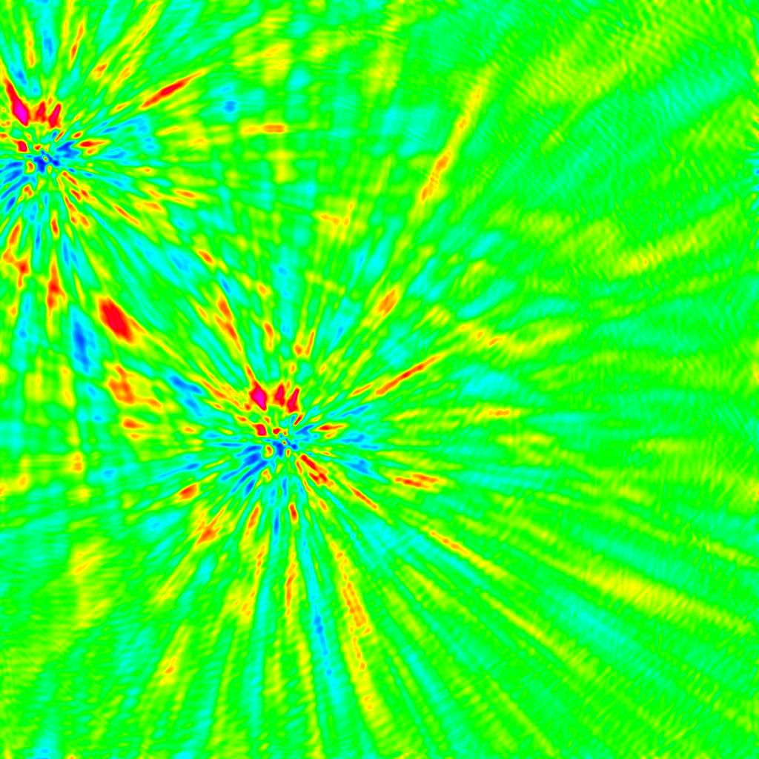
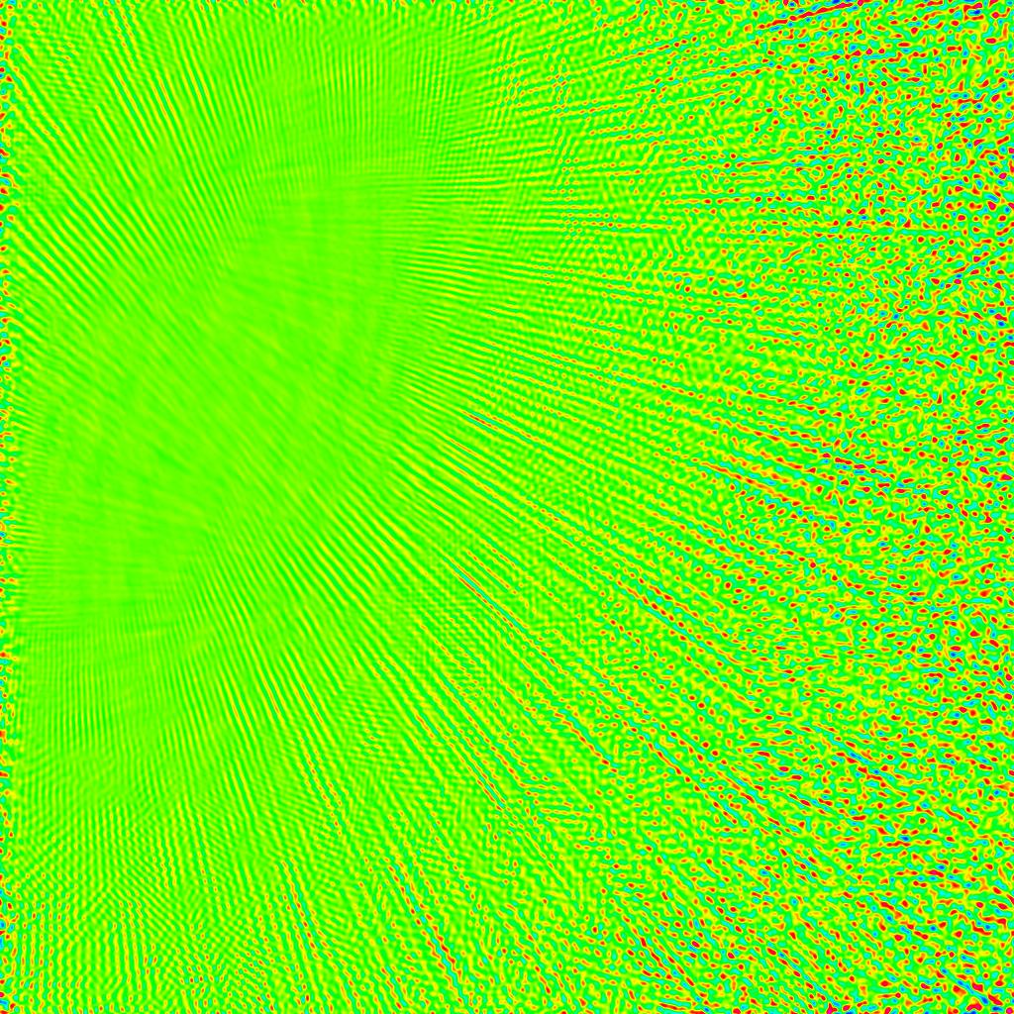
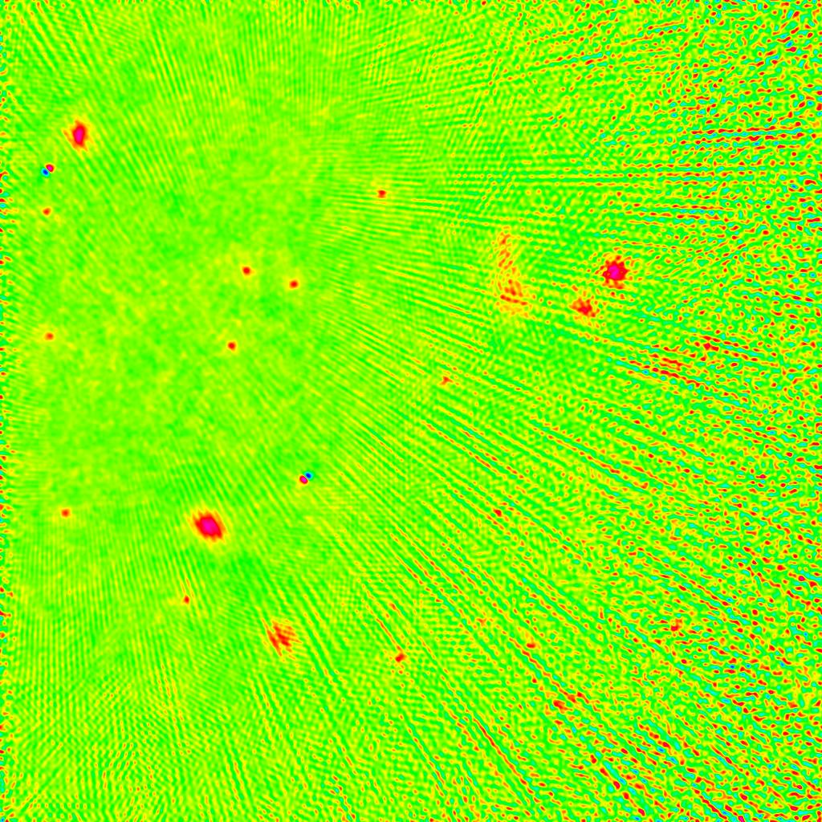
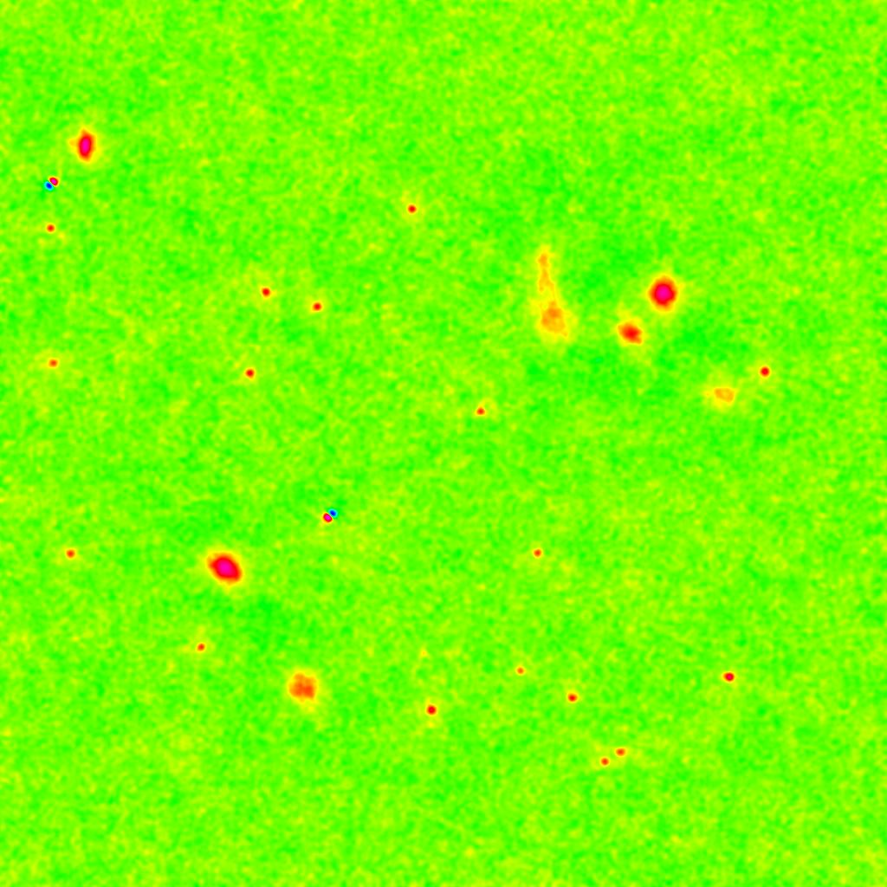
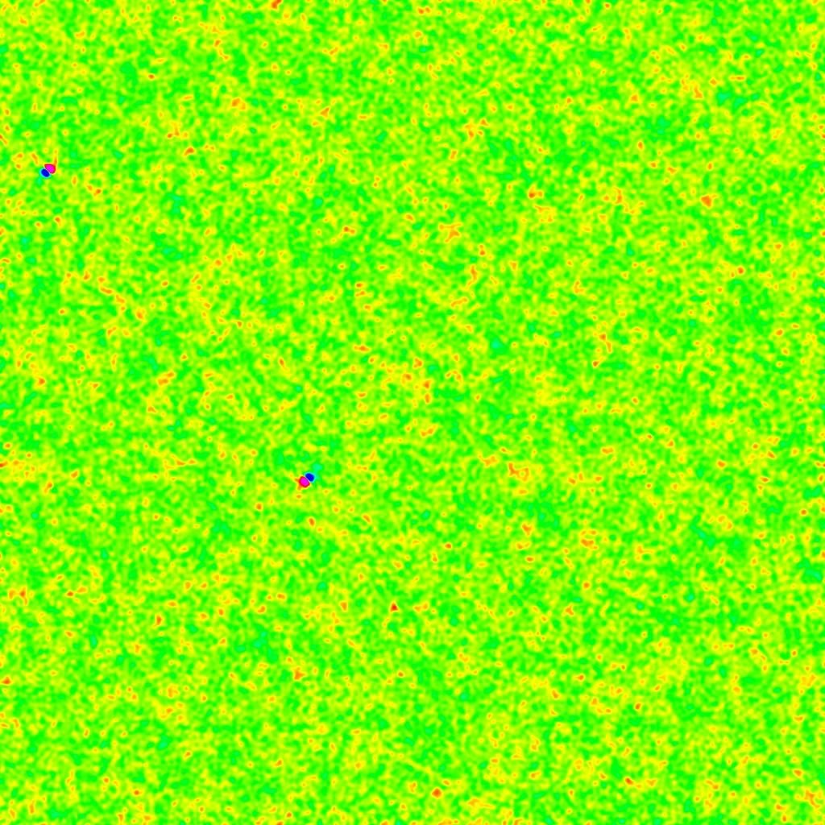

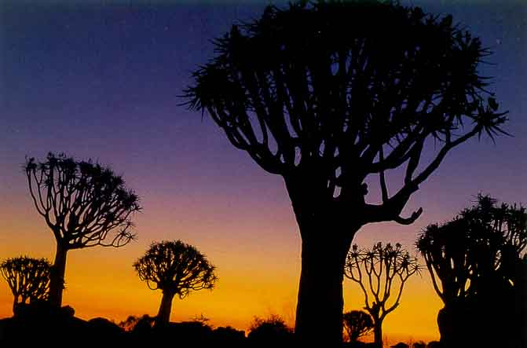
SKA Simulations With MeqTrees
O.M. Smirnov (NWO/ASTRON) & A.G. Willis (NRC/DRAO)
The MeqTree System
MeqTrees are a simulation and calibration system being developed at ASTRON. The crucial difference between MeqTrees and all other calibration or simulation packages is that completely arbitrary Measurement Equations may be implemented. Using MeqTrees, source and instrumental models of any structure and level of complexity may be constructed. This makes it a uniquely useful tool for simulations of future radio-telescopes.
On the calibration side, MeqTrees allows one to fit any model to a set of observational data. This allows calibration for very fine instrumental effects completely unanticipated by current calibration systems.
The CLAR Concept
The Canada Large Adaptive Reflector (CLAR) is a radio-telescope concept being developed by NRC/DRAO. It consists of a very large (~250m) stationary dish mounted on the ground, with the receiver on an aerostat tethered at the focus point, 500m above the dish. The telescope is “steered” by moving the aerostat.
The CLAR is just one of many proposed SKA technology concepts. Simulating observations with the CLAR is especially challenging, since the its primary beam becomes elongated at lower elevations, producing interesting image-plane effects. The concepts developed while simulating a CLAR array can be readily applied to other SKA technology proposals.
3a, 3b: Demonstrating CLAR beam elongation
Due to antenna geometry, the CLAR beam becomes progressively elongated as it is steered from zenith to horizon. How can we quantify this effect?
The images on the right were produced by mapping the difference between a “perfect” model (image 2) incorporating beam elongation, and a simplified model where the beam was held constant for all elevations. These images show the errors we would make if we don’t account for elongation. The residuals here are on the ~.02 Jy level. Since the sources are all ~1 Jy, this corresponds to an error of 2%, which is huge by radio-astronomical standards.
Note the characteristic six-spoke distortion pattern. This pattern is related to the instantaneous PSF of the array, but the spokes are oriented differently for different sources. This is because the elongated beam rotates w.r.t. the sky, and sweeps over different sources at different times, giving each source an apparent variability in time. Meanwhile, the array itself rotates together with the Earth, thus rotating the instantaneous PSF. Spokes are produced when the elongated beam sweeps over a source, and correspond to the PSF orientation at that time.
Not surprisingly, the effect is more pronounced at higher frequencies, where the beam itself gets tighter.
Error pattern at 800MHz
colormap range : 0-30 mJy
Simulated CLAR field at 800MHz
colormap range : 0-2 Jy
Simulated CLAR field at 1.4GHz
colormap range : 0-2 Jy
Simulated CLAR field
(point sources only) at 800MHz
colormap range : 0-1 Jy
Error pattern at 1.4GHz
colormap range: 0-30 mJy
1a, 1b: Mix of point and extended sources,
800 MHz and 1.4 GHz
2: Point sources,
800 MHz
These images are made by running MeqTrees to fill a dataset with a simulated CLAR observation of 10 sources, with an intrinsic flux of 1~2 Jy (at 800 MHz).
The simulated array consists of 27 CLARs in the VLA-C configuration, scaled up by a factor of 10. This provides 351 baselines, with the longest being ~30km.
We simulate an 8-hour observation with 1-minute integration times; there are 32 frequency channels from 800 MHz to 1.4 GHz.
The field of view is about 4.2´ across. Note that the simulated half-power beam width at zenith (HPBWZ) of the CLAR antenna is ~5.3´ at 800 MHz and ~3´ at 1.4GHz. Although this is not immediately apparent from the dirty images, the data is significantly affected by beam elongation throughout the 8 hours of observation time (see images to the right).
The sources are simulated with different spectral indices, hence the difference in relative brightness at lower and higher frequencies. All the extended sources here have a positive spectral index, otherwise we’d see them disappear completely at the higher frequency, since the effective spacings increase by almost a factor of 2 in units of wavelength.
Error pattern at 1.4GHz
colormap range: ±35 uJy
4: Per-antenna beam variations
Beam elongation depends on antenna elevation, and while all antennas track the same source, their elevation depends on their geographic position. So, theoretically, the beam of each antenna will always have a different degree of elongation. With a longest baseline of ~30km, we would expect this variation to be tiny, so perhaps we could save some computing time by using the same beam model for every antenna? If image-plane effects are the same for all antennas, we can save time by simulating sources fully in the image plane.
This image shows the difference between the “perfect” model of image 2, and a simplified model where we used the same (averaged) beam pattern for all antennas. The error level is 10~20 uJy. Therefore, ignoring per-antenna beam variations limits us to a dynamic range of 10,000:1, which is unacceptable for SKA.
5: Calibrating a CLAR observation
Can we even calibrate a CLAR observation, given the complex beam effects shown here? MeqTrees allow us to built arbitrary models and then solve for arbitrary subsets of their parameters, so we can use them to find out.
First we simulate an observation similar to Image 2 above, with the addition of significant noise (1 Jy per channel), and with an extra faint source of 10 mJy (which corresponds to a ~5σ detection given our observational parameters.) Then we ask: given such an observation, and not knowing the exact source fluxes, spectral indices, or the beam width, can we possibly calibrate it accurately enough to detect the fainter source? This is a normally a very tricky problem, since, e.g., beam width is very difficult to separate from spectral index. But perhaps with 10 sources in the field, we have enough information to actually disentangle all these effects?
To calibrate with MeqTrees, we proceed as follows. We build a tree that models a CLAR observation of the bright point sources only (since we’re not supposed to know about the “secret” faint source.) We then assign “initial guesses” to the source and instrumental parameters – zero spectral indices, source fluxes off by ~20% from their actual values, beam width off by ~20%.
Then, we let MeqTrees do a least-squares fit of this model to the simulated observations, varying the source and beam parameters until the best fit is achieved. We then subtract this best-fit model of the bright point sources from the “observed” data, and make a map of the residuals. This is the image on the left (average of all channels, logarithmic brightness scale). Note the following:
The 10 mJy source is clearly detected.
The residuals are entirely noise-like, with a mean of 0 and a standard deviation of ~3 mJy.
This shows that even we can indeed calibrate (at least with MeqTrees) for the complex image-plane effects of the CLAR, all the way down to noise level.
Residual image (multi-frequency synth)
colormap range : -1~5 mJy
Probing The nano-Jansky Sky:
Beyond Fringe-Fitting
Phase errors place a significant limitation on the dynamic range attainable by an interferometer. Uncorrected phase errors effectively “smear” the flux of bright sources all over the map, drowning out fainter structure.
In a geographically extended array such as the SKA the effect is especially severe, as each antenna looks through its own patch of atmosphere. Consequently, each phase has its own, independent, variation with time. Clock offsets also introduce a variation with frequency.
In VLBI observations, this effect has been known for a long time; a procedure called fringe fitting is routinely used to correct for first-order phase errors. Fringe-fitting essentially fits a linear slope to the phase variations over suitably small intervals in time and frequency.
Here we present some MeqTree simulations that investigate the effect of higher-order phase errors on dynamic range. The simulated array is the same as the one used for the CLAR simulations above, but we do not apply any beam effects, and instead concentrate solely on the effect of antenna phase.
1. This image is produced from a MeqTree-simulated dataset. The field contains two 1 Jy point sources, plus a number of extremely faint (5-10 nJy) background sources. We also add 1 uJy of noise per channel, which puts the background sources close to the detection limit. The phase of each antenna is made to vary over time/frequency using a sine-like function. This is a map of the corrupted data. Phase errors have smeared the two bright sources all over the map.
2nd degree phase corrections
colormap range: ±.7 uJy
2. We now use MeqTrees to construct a model of the two bright sources, and use them as a phase reference: that is, simultaneously fit their fluxes and antenna phases. This is the residual map produced when phases are fitted by a 2nd-degree polynomial in frequency and time. The bright sources have been subtracted out, but the map is still dominated by the residual flux caused by third-degree phase errors. Conventional fringe-fitting (i.e. 1st-degree polynomials) produces a similar-looking map, but with ×10 higher errors.
No phase corrections
colormap range: ±8 mJy
3. On the left are the residual maps produced by fitting 3×2 and 4×3-degree polynomials to the antenna phases. The third-degree phase fit is accurate enough to reveal the <10 nJy background, but still leaves spatially extended artifacts after correction. Finally, the 4th-degree fit is almost perfect. The image on the right shows the difference between the 4-th degree corrections and the uncorrupted background model. Apart from two small artifacts where the 1 Jy sources used to be, the map is entirely noise-like, with a standard deviation of .25 nJy. Any remaining higher-order phase errors are within the noise level.
3rd degree phase corrections
colormap range: ±8 nJy
4th degree phase corrections
colormap range: ±8 nJy
4th deg. corrections minus model
colormap range: ±3 nJy
This demonstrates that higher-order phase errors (a) can be fitted and (b) must be fitted if we are to get to the nJy sky!
smirnov@astron.nl
Tony.Willis@nrc-cnrc.gc.ca
www.astron.nl
NETHERLANDS FOUNDATION FOR RESEARCH IN ASTRONOMY

