Slide 1
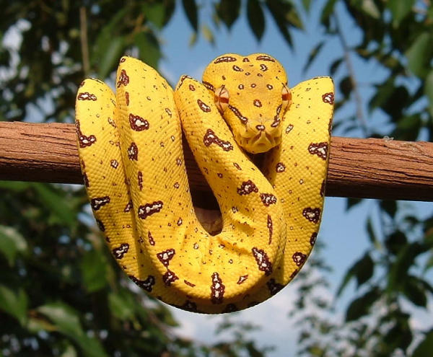
  The Snake In The MeqTree:
  Using Python For Calibration & Simulation
  Of Radio Astronomical Data
Oleg Smirnov
Netherlands Foundation For Research In Astronomy (ASTRON)

Slide 2
Outline
How radio astronomy works
Quirks of radio astronomical calibration
Why do we need modelling
The MeqTree package
Python

Slide 3
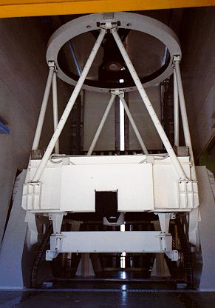
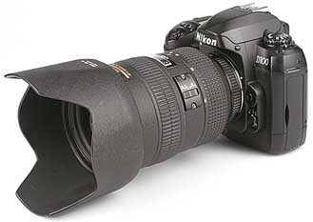
Optical Telescopes:
Direct Imaging
Notes:
I think everyone has a general idea of how a telescope works. It looks something like this, but works pretty much just like this – you have a lens or a mirror to collect light and focus it on an imaging device such as a CCD. You point, you click, and you get something like this...

Slide 4
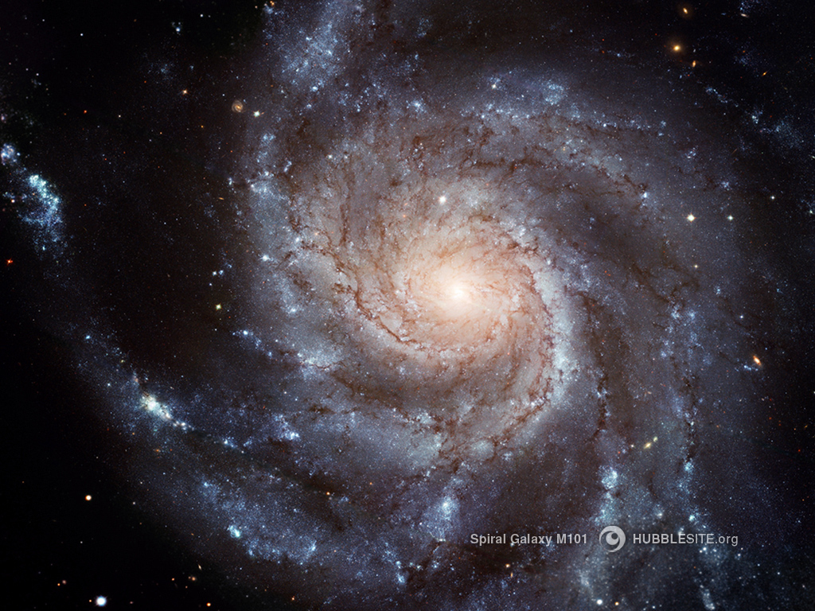
  resolution ~ λ / d
  (λ=475nm, d=2m
  ~ .05” )
sensitivity ~ d²
Notes:
Now, the two limiting factors in any observation are resolution and sensitivity. Resolution is determined by the size of your mirror or lens – you have something called the diffraction limit -- which determines the limiting angular size of features that you can still resolve. This limit is goes as wavelength over size – bigger is better! -- so here, for example, for blue light and a 2m mirror, the limit is .05”. In fact diffraction in the atmosphere sets in long before you reach this limit, which is why we have to do expensive tricks like putting telescopes in space, making “adaptive optics” with flexible mirrors, etc.

Slide 5
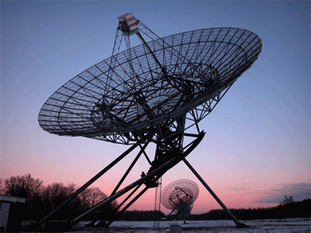
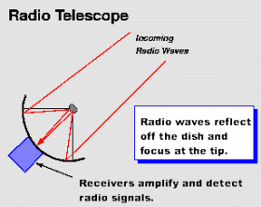
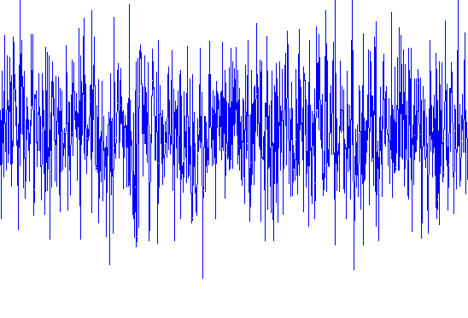
Radio telescopes:
No direct imaging
resolution ~ λ / d
λ=21cm, D=25m
~ 0.5˚
Notes:
Radio telescopes look like this – a sattelite dish on steroids – and work like this. You point, you click, and you get this... white noise basically. Most radio emission from the universe is white noise.
The difference with an optical telescope is that we don't get any kind of image. This is basically because the wavelengths are on the same scale as detector size -- there's no such thing as “radio pixels”. So, all we really do is aim the dish at a spot on the sky, and measure the total signal from that spot. (The size of the spot also goes with wavelength over dish size – and you can see that for a typical dish this “spot” is pretty big.)
Astronomers usually want to look at images though, so how can we make one? Well the first idea is to sweep our “spot” over the sky, measure the intensity at every point, and make some kind of an image that way. In fact this is how radio astronomy started...

Slide 6
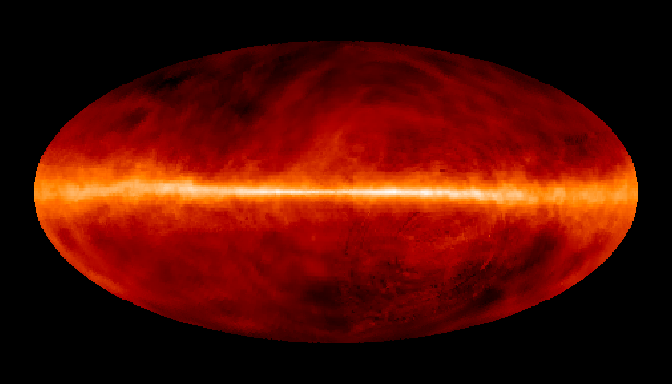
all-sky map of neutral hydrogen (λ=21cm)
Notes:
And you do get a long way. For example, here's a map of the whole sky at the 21cm wavelength, obtained in exactly such a manner. Neutral hydrogen produces radio emission at this frequency, so what you're seeing here are hydrogen clouds within the Milky Way – the galactic plane is here. The stuff does not emit any visible light, so this is already unique science that you can only do in the radio.
Still, just waving a large blurry spot around the sky is not really all that satisfying. Fortunately, we can do a lot better with interferometry.

Slide 7
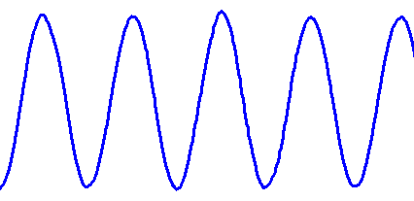
A Simple Interferometer
}
Δ
baseline (b)
correlator
Notes:
Here's how a simple interferometer works. Imagine for a second that there's only one source of radiation in the sky, and we observe it with two separate radio dishes – the distance between them is called the baseline, b. Now if the source is located straight on – at what we call the phase center, along this line of sight, being effectively out at infinity – both dishes receive exactly the same signal. It's still white noise, but it's perfectly in sync. If we feed this signal to a something called a correlator, which basically multiplies two signals and integrates the product over some period of time, the output of the correlator will be 1, in appropriate units. Now if the source moves off center in this direction, the signal to one dish will be delayed by this interval “Delta” here, so it will be a little bit out of phase, and the correlator will report something less than 1 – and so on, until at some point the signals are in perfect anti-phase and the correlator reports -1. In this way we can determine the position of the source with great precision.
That's all very fine for one source, but the sky is full of sources, and both dishes see ALL the sources within their field of view. Another source way over to the right here, so it's Delta equals a whole number of wavelengths, will also be perfectly correlated. Also, any source in the perpendicular direction – perpendicular to the screen here – will also be registered, with exactly the same correlation – in fact we have absolutely no resolution in the perpendicular direction. Basically, if you “multiply” the sky by a “fringe pattern” -- a two-dimensional sine wave here – and add up all the signal, that's exactly what the correlator registers. So, to figure out what the sky really looks like, we need to somehow disentangle all the individual source contributions.

Slide 8

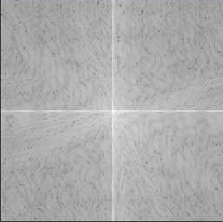
Seeing The Fourier Plane
v
Fourier
transform
×
b
u
isomorphism!
Notes:
Now, for any image – here we have an image with two point sources in it – we can compute a two-dimensional Fourier transform, which looks something like this. The F.T. represents the image as a sum of harmonics with complex coefficients. Each coefficient is given by this formula here. What we show in the image on the right here are the complex amplitudes of the Fourier coefficients corresponding to this image on the left. This is also called the uv plane (as opposed to the sky plane or image plane here).
The F.T. is linear, so the transform of any image is the sum of the transforms of each component in the image.
The transform of a point source in the uv plane is something that's constant in amplitude, but has a phase gradient that depends on the position of the source in the image plane. So the sum of two point sources produces this wavy pattern due to the way that complex phases add up.
This is all really intuitive stuff if you have the time to think about it – which you don't so you'll have to take my word for it.
Now, what this formula really says is that each uv point represents the original image multiplied by some 2D sine wave – this term here, and added up. This sounds familiar because that's exactly what an interferometer measures! So, an interferometer really measures a single point (called a “visibility”) on the uv plane. The location of the point is determined by the length of the baseline b and the angle – to the orientation of the baseline relative to the sky.
Now, if we can somehow contrive to measure the whole uv plane and not just one point, we can do an inverse F.T. and recover the original image. This is actually easier than it sounds.

Slide 9
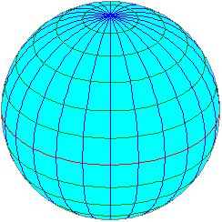
Sampling The UV Plane
v
×
×
×
×
×
×
u
Let the Earth do the hard work!
Notes:
We can use multiple antennas – this is called an interferometer array. Each combination of two antennas gives us a baseline, and thus a different uv point, depending on the length of the baseline. It's kind of impractical to build enough antennas to have the whole uv plane covered, but fortunately we don't have to. Imagine just four antennas arranged on an East-West line. Four antennas give us six baselines, and they'll sample the six uv points indicated here. Now, we sit and do nothing at all. As the Earth rotates, the orientation of all baselines relative to the sky rotates as well. In the uv plane, each baseline sweeps out an arc, and in 12 hours we have sampled half the plane – the whole plane really, since it's symmetric – within this circle indicated here. So even with a few antennas we can get enough information to reconstruct a sky image.
Now you might ask what happens to the uv points out here – well, we never get to sample them because none of our baselines are long enough. These correspond to the high-frequency harmonics, and failing to sample them ultimately determines the resolution of our reconstructed image.

Slide 10
Tom's animation
Tom's animation goes here
Notes:
Here's a little animation that shows this process. We start with an image reconstructed from an instantaneous observation at the Westerbork. All antennas here are on an East-West line, so initially we only have resolution in one direction – in the other all we see are vertical bands.
Now if we start the animation, you can see how over 12 hours of observation we get more and more information, until we have enough to reconstruct the whole image.
These rings you see are artifacts, introduced because we sample the uv plane on a limited grid.

Slide 11
Emil's image?
resolution of a single telescope ~ λ / d
HST: d=2.4m, λ=475nm: resolution ~ 0.05”
resolution of interferometer ~ λ / b
compact radio array (WSRT, VLA):
λ=21cm, b=2km: resolution ~ 20''
VLBI:
λ=3mm, D=10000km: resolution ~ 0.00006'' !!!
Notes:
Now if you're wondering why we go through all this trouble, there's a good reason. The angular resolution limit of a regular telescope – basically the smallest feature it can can see -- goes as wavelength over aperture size. So for the HST with it's 2.4 metre mirror, we get this figure of roughly 5/100 of an arcsecond. For an interferometer, resolution goes as wavelength over baseline size. So while we may be dealing with much longer wavelengths, the huge baselines more than make up for it. In the extreme case – Very Long Baseline Interferometry observations – antennas all over the world are tied together, and we get this ludicrous resolution that's measured in microarcseconds! That's a whole image for every Hubble pixel! Better yet, put an antenna in orbit, and you get even larger baselines – this has already been done, and the Japanese Space agency is planning another mission.
Here's an illustration of this. This is what an optical telescope on Earth sees – this is Hubble – and these are two VLBI images. This kind of resolution is well worth the trouble – although as you'll see in a bit the trouble is only starting...

Slide 12
Calibration: Dealing With Observational Errors
GWB goes here
Notes:
The reason I went into so much detail about all this is because measuring stuff in the uv plane is actually a very quirky business, as soon as you consider measurement errors.
Now, the concept of calibration means different things to different folks, we can vaguely define it as dealing with observational errors. Consider an optical telescope directly imaging a piece of sky here. All we see for now are two bright stars – the sky is full of them, but astronomers are generally interested in the fainter stuff underneath, since all the bright stuff has already been studied into submission. Now, provided our telescope was actually big and sensitive enough to register the faint stuff, then all the information we need is already sitting there in the lower bits, all we have to do is adjust the color mapping, and voila – the picture emerges. There might be geometric distortion, and you still want to calibrate the brightness scale – and the two bright things here have probably killed any useful information in these pixels – but in general, any measurement error you make up here doesn't really affect what comes out here.

Slide 13
Errors In the UV Plane:
All Tangled Up
v
Fourier
transform
×
b
u
isomorphism!
Notes:
Not so in the uv plane. The Fourier transform – and the inverse transform – is an integration. Every point in the image plane is sort of tangled up with every point on the uv plane. So, any error you make in measuring the uv point over here is going to affect the whole image. On the other hand, the bright signal from these two sources here is seen by every uv point in the Fourier plane – so a small relative measurement error anywhere in the uv plane translates to a large absolute error all over the image plane, as long as anything bright is present anywhere in the field of view – which it usually is!

Slide 14
}
Δ
baseline (b)
correlator
Notes:
Here's a simple example. The bread and butter kind of error – something you'll always see with any observation – is phase error. This occurs because every antenna has an intrinsic signal delay, and also looks through its own patch of atmosphere. A signal that started in perfect phase up here ends up all out of phase by the time it gets to the correlator! This is really bad news because remember that phase difference is how we determine source position. Effectively, every baseline is going to see the sky shiften by some random position – and as the atmosphere changes over time, these positions change too. In terms of the uv plane, we make a phase error at every sampling point. So, when we try to reconstruct our original image with the two bright sources, we get...

Slide 15
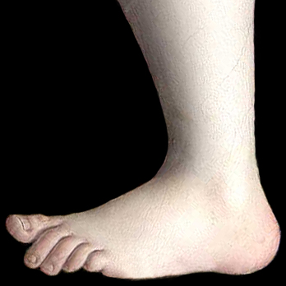
SPLAT!
Notes:
Not surprisingly, the signal from our two bright sources is splattered all over the place. If you were hoping to find any faint stuff underneath, forget it... and it gets worse. Suppose we didn't have any phase errors at all, our image as reconstructed from the uv plane would look something like this.

Slide 16
A Lesser Splat!
Notes:
More reasonable, but if we change the colors to look for the faint signal in the lower bits, we still get...
...not much. And this is because we're not sampling the uv plane perfectly – we have to interpolate in between the sampling points – so we still get a lot of residual signal from these two bright sources dominating the background here.

