Slide 1
An Overview of SKA Simulations With MeqTrees
Oleg Smirnov (ASTRON)
Cormac Reynolds (JIVE)
Tony Willis (DRAO/NRC)

Slide 2
MeqTrees...
overview of meqtrees

Slide 3
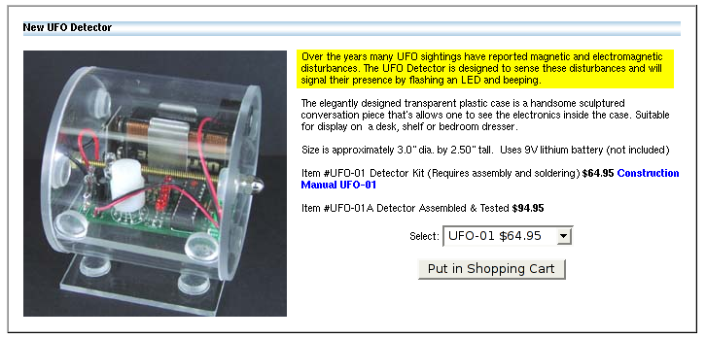
Just For Amusement...
If we were to track a UFO with a radio interferometer, what would we see?
...probably nothing, given a good enough flagger...

Slide 4

A Realistic(?) Example:
Simulating The CLAR

Slide 5
CLAR Features
300m dish on the ground, receiver mounted on aerostat.
Steered by moving the receiver.
Elevation-dependent voltage beam:
  symmetric at zenith
  broadens in the vertical direction as we track towards the horizon.
Different between stations
  different stations see the source at different elevation

Slide 6
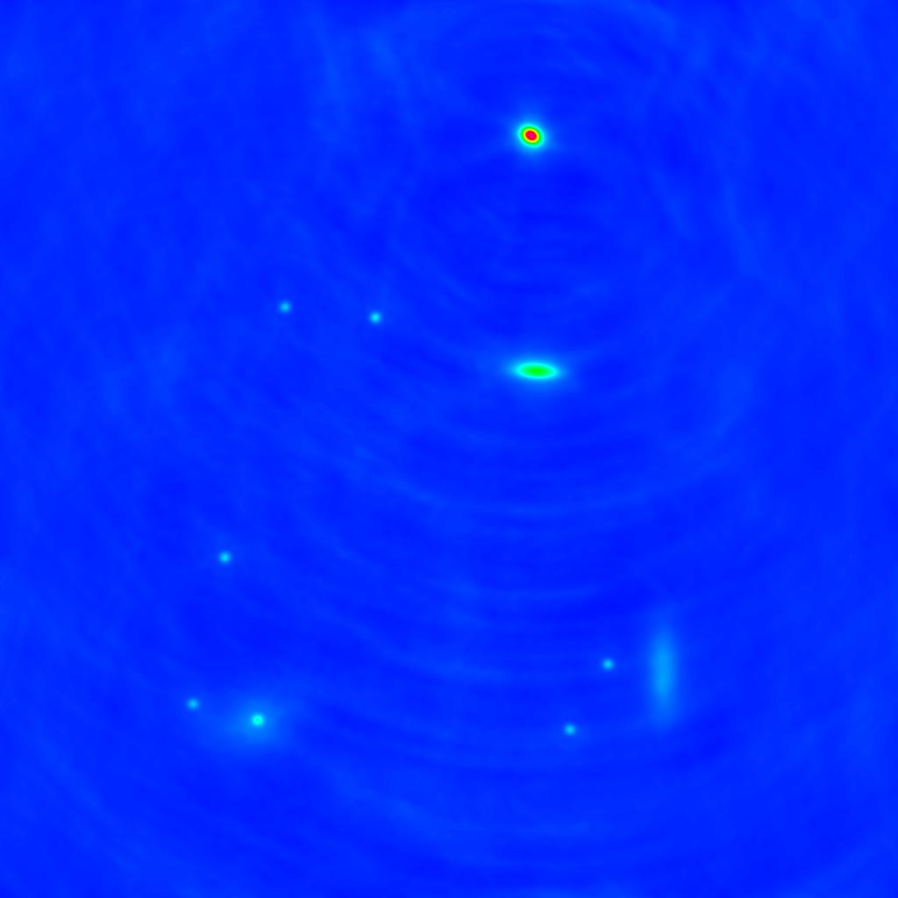
A CLAR Simulation
27 CLARs in a 30km VLA layout
4' field
800MHz to 1.4GHz
~10 point and extended sources

Slide 7
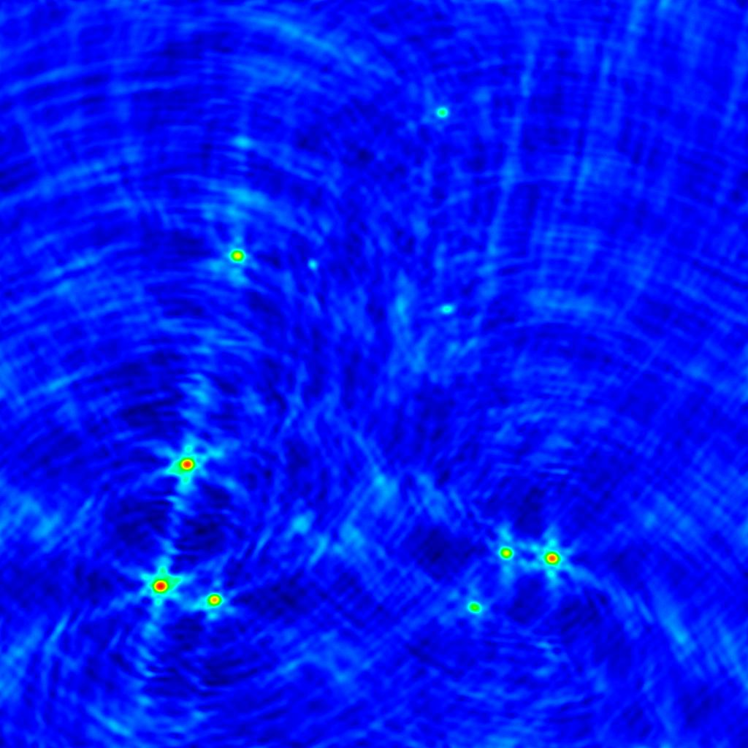
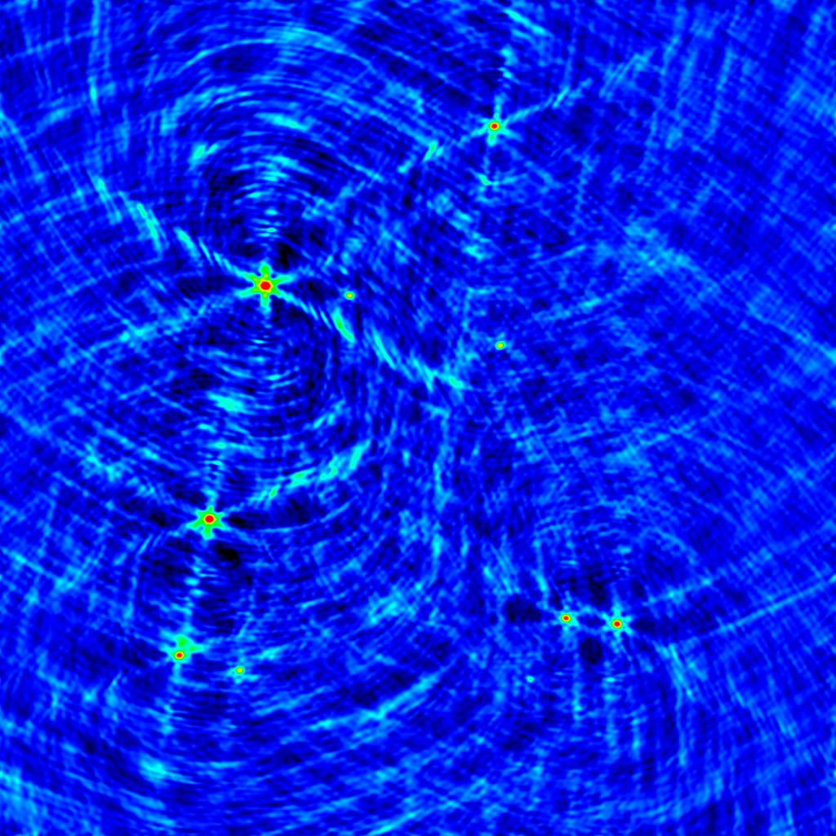
So What Difference
Does The Beam Make?
Make two simulations: one with the true broadened beam, one with a symmetric beam
Output delta-visibilities, make an image
←800MHz
1.4 Ghz→
residual flux is on the level of ~2%

Slide 8
A CLAR Shortcut?
Different stations track slightly different elevations due to the Earth's curvature (30km max separation)
It's very tempting to use the same average beam for all stations
How can we quantify the error we thus introduce?

Slide 9
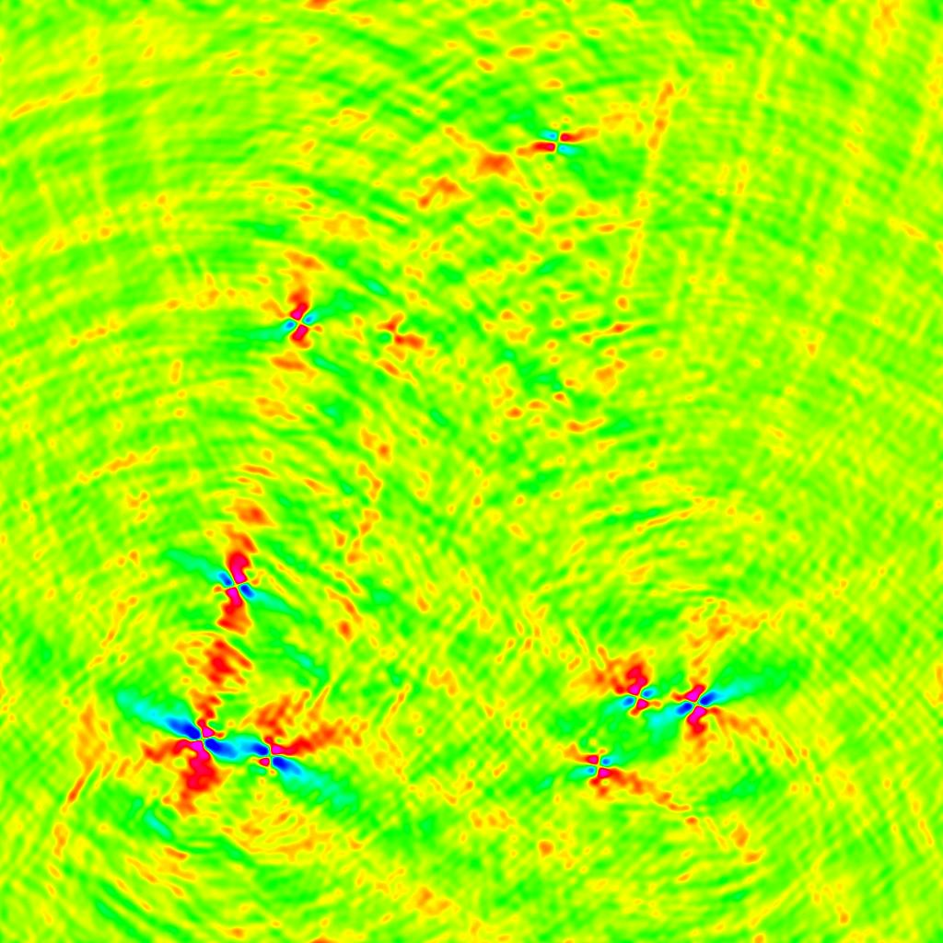
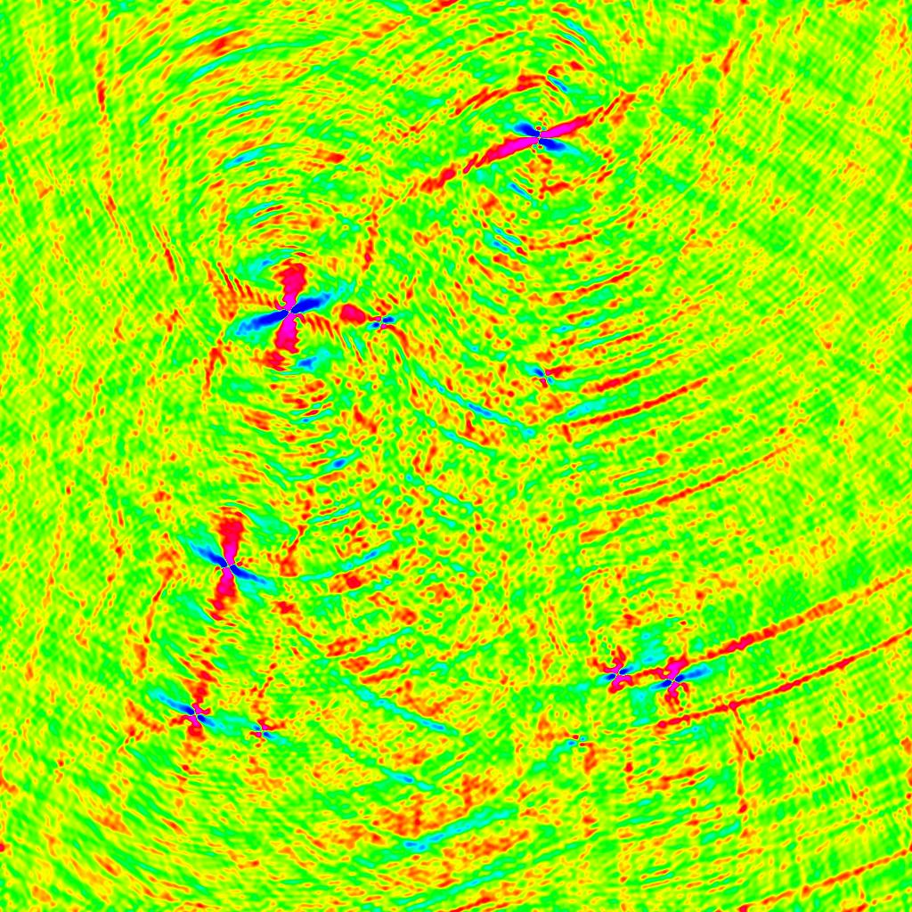
A Flatter Earth...
Make two simulations: one with the true, per-station beam, one with an average beam
Output delta-visibilities, make an image
←800MHz
1.4 Ghz→
residual flux is on the level of 2∙10⁻⁵

Slide 10
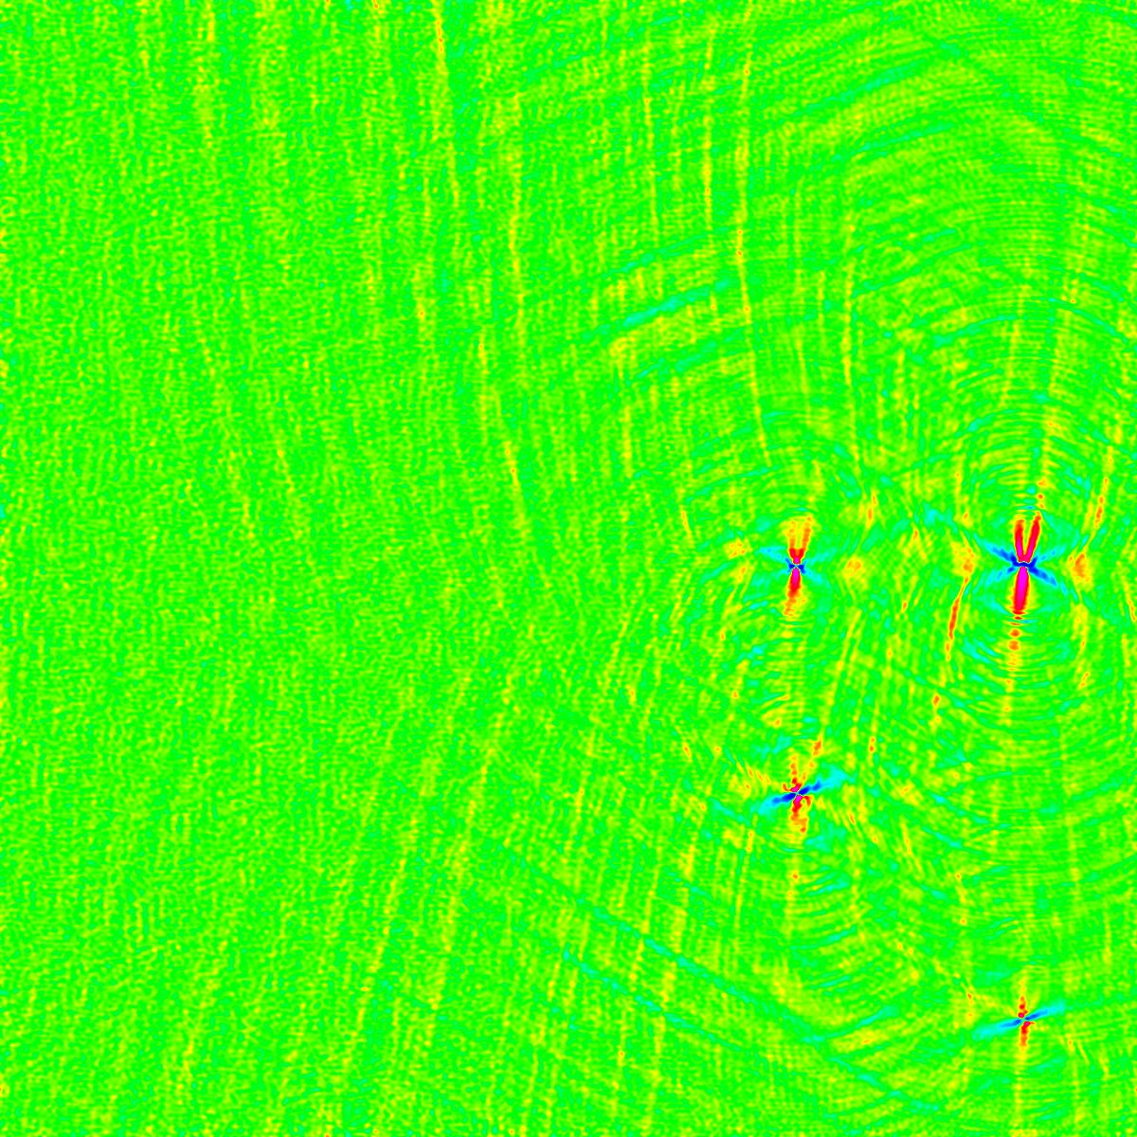
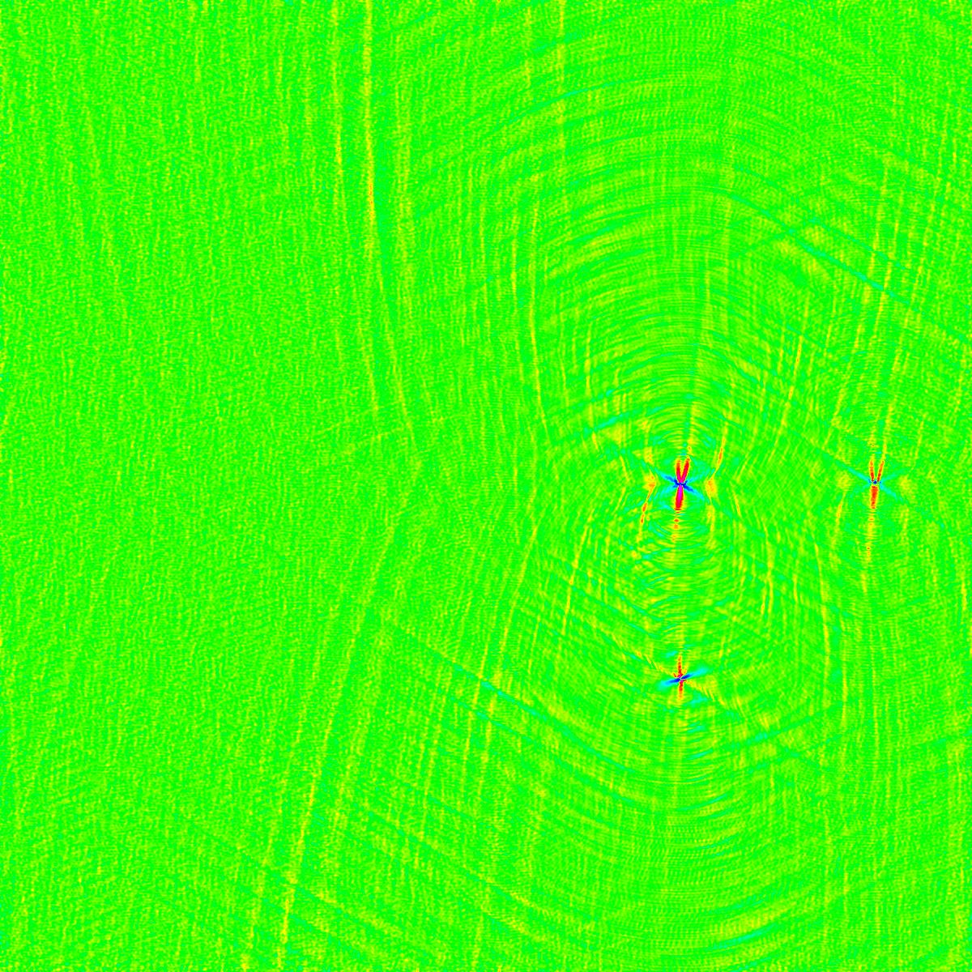
Now The Same, On A Grid
It's more instructive to place the sources on a grid (at 2' and 4'):
←800MHz
1.4 Ghz→

Slide 11
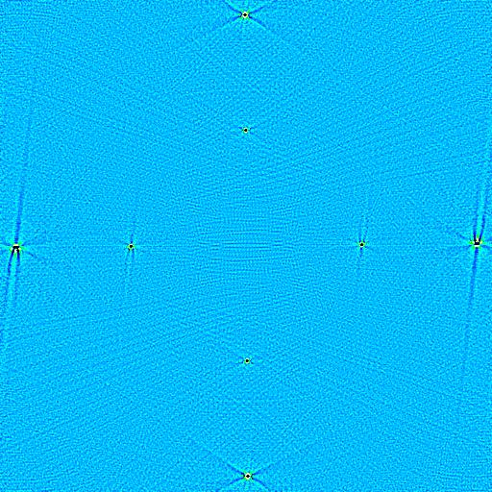
More Differential Maps:
Time Smearing
Point sources of unit flux on a grid = simulations “probe”
Great way to explore and understand an observational effect
Image on the left: smeared (5min integration) minus unsmeared visibilities
Sources at 2' and 4'.

Slide 12
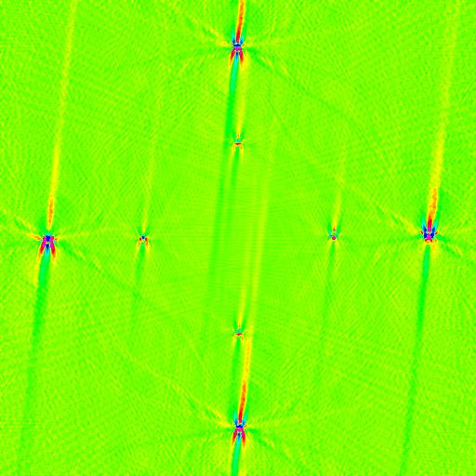
...Why We Need
The w-Projection...
A similar map showing the effect of the n-term
Delta-visibilities between:
  a “perfect” simulation taking the n-term into account
  an “approximate” simulation that assumes n=0
Grid step: 1'
Residuals ~10⁻³

Slide 13
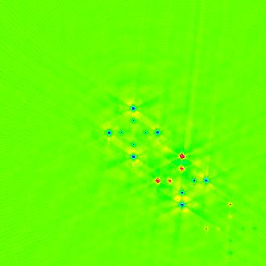
...And What Happens During Facet Imaging
crosses at 2' and 4'
cross “stepping” is 30”
If you don't correct during imaging, you effectively ignore any variation in the image-plane effects
This map shows the effect for the voltage beam
“Perfect” simulation using true beam for every source
“Approximate” simulation using one beam for each “cross”
Residuals: ~1%

