Slide 1
ME2: The Full-Sky
Measurement Equation
Objectives:
Extending the M.E. to a full sky
Mapping this onto conventional implicit assumptions, and understanding their limitations
Simulating multiple point sources with image-plane effects (e.g. primary beam)
svn up Workshop2007 please!

Slide 2
The Full-Sky ME

Slide 3
The Full-Sky ME

Slide 4
Image-plane vs. uv-plane

Slide 5
And Back To The ME....

Slide 6
The Fourier Transform
The integral then becomes a 2D Fourier transform of the “apparent sky”.

Slide 7
The Fly In The Ointment
In the general case, the exponent is not quite an F.T. kernel.
Let's collect the n-terms into an “N-Jones”, and define an “apparent projected sky”:

Slide 8
Apparent Skies & Apparent Cohaerencies
In other words, each antenna pair p-q measures an apparent cohaerency distribution Xpq(u,v) that corresponds to a 2D Fourier Transform of its own apparent projected sky Bpq.
...at a single point in time!

Slide 9
Time Is Not On Our Side
Cohaerencies are sampled along a “uv track” over some period of time:
The true sky B is probably constant(?) in time
Image-plane effects (beam shapes, ionosphere) may vary in time.
For wide fields, the N term is non-negligible. It varies with w which varies with time.
All this is especially relevant with new telescope designs.

Slide 10
The “Classic” Assumptions
Only under these assumptions is a single F.T. of the sky sufficient to simulate the entire observation!

Slide 11
Conclusions
Under the “classic” assumptions, the visibilities measured by an array correspond to ONE cohaerency distribution X that is in an F.T. relationship with ONE apparent sky.
In the presence of non-trivial image plane effects, or with wide fields and non-coplanar arrays, each interferometer p-q measures its “own” cohaerency Xpq(t) corresponding to its “own” apparent sky Bpq(t) -- variable in time!
The K term becomes an F.T. kernel with narrow FOVs/coplanar arrays, but is “not quite” an F.T. otherwise.

Slide 12
Divide And Conquer

Slide 13
A Sky Of Point Sources

Slide 14
Let's Build a Tree
See ME2/demo1-predict-nps.py
We can already do one point source, adding more is just some for loops...
...and a Meq.Add node to sum the visibilities.
We'll put the sources on a grid.
Run the tree and make an MFS map.

Slide 15
Exercise 1: Complex Gains
Use ME2/demo1-predict-nps.py as a starting point.
Add the gain terms from ME1/demo3-predict-ps-gain.py.
Make an MFS map.

Slide 16
Exercise 2: Adding Beams
Use the previous script as a starting point.
  reset Gs to 1
Make a per-channel map.

Slide 17
Code Reuse?
By now our scripts are getting rather complex.
On the other hand, we're reusing the same building blocks, e.g.:
  point sources
  Jones matrices
Good programming strives for maximum code reuse; good languages simplify this via modules, libraries, objects, etc.
TDL is Python, and Python is an excellent programming language.

Slide 18
Frameworks!
A tree is like assembly language – the nuts'n'bolts view of what's going on.
Pure TDL is like C – a higher level language, but still very close to what the “tree machine” is doing.
An OO framework provides abstraction, so you talk in terms of your “domain language”:
  I have an interferometer array of N antennas
  make me a point source here
  make me the nodes to compute visibilities at each baseline
  apply this Jones matrix and give me the corrupted visibilities

Slide 19
OOP
6. Object-Oriented Programming:
[ 0] wasn't that in FORTRAN77?
[ 8] heard of it
[10] have used OOP concepts in my programs
[ 2] can't imagine writing a non-trivial program without it
[ 1] I use multiple inheritance to design my breakfast

Slide 20
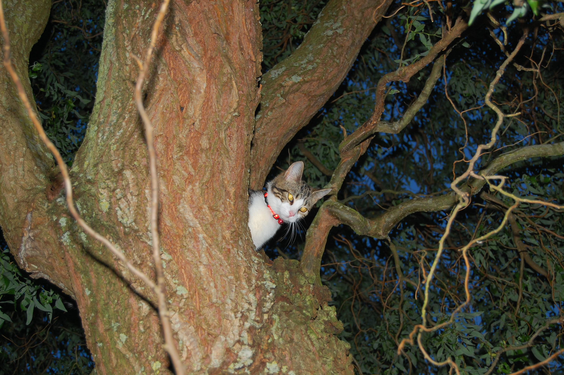
Meow

Slide 21
Meow
(Measurement Equation Object Framework)
See ME2/example2-nps-meow.py.
This is the equivalent of demo1.
Highlights:
  we deal in “sky components”, “arrays”, “observations”
  details of sources are hidden, it just gives us the visibilities
also provides convenient utilities for
  GUI options
  I/O records
  imaging, bookmarks, etc.

Slide 22
Meow With Jones
Now let's add E and G terms
See ME2/example3-nps-corrupt-meow.py.
We make CorruptComponents from components by adding a Jones corruption term.
Corrupt Components are also sky components, so they can be treated the same way.
Modularity:
  sky models defined in one place...
  Jones terms defined in another place...
  main sim script just puts them together

Slide 23
...Meoooooooow
Extended sources?
See ME2/example4-nps-ext-meow.py.
Run & make per-channel map, observe frequency behaviour.
Small change here: we use GaussianSource in place of some PointSources.
Don't need to know the details of a Gaussian implementation, since we can just get the visibility nodes from the source.

Slide 24
Meow Inheritance...
RA, Dec
lmn()
Direction
visibility(nodes): None
SkyComponent
PointSource
GaussianSource
Patch
FITSImageComponent

Slide 25
“Well I'm liberal, but to a degree...”
-- Bob Dylan
Meow is just “a” framework, we can have others
We believe in creative pragmatic anarchy...
...so don't take any framework as gospel.
  especially as it's a work in progress
  your feedback will drive that progress!
Use them, or make your own, but be pragmatic:
  if you feel if something is missing, think of how to improve it, and talk to the author
  ideally, we want to fold your improvements back into the mainstream, for the benefit of others.

Slide 26

A “Real”-Life Example:
The CLAR

Slide 27
A Simple CLAR Sim
The CLAR primary beam is elevation-dependent
  symmetric at zenith
  broadened vertically as we track towards the horizon
Let's simulate 10 point sources:

Slide 28
A Simple CLAR Sim
See ME2/example5-clar.py
This defines a per-station, per-source E Jones term.
E Jones details are in clar_model.py.
We use pre-computed beam gains:
  The vgain parameter is a Meq.Parm node
  There's a ParmTable (*.mep) supplying vgain values (as a function of time)
  These are precomputed by another script
  (clar_fit_dq.py)
  ...but in principle could have come from anywhere.

Slide 29
A Simple CLAR Sim, continued
Note also the “source model” option in the GUI.
This selects a function, which the script then calls to obtain a source model.
This a “compile-time” option
  determines the kind of tree that is built
  ...as opposed to run-time options, which determine what kind of request to give the tree.
Python makes this sort of thing easy, and it gives us a further degree of abstraction.

Slide 30
An Ionospheric Sim
See ME2/example6-iono.py
This is adaptation of our previous ionospheres:
  multiple sources laid out in a grid (size and grid step configurable)
  we compute proper piercing points per source and per station
  code to compute Z-Jones resides in iono_model.py and iono_geometry.py
  this returns the Z nodes as a series, individual matrices are Z(src.name,p)

Slide 31
First, A Different MS...
We'll use a different MS:
  30-190 MHz in steps of 5 MHz
  more LOFAResque
Make demo-30-190.MS by running:
  glish -l demo_sim_30-190.g

Slide 32
An Ionospheric Sim, continued
Set compile-time options as follows:
  Rotate ionosphere with sky: True
  TID X amplitudes: 0.01 at t=0 and t=1hr
  Size 50km, speed 200 km/h
  TID Y amplitudes: 0
  Grid size 3, grid step 5'
  Noise: 0 Jy
Run tree and make a per-channel map
Make a time-slice movie:
  glish -l make_movie.g DATA ms=demo.MS channel=32 npix=300 cell=3arcsec
  (or whatever output column you used)

Slide 33
And Now For Something Completely Different:
Time & Bandwidth Smearing

Slide 34
Simulating Smearing
The same effect occurs with other Jones terms, such as ionospheric or tropospheric phase, etc. (hence, decohaerency time).
How to simulate?
The brute force approach:
See ME2/example7-smear.py (and compare to example2...)
  Meq.ModRes changes resolution
  Meq.Resampler averages back

Slide 35
So What's The Difference?
Run the tree and make an per-channel map
  5x5=25 times more visibilities to compute, so it takes longer...
Hard to see all that much in the map
(although you could make another map without smearing, and subtract it...)
So let's build a differential tree instead, to compute
...and write the delta-visibilities to the MS.

Slide 36
Differential Trees
(Or Simulations About Simulations)
Given infinite CPUs, we can implement m.e.'s of arbitrary precision.
In real life, we have to take shortcuts
(e.g. choosing time/freq intervals here).
The main question: how much error does a particular shortcut introduce?
  given infinite mathematical skill, we could work it out analytically...
  ...but given MeqTrees, we don't have to.

Slide 37
Interlude:
How To Make Your Tree Run Very Slow
There's a naïve way to compute the deltas:
  subtract “predict” from “resampled”, and connect that to the sink.
Why is this so slow??
  each “predict:p:q” subtree is called twice, once at low res, once at high res.
  ...so we're not using the node caches.
The right way to do it: parallel trees
See ME2/example8-smear-diff.py (run the tree and make a per-channel map)
Moral: reuse values, not nodes.
  normally, this only occurs with resampling

Slide 38
The Lowly Point Source as a probe of the simulations universe
For single point sources, we can implement a very precise form of the ME.
For large-scale simulations, we're forced to implement an approximate m.e.
We can cheaply predict a grid of point sources:
  with a precise m.e.
  with an approximate m.e.
The difference tells you the error you make when using the a.m.e.

Slide 39
A CLAR Shortcut?
Do we need per-station beams?
  the beam depends on elevation
  all antennas track the same point on the sky
  ...so will have slightly different elevations
  ...very slightly (max separation is ~30km)
Can't we just use an average beam?
Let's make a tree to compute the delta-visibilities between the “precise” CLAR sim with per-station beams, and an “approximate” sim with an averaged beam.

Slide 40
A CLAR Shortcut, implementation
Start with demo5-clar.py.
Put 7 1Jy sources in a “fan” pattern, at:
0,0 2',0 4',0 2',2' 4'4' 0,2' 0,4'
Set npix=300,cellsize=”2arcsec” in the imager invocation, since we have a bigger field.
Use a tile_size of 5 (saves memory)
For the beam model, use:
Ej = clar_model.EJones(ns,array,observation,source_list);
(since we have no precomputed beams for the “fan” pattern)
Hint 1: Meq.Mean with multiple children takes the mean.
Hint 2: You can reuse subtrees as you see fit – the performance problem we saw with smearing does not apply here.
Hint 3: you should end up with ~12000 nodes.

Slide 41
Exercise 4:
Patches & Beams
How does the error we thus introduce vary with patch size and patch position?

Slide 42
Exercise 4:
Patches & Beams
Use the CLAR beam model.
Create three patches
  at l0,m0 = 0,0; 2',2' and 4',4'
  each patch to contain 9 sources of 1Jy each arranged in a cross, at 0,0; ±.5' and ±1' in each direction, relative to the center of the patch.
Apply Ep(l0,m0) to each patch as a whole.
Make a differential tree to compute the delta-Vs between this approximation, and a “precise” model where each source has its own Ep.
Make MFS and per-channel maps.
You should be able to do it within 35000 nodes.

