Slide 1

Day 1: MeqTree &
Measurement Equation Flyover

Slide 2
The Measurement Equation:
Putting the “Meq” into MeqTrees!
The Measurement Equation tells you what you can expect to observe with an interferometer, given a sky and the properties of your instrument.
Absolutely crucial for simulating and calibrating the next generation of radio telescopes; everything literally revolves around it.
Therefore: no-one gets any beer tonight until we achieve full harmony and understanding!

Slide 3
A Wafer-Thin Slice of Physics:
EM Field Propagation

Slide 4
A Wafer-Thin Slice of Physics:
Jones Matrices

Slide 5
A Wafer-Thin Slice of Physics:
Correlations & Visibilities

Slide 6
A Wafer-Thin Slice of Physics:
The M.E. Emerges

Slide 7
And That's The Measurement Equation!
Or in more pragmatic terms:
NB: it is also possible to write the ME with a circular polarization basis (RR, LL, etc.) We'll use linear polarization throughout.

Slide 8
Accumulating Jones Terms

Slide 9
Jones' Anatomy
Jp is “cumulative”: more effects correspond to additional multiplicative Jones terms.
Therefore, the “total” Jp is a matrix product of a “Jones chain” of individual effects:
Jp = Jpn Jpn-1 ... Jp1
The order of the J terms corresponds to the physical order of the effects. In general, the matrices don't commute!

Slide 10
Why is this great?
A complete and mathematically elegant framework for describing all kinds of signal propagation effects.
...including those at the antenna, e.g.:
  beam & receiver gain
  dipole rotation
  receptor cross-leakage
Effortlessly incorporates polarization:
  think in terms of a B matrix and never worry about polarization again.
Applies with equal ease to heterogeneous arrays, by using different Jones chains.

Slide 11
Why is this even greater?
Most effects have a very simple Jones representation:

Slide 12
Three Layers Of Intuition
Physical: e.g. beam gain, parallactic angle
  beam pattern of X and Y dipoles different, causes polarization of off-center sources
  P.A. rotates polarization angle
Geometrical: stretching, rotation
  do not commute...
Mathematical: matrix properties

Slide 13
ME ME ME
The general formulation above is “The Measurement Equation” (of a generic radio interferometer...)
When we want to simulate a specific instrument, we put specific Jones terms into the ME, and derive a measurement equation for that instrument.
We then implement that specific m.e. in software (e.g. with MeqTrees)
Existing packages implicitly use specific m.e.'s of their own.

Slide 14
Observing a point source with a perfect instrument

Slide 15
The (familiar?)
Scalar Case

Slide 16
Antenna UVWs and Antenna Phase
P
Q

Slide 17
The (familiar?)
Scalar Case

Slide 18
K: A Jones In Its Own Right
The interferometer phase term is traditionally considered separately; however, it fits the Jones formalism like a glove.
K combines two physical effects:
  pathlength difference
  time delays (i.e. fringe stopping)
Scalar matrices commute with everything, so we're allowed to “merge” these two effects and shift the resulting K's around.
NB: K is scalar only for co-located receivers:
  moral: keep your dipoles together!
Forget about the Fourier Transform for now...

Slide 19
The ME & MeqTrees
What do we need to do?
Simulation
  build an ME to model your simulated instrument/observation
  evaluate this ME over a frequency/time grid
  store “model” visibilities to disk
Calibration (self-cal)
  build an ME to model your observation
  evaluate over frequency/time grid
  compare to observed visibilities, and adjust model for best fit
  optional: subtract model from data, store “residual” visibilities to disk

Slide 20
MeqTrees:
LEGO for numerical models
An ME gives us a numerical model of an observation
MeqTrees is a toolkit for constructing and running arbitrary numerical models
A numerical model is based on mathematical expressions.
  and that's where trees come in...

Slide 21
A Basic Tree
Any mathematical expression can be represented by a tree.
b
x
b
x
b
x
c
y
*
*
1
+
α
sin
*

Slide 22
The World Of Nodes
A single tree element is a node.
A parent node operates on its child nodes.
A node belongs to a class. This determines the kind of operation it performs
  e.g.: Add, Multiply, Sin.
A leaf node has no children (“top” of tree)
A root node has no parents (“bottom” of tree)
A subtree is any complete part of a tree, rooted at a specific node.
  a subtree evaluates some compound function of its leaf nodes.
A forest has many (1+) trees.

Slide 23
Our First Tree...
cd Workshop2008/Intro1
Run meqbrowser.py, press “Start” to “attach to a meqserver”.
From the menu, choose “TDL | Load & compile TDL script” (or just press Ctrl+T).
Select demo1-first-tree.py
Observe....

Slide 24
meqbrowser & meqserver
The GUI you're looking at is called the meqbrowser
There's also something called a meqserver aka “kernel”, which runs in a separate process and talks to the browser
Trees are built inside the meqserver...
  ...according to commands from a TDL script, which is loaded by the browser.
  a tree in the meqserver is like an “evaluation machine”
The browser provides a graphical representation of the trees in a meqserver.

Slide 25
TDL
Tree Definition Language
TDL is Python
...with some “magic” objects for declaring trees.
ns.xxx declares a node named “xxx”
all nodes must have unique names
  this is not the same thing as their class!
(ns.xxx << ...) binds the named node to a definition of what that node is and does.
TDL provides shortcuts for implicit naming and binding of intermediate nodes.

Slide 26
Running The Tree
From the “TDL Exec” drop-down, choose “test forest”
Observe...
From the “Bookmarks” menu, select “result of 'f'”
Observe...
A long way to go for a simple answer...

Slide 27
A More Interesting Tree
Load demo2-improved-tree.py.
Execute “test forest”
Look at Bookmarks | Result of 'f'.
And Bookmarks | Result of 'f1'
Observe the difference...
The crucial difference are the Meq.Time and Meq.Freq nodes.

Slide 28
Dealing In Functions
MeqTrees are designed for evaluating functions, not just single scalars.

Slide 29
Functions Everywhere
Most concepts we deal with are a function of something.
  the visibility observed by an interferometer is a function of frequency and time.
  images are functions of l,m (or RA/Dec, ...)
  the Fourier Transform turns a function of l,m into a function of u,v.
Numerically, we represent a function by a set of values on some grid

Slide 30
Grids
Numerical code is often filled with for statements iterating over grids...
With MeqTrees, you instead build up a compound function (f) from its constituent parts...
...then you give it a grid, and get back the values of the function on that grid.
This happens at every level of the tree – every subtree can be considered to represent some function.

Slide 31
Supplying a Grid
Look at _test_forest
First we make a domain object.
  here we use t and  from 1 to 10
Then, we make a cells object. This represents our grid.
  in this case, we specify a regular 100x100 grid over the given domain
Then, we put the cells into a request.
We execute the root node with the given request.
Try changing the grid...

Slide 32
Exercise 1: Basic Trees
Implement tree for f above (use demo2 as starting point)
Evaluate over a 100x100 grid, with time/freq from [-30,30]
Plot results & cross-sections

Slide 33
A Node's Life
A node just sits there, until its parent gives it a request
  in the case of a root node, the request is supplied from somewhere else, via execute()
If it has children, it sends the request up to its children (by calling their execute())
A leaf node (Freq, Time, Constant) can evaluate a request directly and return a result.
Once a parent has collected results from its children, it performs some operation on them – according to its class -- and returns a result of its own.

Slide 34
Botany For Beginners
Each node has a state record. You can see it by clicking on a node. This tells you way more than you wanted to know about that node.
The request field contains the most recently executed request.
Note that just about data object in the system is a record
  or at least can be viewed as a record
request.cells contains the grid of the request.
  also the domain, cell sizes, and other stuff...

Slide 35
The Result Cache
  cache.result contains the last result returned by the node.
  Important for two reasons:
    lets you see what's been going on in the tree;
    speeds things up, because often intermediate results can be reused.
  In real life, a tree deals in millions of values, so caching everything would use too much memory;
    nodes are smart enough to cache only those results that are actually reused.
  For small demos, having everything cached is instructive, so we change the cache policy...

Slide 36
Dissecting a Result
A Result object represents a real or complex-valued function on an N-dimensional real grid.
It contains a copy of the Cells, giving the grid.
The function value is found inside a VellSet:
  as result.vellsets[0].value
  the value is a Vells object -- a glorified array
  VellSets can also contain optional flags and derivatives, but we won't be meeting them soon.
A Result with one VellSet ([0]) represents a scalar function, but later on we'll meet vector and tensor functions.

Slide 37
The Priciple of
Informational Greediness
SKA source subtraction requires 47 million laptops (J. Bregman):
  SKA a contributor to global warming?
Redundant computations and redundant information should therefore be avoided as much as possible
MeqTrees does a lot of this for you

Slide 38
P.I.G. In Essense
A Vells may contain only as many axes as actually needed to represent the function.
E.g. for an NxM grid, a node may return a result with an NxM Vells, or an Nx1 Vells, or an 1xM Vells, or even a 1x1 Vells
  Nx1 is the same thing as N
  but 1xM is not the same thing as M – the order of the axes is fixed.
We refer to the missing axes as collapsed. A collapsed axis simply means that the function is NOT variable over that dimension, i.e. not variable in freq or time or whatever.

Slide 39
P.I.G. In Action
The node knows its function best...
  some nodes return constant values
  some nodes return things variable in time only
  some nodes return things variable in frequency
When you combine an Nx1 (i.e. time-variable only) value with an 1xM (freq-variable only) value in, e.g., a Multiply node, the result is NxM.
The tree does the “right” thing regardless.
So in fact you don't need to worry about this at all...
  unless you're Tony;
  unless you're optimizing for calculations.

Slide 40
Node Names & Qualifiers
Load Intro1/demo3-quals.py
This makes a tree to sum the series above.
  note how we create nodes “f:k:l” to represent fkl
  note how n became a GUI option
  We use Python list comprehension and the *-syntax to specify a large number of children with one compact statement.

Slide 41
Exercise 2: A Fourier Series
Start with Intro1/demo3-quals.py
Modify it to compute the series above.
Make a and b GUI options, with possible values of, e.g., [0, 5, 10].
What have we demonstrated?

Slide 42
Learning More
See wiki:
  http://www.astron.nl/meqwiki
  for not-quite-complete documentation.
Tony Willis has prepared a number of tutorial videos, search youtube for “MeqTrees”
The (unfinished) tdl-companion.pdf manual...

Slide 43
Building a Tree for a measurement equation
See Intro1/demo4-predict-ps.py
The Meq.MatrixMultiply node implements matrix multiplication.
We repeat this for all interferometers (all p-q pairs), in a for loop.

Slide 44
Building a Tree:
Creating a B Matrix
The Meq.Matrix22 shortcut creates a matrix from four children (using a Meq.Composer node).
IQUV's will be hardwired constants (for now)

Slide 45
Building a Tree:
VisPhaseShift
The Meq.VisPhaseShift node computes the a phase term as follows:
Takes two “vector” children for uvw's (in meters) and lmn's.
The Meq.ConjTranspose shortcut implements the “†” operation.
We can explicitly form up an (l,m,n-1) vector using a Meq.Composer node.
But where do we get the uvw's?

Slide 46
Building a Tree:
Where to get UVWs?
Where do uvw's come from?
uvw's can be computed by a Meq.UVW node from first principles:
  antenna positions (from MS)
  phase centre RA/Dec: (from MS)
  time
...or can be read from the Measurement Set.
We used to prefer doing it the former way, but that can lead to inconsistencies between the simulation and the imager.
Now we prefer reading them from the MS.

Slide 47
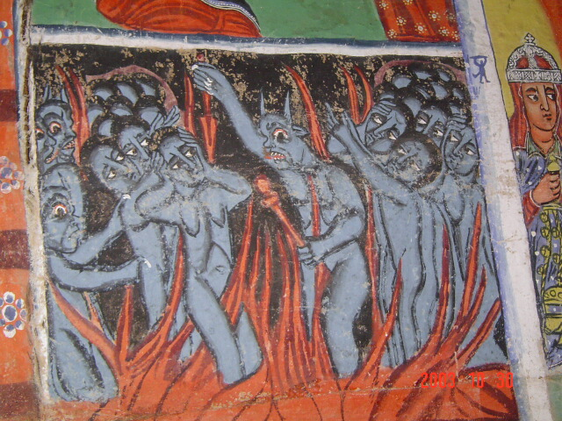
Intermezzo: Visibility Data &
AIPS++ Measurement Sets

Slide 48
Working With
Visibility Data
MeqTrees interface with AIPS++ Measurement Sets
  an MS is a container for visibility data + metadata
For calibration, you already have an MS presumably
  can be imported from UVFITS, etc.
For simulations, an “empty” MS has to be pre-fabricated
  e.g. Workshop2008/demo.MS
  see Workshop2008/demo_sim.g script

Slide 49
VLA In Space
(About demo.MS)
This contains 27 antennas in VLA-C configuration...
  ...but blown up by a factor of 10
So the max baseline is ~30km
8 hours observation, 5 minute sampling, 96 timeslots
32 frequency channels of 16MHz each, from 800MHz to 1.31GHz
Four polarizations: XX XY YX YY
One pointing

Slide 50
An MS Is A “Skeleton”
An MS provides a time/frequency grid (e.g., for use in simulations)
  thus, “skeleton”: we ignore the data in the MS (and write our own)
Sink nodes turn this grid into a request and send it up the tree.
  one Sink per interferometer
When a result comes back, this can be written out to a visibility column in the MS.
MSs are processed in chunks of time called “tiles”.

Slide 51
Building a Tree:
Sinks & Spigots
A Spigot node reads data from an MS, and returns it (as a function of freq/time...)
  this can be the UVWs
  but can also be observed visibilities (later...)
A Sink node writes data to an MS
  model visibilities, in this case
Typically, we create one Spigot/Sink per interferometer

Slide 52
Building a Tree:
Writing the data
VisTile is an intermediate uv data layer (don't want to be locked into MSs forever...)
The I/O record maps MS columns to VisTile
Sinks & Spigots map tile columns to trees
MS columns
VisTile
Spigot
Spigot
init
req.input
DATA
MODEL_DATA
CORRECTED_DATA
??
DATA
PREDICT
RESIDUALS
Sink
Sink
init
req.output

Slide 53
Building a Tree:
Ready!
Load up the “K Jones” and “Inspector” bookmarks.
Run the tree by selecting “test forest”
  observed bookmarks...
Now we want to make an image.

Slide 54
TDL Jobs:
Doing other useful stuff
_test_forest() is a “TDL job”.
More jobs can be added by defining functions called _tdl_job_foo(), all these will be automatically placed into the “Exec” menu.
Jobs can contain arbitrary Python code...
  ...including calling the shell...
  ...e.g. to run Glish and call the AIPS++ imager.

Slide 55
Introducing (Complex)
Gain Errors

Slide 56
Building a Tree With Gains
See ME1/demo5-predict-ps-gain.py
It's trivial to add extra Jones terms to Meq.MatrixMultiply.
The biggest effort is actually figuring out what numbers to plug in.
  for now, let's assign a random, time-variable gain-phase to each antenna...

Slide 57
Time Variability
On the Cheap
Remember that we get a “time grid” with each request.
The Meq.Time node returns f(t) = t, combine it with a Meq.Sin node to compute A*sin(Bt+C)
Generate random A,B,C's per dipole (using Python's random module)
Meq.Polar builds x*exp(iy)
Run the tree (load up the bookmarks).
Make a map.
  note that we can now select a column to image, the new simulation is in DATA, the old one is in MODEL_DATA.

Slide 58
Exercise:
Instrumental Polarization
Use ME1/demo5-predict-ps-gain.py as a starting point.
Make the source unpolarized, with I=1Jy.
Make the gain amplitudes frequency-dependent (and reset the gain phases to 0):
  pick random ap's in the range [1e-10,1e-9]
For 0, use a constant (ns.freq0<<8e+8)
Produce a per-channel map, look at Q fluxes.

Slide 59
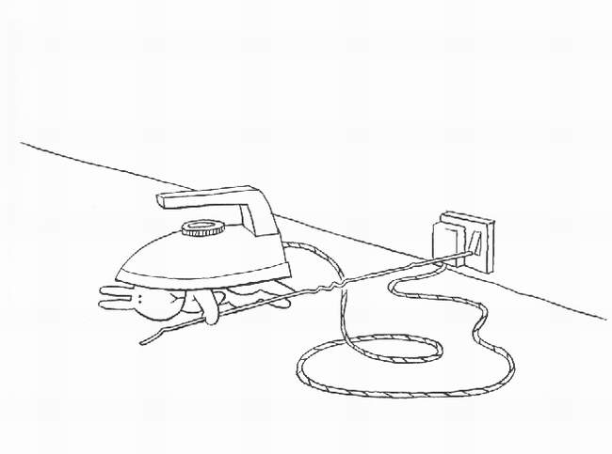
But actually we try to make things easier...

Slide 60
Frameworks
“Pure TDL” scripts tend to get rather complex and repetitive at the same time
We're reusing the same building blocks, e.g.:
  point sources
  Jones matrices
Good programming strives for maximum code reuse; good languages simplify this via modules, libraries, objects, etc.
TDL is Python, and Python provides excellent facilities for this.
We can make frameworks to make your life easier.

Slide 61

Meow
(Measurement Equation Object frameWork)
software
bloat

Slide 62
Meow
Object-oriented framework for putting together ME-related trees
Better than “pure TDL”
  but still (kind of) low-level
  for for the more advanced MeqTree user
Deals with objects such as Observation, IfrArray, SkyComponent, PointSource, GaussianSource, etc.
Base for higher-level frameworks

Slide 63

Siamese
(Simulations In Your Sleep)

Slide 64
Siamese
cd Siamese, load demo6-siamese.py
A framework for gluing together arbitrary sky models and Jones matrices
Three user levels:
  developers write sky models and Jones modules
  power users put these together into a simulator
  astronomers push buttons
Siamese organizes option GUIs, automatically provides visualizations

Slide 65
Siamese Demo
cd Siamese, load demo6-siamese.py
In Sky model, select “grid_model”, 3 sources, grid step 2', flux 1 Jy.
Select “Use G Jones”, “periodically varying error”.
Build tree, load bookmark for “inspect:G”, run “simulate MS”
Make an image

Slide 66
Siamese Principles:
Three User Levels
A framework for gluing together arbitrary sky models and Jones matrices
  Somebody (a developer) makes Jones terms
  Somebody (a developer) makes sky models
  Somebody (a power user) puts them together into a script, following the Siamese template
Siamese organizes option GUIs, automatically provides visualizations
You (a button-pushing astronomer) get a complete simulation tool

Slide 67
Sky Models
A “sky model” is essentially a list of sources (or “components”)
  we'll only use point sources for now
  other source types possible: gaussians, shapelets, images
Siamese includes a gridded_sky model for making pretty patterns
Alternative: Local Sky Model (LSM)
  list of sources for an actual (or simulated) sky
  can be generated from catalogs

Slide 68
A Sky Of Point Sources

Slide 69
A Sky Of Point Sources
uv-plane effects apply to all directions (i.e. all sources) equally
  e.g. receiver gain
image-plane effects depend on direction
  e.g. beam pattern
source coherency is (in a sense) intrinsic, so we will often just use Xpq from here on.

Slide 70
Exercise:
Instrumental Polarization
Use oms_gain_models.py as a starting point
Make the gain amplitudes frequency-dependent
  pick random ap's in the range [1e-10,1e-9]
Add this to demo6-siamese.py as an option to the G term.
Produce a per-channel map, look at Q fluxes.

Slide 71
Exercise:
Alt-Az Mounts
A “perfect” instrument has an equatorial mount, i.e. stationary sky.
With an alt-az mount, the sky rotates relative to each antenna, so we must add a rotation term to our M.E.

Slide 72
Demo/Exercise:
Alt-Az Mounts
The P term is implemented by jones_par_angle.py.
Add this to demo6-siamese.py
Make a cross of polarized sources (Q/I ratio = .1), and make a map of Q and U fluxes.

