Slide 1
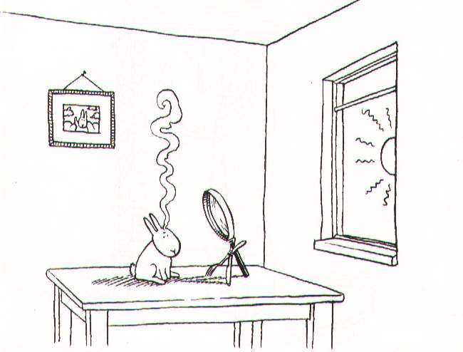
Day 2: Calibration & Polarization

Slide 2
What Is Calibration?
...according to Google
# The process whereby the magnitude of the output of a measuring instrument is related to the magnitude of the input force driving the instrument (ie Adjusting a weight scale to zero when there is nothing on it). (Course Material/Ultrasonics/CalibrationMeth/calibrationmethods.htm)
www.ndt-ed.org/GeneralResources/Glossary/letter/c.htm
# The process of adjusting an instrument or compiling a deviation chart so that its reading can be correlated to the actual value being measured.
www.omega.com/literature/transactions/volume1/glossary.html
# The process of choosing attribute values and computational parameters so that a model properly represents the real-world situation being analyzed. For example, in pathfinding and allocation, calibration generally refers to assigning or calculating appropriate values to be entered in impedance and demand items.
www.geog.leeds.ac.uk/staff/m.blake/magis/glossary/esriglos.htm
# (cal·i·bra·tion) (kal²[ibreve]-bra¢sh[schwa]n) 1. determination of the accuracy of an instrument, usually by measurement of its variation from a standard, to ascertain necessary correction factors. 2. measurement of the caliber of a tube.
www.mercksource.com/pp/us/cns/cns_hl_dorlands.jspzQzpgzEzzSzppdocszSzuszSzcommonzSzdorlandszSzdorlandzSzdmd_c_03zPzhtm
# Checking, adjusting and systematically standardizing the graduations of a device.
www.inkcartridgesworld.com/_glossary.html
# The process of establishing a set of values for correct operation.
www.blazepoint.co.uk/faq_label_printers_glossary.html
# A process that establishes, under specified conditions, the relationship between the values indicated by the measuring system, and the corresponding values of a quantity realised by a reference standard or working standard.
www.nzelectricity.co.nz/H9glossary.htm
# process of comparing an instrument's accuracy to known standards
www.tsgc.utexas.edu/stars/glossary1.html
# is defined as the process of quantitatively defining the system response to known, controlled signal inputs.
www.eumetsat.int/en/dps/helpdesk/glossary.html

Slide 3
...according to Noordam

Slide 4
...according to the
EoR KSG
EoR Signature???

Slide 5
Our Definition For Today...
Determining the properties of the sky and the instrument with sufficient accuracy.
“Taking out” (as much as possible) instrumental corruptions.
Subtracting known sources
...to find the noise (or at least to achieve our scientific objectives)

Slide 6
“Classic” Self-calibration
(for phases/gains)

Slide 7
The M.E. Analogue

Slide 8
Or In Broad Terms...
Predict corrupted visibilities
  we already do this with Siamese
Fit to observed visibilities
  solving for parameters of the sky and/or the instrument
(Optional: subtract bright sources)
Correct
Rinse & repeat
  aka the “major loop”: source extraction, updating sky model, etc.

Slide 9
Correcting For Multiple Jones Terms

Slide 10
Limitations Of Correction
Matrix inversion has its pitfalls
What happens if J is singular?
  and what physics does this correspond to?

Slide 11
Limitations Of Correction 2
If a Jones matrix is singular, then we don't have enough information to begin with
  e.g. if a dipole gain is 0, then we haven't measured the EM field in one direction...
It is also possible for a Jones term to be ill-conditioned
  numerical inversion of an ill-conditioned matrix breaks down due to precision limitations
  e.g.: projection matrix of an aperture array (Tobia Carozzi)

Slide 12
Calibration Of An MS?
A model tree computes corrupted visibilities X'pq(t,)
  we've used Siamese for this
MS DATA column contains observed data Vpq(t,)
We can take the difference and form up a ² sum...
...and try to minimize it w.r.t. the solvable parameters.
Which is the same as fitting the model to the data, in a least-squares sense.
We can thus solve for any (reasonable) subset of parameters of a measurement equation.

Slide 13
A General Approach
To Fitting & Solving
A tree evaluating any m(t,) also depends on values of parameters up in the tree. We write this as:
m(t,;a,b,...)
Imagine a “magic” constant node a that returns not one, but two values: a and a+a.
Its parent, f, then returns f(a) and f(a+a)...
...and at the bottom we get m(t,;a) and m(t,;a+a)

Slide 14
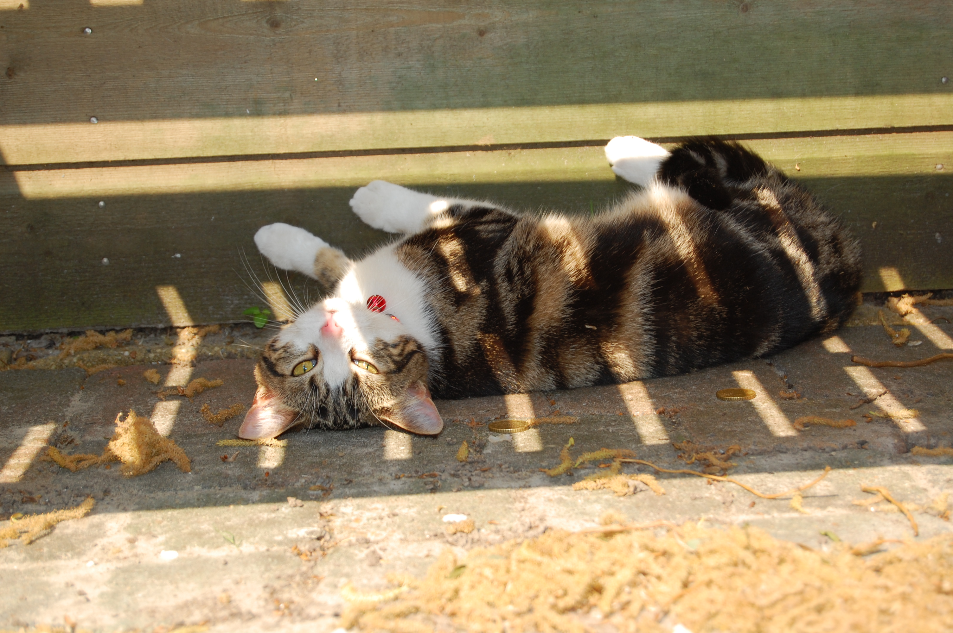
Calico
(Calibration Components)
I detect fringes...

Slide 15
Calico
Siamese's calibration cousin.
Same principle: build a measurement equation from a sky model + plug-in Jones modules.
  Siamese modules are fully compatible
...but, modules can also specify their solvable parameters.
Calico provides a standard solving interface to these.
cd Workshop2008/Day2

Slide 16
Calico At Work: 3C286
3C286 is a standard WSRT calibrator
  has significant QU (~10%)
We'll try to calibrate a short WSRT 1.4GHz observation.
  ~15 mins at 10 sec. integration
Make a local copy like this:
cp -a ~/Workshop2008-Data/3C286-10705290.MS .

Slide 17
Viewing MSs
Load calico-view-ms.py
Select MS: 3C286-10705290.MS
  antenna subset: 1:14
  do not invert phases
Compile, load bookmarks for “inspect input visibilities”, and also for a few individual baselines.
Select “view MS”, inspect results...
Make an image
  uniform weight, IQUV, average all channels

Slide 18
Thinking About Polarization 1
Diagonal Jones matrices will intermix I↔Q and U↔V:
Off-diagonal terms will intermix IQUV
Pure real terms won't touch V
  e.g. a rotation matrix mixes QU, but not V
Thinking in terms of matrices will help you understand everything about polarization!

Slide 19
Faraday Rotation
F.R. rotates the angle of polarization
  i.e. intermixes Q and U.
In the interstellar medium: “intrinsic” F.R.
  same for all antennas, varies slowly/not at all
Ionospheric F.R.
  may differ on long baselines, varies fast
  ...but at higher frequencies and with small arrays -- effectively “intrinsic”

Slide 20
Thinking About Polarization 2
WSRT is an equatorial mount, so (to first order) it only has diagonal Jones terms
  for off-center sources, we do get significant instrumental Q (on the diagonal)
  this occurs after any F.R.
  in fact, there are small off-diagonal Jones terms: “polarization leakage”
  but if the source is intrinsically unpolarized, we can ignore the off-diagonal correlations
With an alt-az mount, the sky rotates, so you'll see instrumental Q and U.

Slide 21
What Causes
Polarization Leakage?
Simple errors in dipole geometry:
    these vary in time (slowly) due to the telescope mechanically deforming as it elevates
Electromagnetic cross-talk:
Both cases correspond to small values off the main diagonal of J

Slide 22
Calibrating 3C286
Load calico-286.py and look at Options
This is the M.E. we're going to use:
  G (diagonal): short-term phase and gain variations
  B (full 4-element): bandpass and pol. leakage
Unlike simulations, neither G or B is all that physical – each combines several physical effects
  we don't care, as long as there's enough terms in our model to account for the physics

Slide 23
The Local Sky Model
Instead of pretty grid, we obviously want to calibrate on a realistic sky
The LSM module will read in a file and create a sky model based on it.
  various formats supported
lsm286.txt is our model for this calibrator
  cat lsm286.txt

Slide 24
Lost In TDL Options?
All options you set in the Options and TDL Exec windows are stored to a file called .tdl.conf (in the current directory)
A sensible copy of this file is in tdl.conf.orig
So if you completely mess up your Options, exit the browser and do
  cp tdl.conf.orig .tdl.conf
  ...to revert to the original settings.

Slide 25
MS/data selection options
This menu (in TDL Exec) determines what subset of the data we solve for
  Input column is always DATA (for observed data)
  Select channels 8 through 56, step 1
  No Hanning tapering
  “Data description ID” determines the spectral window. Pick one...

Slide 26
Step 1: Solving For G
G represents receiver + troposphere/ionosphere gain/phases
  diagonal (i.e. no cross-terms)
  same across all channels
  would like a separate solution per timeslot.
Build the tree, and open up the “Calibrate G diagonal terms” option.

Slide 27
Tiles And Solution Intervals
We go through the MS in chunks of time called tiles (a full MS wouldn't fit in memory...)
  a tile contains N consecutive timeslots, and all [selected] channels of a spectral window
By default, each parameter has one solution per tile (constant or polynomial in time/freq)
  but you can use a smaller solution interval via the “solution subinterval” option. This cannot be be bigger than the tile itself.
Bigger tiles are (to a point) faster, but too big can lead to poor convergence.

Slide 28
Step 1: Solving For G
Set “solution subinterval (time)” to 1
Set tile size to e.g. 20
Load the “inspector:G” and “inspect corrected data” bookmarks
Run “Calibrate G diagonal terms”
Watch the χ² display at the bottom of the browser window.

Slide 29
MEP tables
Parameter solutions are stored in MEP (ME Parameter) tables.
  these are called “*.mep” or “*.fmep”, and are generally kept within the MS directory
Once a solution is stored in the table, it is reused in all subsequent runs
  so we can go on and solve for B, while including our G estimate in the predict
To clear out solutions and start anew:
  rm -fr xxxxx.MS/*mep

Slide 30
Step 2: Solving For B (diagonal terms)
Open up “Calibrate for B diagonal terms”
We want separate solutions per each channel, for all timeslots.
  set “solution subinterval (freq)” to 1
  set tile size to 100
Load the “inspect corrected data” bookmarks, and some “B diagonal terms”
Run “Calibrate B diagonal terms”
Observe results... check also the XY/YX residuals

Slide 31
Step 3: Solving For B (off-diagonal terms)
Open up “Calibrate for B off-diagonal terms”
Select a simultaneous solution for B diag.
Run “Calibrate B off-diagonal terms”
Observe results... check also the XY/YX residuals

Slide 32
A More Serious Case: 3C343
Field is dominated by two bright sources:
  3C343.1 (~6 Jy) at phase center
  3C343 (~1.8 Jy) off-center
  see lsm343.txt
Significant instrumental Q
  we will ignore the cross-correlations
12-hour WSRT observation, 03/08/2000
64 channels ~ 1.2 Ghz (we use 26)
Get yourselves a copy:
cp -a ~/Workshop2008-Data/3C343.MS .

Slide 33
Step 0: Standard Selfcal
Let's try solving for just a central source
  lsm343.txt contains our Local Sky Model
  cp lsm343.txt lsm343-1.txt
  edit lsm343-1.txt: remove the second source
Go into Options|Sky model, and select lsm343-1.txt
Load “inspector:G” and “inspect residuals”
Try a solution for “G diagonal terms”, make a residual image
The M.E. here is:

Slide 34
Step 1: A Two-Source Model
Go into Options|Sky model, and select lsm343.txt again
Load “inspector:G” and “inspect residuals”
Run a solution for “G diagonal terms”, make an image.
The M.E. here is:

Slide 35
Step 2: Bandpasses
We split out separate Jones terms according to their time/frequency behaviour:
  G represents a fast-varying gain/phase term w/o a frequency dependence
  B represents a slow-varying bandpass term, with a frequency dependence
Load some bookmarks for “B diagonal terms”, load “inspect residuals”
Run a solution for B diagonal terms, make an image

Slide 36
The Difficulty With 3C343
The off-center source (3C343) contaminates selfcal solutions, must be included in sky model
3C343 is not subtracted cleanly because...
...it has a different phase/gain
  actually, all sources in the field do, but 3C343 is bright enough to make this a real problem
This is very awkward for “classic” calibration, at least without peeling

Slide 37
Step 3: Differential Gains
This assigns a separate beam gain E to 3C343
  will also account for phase difference, and for instrumental polarization
Load “inspect:E”, load “inspect residuals”
Run a solution for E diagonal terms, make an IQUV image
  also look at E phases
  note instrumental polarization

Slide 38
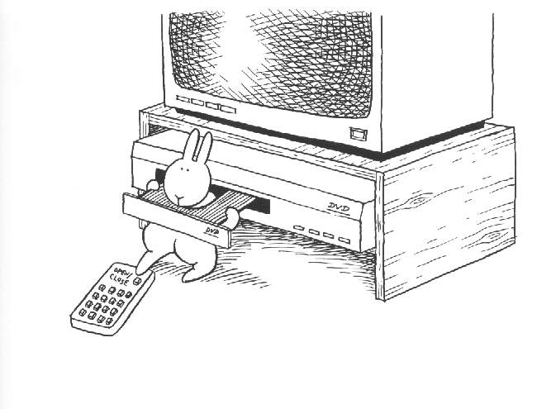
Some Pitfalls Of Selfcalibration

Slide 39
Exercise: Wrong Sky Model
We'll start with the wrong sky model
cp lsm343.txt lsm343-1.txt, edit lsm343-1.txt, and change Q of 3C343.1 to 0.6 (i.e. ~10% polarized)
Clear out previous calibrations:
  rm -fr 3C343.MS/*mep
Repeat solutions for G-diag, B-diag, E-diag
  pay attention to residuals
  make images as you go
Think about what we should see at the end. Can we even expect to calibrate?

Slide 40
Limitations Of Selfcal a.k.a. self-alignment (Hamaker)
So, we can only “know” the sky to within a (non-singular) Jones factor of Y.
What can this do to polarization?
  anything...

Slide 41
Thinking About Polarization 3
Diagonal Jones matrices will intermix I↔Q and U↔V
Off-diagonal terms will intermix IQUV
So, starting with an unpolarized source, I flux can be moved into Q, Q can be rotated into U, and U can be phase-shifted into V.

Slide 42

The Evil Leprechaun
Principle
If evil leprechauns were to come and change your telescope in the middle of the night, would you notice?
  without knowledge of the sky, that is.
...not if they changed them all by the same factor of Y.
  e.g.: rotate all dipoles by the same angle
  e.g.: change gain of all X dipoles
  etc.
Moral: we can only get so far without known calibrators.

