Slide 1
ME3: Extended Sources,
Images, Image-Plane Effects
Objectives:
Learning to predict extended sources
Getting to grips with wide fields and n
Thinking about image-plane effects
Planting the seeds of some advanced topics and techniques
  svn up ~/Workshop2006 please!!!

Slide 2
Prelude: Is There Such a Beast As “Corrected” uv-Data?

Slide 3
NO!
uv-plane effects (the Gs) can be easily taken out:
image-plane effects are generally irreversible:

Slide 4
Correcting at a single point
In general, uv data can only be “corrected” for a single point on the sky.
This is the motivation for facet imaging.
(There are some shortcuts...)

Slide 5
Divide And Conquer

Slide 6
Case 1. Point Sources
Point sources we have already done, their B is a delta function.
Product of five 2x2 matrices.
We can predict point sources perfectly.
Computationally practical for a limited number of sources.

Slide 7
Case 2. Extended Sources
And Patches
Any B that is not a delta-function gets interesting, especially if E is not trivial, and especially for wider fields (the “not quite an F.T.” problem.)
...but we need to solve this for two reasons.
Reason 1: spatially extended sources...
Reason 2: it is impractical to directly predict large numbers of fainter sources individually, so we need to organize them into “patches”, and find a faster way to predict a patch en masse.

Slide 8
First, Reduce To Center...

Slide 9
...Where Life Gets Easier
In other words, to predict a source at l0,m0, it is sufficient to predict it at the phase center (shifting E accordingly...), then apply the phase terms Kp0, Kq0 to “move” the source to its true position.
This is beautifully symmetric w.r.t. the ME for a point source:

Slide 10
So All We Need
To Figure Out Now...
  ...is how to predict extended sources at the phase center. We've simplified the problem considerably. If we now expand the K terms:
  ...and we only require the “Weak Assumption” that n→1 over the extent of the source.

Slide 11
Or Even More Optimistically...
  This is very good from a practical point of view, since:
    F.T.'s are easier than strange integrals
    phase shifts and (in the optimistic case) image-plane effects are applied in the same way to all kinds of sources
    we only need to worry about predicting the source (or patch) at the phase center

Slide 12
The Bad News
  This is only an approximation.
  Error levels will depend on:
    source flux (in a linear way, so we can talk about relative error);
    patch/source size (because of the n term);
    the variation in E over the extent of the patch.
  We need to develop some feeling for how small the patches/sources need to be to make the error suitably small.
  We can build some trees to simulate these errors (well this is actually good news, isn't it?)

Slide 13
n: Naughty, Nasty, Notorious, Nefarious, Nebulous, Noxious, or Just Negligible?
The “Weak Assumption” is that n=1 over the extent of the source.
Let's make a differential tree to estimate the error that this assumption introduces.
General idea: make a test grid of point sources, then:
  predict them perfectly in one branch.
  predict them with (l,m,1) in the other branch.
The former are Meow.PointSources, how do we implement the latter?
...through OOP, of course!

Slide 14
A Naughty Direction
lmn's ultimately come from Meow.LMDirection.
We're going to derive a subclass from Meow.LMDirection
This subclass reimplements the n() function, which LMDirection uses to create its n node (which is subsequently used to make a K term).
The end result: a direction that “ignores” the normal n term, and uses 1 instead.
See Day4/NaughtyDirection.py.

Slide 15
Demo 1: So How Weak
Is The “Weak Assumption”?
Load up Day4/demo1-naughty.py.
This makes two sets of sources arranged in a “cross”:
  Regular PointSources in one branch
  PointSources with a NaughtyDirection in the other branch
You can select the grid stepping size – compare results for 1' and 60'.
Compare MFS and per-channel maps.

Slide 16
Bonus Exercise 1:
Make a MovingSource
Meow.PointSource presumes the source is stationary.
How do we reproduce the moving source of Day 2?
Derive a MovingSource from Meow.PointSource to implement this.
  you'll may need to look in Timba/WH/contrib/OMS/Meow/PointSource.py to get this right.
This will primarily exercise your Python and OOP development skills, hence very optional.
Something else to ponder: how can we apply image-plane effects to a moving source (in Meow)?

Slide 17
Case 2:
“Analytic” Extended Sources
For some kinds of sources (e.g., a 2D Gaussian), we can write out the F.T. analytically.
Meow.GaussianSource implements the trees for this.
Only correct under the “Strong Assumption”, obviously.

Slide 18
Shapelets: The Ultimate
In Analytic Sources
The shapelet transform decomposes an image (in l,m) into a sum of shapelet basis functions:
Complex source structure can (potentially) be represented with relatively few low-order {cn} coefficients.
The basis functions sn have an analytic F.T.
Therefore, we can quickly compute the F.T. of a shapelet source, given a set of coefficients.
“Strong Assumption” required...
Just making its way into MeqTrees, so no demo...

Slide 19
Case 3: “Image” Sources
Finally, we can have an image – B (or perhaps just plain I) sampled on a RA/Dec (or other) grid.
An FFT gives us the F.T. on a regular uv grid:
This is done by the Meq.FFTBrick node.
The Meq.UVInterpol node then takes...

Slide 20
Implementing An Image Source
Meow.FITSImageComponent implements the right combination of Meq.FFTBrick, Meq.UVInterpol, and Meq.FITSImage.
Images can also have a frequency axis, this is seamlessly propagated through the tree.
No demo – something is currently broken :(

Slide 21
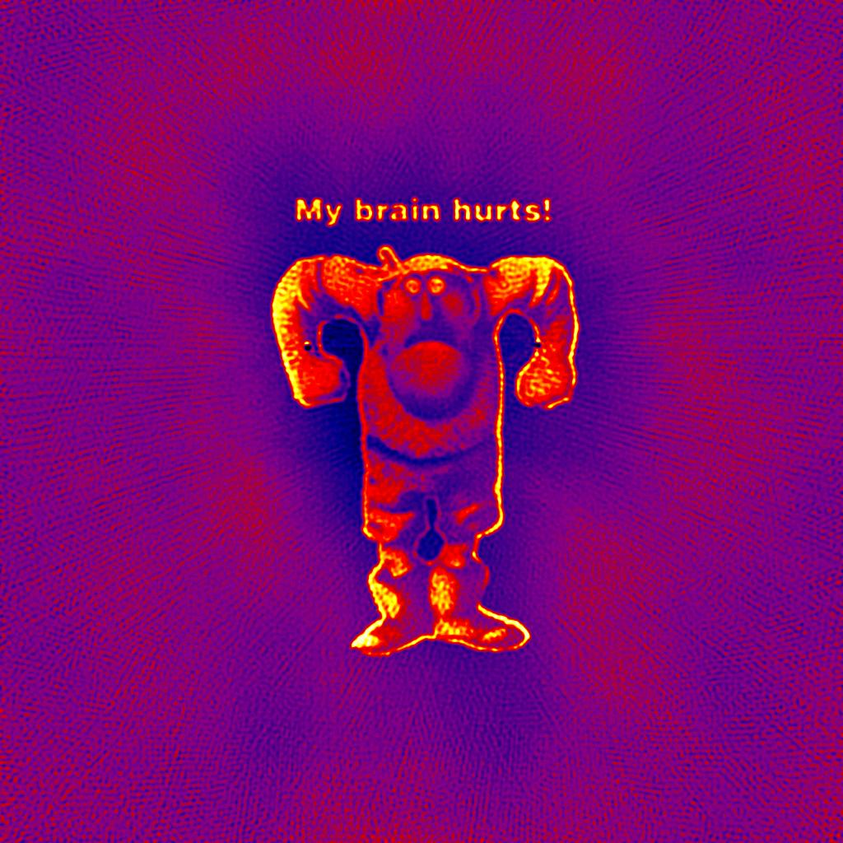
Bonus Image:
The True nJy Sky

Slide 22
Image Sources &
Image-Plane Effects
This can be done in a simple tree:
  the FFTBrick node expects a “brick” child.
  this doesn't have to be an actual FITSImage node, but can also be any subtree, i.e. one that does some operations on the image.
If the Ep's are different per antenna, this is INSANELY expensive (an FFT per baseline!)

Slide 23
The Bhatnagar Approach:
Coming Soon To a Tree Near You?
Convolution with a “small” kernel can be computed directly, fairly cheaply.
...and in fact the interpolation function used inside UVInterpol to interpolate X to the uv track is a form of convolution.
So we can apply E's with a suitable modification to the convolution function.

Slide 24
Mega-Exercise 3:
Replicating The Perley Movie

