Slide 1
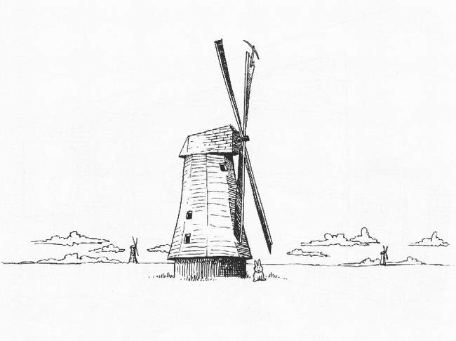
Day 5: Wide-Field Issues

Slide 2
Before we start...
$ cd ~/Workshop2008
$ svn up

Slide 3
The Full-Sky ME

Slide 4
The Full-Sky ME

Slide 5
Image-plane vs. uv-plane

Slide 6
And Back To The ME....

Slide 7
The Fourier Transform
The integral then becomes a 2D Fourier transform of the “apparent sky”.

Slide 8
The Fly In The Ointment
In the general case, the exponent is not quite an F.T. kernel.
Let's collect the n-terms into an “N-Jones”, and define an “apparent projected sky”:

Slide 9
Apparent Skies & Apparent Cohaerencies
In other words, each antenna pair p-q measures an apparent cohaerency distribution Xpq(u,v) that corresponds to a 2D Fourier Transform of its own apparent projected sky Bpq.
...at a single point in time!

Slide 10
Time Is Not On Our Side
Cohaerencies are sampled along a “uv track” over some period of time:
The true sky B is probably constant(?) in time
Image-plane effects (beam shapes, ionosphere) may vary in time, and across the array.
For wide fields, the N term is non-negligible. It varies with w which varies with time.
All this is especially relevant with new telescope designs.

Slide 11
The “Classic” Assumptions
Only under these assumptions can we consider an F.T. of the sky as being an accurate representation of what an interferometer sees.

Slide 12
Conclusions
Under the “classic” assumptions, the visibilities measured by an array correspond to ONE cohaerency distribution X that is in an F.T. relationship with ONE apparent sky.
In the presence of non-trivial image plane effects, and/or with wide fields and noncoplanar arrays, each interferometer p-q measures its “own” cohaerency Xpq(t), corresponding to its “own” apparent sky Bpq(t) -- variable in time!
The K term becomes an F.T. kernel with narrow FOVs/coplanar arrays, but is “not quite” an F.T. otherwise.

Slide 13
Implications?
For calibration, we need to predict & subtract bright sources accurately in the presence of image-plane effects
The M.E. provides all the mathematical apparatus to do this right:
  remember 3C343
  remember the ionosphere
The residuals may still need to be corrected...

Slide 14
Can We Correct Visibilities?
In general, no...
uv-plane effects (the Gs) can be taken out by simple matrix inversion/multiplication
Image-plane effects correspond to convolution in the uv-plane:
  ...with time-variable kernels
  ...and with each baseline's uv-plane sampled along just a single track
(Note: Bhatnagar et al. (EVLA Memo 100) suggest a method for approximate correction during the imaging step. We'll return to this later.)

Slide 15
Correcting At
A Single Point
In general, uv-data can only be “corrected” for a single point on the sky.
Hence, e.g., multifacet imaging.

Slide 16
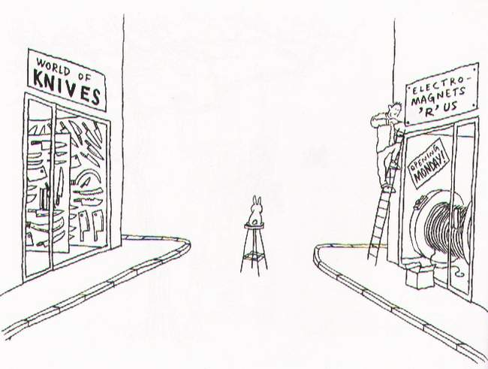
Playing With The ME
For Fun & Profit

Slide 17
Meet Supersim
cd Workshop2008/Day5
Start the browser and load up supersim.py
This is a Siamese script with enough bells and whistles to demonstrate most aspects of wide-field imaging

Slide 18
Exercise: The w-effect
To see the effect of the w-term:
  disable all Jones matrices
  make a 3x3 grid of sources with grid step 60'
  make an image (2048 pixels)

Slide 19
Exercise: Beams & Instrumental Polarization
Set grid step to 20'
Enable the E-Jones
  set beam eccentricity to .1
Open an inspector for E
Make IQUV map (average all channels)
Enable P-Jones
Make another IQUV map.

Slide 20
Exercise: Pointing Errors
Enable pointing errors (see the submenu for E-Jones)
  set to periodic error of 5”
Open inspector for E and for dlm
Make an I map (average all channels)
Observe the difference (or lack thereof...)

Slide 21
So What's The Difference?
It's hard to see all that much in the map
(although you could make another map without pointing error, and subtract it...)
So let's build a differential sim instead, to compute the difference between visibliites with and without pointing errors
Set “simulation mode” to “subtract for MS”, for input column use CORRECTED_DATA, for output use MODEL_DATA.
Make an I map.

Slide 22
Differential Trees
(Or Simulations About Simulations)
Given infinite CPUs, we can implement m.e.'s of arbitrary precision.
In real life, we have to take shortcuts
(e.g. choosing time/freq intervals here).
The main question: how much error does a particular shortcut introduce?
  given infinite mathematical skill, we could work it out analytically...
  ...but given MeqTrees, we don't have to.

Slide 23
Exercise: N-correction
With wide fields, it is difficult to distinguish distortion introduced by the w-effect from other distortions
The “Ncorr-Jones” adds an artifical Jones term of:
This causes the sources to image perfectly
Alternative: enable w-correction in the imager (use 1024 planes)

Slide 24
Back To The Basics...

Slide 25
And Now For Something Completely Different:
Time & Bandwidth Smearing

Slide 26
Simulating Smearing
The same effect occurs with other Jones terms, such as ionospheric or tropospheric phase, etc. (hence, decohaerency time).
How to simulate?
The brute force approach:
Enable resampling in supersim.py (use 5x5) and observe the results...

Slide 27
Exercise: Smearing
Set grid step to 30'
Disable all Jones terms
Enable resampling (use 5x5 factors)
Make I map (average all channels)
Optional: try this with the ionosphere, etc.

Slide 28
Divide And Conquer

Slide 29
A Sky Of Point Sources

Slide 30
Extended Sources & Patches
Any B that is not a delta-function gets interesting, especially if E is not trivial, and especially for wider fields (the “not quite an F.T.” problem.)
...but we need to solve this for two reasons.
Reason 1: spatially extended sources...
Reason 2: it is impractical to directly predict large numbers of fainter sources individually, so we need to organize them into “patches”, and find a faster way to predict a patch en masse.

Slide 31
First, Reduce To Center...

Slide 32
...Where Life Gets Easier
In other words, to predict a source at l0,m0, it is sufficient to predict it at the phase center (shifting E accordingly...), then apply the phase terms Kp0, Kq0 to “move” the source to its true position.
This is beautifully symmetric w.r.t. the ME for a point source:

Slide 33
So All We Need
To Figure Out Now...
  ...is how to predict extended sources at the phase center. We've simplified the problem considerably. If we now expand the K terms:
  ...and we only require the “Weak Assumption” that n→1 over the extent of the source.

Slide 34
Or Even More Optimistically...
  This is very good from a practical point of view, since:
    F.T.'s are easier than strange integrals
    phase shifts and (in the optimistic case) image-plane effects are applied in the same way to all kinds of sources
    we only need to worry about predicting the source (or patch) at the phase center

Slide 35
The Bad News
  This is only an approximation.
  Error levels will depend on:
    source flux (in a linear way, so we can talk about relative error);
    patch/source size (because of the n term);
    the variation in E over the extent of the patch.
  We need to develop some feeling for how small the patches/sources need to be to make the error suitably small.
  We can build some trees to simulate these errors (well this is actually good news, isn't it?)

Slide 36
The Bhatnagar Approach:
Coming Soon To a Tree Near You?
Convolution with a “small” kernel can be computed directly, fairly cheaply.
...and in fact the interpolation function used in the traditional FFT/gridding method to interpolate X to a given uv track is a form of convolution.
So we can apply E's during gridding, via a suitable modification to the convolution function.
(NB: the inverse process, for N, is w-projection)

Slide 37
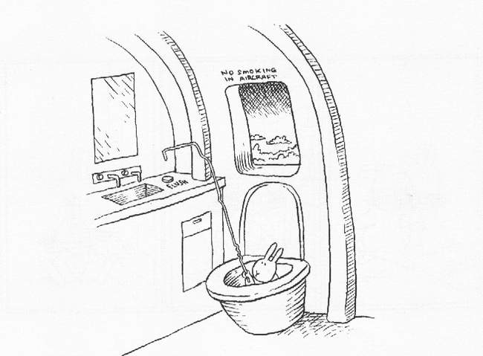
And That's All, Folks!

