Slide 1
House Prices: Advanced Regression Techniques

Slide 2
Motivation
Get my feet wet with advanced regression techniques
Specifically:
I would like understand the intricacies involved in cleaning and preparing data
To gain some insights into the various algorithms for training and prediction

Slide 3
Outline
Data cleaning and preparation
Model training and prediction; Kaggle scores
Concluding remarks

Slide 4
The Data-set
The data comprises Ames, Iowa house prices (response variable) and 79 predictor variables (i.e. features) publicly available on Kaggle.
The 79 predictors span all the featured associated with house: swimming pool size, lot, year house was built and so forth
Training data set: Information on 1460 houses, 80 columns [the columns comprise 79 predictors columns and a house price column]
Test data set: Information on 1459 houses [79 predictor columns; house prices are unknown; our job is to predict the prices]

Slide 5
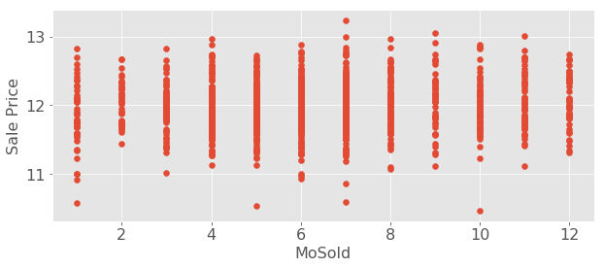
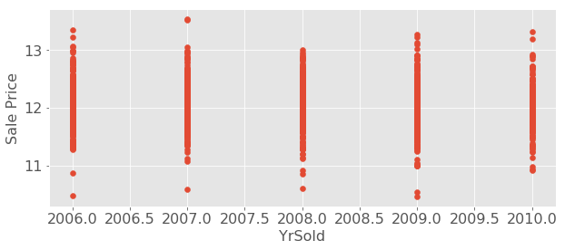
Cleaning the data: Step 1
Step 1: distinguish between numerical/quantitative and categorical/qualitative data. Below are two example of categorical features with numerical representation.
In the end, there were 23 numerical variables; 56 categorical variables

Slide 6
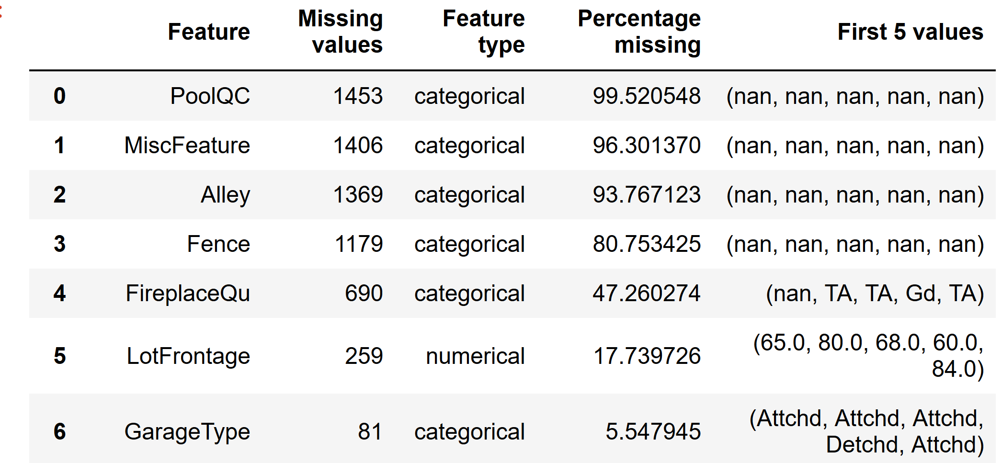
Cleaning the data: Step 2
Step 2: Identify columns with the most missing data and drop them (missing data threshold is 40-50%); 5 features, namely PoolQC, MisFeature, Alley, Fence, and FireplaceQu, were dropped (see below)

Slide 7
Cleaning the data: Step 3
Step 3: Imputate the missing data using a simple algorithm: for numerical columns use the mean value of the column; for categorical columns use the mode

Slide 8
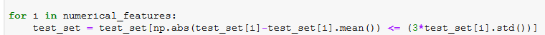
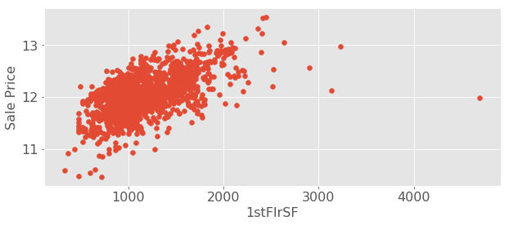
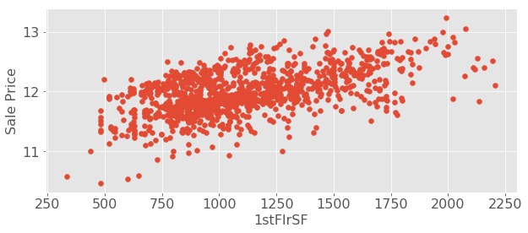
Cleaning the data: Step 4
Step 4: Remove the outliers in the numerical features (at least three standard deviations beyond the mean); see example below
With outliers
Outliers removed

Slide 9
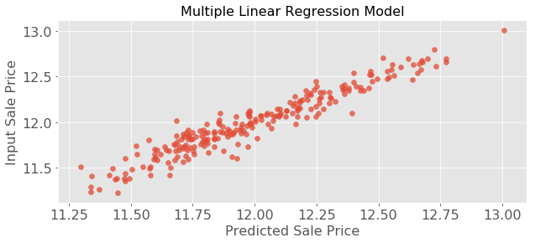
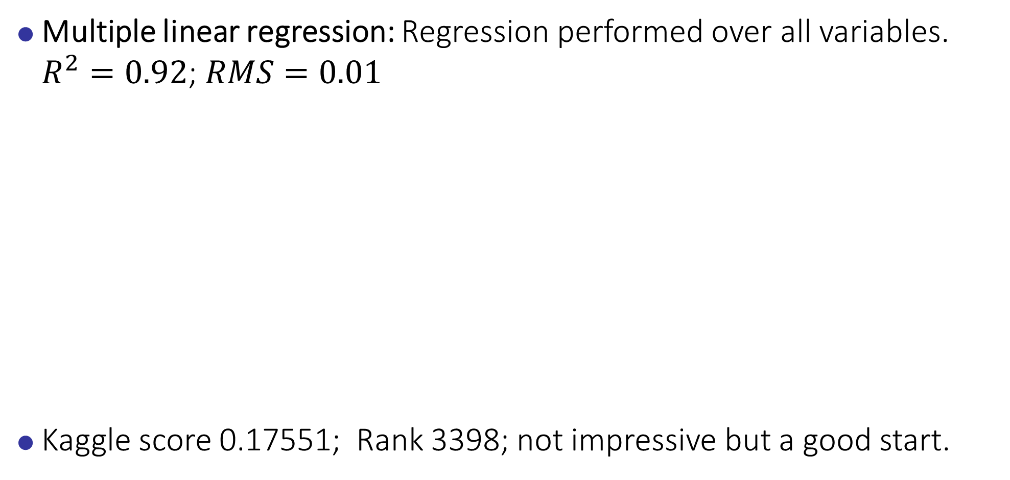
Model training and prediction: Multiple Linear Regression
Multiple linear regression: Regression performed over all variables. $R^{2}=0.92$; $RMS=0.01$
Kaggle score 0.17551; Rank 3398; not impressive but a good start.

Slide 10
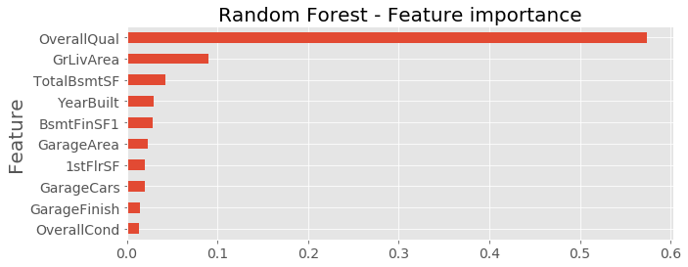
Model training and prediction: Random forest
“Overall quality” was the most important feature
Kaggle score 0.14588; Rank improved from 3398 to 2631

Slide 11
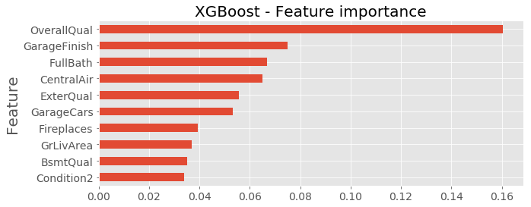
Model training and prediction: XGBoost
Tried a couple of parameters; not too thorough. “Overall quality” was again the most important feature.
Kaggle score 0.13165 Rank is 1922.

Slide 12
Conclusion
I trained the models and made predictions with: multiple linear regression, Lasso, Random Forest, and XGBoost.
Per Kaggle, XGBoost yielded the best prediction
Although I did not get the opportunity to work with a group, I have to say that I enjoyed this project out of all the three projects that we have done so far.
Substantial improvements will be made using k-fold cross validation and hyperparameter tuning; this will be reflected in the blog post.
I learned a lot and I hope to work on more machine learning projects as part of my capstone.

