Slide 1
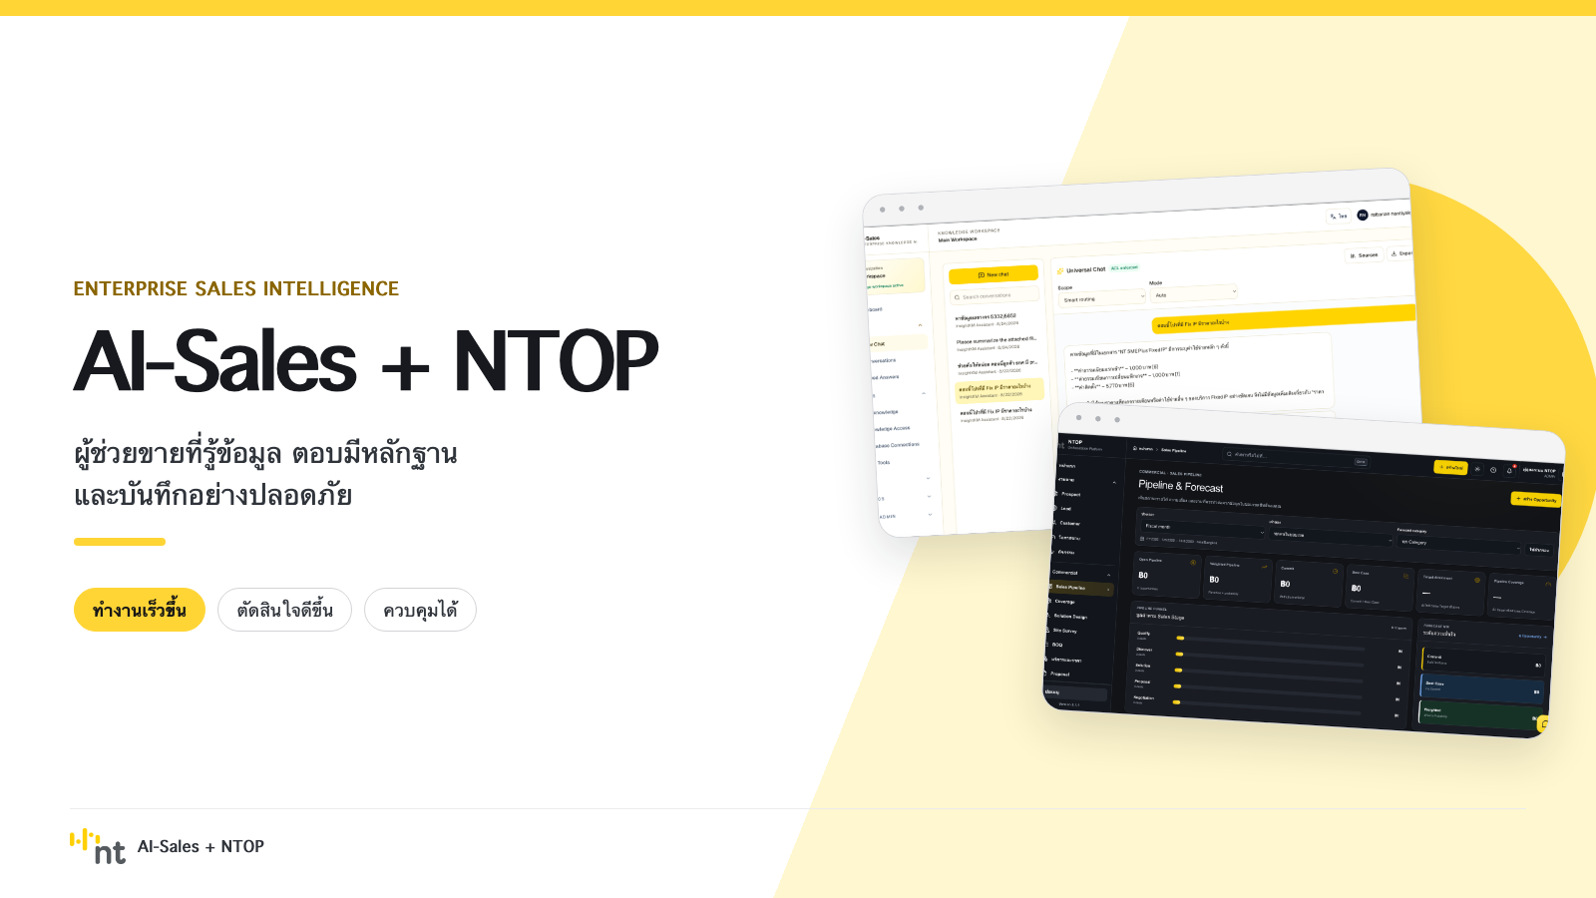
Notes:
[Sources]
- User-directed presentation visual and local system screenshots: /Users/rattananair/codes/ai-sales/docs/assets/ai-sales-ntop-executive/00-cover.png

Slide 2
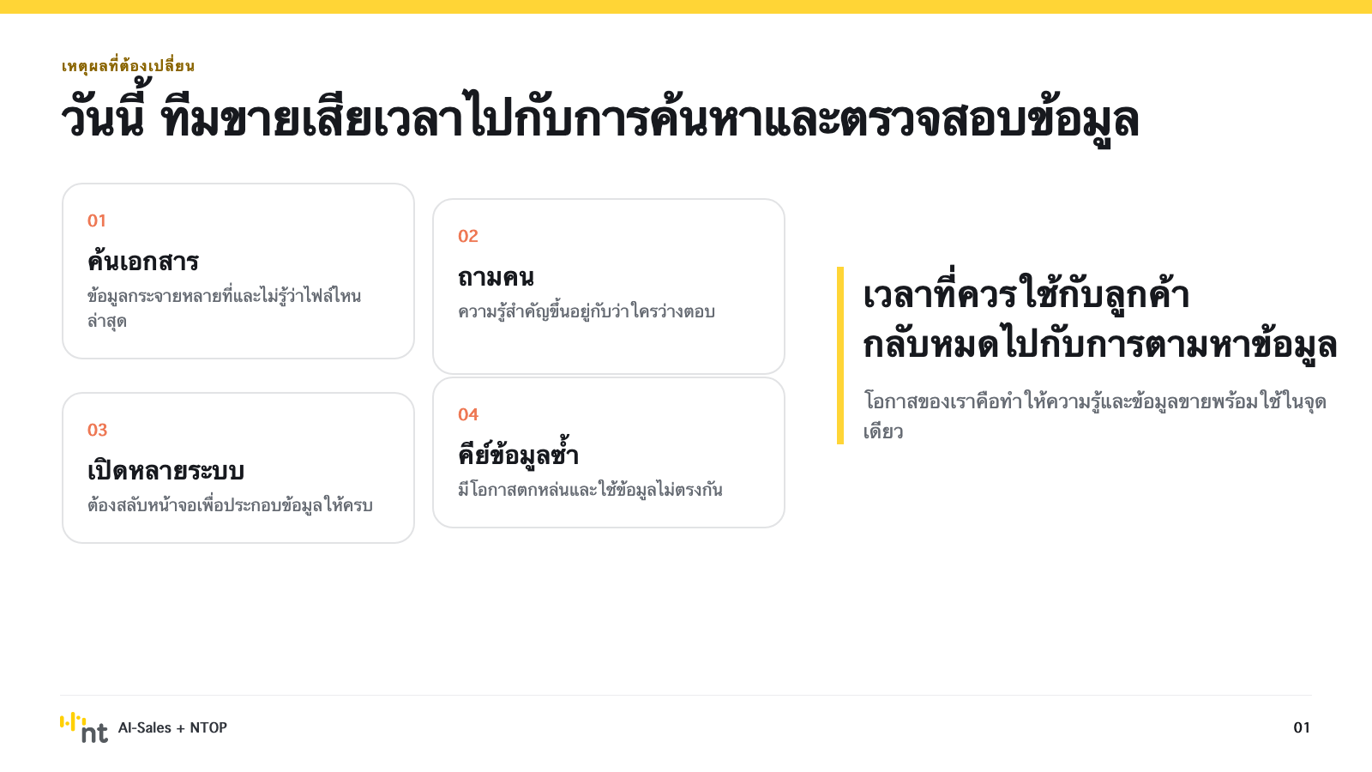
Notes:
[Sources]
- User-directed presentation visual and local system screenshots: /Users/rattananair/codes/ai-sales/docs/assets/ai-sales-ntop-executive/01-problem.png

Slide 3
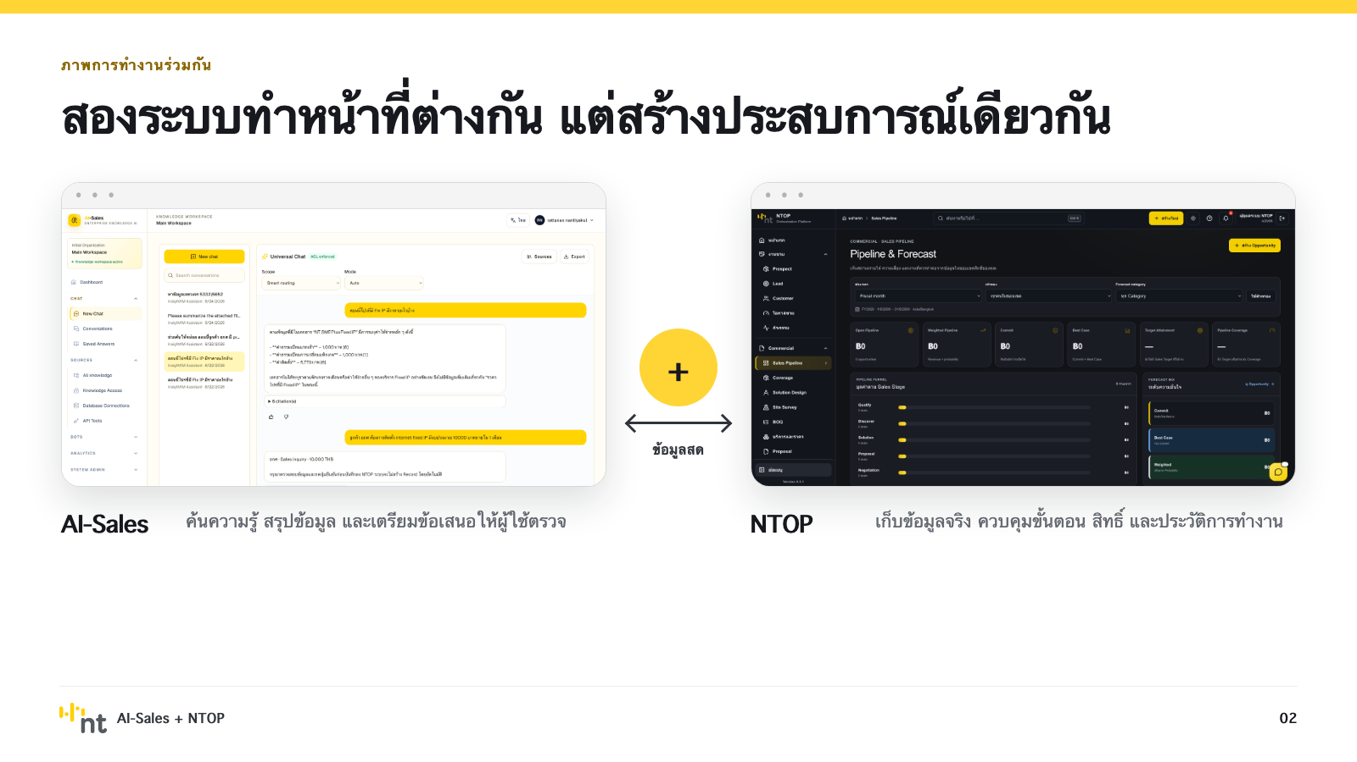
Notes:
[Sources]
- User-directed presentation visual and local system screenshots: /Users/rattananair/codes/ai-sales/docs/assets/ai-sales-ntop-executive/02-one-experience.png

Slide 4
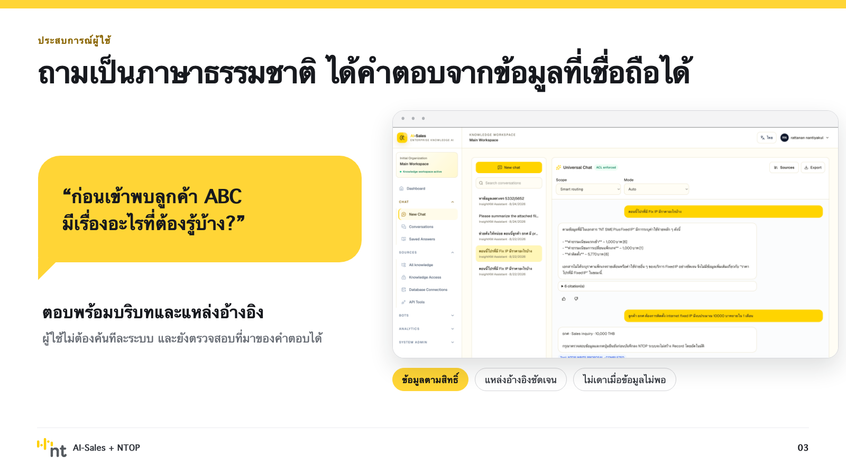
Notes:
[Sources]
- User-directed presentation visual and local system screenshots: /Users/rattananair/codes/ai-sales/docs/assets/ai-sales-ntop-executive/03-grounded-answer.png

Slide 5
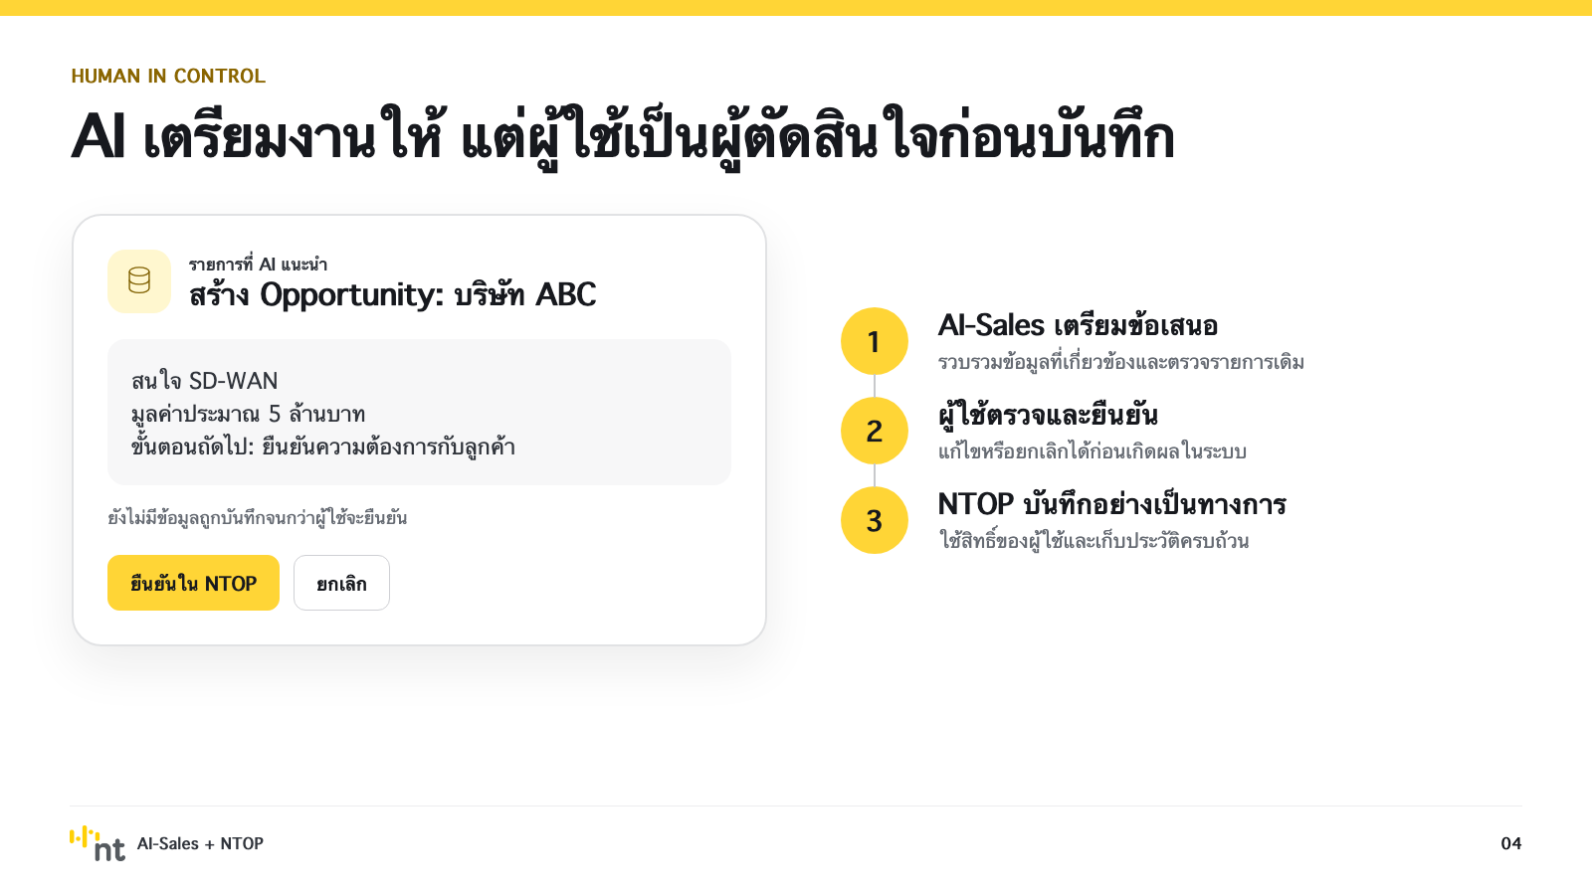
Notes:
[Sources]
- User-directed presentation visual and local system screenshots: /Users/rattananair/codes/ai-sales/docs/assets/ai-sales-ntop-executive/04-human-confirmation.png

Slide 6
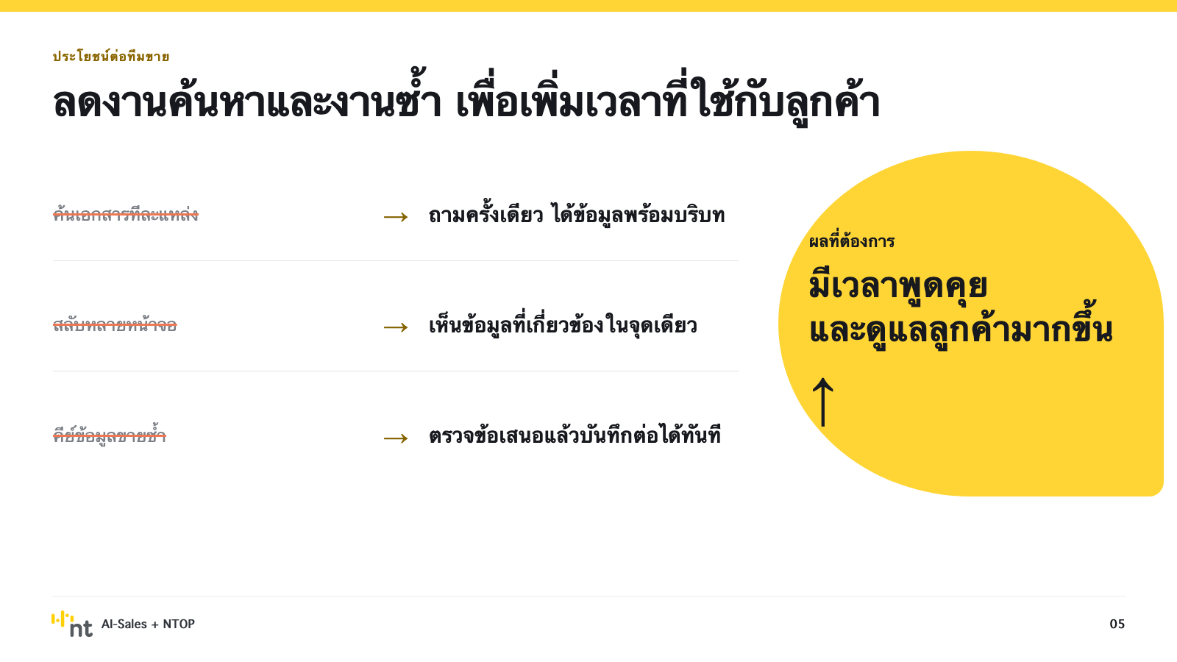
Notes:
[Sources]
- User-directed presentation visual and local system screenshots: /Users/rattananair/codes/ai-sales/docs/assets/ai-sales-ntop-executive/05-sales-benefits.png

Slide 7
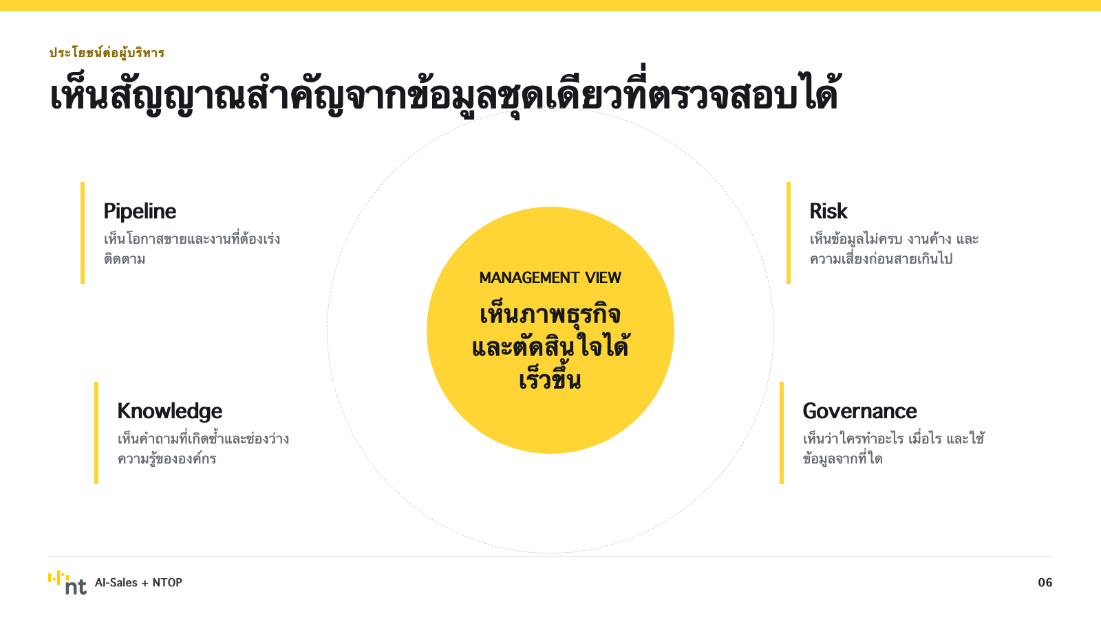
Notes:
[Sources]
- User-directed presentation visual and local system screenshots: /Users/rattananair/codes/ai-sales/docs/assets/ai-sales-ntop-executive/06-executive-benefits.png

Slide 8
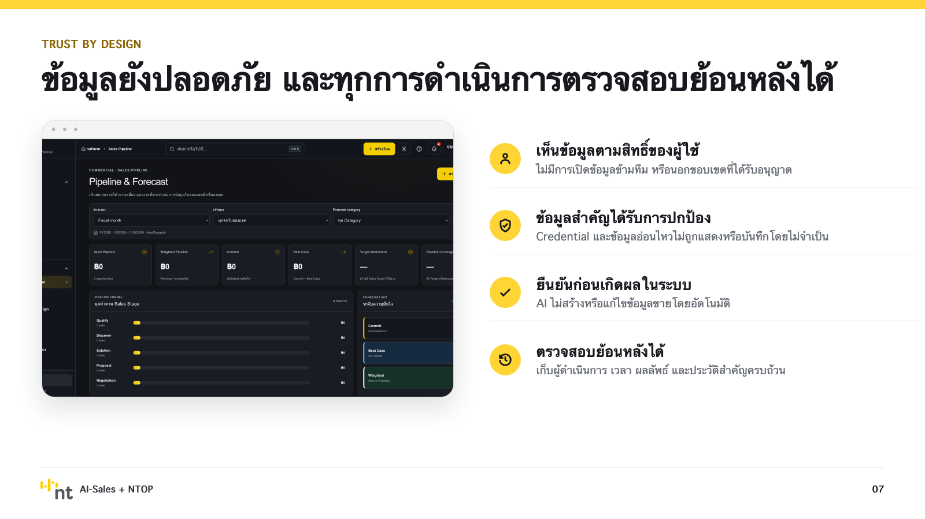
Notes:
[Sources]
- User-directed presentation visual and local system screenshots: /Users/rattananair/codes/ai-sales/docs/assets/ai-sales-ntop-executive/07-trust-control.png

Slide 9
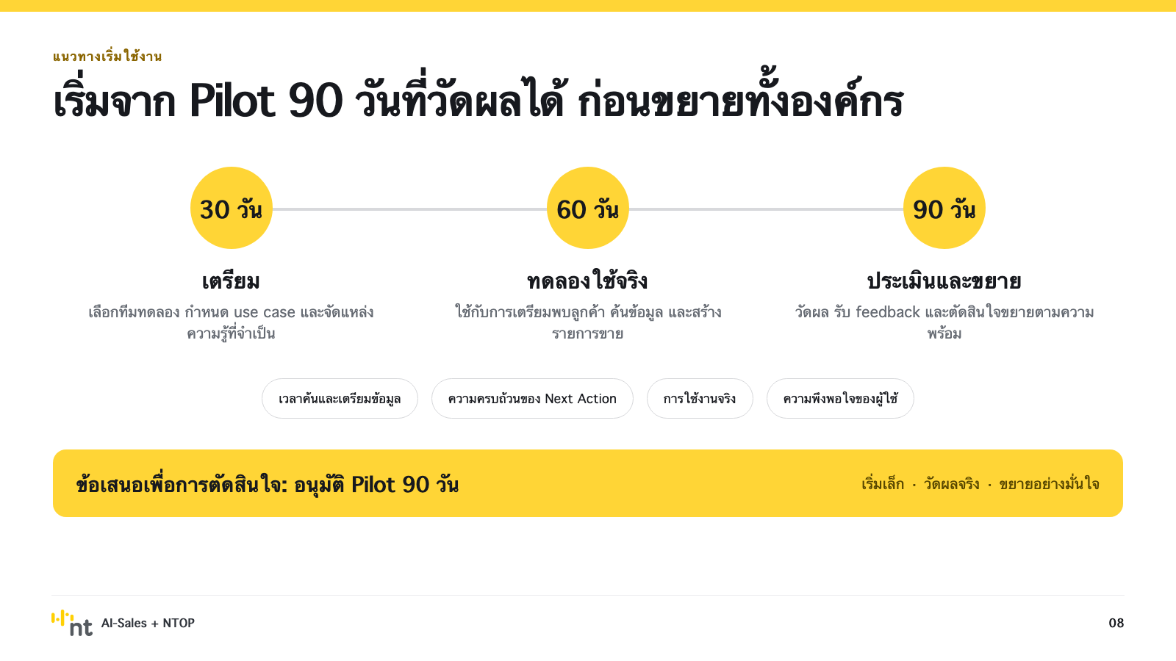
Notes:
[Sources]
- User-directed presentation visual and local system screenshots: /Users/rattananair/codes/ai-sales/docs/assets/ai-sales-ntop-executive/08-pilot.png

