Slide 1
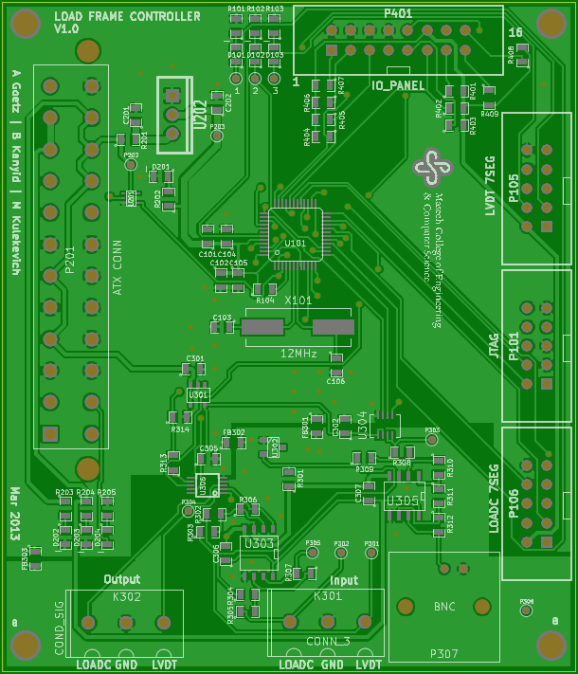
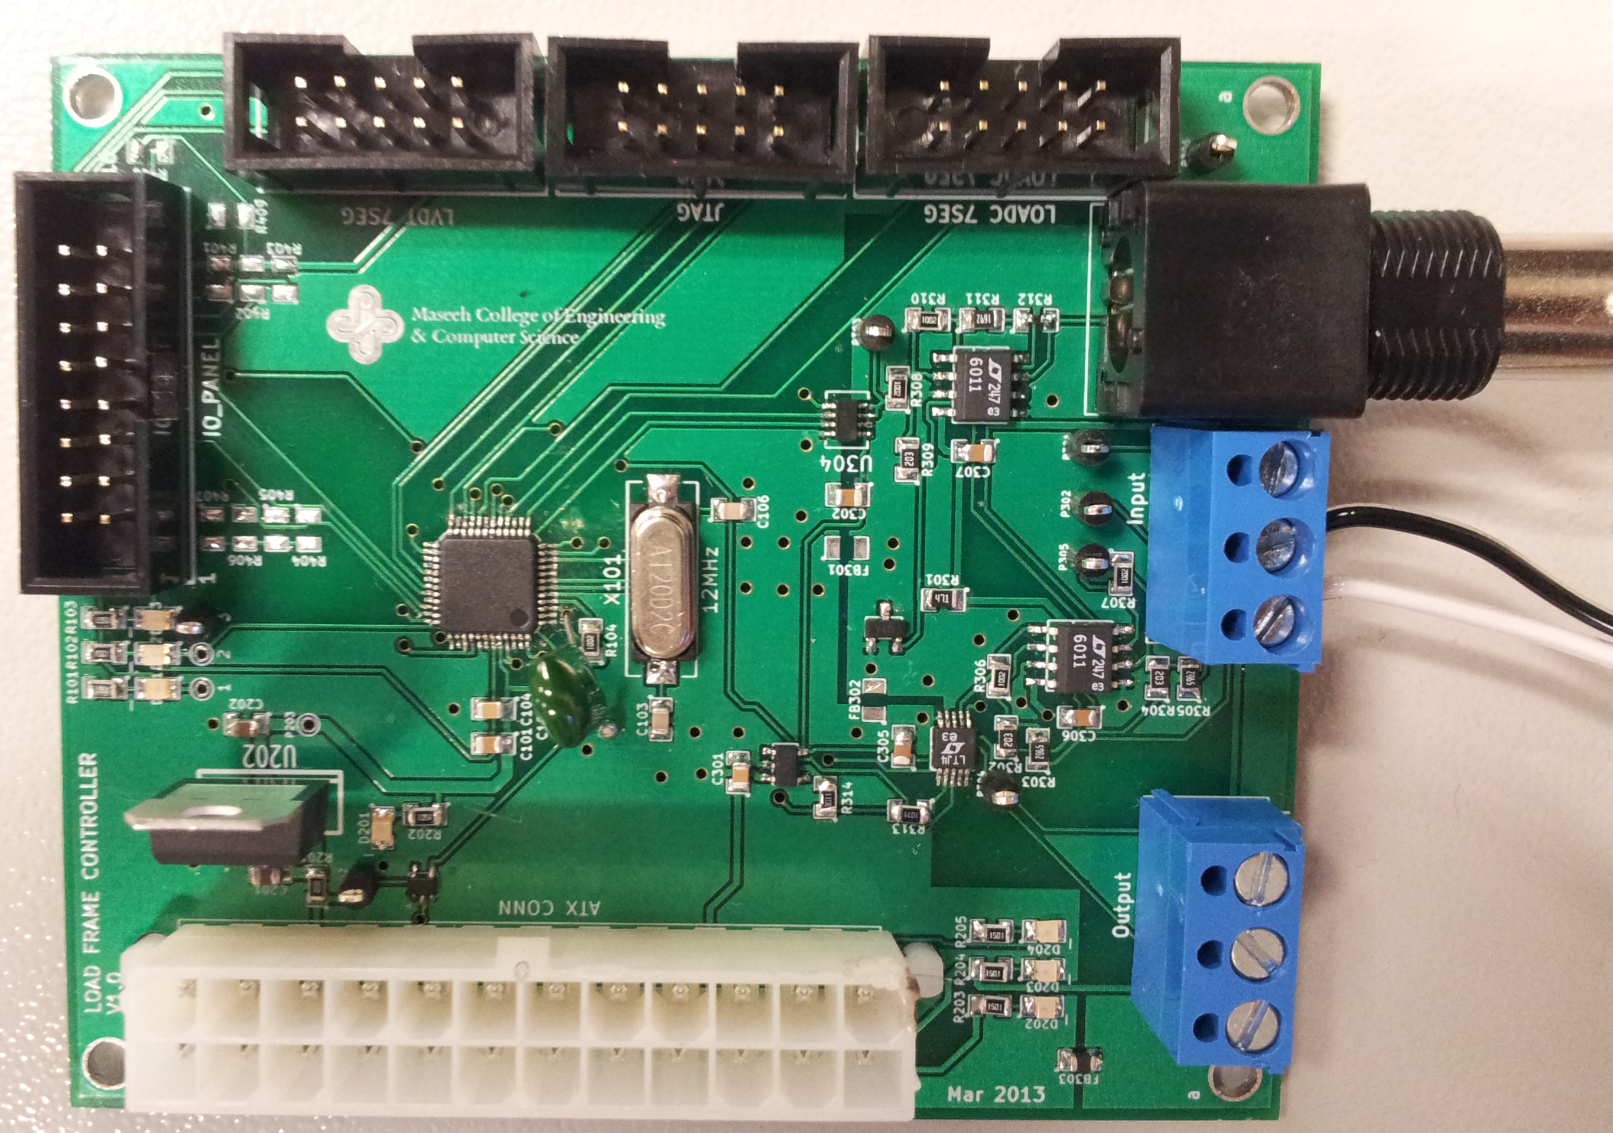

Load Frame Control and Data Logging Station
Andy Goetz | Bradon Kanyid | Mikhail Kulekavich
Overview
The purpose of this project was to restore an MTS load frame to working order for the Civil Engineering Department of Portland State University.
Hardware Overview
Design Goals
Able to measure the displacement of the load frame
Measure the forces acting on a sample coupon
Integration with existing Systems
Used MTS 406 Servo Controller
LVDT, Hydraulic pump, and Load cell already purchased.
Final Results
Look at how cool we are!
Acknowledgments
The authors would like to thank Tom Bennett for the many conversations, as well as for having the moxie to get things done.
References

