Slide 1
Demo

Slide 2
Demo scenarios:
Test a New Version in Production
Ensure a New Version is Stable
Find Out if Customers Like a New Version Better than the Current Version
Move Users to a New Version Without Downtime

Slide 3
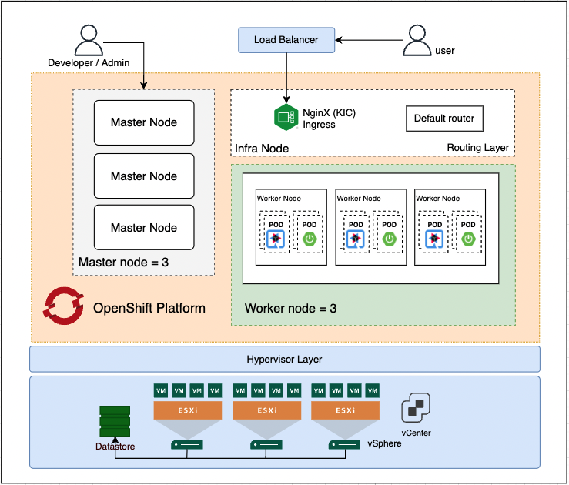
Demo infrastructure

Slide 4
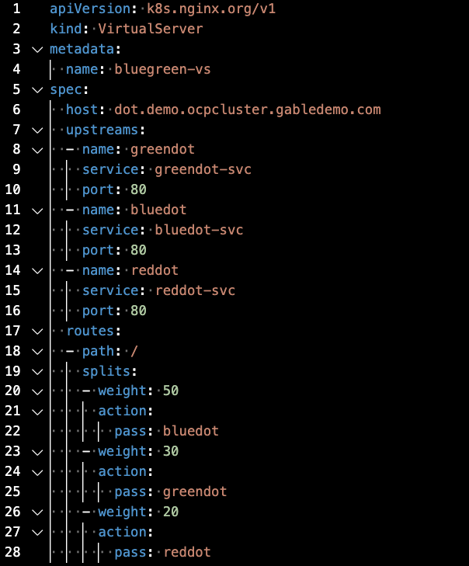
Demo : VirtualServer CRD (Custom Resource Definition)
VirtualServer Resource : a new load balancing configuration offered as an alternative to the Ingress resource
host : domain name of the server
upstreams : defines a destination for the routing configuration
Defines rules for matching client requests to actions like passing a request to an upstream.

Slide 5
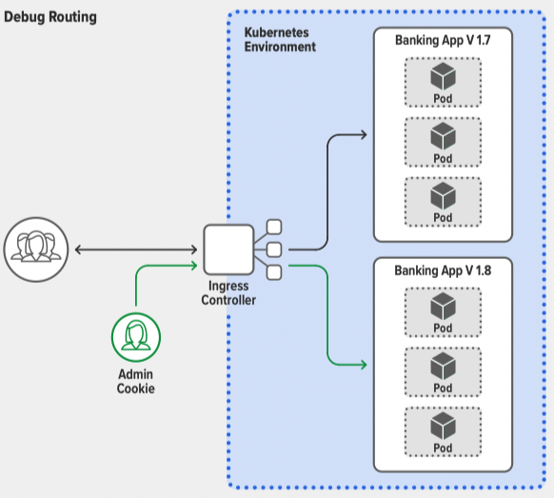
Use case : Test a New Version in Production
Solution : Debug routing
Before testing with customers, you probably want to see how it performs in production.
Debug routing (also known as conditional routing) lets you deploy it publicly yet “hide” it from actual users by allowing only certain users to access it, based on Layer 7 attributes such as a session cookie, session ID, Header, or group ID.
For example, you can allow access only to users who have an admin session cookie – their requests are routed to the new version with the credit score feature while everyone else continues on the stable version

Slide 6
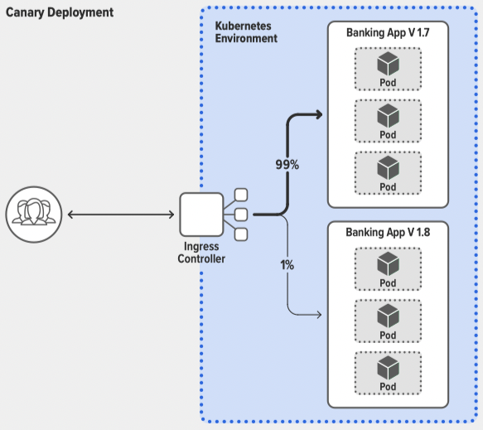
Use case : Ensure a New Version is Stable
Solution : Canary deployment
Canary deployments provide a safe and agile way to test the stability of a new feature or version.
A typical canary deployment starts with a high share (say, 99%) of your users on the stable version and moves a tiny group (the other 1%) to the new version.
If the new version fails, for example crashing or returning errors to clients, you can immediately move the test group back to the stable version.
If it succeeds, you can switch users from the stable version to the new one, either all at once or (as is more common) in a gradual, controlled migration.

Slide 7
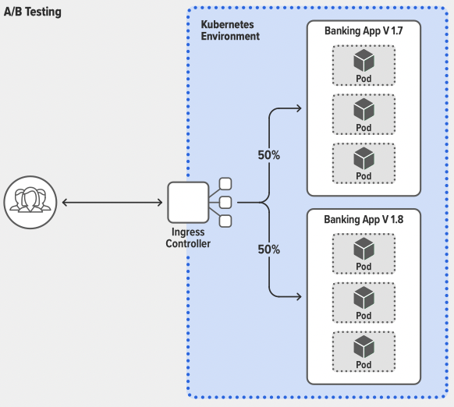
Use case : Find Out if Customers Like a New Version Better than the Current Version
Solution : A/B Testing
Now that you’ve confirmed your new feature works in production, you might want to get customer feedback about the success of the feature, based on key performance indicators (KPIs) such as number of clicks, repeat users, or explicit ratings .
A/B testing is a process used across many industries to measure and compare user behavior for the purpose of determining the relative success of different product or app versions across the customer base.
In a typical A/B test, 50% of users get Version A (the current app version) while the remaining 50% gets Version B (the version with the new, but stable, feature).
The winner is the one with the overall better set of KPIs .

Slide 8
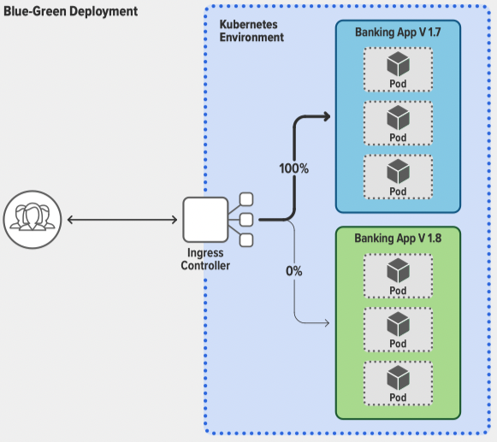
Use case : Move Users to a New Version Without Downtime
Solution : Blue-green deployment
Blue-green deployments greatly reduce, or even eliminate, downtime for upgrades.
Simply keep the old version (blue) in production while simultaneously deploying the new version (green) alongside in the same production environment .
Most organizations don’t want to move 100% of users from blue to green at once – after all, what if the green version fails?!
The solution is to use a canary deployment to move users in whatever increments best meet your risk mitigation-strategy.
If the new version is a disaster, you can easily revert everyone back to the stable version in just a couple of keystrokes .

