Slide 1


Internet Programming
React UI & Navigation + JSON + GitHub
Lecturer : Dr. Somsawut Nindam, Ph.D.
TA: Mr. Korkrit Pipatset
Asst-TA : Mr. Kawinphop Tuddaung
1st Semester 2026
Department of Computer Science and Information
Kasetsart University Sriracha Campus
Nindam, S., 2026, nindams.ku@gmail.com

Slide 2
Topics Outline
Graphic User Interface (GUI) Design
Show Products Page: Call the product from GitHub
Nindam, S., 2025, nindams.ku@gmail.com

Slide 3
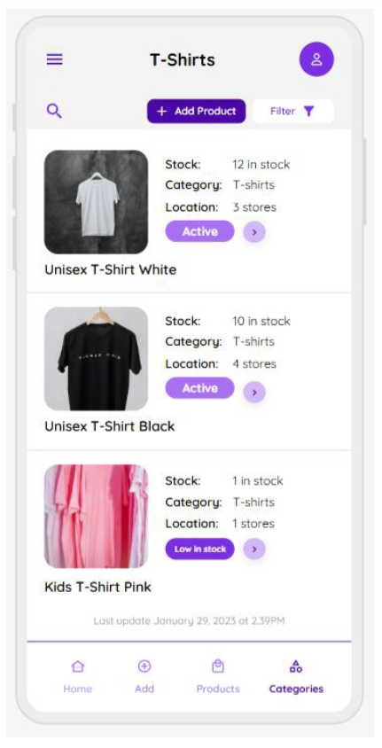
Graphical User Interface (GUI) Design
https://app.uizard.io/templates/z6474wwa9pFKrjOlo0o6/overview
Nindam, S., 2026, nindams.ku@gmail.com

Slide 4


Show Products Page: Call the product from GitHub
[
{
"id": "1",
"name": "Unisex T-Shirt White",
"stock": 12,
"stock_text": "12 in stock",
"category": "T-shirts",
"location_count": 3,
"location_text": "3 stores",
"badge_status": "Active",
"image_url": "http://nindam.ddns.net/imges_prodcut/T_Shirt_White.jpg"
},
{
"id": "2",
"name": "Unisex T-Shirt Black",
"stock": 10,
"stock_text": "10 in stock",
"category": "T-shirts",
"location_count": 4,
"location_text": "4 stores",
"badge_status": "Active",
"image_url": "http://nindam.ddns.net/imges_prodcut/T_Shirt_Black.jpg"
},
{
"id": "3",
"name": "Kids T-Shirt Pink",
"stock": 1,
"stock_text": "1 in stock",
"category": "T-shirts",
"location_count": 1,
"location_text": "1 stores",
"badge_status": "Low in stock",
"image_url": "http://nindam.ddns.net/imges_prodcut/Kids_T_Shirt_Pink.jpg"
}
]
https://app.uizard.io/templates/z6474wwa9pFKrjOlo0o6/overview
Nindam, S., 2026, nindams.ku@gmail.com

Slide 5
Q/A
Thanks!
Nindam, S., 2025, nindams.ku@gmail.com

