Slide 1

Round 2
Phase 2 - Proof of Concepts
Presented by team : ITER_Bhubaneswar_Winners
- Vipul Sharma ( Team Leader )
- Shanta Karn
- Priya Raj

Slide 2
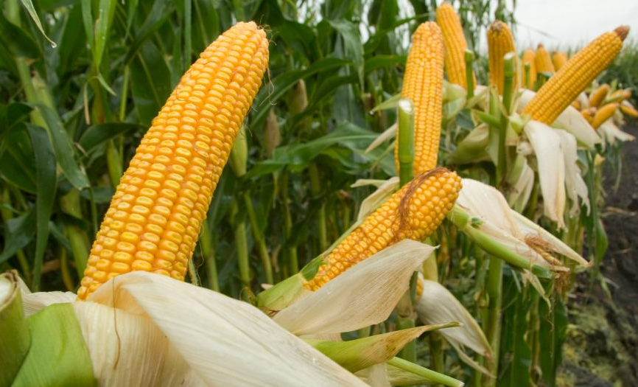
Agro
Corn Crop Prediction Application

Slide 3
Intro
Crop prediction plays a vital role in global food production. Droughts and less rainfall has often affected the Indian agriculture resulting in low productivity of crops, weak infrastructure and reduced in advancement of technology.
Environment plays a heavy role in producing crops, that is, it depends upon the climate, soil moisture and humidity etc.

Slide 4
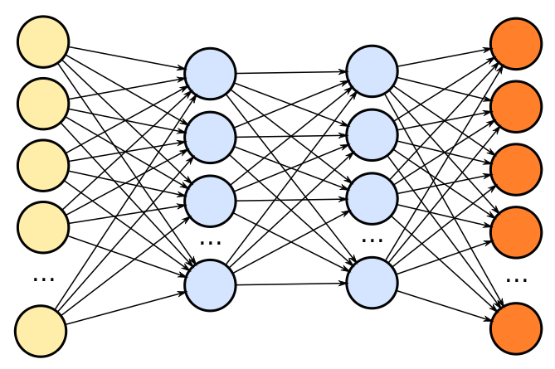
Brief
For this project we will use deep neural networks to predict and check yield and also the difference of corn hybrids from genotype and environment data.

Slide 5
Corn ( About and Use Case )
Also called queen of cereals, corn or maize is the most versatile and emerging crop under certain agro-climatic conditions.
Cultivated on nearly 190 m ha in about 165 countries contributing to 39% in the global grain production.
USA is the largest production of corn contributing 36% of the total production in the world. Corn accounts for around 10% of the total food gain production in INDIA serving as a basic raw material ingredient to industrial products like starch, oil, protein, alcoholic beverages, food sweeteners, pharmaceutical, cosmetic, textile, gum, package and paper industries etc.
India’s Production - 21,810 thousand tonnes in 2015-16.

Slide 6
Drawback and Approach
A main drawback of existing approaches is that the models established between reported yields and remote sensing measurements are location specific and having limited applicability to other regions where it does not have extensive ground truth data.
Approach - Deep transfer learning model based on Bayesian Neural Network development to include the model transferability across different spatial domains along with indication of uncertainty of the prediction results in the new spatial domain.

Slide 7
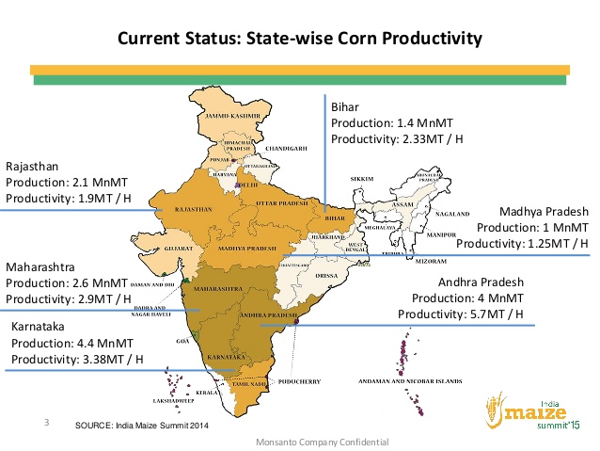
Solution Design
Ground Truth - Yield records from a certain spatial domain.
Input to model - Large set of potential yield determinants derived from various data sources
Features used for model - Enhanced Vegetation Index, Land Surface Temperature, Climate Temperature, Precipitation, Soil properties - Depth, Texture, Organic Carbon Content
Training - Model would be trained on areas covered with dense and diverse forests
Testing - Model would be tested on areas consisting of flat grasslands and has a scarcity of forests.
Tools Used - R, Tensorflow, SKLearn, Python 3, Angular CLI, Material Designed

Slide 8
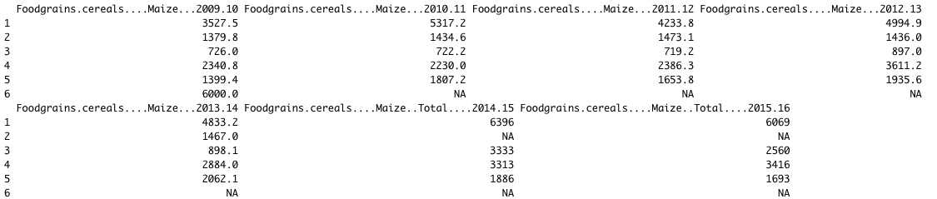
Ground Truth Dataset
Head (first 6 rows) for the ground truth data set has total average yield from 2009 - 2016 in India.
Dataset is taken from data.gov.in.
Average Yield of Principal Crop (Corn)

Slide 9
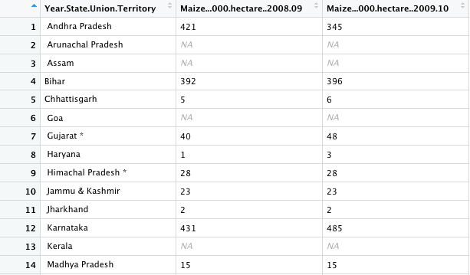
Validation Dataset
State wise irrigation for Maize 2008-2010 for prediction validation.
We also have the soil and environment dataset for prediction. Corn genotype will be used along with the yield performance and environment dataset to train the model.

Slide 10
Installation Guidelines
To install the project we will install all the packages using pip. ` pip install -r requirements.txt `.
We will also need an ` npm install ` for node modules.
To build and compile the project on local host, we will use Angular’s ` ng serve `. The project will then be hosted on the default port 4200.

Slide 11
