Slide 1
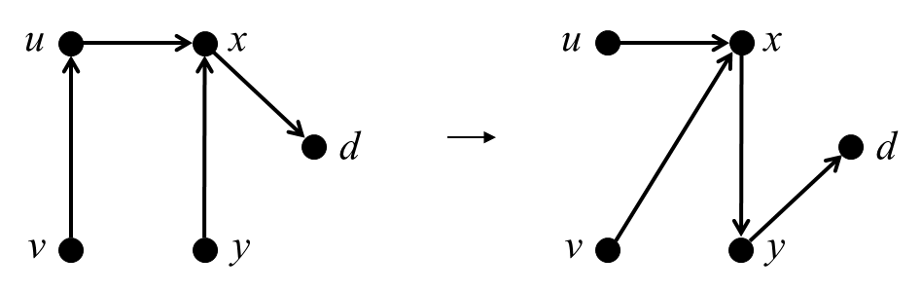
u
x
u
x
d
d
v
y
v
y

Slide 2
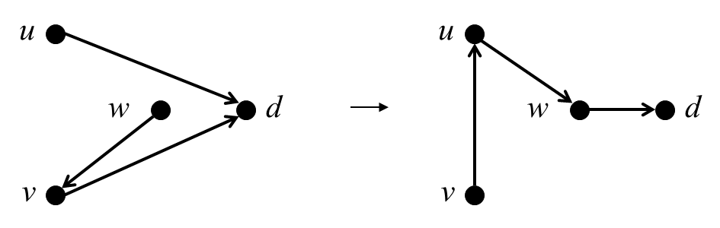
u
u
w
d
w
d
v
v

Slide 3
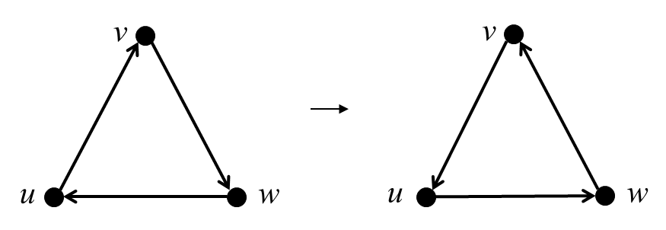
v
v
u
w
u
w

Slide 4
Routing policy
Consistency property
Network characteristics
Rule generator
New rules
Update plan generator
Update DAG
Plan optimizer and executor

