Slide 1
RED-PD: RED with Preferential Dropping
http://www.aciri.org/red-pd
Ratul Mahajan
Sally Floyd
David Wetherall
Notes:
Hello everyone.
Thanks for coming.
Today, I’ll talk about RED-PD. Most of this work was done at aciri.
Make sure ppl know what RED is.

Slide 2
Background
Buffer
FIFO – first in first out
  drop tail
RED – Random Early Detection
  detect incipient congestion
  distribute drops fairly

Slide 3
Problem
High bandwidth flows increase
the drop rate at the router
Without flow based differentiation
all flows see the same drop rate
  flows get more by sending more
Solution: router mechanisms to protect rest of the traffic from high bandwidth flows
Throughput
RED: y=(1-p)x
Sending Rate
p: drop rate
Notes:
So here’s the problem.
When the demand exceeds link capacities and a router does not differentiate between flows all the flows see the same drop rate at the router. Which means that a flow gets more by sending more.
What this means is that the high bandwidth flows in the lot can make life worse for everyone going through the router.
These high bandwidth flows can be both just big guys or bullies, conformant high bandwidth conformant flows or misbehaving flows.
Clearly there is need for router mechanisms that control these high bandwidth flows and protect rest of the traffic.

Slide 4
Relevance
Where is congestion?
  Backbone (?)
  Edge routers
  Exchange points
  Intercontinental links
Starting point for aggregate based congestion
Notes:
There is an increasing belief in the networking community that network backbones are not congested, which makes the congestion control irrelevant. Even if that is true, there are places in the network which are still susceptible to congestion.
Presence of flow based congestion schemes becomes necessary as a starting point in aggregate based congestion. ACC invoked only when flow based congestion scheme fails to control the levels of congestion on the router.

Slide 5
A Possible Approach – Per-flow state
Examples: FQ, DRR, CSFQ, FRED
Sequester all flows from each other
  + provide full max-min fairness
    required for best-effort traffic?
  state for ALL the flows passing through the router, most of which are small “Web mice”
Notes:
Here is an existing approach to solve the problem.
Go to the other extreme, a full max-min fair technique like FQ or one of it variant or approximations.
I am not going to talk about these schemes individually, but talk about things all these schemes have in common.
These schemes achieve what they do by keeping state for all the flows passing through the router. This in my opinion is an overkill, since most of the flows through the router are small web mice.

Slide 6
RED-PD’s Approach – Partial Flow State
State for high bandwidth flows only
Identify high bandwidth flows during times of congestion. These are called monitored flows.
Preferentially drop from monitored flows to limit their throughput.
Combines the simplicity of FIFO with the protection of full max-min fair techniques that keep per-flow state.
Notes:
I call RED-PD’s approach partial flow state. It keeps state for just the high bandwidth flows.
It is composed of two steps
The first being identifying the high bandwidth flows
And the second is preferentially dropping packets from them to limit the bandwidth hogged by them
With this approach we combine the simplicity of FIFO queuing with the protection of full max-min fairness techniques.
Now some of you must be wondering why this technique is simple and lightweight, something which all proposals should be.

Slide 7
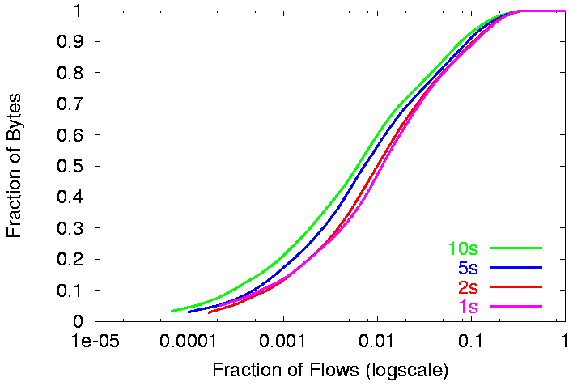
Why Partial Flow State Approach Works
What fraction of flows get what fraction of bytes over different time windows.
  Bandwidth distribution is very skewed - a small fraction
  of flows accounts for most of the bandwidth.
Notes:
So why does keeping state for just a small fraction of flows work?
It is a well known fact that …..
The graph here shows why. This is from a one hour trace taken from the UCB access link in August.
What we see here is that bandwidth distribution is skewed. That means there are a small fraction of flows responsible for a large chunk of bandwidth.
So our job is to identify these high bandwidth flows and control them.
In this it helps that …..
Not only that, usually these high bandwidth flows remain high bandwidth. This is important for us. If, by the time we detect a flow as high bandwidth and initiate state for it, it stops being high bandwidth, all the work we do is wasted and the scheme would be useless.

Slide 8
Identification Approach – Drop History
Flows that send more
suffer more drops
Cheap means for identification
Drop history contains flows that have been sent congestion signal
p.x
Throughput
RED: y=(1-p)x
Sending Rate
p: drop rate
Notes:
Now I talk about the first step of RED-PD identifying the high bandwidth flows.
Here is the good news in the bad graph I showed you earlier. While flows that send more get more, they also get dropped more.
So the drop history offers a very cheap means of identifying high bandwidth flows.
There is another advantage to using drop history for identification . Drops are congestion signals. Drop history also represents flows that have been sent congestion signal.

Slide 9
Defining “High Bandwidth”
Pick a round trip time (RTT) R
  call a TCP with RTT R as reference TCP
High bandwidth flows:
  All flows sending more than the reference TCP flow
Target bandwidth Target(R,p) given by the TCP response function
  Target(R,p) =~ packets/second
  where p is the drop rate at the output queue
√1.5
R √ p
Notes:
So far I have been talking about high bandwidth as a binary property. This obviously is not true. So we have to draw some artificial line and declare all flows above them as high bandwidth.
We draw this line using the round trip time of TCP. Define high bandwidth flows all flows sending at a rate greater than a reference TCP of round trip time R.
This target bandwidth can now be computed using the TCP response function. Note that it is dependent on the current drop rate at the router. This is how choosing a constant target bandwidth is different from choosing a target RTT.
In an environment dominated by TCP flows, it is much easier to understand the effect of picking rtt parameter in the scheme.

Slide 10
Identifying High Bandwidth Flows
W
TCP suffers one drop in a congestion epoch
Length of congestion epoch can be computed using drop rate
CELength(R,p) = congestion epoch length of the reference TCP
  identify flows with one or more drops in CELength(R,p) seconds
Congestion Window
W/2
Congestion Epoch
R
√1.5 √ p
Notes:
This slide describes how we restrict identification to what we have defined as high bandwidth flows.
A congestion epoch is defined time between two corresponding points in the TCP sawtooth. TCP suffers exactly one drop in a congestion epoch.
So flows sending more than the reference TCP suffer more than one drop in a time period of CL(R,p).
Drop history has this information readily available.

Slide 11
Tuning Identification
1. Issue: all flows suffer a drop once in a while
  keep the drop history of K.CELength(R,p) seconds and identify flows with K or more drops (K>1)
2. Issue: multiple losses in a window of data
  maintain the drop history as M separate lists instead of a single list
    length of each list is (K/M) .CELength(R,p) seconds
  identify flows with drops in K or more of the M lists
    lets go flows with more than K drops in a short period
Notes:
Now I describe two engineering modifications to the simple identification scheme described in the last slide.
For accuracy, and not wanting to punish a flow with an odd drop, we instead identify flows with K or more drops in history of K*CL(R,p) seconds.
The second change we make is that instead of keeping a single big list of K*CL(R,p) seconds, we keep multiple lists and the length of each list is K/M times the congestion epoch length.
This protects flows which happen to suffer multiple drops in a window of data. It also will not penalize flows that back off after suffering initial losses.
We use K=3 and M=5. These numbers have worked well in our simulations, and I must admit have not been arrived at using some systematic parameter space search. Though, the broad guidelines for choosing them are discussed in the paper.

Slide 12
Preferential Dropping
Probabilistically drop packets from monitored flows before they enter the output queue
The dropping probability is computed to bring down rate of a monitored flow into the output queue to Target(R,p)
  probability = 1 – Target(R,p)/arrival rate
Notes:
Moving onto the second step of RED-PD – preferential dropping.
RED-PD controls monitored flows by probabilistically dropping packets from these flows before they enter the common output queue.
The dropping probability is computed such that no more than target bandwidth of monitored flows is getting into the output queue.
A naïve way of achieving this would be estimating the arrival rate of the flow and computing the dropping probability.
We don’t d o that, instead we rely on the identification scheme itself to lead us to the right dropping probability.

Slide 13
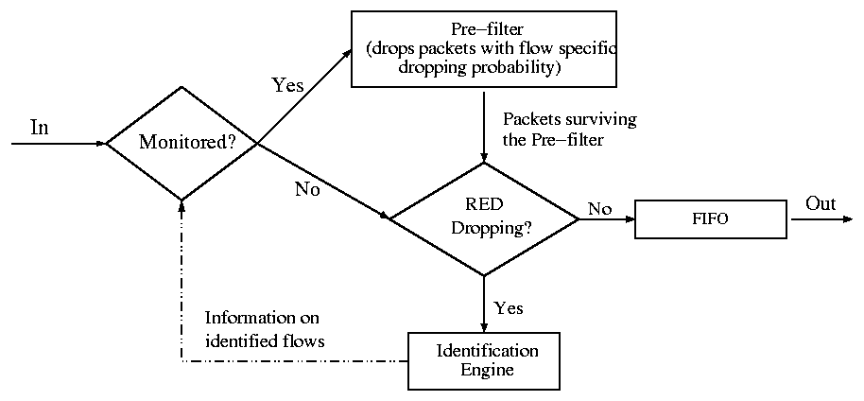
Architecture
RED does not differentiate between monitored and unmonitored flows
The identification engine does not consider drops in the pre-filter
If a monitored flow is identified again, the pre-filter dropping probability is too small
If a monitored flow is suffering too few drops, the pre-filter dropping probability is too large
Notes:
When packets come to the router …..
The pre-filter drops monitored flows with a probability as computed by the process I explain in the next slide.
The pre-filter puts the surviving packets from the monitored flows into the regular output queue, where they might be dropped again depending on the RED dynamics. Since the output queue does not differentiate between flows, the monitored flows are not saved from the general congestion experienced by unmonitored flows.
The job of the identification engine is to identify all flows that are coming into the RED box with a rate greater than T. The flows that are identified may be unmonitored flows or monitored flows whose dropping probability is not large enough.
If the pre-filter dropping probability is such that it lets more than T of the flow go by, it would be identified again and we would increase its dropping probability.
Similarly, when a monitored flow is being dropped such that its rate into the RED box is much less than T, its dropping probability would increase.
The various positive props of the preferential dropping mechanism

Slide 14
Probability Computation
Decrease dropping probability of a monitored flow with no drops in M lists by halving it
  upper bound on reduction in one round
Increase dropping probability of an identified flow
  an identified flow could be either a monitored flow or a newly identified flow.
Don’t change dropping probability too fast
Notes:
Here is how we determine the dropping probability for a flow.
If a monitored flow has zero drops in M lists, its dropping probability is halved. But this reduction is bound by a maximum decrease in one step to avoid oscillations.
When a flow is identified i.e. occurs in K or more lists, its dropping probability is increased. Assuming 0 dropping probability for an unmonitored flow, the identification means that the flows pre-filter dropping probability is not enough and should be increased.

Slide 15
Probability Increase
Add an increase quantum to existing probability
The increase quantum should depend on
  ambient drop rate (drop rate at the output queue)
  sending rate of a flow
increase quantum = (number_drops/avg_drops).p
  upper bound on increase in one step
Notes:
The quantum of increase for a flow should be dependent on two factors.
The first being the ambient drop rate at the queue. Ambient drop rate is the drop rate at the output queue, it does not consider the pre-filter dropping. When the ambient drop rate is high, the router should come down on high bandwidth flows faster and thus the increase quantum should be larger.
The second factor is the sending rate of the flow itself. For flows sending at a higher rate, the quantum should be larger so that they can be brought under control faster.
Computing increase quanta as displayed on this slide has both the above properties.
Drops_flow are the number of drops from the flow in this identification round and average_drop_count is the average number of drops for all the identified flows.
Again, the max increase in one step is bounded to avoid a TCP seeing a sudden shift in its drop rate and not having time to react loosing multiple packets in a window of data.

Slide 16
Effect of RED-PD
Reduction in ambient drop rate (p’ < p)
Full max-min fair in the extreme case (p’ = 0)
Throughput
RED-PD: y=(1-p’)x
RED: y=(1-p)x
Sending Rate
p: drop rate with RED
p’: ambient drop rate with RED-PD
Target Bandwidth

Slide 17
Evaluation
Fairness
Response time
Effect of target RTT R
Probability of identification
Persistent congestion throughput
Web traffic
Multiple congested links
TFRC
Byte mode operation
Notes:
Ok, I have finished describing RED-PD. Does any one has questions before I move onto describing the evaluation?
In this talk I’ll show results from the top three simulations. The results of the other simulation are described in the paper.

Slide 18
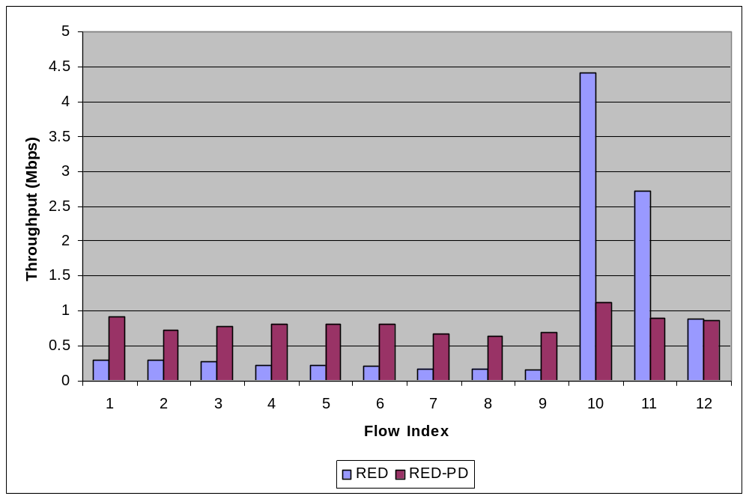
Fairness
10 Mbps link
R= 40ms
Flow Index
1-3 30ms TCP
4-6 50ms TCP
7-9 70ms TCP
10 5 Mbps CBR
11 3 Mbps CBR
12 1 Mbps CBR
Iterative probability changes successfully approximate fairness
Notes:
This simulation shows that RED-PD does provide fairness by iterative probability changes.
In this simulation, the monitored flows were the three CBR flows and the 3 TCP flows with RTT 30 ms. The bandwidth obtained by all of them is roughly equal. To manage that, RED-PD must have come to the right dropping probability for each of those flows.
The simulation also shows that RED-PD’s preferential dropping scheme does not have a negative impact on TCP throughput when the TCP flows they are monitored.

Slide 19
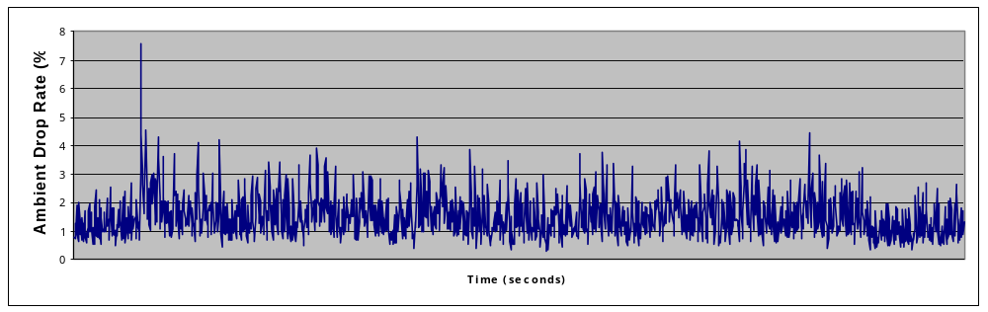
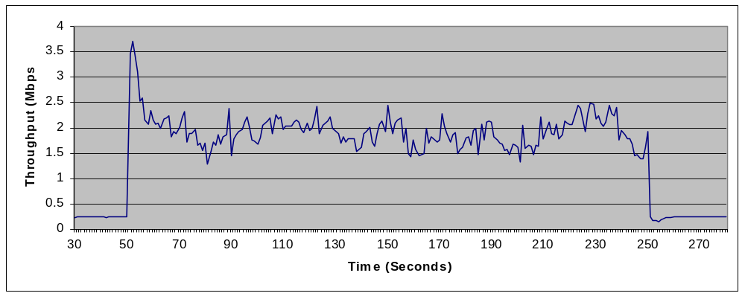
Response Time
10 Mbps link
1 CBR flow
9 TCP flows
R = 40 ms
Flow brought down in 6s and released in 5s
The speed of RED-PD’s reaction depends on ambient drop rate and flow’s sending rate.
Its faster when either is higher
0.25Mbps
4Mbps
0.25Mbps
Sending rate of CBR changes with time
Notes:
Now the good part.
This graph shows the response time of RED-PD to sudden changes in a flows sending rate.
Time to bring down the flow is about 7 seconds.
RED-PD’s reaction time is a dependent on the ambient drop rate and the flow’s sending rate because the probability increase quantum is a function of these two. Thus, RED-PD reacts faster when the situation is worse, a high ambient drop rate or high sending rate of the flow.
Time to forget a flow is less than 5 seconds in this case.

Slide 20
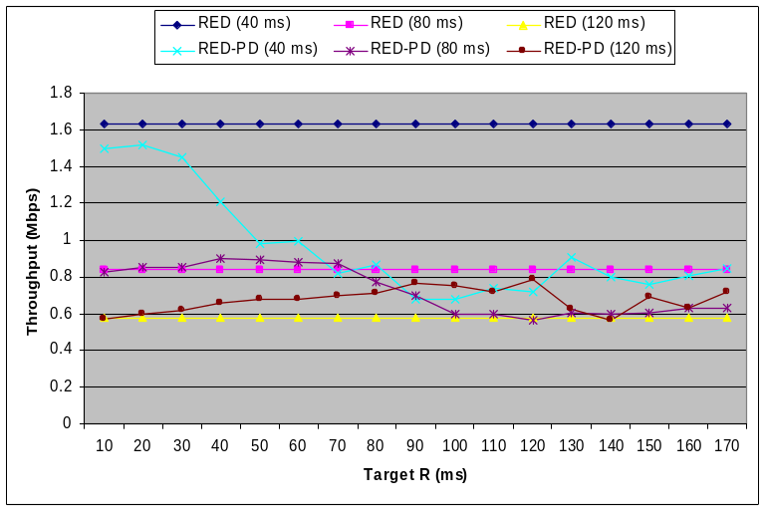
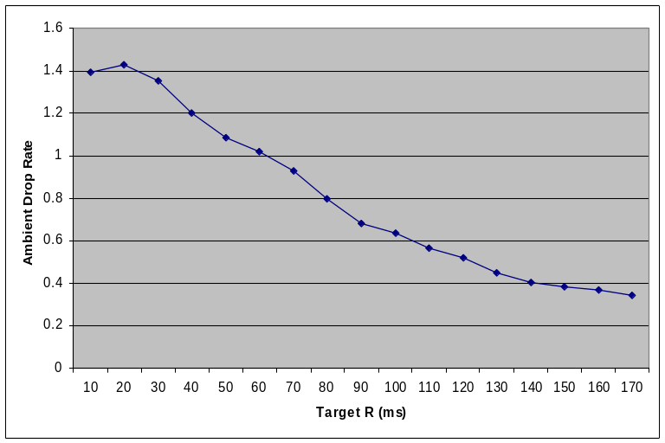
Effect of target RTT R
10 Mbps link
14 TCP flows
2 each of RTT 40, 80 & 120 ms and 8 of RTT 160 ms
Increasing R
increases fairness
increases state
decreases ambient drop rate
Notes:
This is the most important simulation result. It explores the effect of target RTT R.
TCP flows with different RTT’s were started and target RTT R varied.
The simulation shows that as long as R is below the minimum RTT present in the traffic, RED-PD has little effect on the bandwidth distribution which is almost same as that with RED.
When R reaches 40 ms the 40-ms TCP are identified and brought down. The bandwidth obtained by them, goes down as R is increased further.
As R is increased further, RED-PD starts monitoring most of the traffic on the link. At this stage most of the drops move to the pre-filter rather than the output queue. This is demonstrated by a decrease in ambient drop rate but no change in bandwidth distribution which is about equal for all the flows. This is where RED-PD has come close to full max-min fairness.
So the trend is that increasing R, increases fairness, state and decreases the ambient drop rate.

Slide 21
Implementation Feasibility
Identification engine
  state for drop history
  not in fast forwarding path
Flow classification and pre-filter
  hash table of all flows being monitored
  drop with the computed probability
Notes:
A slide on implementation feasibility of RED-PD, or how easy it is to implement it.
There are two additional elements in RED-PD over and above a RED queue.
The identification engine and the pre-filter.
The engine requires state for the drops. And it needs to be passed drops by the output queue. The identification engine does not sit in the fast path and does not require fast memory, can work in the background and should be easy to implement.
The other component requires to classify incoming flows as belonging to monitored flows or not. And probabilistically drop packets from monitored flows. The state required for this is proportional to the number of flows being monitored. Since RED-PD does not aim to monitor too many flows, this should be easy doable even in high speed routers.

Slide 22
Comparison
 | State for what? | What state? | Fast-path processing? | When processing?
FQ/ DRR | All flows | Queues | Queue management and scheduling | Arrival/ Departure
FRED | All buffered flows | Number of buffered packets | Drop probability computation and coin tossing | Arrival/ Departure
CSFQ | All flows | Arrival rate estimate, time of last packet | Update arrival rate estimate, change header | Arrival
RED-PD | High bandwidth flows | Dropping probability, drop history | Coin tossing | Arrival
Notes:
This slide provides a comparison of some existing technique with red-pd, mainly for factors which influence implementation simplicity

Slide 23
Future Work
State requirements
Dynamically varying R
  Target ambient drop rate
  State limitations
Misbehaving flows
Notes:
These are some of the things I hope to get to in the near future.
Investigation state requirements of RED-PD in more detail. This would require a more detailed analysis of the composition of traffic going through a link. This is Scott’s hypothesis of scalability of such schemes …..
Different R required for different sites depending on the mix of traffic through it.
Techniques to dynamically vary R to achieve a certain goal like bringing down the ambient drop rate at the queue or operating within the state limitations.
It is important to actively punish bullies, the misbehaving high bandwidth flows. RED-PD’s iterative increase of a flow’s dropping probability gives a perfect tool to differentiate between nice big guys and bullies. I hope to make more progress in this direction.

Slide 24
Conclusions
Increased fairness using much less state
Tunable degree of fairness
Reasonable response time
Lightweight and easy to implement
Notes:
RED-PD increases fairness at the congested router using much less state than traditional fairness/ congestion control schemes.
The degree of fairness achieved by RED-PD can be tuned. I talked about this, I think.
RED-PD has a reasonable response time to a flow changing its sending rate suddenly. It reacts faster when the situation is worse, a high ambient drop rate or high sending rate of the flow.
And whats more it is easy to implement being lightweight.

Slide 25
A continuum of policies
Per-flow
state
High bandwidth flow state
Misbehaving flow state
No flow
state
Continuum of policies
FQ
CBQ Router Mechanisms
DRR
SFQ
FIFO
Scheduling Approaches
RED-PD
CSFQ
FRED
SFB
RED
Preferential Dropping Approaches
Notes:
There are two axes of categorizing these. The first one being how much state they keep.
At one end is FIFO with no state at all, which is simple to implement but provides no protection.
At the other extreme is full max-min fair techniques, which keep per-flow state. They provide protection but are too complex, especially when you think of the fact that most flows are small web mice. We believe that the extreme level of fairness provided by these techniques is not required for best effort traffic.
The reason RED-PD is show extending over a range is because it can trade-off fairness and state using a configurable parameter.
The other axes of categorization is scheduling vs preferential dropping. Scheduling approaches queue separately. different flows or group of flows. Packets are scheduled from different queues to achieve fairness.
Preferential dropping schemes keep just one queue and bandwidth control is achieved by dropping packets from flows that send more.
Which one is better is a subject of much debate into which I would not like to go. But I would point out that it is easier for preferential dropping based schemes to let small bursts go through, do active queue management and actively punish misbehaving flows.

