Slide 1
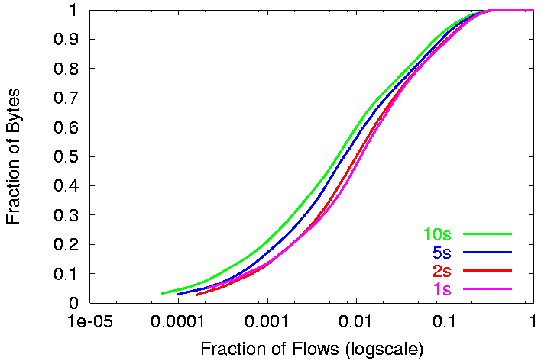
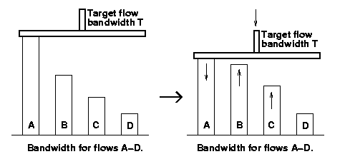
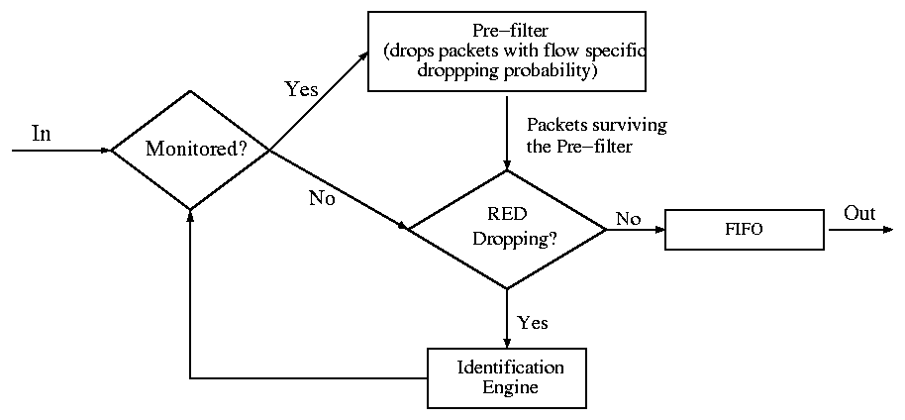
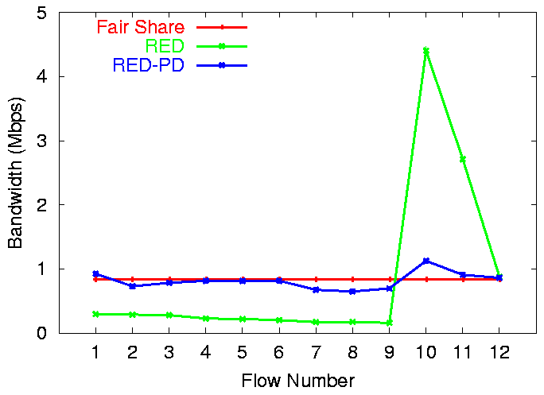
RED-PD: RED with Preferential Dropping
Ratul Mahajan Sally Floyd (ACIRI) David Wetherall
RED-PD identifies and controls high bandwidth flows at the congested router to improve fairness.
Challenge: to do the above while keeping routers simple.
Per-flow
state
High bandwidth flow state
Misbehaving flow state
No flow
state
Spectrum of possibilities
  No flow state is simple but implies no protection.
  Per-flow state provides protection but is heavyweight in presence of lots of “Web mice”.
  RED-PD combines simplicity and protection by keeping state only for flows which are high bandwidth. We call this “partial flow state”.
FQ
Continuum of policies
DRR
SFQ
CBQ Router Mechanisms
FIFO
Scheduling Approaches
CSFQ
FRED
SFB
RED-PD
RED
Preferential Dropping Approaches
Why the partial flow state approach works?
RED-PD internals
  Define target bandwidth T as throughput of a TCP flow with RTT R given drop rate p at the router.
  Use drop history of length dependent on R and p to identify flows sending more than T. Divide the history into multiple lists to filter out losses in a window of data.
  Preferentially drop from these flows with a dropping probability based on the flows’ sending rate. Make iterative changes to dropping probability based on p and feedback from identification engine to bring down the flow to T before inserting it into the output queue.
Bandwidth distribution over different time windows at a router.
  Bandwidth distribution is heavy tailed. A small fraction of flows account for most of the bandwidth.
  In this case, controlling only 10% of the flows will give control over 80% of the bandwidth.
Effect of RED-PD
  Flows above T are preferentially dropped, and state kept for them.
  Decreasing T increases fairness, but also state.
Simulation Results
Main features
  Enhanced fairness using much less state.
  Tunable degree of fairness.
  Reasonable response time.
Flows 1-9 are TCPs, 10-12 are high bandwidth CBRs.
More simulations done to evaluate RED-PD for response time, web traffic, TFRC, multiple congested links and effect of R
Future directions
  Identify unresponsive flows and actively punish them.
  Investigate state requirements in more detail.
http://www.cs.washington.edu/homes/ratul

