Slide 1
Configuration verification: A missing link toward fully verified networks
Ratul Mahajan Microsoft Research
With: Ari Fogel, Stanley Fung, Ramesh Govindan, Todd Millstein, Luis Pedrosa, Meg Walraed-Sullivan

Slide 2
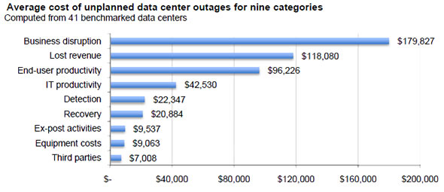

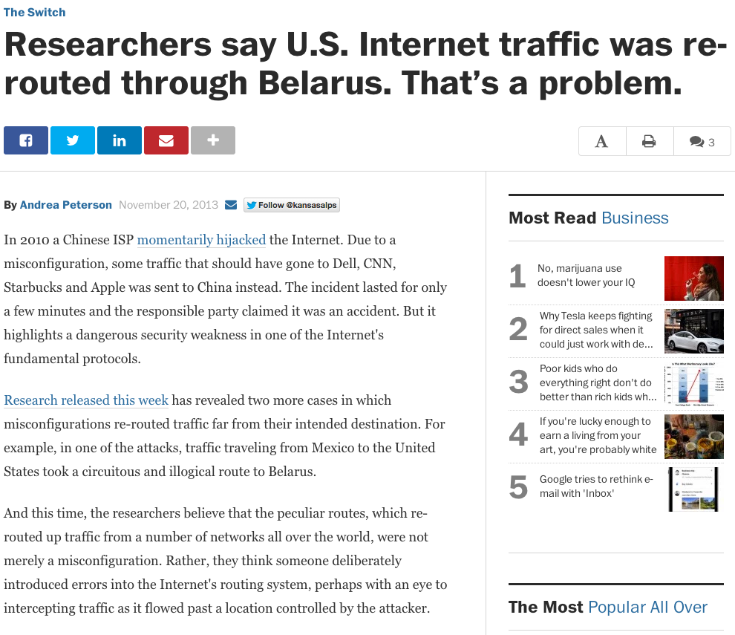

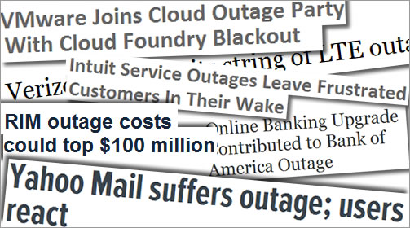

Networks are unreliable
Unreliability is expensive

Slide 3
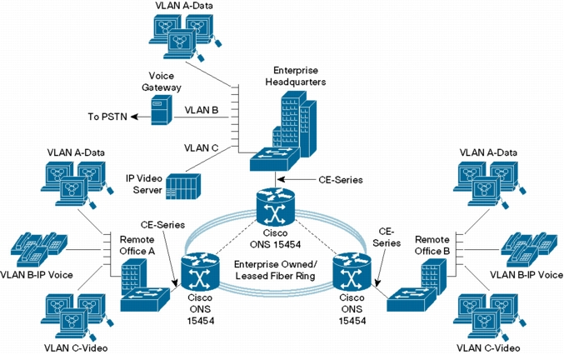
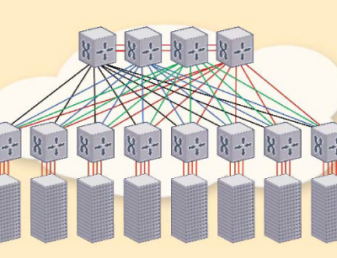

(An old) vision

Slide 4


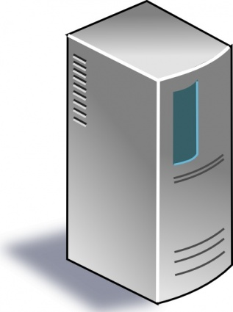
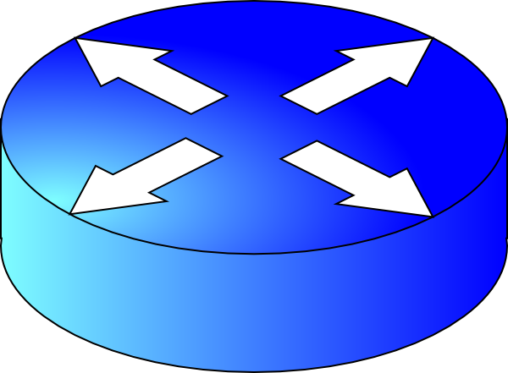
But what does it mean?
Configuration
Router runtime
Data plane state
Forwarding software
Hardware

Slide 5

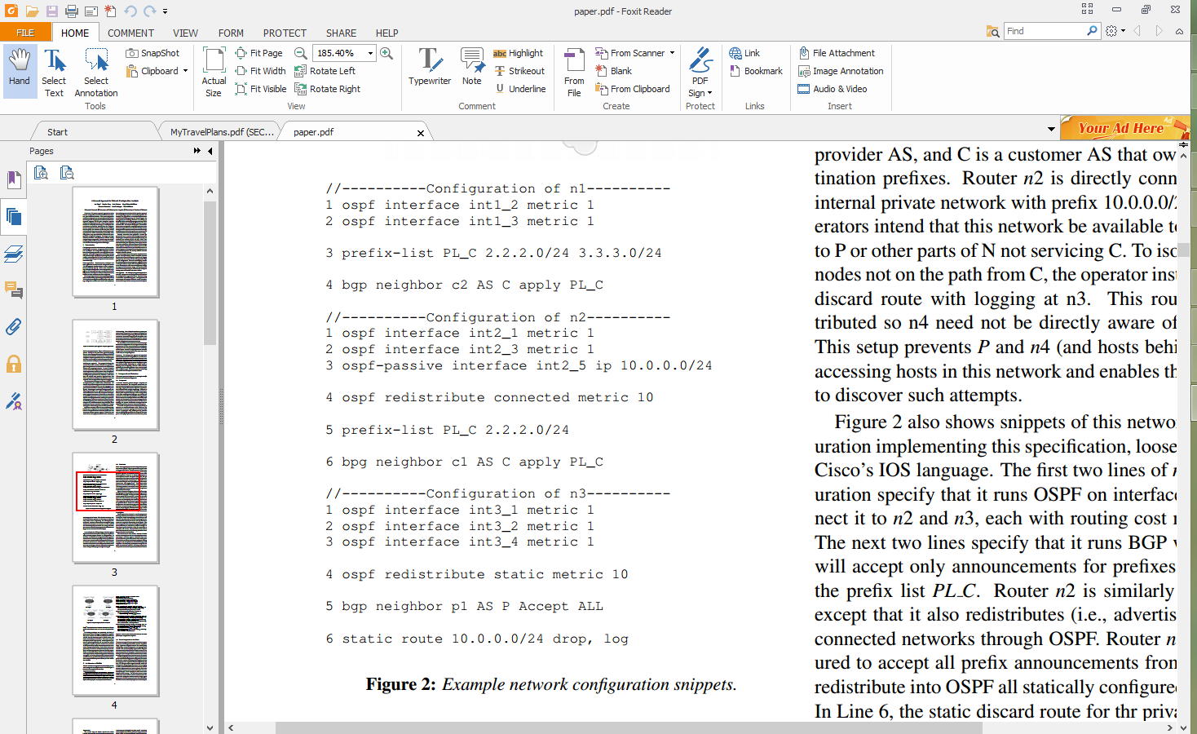
Why configuration (verification) is hard?
Low-level, per-device configuration
Multiple routing protocols
Redistribution across protocols
Access control and isolation
10.0.0.0/24
2.2.2.0/24
3.3.3.0/24
C
c1
n2
c2
P
n1
n3
N
p1
n4

Slide 6
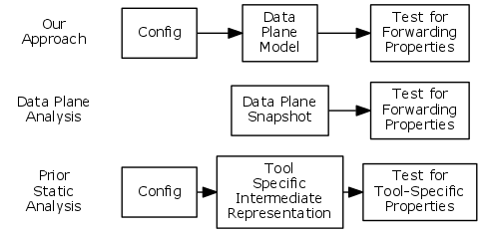
Approaches for configuration analysis
Configuration
Router runtime
Data plane state

Slide 7
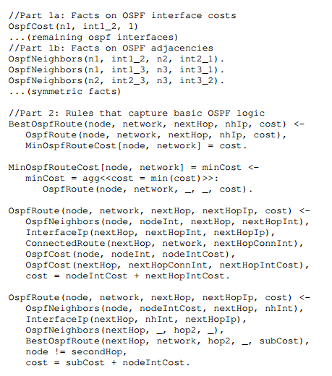
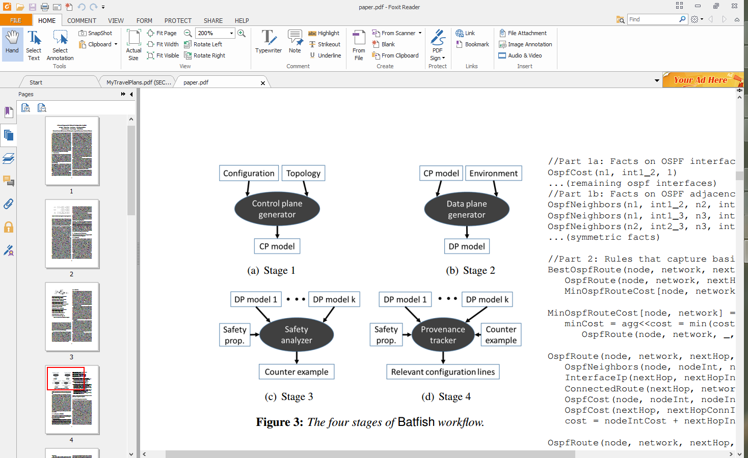
Batfish
10.0.0.0/24
C
2.2.2.0/24
3.3.3.0/24
n2
c1
c2
P
n1
n3
N
p1
n4
[A generalized approach to network configuration analysis, NSDI 2015]

Slide 8
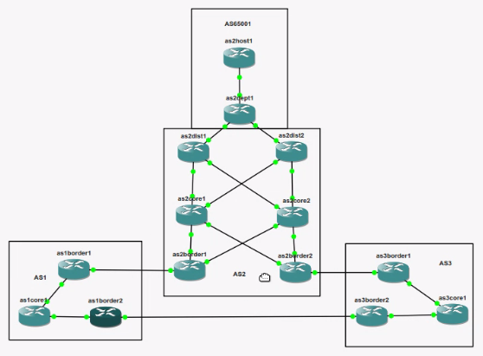
Demo

Slide 9
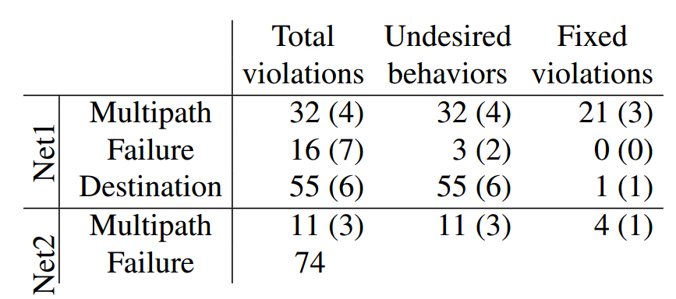
Results on two university networks
PS. Wrt the prefix that was dual-assigned from yesterday, one of my NOC guys stopped by today to ask what voodoo I was using to find such things ☺
- Email from the head of the Net1 NOC

Slide 10
Implications
It is possible to build a declarative model of existing networks
Can aid transition to SDNs
Can capture network management activity across time
Can capture network’s computation and its complexity
https://github.com/arifogel/batfish

Slide 11
Toward fully verified networks
Management plane
Configuration
Data plane computation
Router runtime
Protocol interactions
Data plane state
….
?
Forwarding software
Hardware

