Slide 1
Smartphone energy considerations (for browser design)
Ratul Mahajan
Microsoft Research

Slide 2
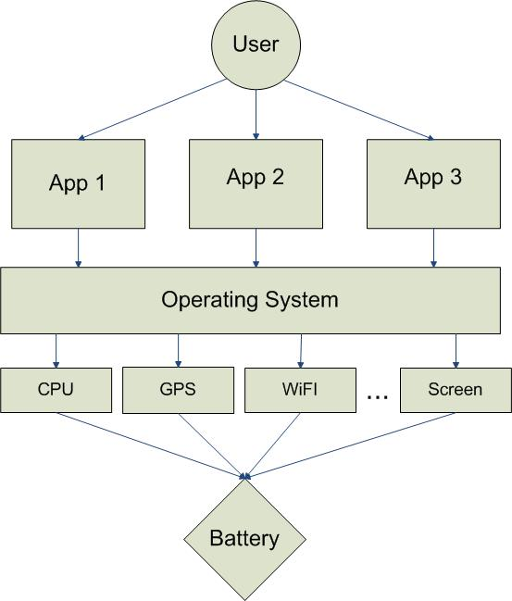
Smartphone energy use
High diversity of users motivates adaptation
Users run many apps, and no one app dominates.
Accounting for low-level device behavior is critical
Non-linear battery effects can be ignored

Slide 3
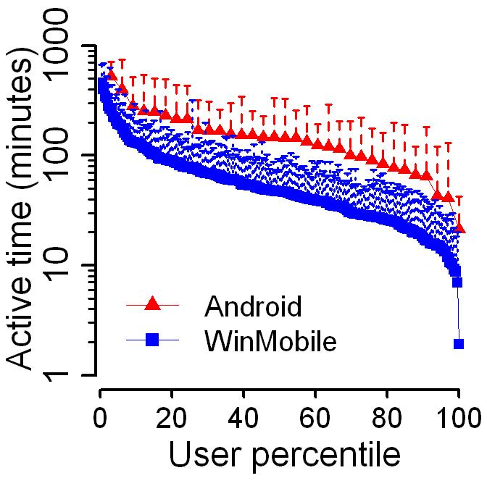
High diversity across users
Two orders
Diversity in smartphone usage
MobiSys 2010

Slide 4
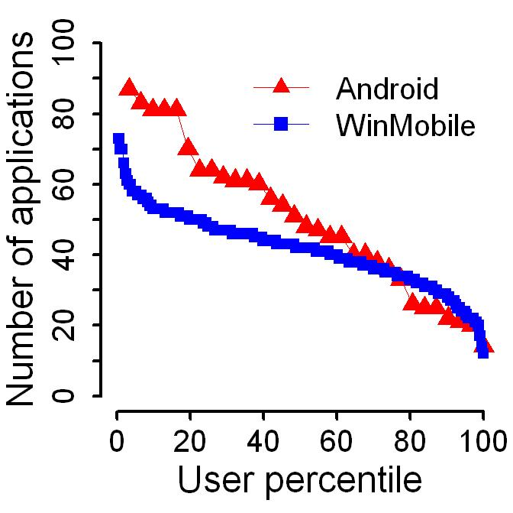
Number of apps used is high
50% of users run more than 50 apps

Slide 5
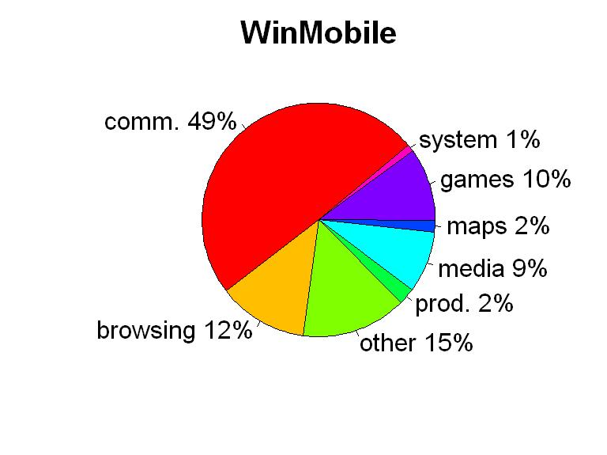
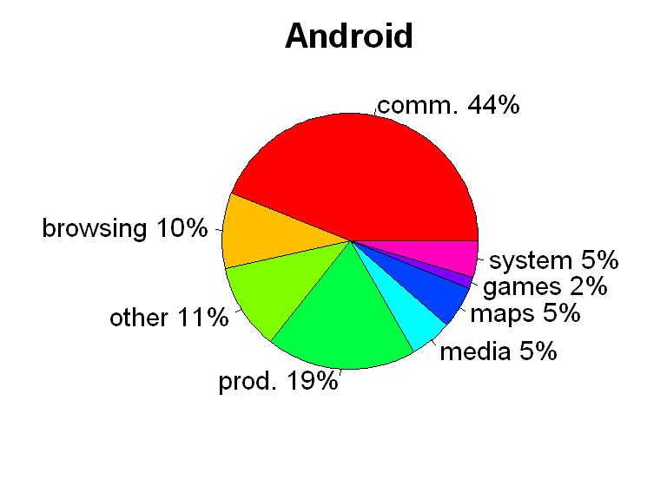
Time spent on different app types

Slide 6
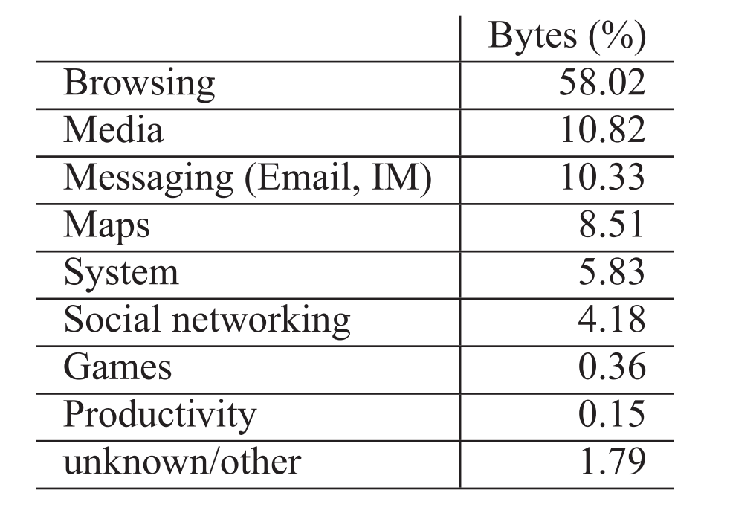
Traffic generated by different app types
A first look at traffic on smartphones
IMC 2010

Slide 7
Energy hungry hardware devices
Top 4
Screen
CPU
Memory
Radio
GPS is expensive but not always on

Slide 8
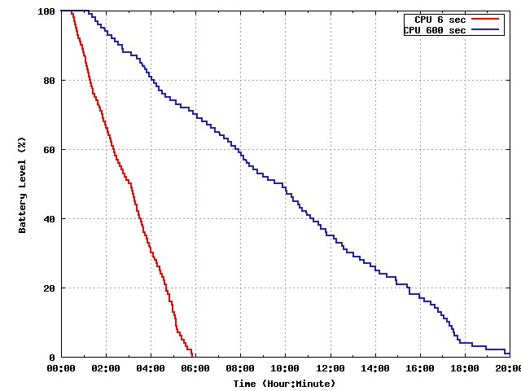
CPU energy use depends on how its used

Slide 9
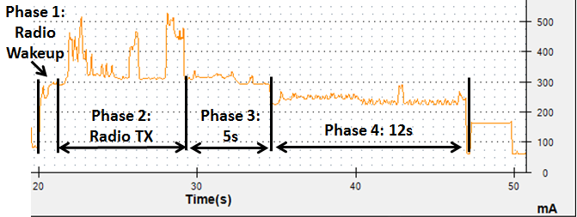
Behavior of 3G radio
Tail

Slide 10
Savings from reducing tail length

Slide 11
Summary
High diversity of users motivates adaptation
Users run many apps, and no one app dominates.
Accounting for low-level device behavior is critical
Non-linear battery effects can be ignored

