Slide 1
View the home as a computer
Ratul Mahajan
Microsoft Research
IEEE CCW, Oct 2011
Joint work with Sharad Agarwal, AJ Brush, Colin Dixon, Bongshin Lee, Stefan Saroiu
Notes:
Abstractions are important. Solutions deeply affected by abstractions. I argue for a particular abstraction. I’ll describe our attempts to implement that abstraction and describe how well it worked.

Slide 2
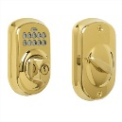
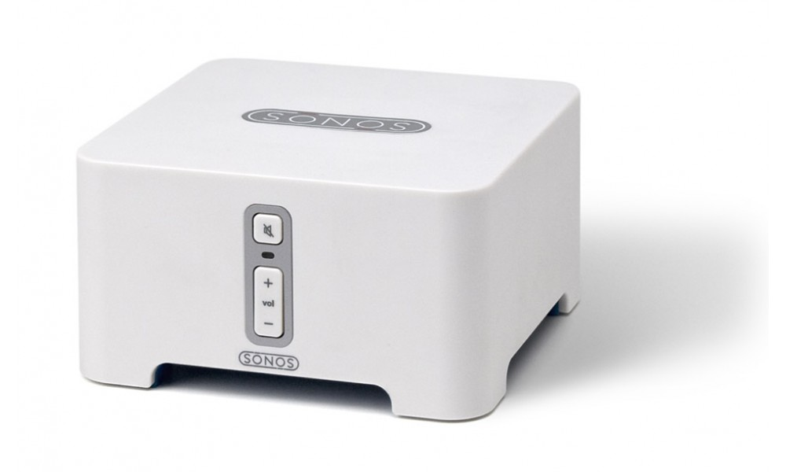
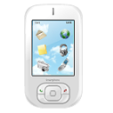
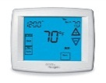

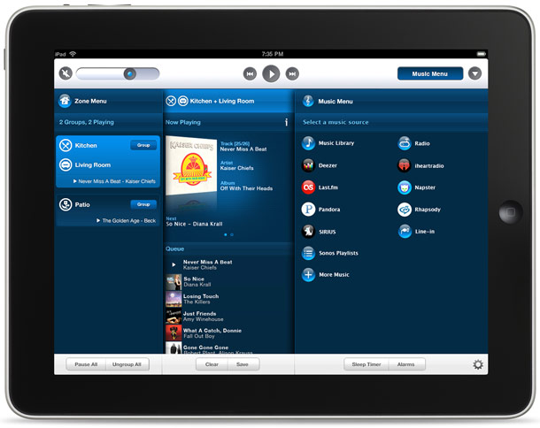

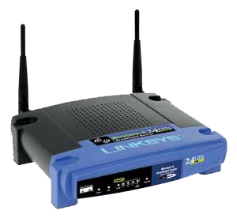
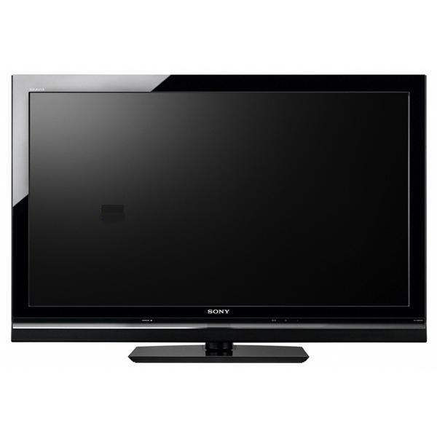
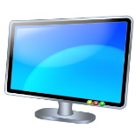
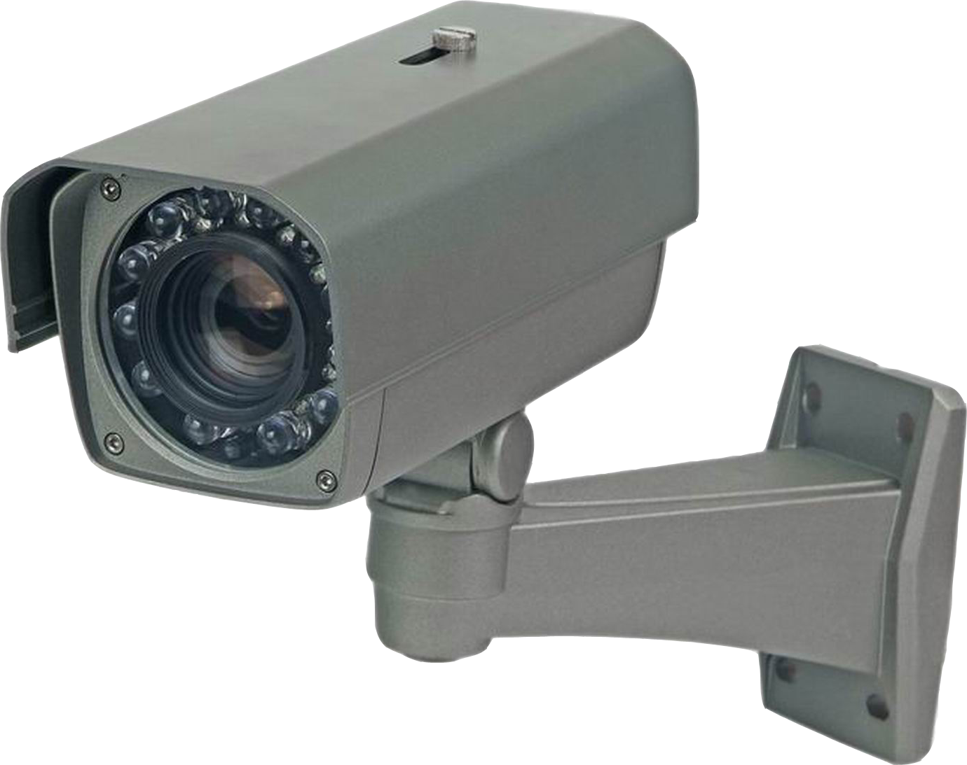
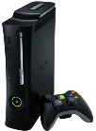
The home computing environment
Video Recording
Climate
Control
Camera-Based Entry
Remote Lock
Notes:
Here is how I look at the home computing environment.

Slide 3





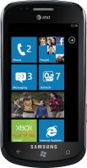

Problems faced by users
1. Management nightmare
or
Easily give the babysitter access to the DVR content, but not the printer
Add devices that are compatible with existing devices and eliminate guess work
2. Enabling cross-device functionality
Check on your house from your phone using home computer’s webcam
Transfer the audio from the car to home speakers to continue listening
Notes:
The first is device management. Today, users must manage these devices individually, and using different UIs and semantics. Simple management tasks can be nightmarish.
Management is a problem for device vendors as well. As they must invest in making their devices manageable in a stand-alone manner.
The second is enabling cross-device functionality in which multiple devices are involved. While the devices work well individually, users have a strong need and desire to combine them. Such cross-device functionality is very hard for users for achieve, unless they plan for it well in advance. Because of vertical integration and network fragmentation, they cannot organically combine devices in their homes.
This can be highly frustrating because users are unable to fully exploit the capabilities of the technology that they have invested in. The collective capability of their technology is a lot more than what they are able to do with it.

Slide 4
Traditional view of home computing
The home is a network of devices
Similar to the Internet and enterprise networks
Resulting solutions are poor fits
Management: DNS, Kerberos, Active directory, etc.
Cross-device function: interoperability protocols

Slide 5

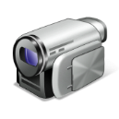




Interoperability is insufficient
Video Recording
Climate
Control
Camera-Based Entry
Remote Lock
Does not handle coordination, topological heterogeneity, and user control
Notes:
Obviously, we aren’t the first people who have tried to deal with the problem of heterogeneity inhibiting innovation in the home technology.
Interoperability simply handles device heterogeneity, leaving the other 3 kinds of heterogeneity.

Slide 6
The home as a computer
Networked devices =~ peripherals
Software that uses devices =~ apps
Managing networked devices =~ managing files
Conducting cross-device tasks =~ running apps

Slide 7
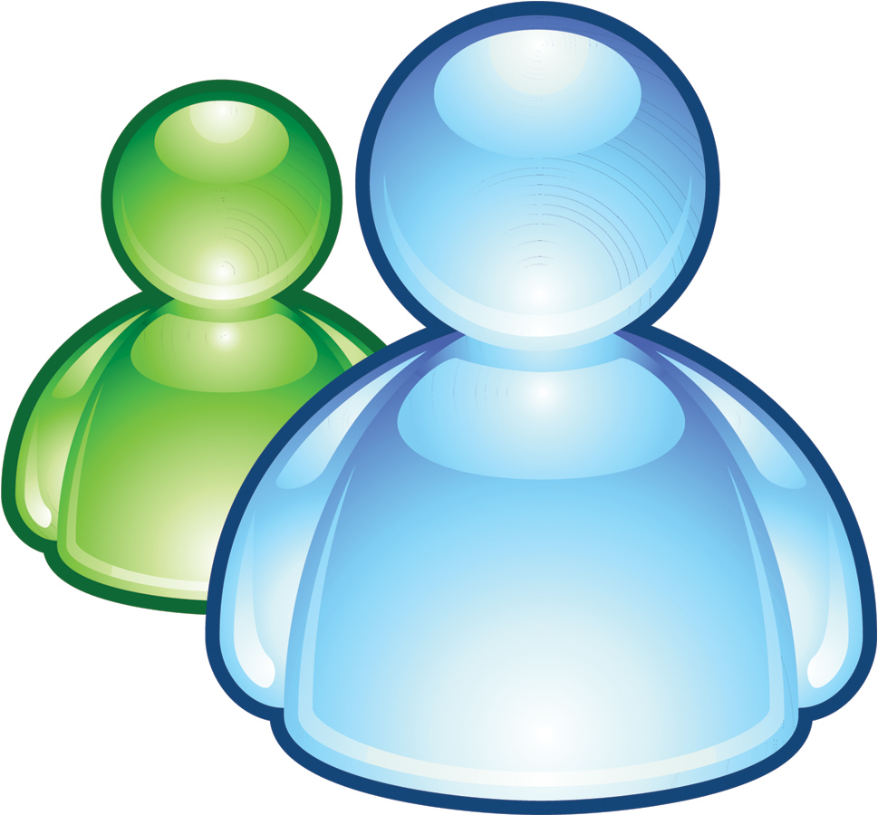
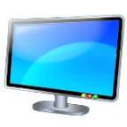

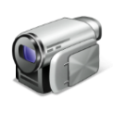

HomeOS: An OS for the home
HomeStore
Video Rec.
Remote Unlock
Climate
HomeOS
Z-Wave, DLNA, WiFi, etc.
HomeOS logically centralizes all devices in the home
Users interact with HomeOS rather than individual devices
Apps (not users) implement cross-device functionality using simple APIs
HomeStore helps users find compatible devices and apps
Notes:
HomeOS logically centralizes all technology in the home.
Users interact with HomeOS rather than individual devices, which makes them easy to manage.
HomeOS provides applications simple APIs to access these devices.
Cross-device functionality is implemented by applications, not users.
HomeStore simplifies the tasks of finding compatible devices and applications.
This is doable today because:
- most devices are network controllable
- technology around remote control of devices is maturing, for example, through standards such as DLNA, Z-Wave, and ZigBee.

Slide 8
HomeOS layering model
Apps use high-level abstractions
Simplifies app development
Manifests enable compatibility checks
Application
Mgmt. and access control
Device functionality
Device connectivity
Primitives are specialized to home setting
Simplifies configuration
Device services are exported in protocol independent manner
Decouples apps and protocols
Allows for differentiation by vendors
. . . . .
Device discovery, pairing, and comm. for multiple protocols (e.g., DLNA, Z-Wave)
Not tied to specific protocols
Notes:
Implementing all those scenarios in a tractable manner requires a robust and flexible software architecture.
HomeOS architecture is composed of five layers.

Slide 9
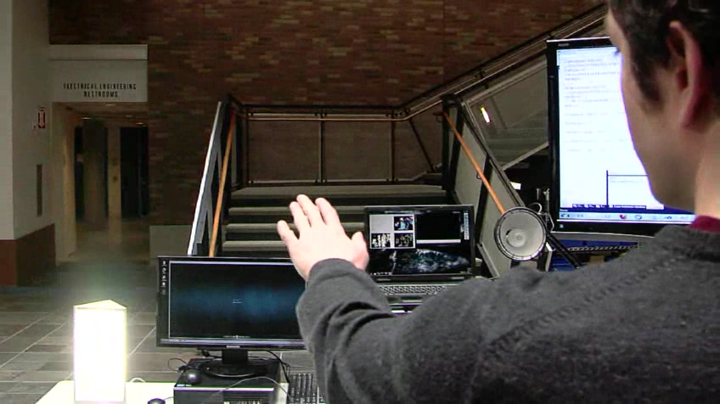
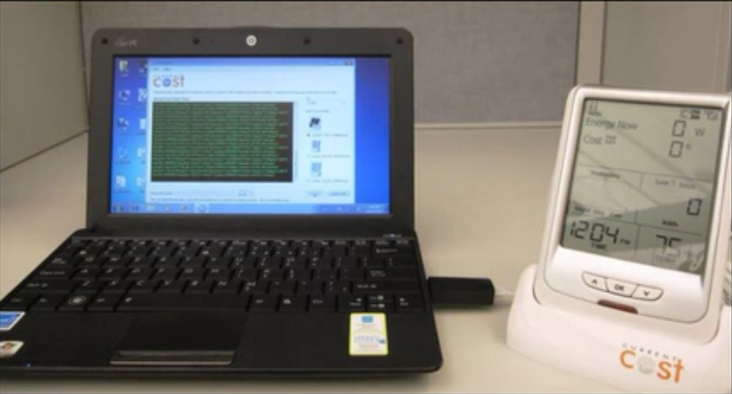
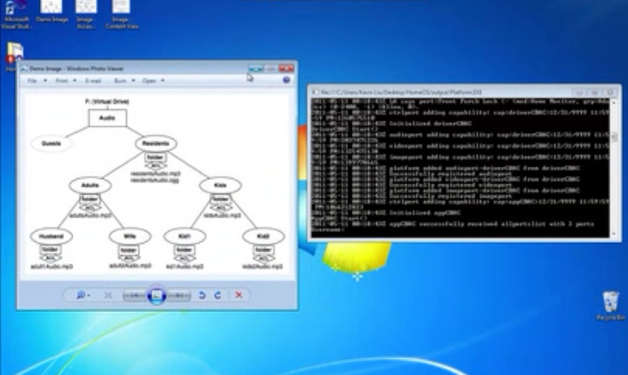
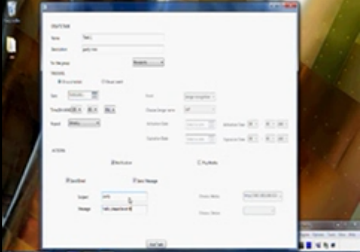
Experience with HomeOS
12 homes running HomeOS for 4-8 months
Only 2 had prior experience with home automation
Using several different devices (e.g., cameras, light controllers, door-window sensors)
41 student developers across 10 research groups
New drivers (e.g., energy meters, IM, appliance controllers).
New applications (e.g., Kinect-based control, face-recognition based reminders)
See http://research.microsoft.com/homeos/ for demos
Controlled studies of usability and programmability

Slide 10
Experience with HomeOS: The good
Users could manage their deployment
Users particularly liked the ability to organically grow their technology
Developers found the programming abstractions and layering to be “natural”

Slide 11
Experience with HomeOS: The bad
Users found it hard to diagnose their deployments
Interoperability protocols reveal limited information
Interoperability protocols can be fragile
Particularly hurts in the face of decentralized data plane
Not all device features are exposed over the network
Hinders rich application development
Control of the home can be unpredictable

Slide 12
Conclusions
View the home computing environment as a computer
Move away from viewing it as a network of devices
Simplifies management and application development
HomeOS is one way to realize the view
Experience points to both the promise and the challenges of realizing the view

