Slide 1
Systematically exploring control programs (Lecture I)
Ratul Mahajan
Microsoft Research
Joint work with Jason Croft, Matt Caesar, and Madan Musuvathi

Slide 2







Control programs are everywhere
From the smallest of networks to the largest

Slide 3
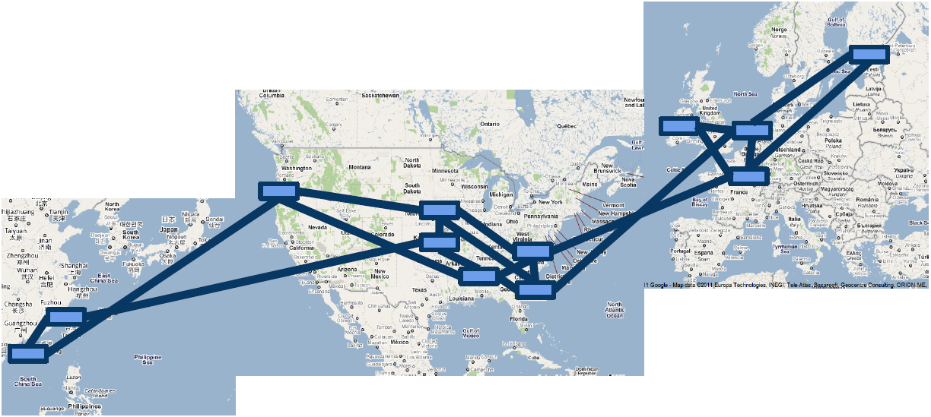

Control programs are everywhere
From the smallest of networks to the largest

Slide 4
The nature of control programs
Collection of rules with triggers and actions
motionPorch.Detected: if (Now - tLastMotion < 1s && lightLevel < 20)
porchLight.Set(On)
tLastMotion = Now
@6:00:00 PM:
porchLight.Set(On)
@6:00:00 AM:
porchLight.Set(Off)
packetIn:
entry = new Entry(inPkt.src, inPkt.dst) if (!cache.Contains(entry)
cache.Insert(entry, Now)
CleanupTimer:
foreach entry in cache
if (Now – cache[entry] < 5s)
cache.Remove(entry)

Slide 5
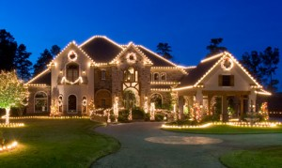

Buggy control programs wreak havoc
One nice morning in the summer

Slide 6
Buggy control programs wreak havoc
“I had a rule that would turn on the heat, disarm the alarm, turn on some lights, etc. at 8am …..
I came home from vacation to find a warm, inviting, insecure, well lit house that had been that way for a week……
That’s just one example, but the point is that it has taken me literally YEARS of these types of mistakes to iron out all the kinks.”
Notes:
“At one point I had a rule that would turn on the heat, disarm the alarm, turn on some lights, etc. at 8am in the morning on weekdays. What I didn’t consider was the fact that I wouldn’t want this to happen when I was on vacation. I came home from vacation to find a warm, inviting, insecure, well lit house that had been that way for a week. I didn’t realize until then that I needed the morning setup process to only apply when the alarm was set in sleep mode which I set every night before I go to bed. That’s just one example, but the point is that it has taken me literally YEARS of these types of mistakes to iron out all the kinks.”

Slide 7
Control programs are hard to reason about
motionPorch.Detected:
if (Now - timeLastMotion < 1 secs
&& lightMeter.Level < 20)
porchLight.Set(On);
timeLastMotion = Now;
porchLight.StateChange:
if (porchLight.State == On)
timerPorchLight.Reset(5 mins);
timerPorchLight.Fired:
if (Now.Hour > 6AM && Now.Hour < 6PM)
porchLight.Set(Off);
9:00 PM
Physical actuation
9:04 PM
Motion
9:05 PM
Lights off
Large input space
Dependence on time
Rule interaction

Slide 8
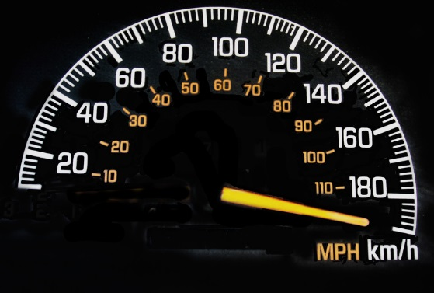
Desirable properties for bug finders
Sound
Complete
Fast
Notes:
Soundness
All discovered bugs are real bugs
Completeness
All real bugs are found
Speed
Bugs are found quickly

Slide 9
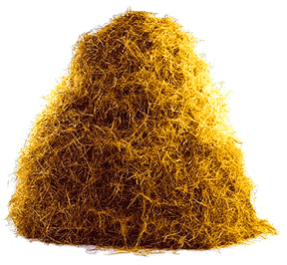
Two bug finding methods
Testing
Model checking
Notes:
Examples of mathematical objects often used to model systems are: finite state machines, labelled transition systems, Petri nets, timed automata, hybrid automata, process algebra, formal semantics of programming languages such as operational semantics, denotational semantics, axiomatic semantics and Hoare logic.^{[citation needed]}

Slide 10
Two threads in model checking
Check models
Check code

Slide 11
Model checking code
FSM is the most popular abstraction

Slide 12

Model checking code
FSM is the most popular abstaction

Slide 13
Model checking code
FSM is the most popular abstraction
Decide what are “states” and “transitions”
S0
T1
T2
S1
S2
T2
T1
T2
T1
S3
S4
Notes:
Start with an initial state
Fire all transitions to reveal new states
Repeat until no new states are revealed
Partial order reductions
Many different search strategies
Invariants on states used to find bugs

Slide 14
Example
motionPorch:
porchLight.Set(On)
timer.Start(5 mins)
porchLight.On:
timer.Start(5 mins)
timer.Fired:
porchLight.Set(Off)
[PorchLight, Timer]
[Off, Off]
Timer
Motion
LightOn
[On, On]
Motion
LightOn
LightOff
LightOn
Motion
[Off, On]
Timer
Notes:
Lets us check certain properties, such as the timer is always on when then light is on.
- Does not let us check certain properties, e.g., the light is never on for more than 5 minutes.
This was a basic introduction to model checking. How different tools differ is in how they extract program state and possible events.
- some tools uses developer input to define these things
- others use the entire memory as state and capture the inputs coming into them as events

Slide 15
Exploring input space
motionPorch:
if (lightLevel < 20)
porchLight.Set(On)
timer.Start(10 mins) porchLight.On:
timer.Start(5 mins)
timer.Fired:
porchLight.Set(Off)
To explore comprehensively, must consider all possible values of input parameters
[PorchLight, Timer]
[PorchLight, Timer]
[Off, Off]
[Off, Off]
LtLvl=0
LtLvl=99
LtLvl=0
LtLvl=19
LtLvl=99
● ● ●
● ● ●
LtLvl=20
● ● ●
[…]
[…]
[Off, Off]
[On, On]

Slide 16
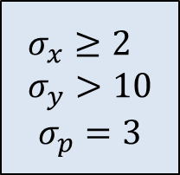


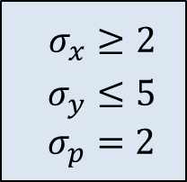

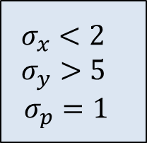




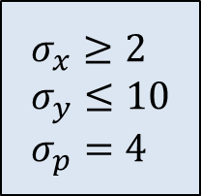
Symbolic execution
if (x < 2)
if (y > 5)
p = 1;
else
p = 2;
else
if (y > 10)
p = 3;
else
p = 4;
(x,y,p) = ($σ_{x}$, $σ_{y}$, $σ_{p}$)
$$σ_{x}<2$$
$$σ_{x}≥2$$
$$σ_{y}>5$$
$$σ_{y}≤5$$
$$σ_{y}>10$$
$$σ_{y}≤10$$
$$σ_{x}<2 \\ σ_{y}>5$$
$$σ_{p}=1$$
$$σ_{x}≥2$$ $σ_{y}≤5$ $σ_{p}=2$
$$σ_{x}≥2 \\ σ_{y}>10$$
$$σ_{p}=3$$
$$σ_{x}≥2 \\ σ_{y}≤10 \\ σ_{p}=4$$
Notes:
Explores all feasible paths symbolically
Along the way collect constraints on variables that are required to take that path

Slide 17




Finding equivalent inputs using symbolic execution
Symbolically execute each trigger
Find input ranges that lead to same state
motionPorch:
if (lightMeter.level < 20)
porchLight.Set(On)
timer.Start(5 mins)
porchLight.On:
timer.Start(5 mins)
timer.Fired:
porchLight.Set(Off)
LtLvl$<20$
LtLvl$≥20$
LtLvl$=∗$
LtLvl$=∗$

Slide 18


Finding equivalent inputs using symbolic execution
Symbolically execute each trigger
Find input ranges that lead to same state
motionPorch:
x = lightMeter.Level
porchLight.On:
timer.Start(5 mins)
timer.Fired:
porchLight.Set(Off)
LtLvl$=0$
• • • •
LtLvl$=99$

Slide 19


Efficiently exploring the input space
Pick random values in equivalent classes
motionPorch:
if (lightMeter.level < 20)
porchLight.Set(On)
timer.Start(5 mins)
porchLight.On:
timer.Start(5 mins)
timer.Fired:
porchLight.Set(Off)
LtLvl$<20$
LtLvl$≥20$
[Off, Off]
Motion, LtLvl =10
Motion, LtLvl = 20
[Off, Off]
[On, On]

Slide 20

Use symbolic execution alone?
Symbolic, path-based
Concrete, state-based
Trigger0, Trigger1,
Trigger2
[]
Trigger0
[]
Trigger1
• • •
• • •
• • •
Trigger2
Notes:
Symbolic execution is imprecise
Too many paths
The two dimensions are independent

Slide 21
Exploring temporal behavior: soundness
motionPorch:
porchLight.Set(On)
timerDim.Start(5 mins)
timerOff.Start(10 mins)
porchLight.On:
timerDim.Start(5 mins)
timerOff.Start(10 mins)
timerDim.Fired:
porchLight.Set(Dim)
timerOff.Fired:
porchLight.Set(Off)
if timerDim.On()
Abort();
[PorchLight, TimerDim, TimerOff]
[Off, Off, Off]
LightOff
Motion
LightOn
[On, On, On]
Motion
LightOn
LightOff
TimerOff
TimerDim
[Off, On, On]
[Dim, Off, On]
[Off, On, Off]
Notes:
False positive: timerDim is on but timerOff is not.
- on → off → dim is a possible sequence in exploration
- in reality, only on → dim → off will occur
The fix is not that hard (conceptually):
- Maintain a list of timer values and fire them in order

Slide 22
Exploring temporal behavior: completeness
motionPorch:
if (Now - tLastMotion < 60)
porchLight.Set(On)
timer.Start(600)
tLastMotion = Now
porchLight.On:
timer.Start(600)
timer.Fired:
porchLight.Set(Off)
To explore comprehensively, must fire all possible events at all possible times
Notes:
Can we use a trick similar to the one for input space reduction? Works for this example, but not generally ……

Slide 23

Trigger0:
tTrigger1 = Now
tTrigger2 = Now
trigger1Seen = false
Trigger1:
if (Now – tTrigger1 < 5)
trigger1Seen = true
tTrigger1 = Now
Trigger2:
if (trigger1Seen)
if (Now – tTrigger2 < 2)
DoSomething()
else
DoSomethingElse()
[trigger1Seen, tTrigger1, tTrigger2]
[false, T, T]
Trigger1 [Now=T+3]
Trigger1 [Now=T+6]
[true, T+3, T]
[false, T+6, T]
Trigger2
DoSomething()
DoSomethingElse()

Slide 24
Trigger0:
tTrigger1 = Now
tTrigger2 = Now
trigger1Seen = false
Trigger1:
if (Now – tTrigger1 < 5)
trigger1Seen = true
tTrigger1 = Now
Trigger2:
if (trigger1Seen)
if (Now – tTrigger2 < 2)
DoSomething()
else
DoSomethingElse()
[trigger1Seen, tTrigger1, tTrigger2]
[false, T, T]
Trigger1 [Now=T+1]
Trigger1 [Now=T+6]
[true, T+1, T]
[false, T+6, T]
Trigger2
DoSomething()
DoSomethingElse()

Slide 25
The tyranny of “all possible times”
Completeness
Speed
Notes:
Must discretize time but no suitable discretization interval
Trade-off between overhead and completeness

Slide 26
Timed automata
FSM (states, transitions) + the following:
Finite number of real-values clocks (VCs)
All VCs progress at the same rate, except that one or more VCs may reset on a transition
VC constraints gate transitions

Slide 27
Trigger0:
tTrigger1 = Now
tTrigger2 = Now
trigger1Seen = false
Trigger1:
if (Now – tTrigger1 < 5)
trigger1Seen = true
tTrigger1 = Now
Trigger2:
if (trigger1Seen)
if (Now – tTrigger2 < 2)
DoSomething()
else
DoSomethingElse()
[trigger1Seen]
Trigger0
() [x1,x2]
Trigger1
(x1 >=5) [x1]
[false]
Trigger2
() []
Trigger1
(x1<5) [x1]
Trigger0 () [x1,x2]
Trigger1 (x1 >= 5) [x1]
[true]
Trigger1
(x1 < 5 ) [x1]
Trigger2 (x2 < 2)
[] {DoSomething}
Trigger2 (x2 >= 2)
[] {DoSomethingElse}
Notes:
x1 and x2 are VCs for tTrigger1 and tTrigger2

Slide 28

Properties of timed automata
If VC constraints are such that:
No arithmetic operation involving two VCs
No multiplication operation involving a VC
No irrational constants in constraints
Time can be partitioned into equivalence regions
x < 2
x < y + 2
x + y < z
2x < 3
x < $\sqrt{2}$
t1 (x<2) [x]
Y →
28 regions
Corner points (6)
Line segments (14)
Spaces (8)
[s0]
[s1]
1
t2 (y<1) [y]
0
1
2
X →
Notes:
Definition of equivalence: all states reachable from one concrete time in a region should be reachable from another.

Slide 29
Trigger0:
tTrigger1 = Now
tTrigger2 = Now
trigger1Seen = false
Trigger1:
if (Now – tTrigger1 < 5)
trigger1Seen = true
tTrigger1 = Now
Trigger2:
if (trigger1Seen)
if (Now – tTrigger2 < 2)
DoSomething()
else
DoSomethingElse()
X2 →
2
1
0
1
2
3
4
5
X1 →
Notes:
Point out virtual clocks and why those constraints meet the conditions
28 open spaces
18 corners
46 line segments

Slide 30
Why regions are fine-grained
t1 (x<2) [x]
Y →
[s0]
[s1]
1
t2 (y<1) [y]
0
1
2
X →
Y →
t1 (x<2) [x]
●
●
● (1.5, 1.5)
● (2.5, 1.5)
1
[s0]
[s1]
●
●
● (0.5, 0.5)
● (1.5, 0.5)
0
1
2
X →
t2 (y<1) [y]
t3 (x<2, y > 1)
[s2]
Notes:
Those two dots take you to different regions, and hence are not equivalent.
In that sense, region construction is future proof. Equivalent means equivalent.
- I’ll get to how these magic is preserved in the next slide
But in our exploration, I show how we can counter some of the inefficiency that arises out of small regions

Slide 31
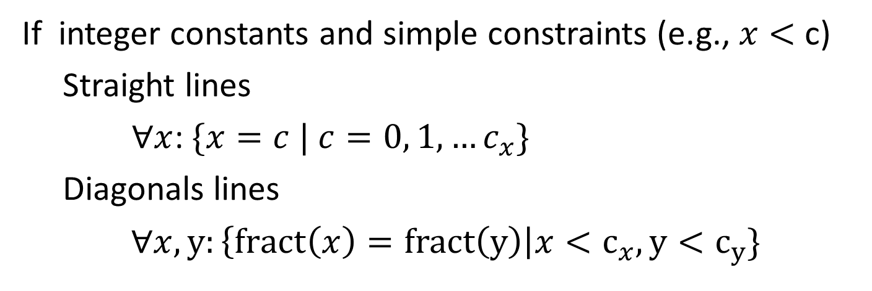
Region construction
If integer constants and simple constraints (e.g., $x<$ c)
Straight lines
$∀x$: $\{x=c | c=0, 1, …c_{x}\}$
Diagonals lines
$∀x,y:\left\{fract\left(x\right)=fract\left(y\right)\right|x<c_{x}, y<c_{y}\}$
X2 →
x2 < x1 + 2
2
1
0
1
2
3
4
5
X1 →
Notes:
Instead of steps of 1, we can go in steps of GCD
The number of regions grows exponentially in the number of VCs

Slide 32
Why this construction works
X1 < 5
X2 < 2
X1 < 5 && X2 > 2
X2 →
●
●
2
●
●
1
0
1
2
3
4
5
X1 →
Notes:
Recall the definition of equivalence: reachable states are identical
The main consideration is that arbitrary things can happen when VCs reach constant boundaries.
So, we get the straight lines.

Slide 33
Why this construction works
X1 < 5
X2 < 2
X1 < 5 && X2 > 2
X2 →
●
2
●
●
1
●
0
1
2
3
4
5
X1 →
Notes:
What about diagonal lines?
They ensure that, for two sets of VC values, the same VC reaches the constant boundary.
This construction is not minimal. Folks have proposed this concept of zones, which are coarser than regions, and they combine regions for which behaviors are equivalent.
But we’ll focus on regions for the purposes of this talk.

Slide 34
Exploring a TA
Trigger0 () [x1,x2]
Trigger0
[false]
[false]
x1=0, x2=0
Trigger1
(x1 >=5) [x1]
Trigger2
Trigger2
() []
Trigger0
Trigger1
Trigger0
δ
Trigger1
Trigger0 () [x1,x2]
[true]
x1=0, x2=0
[false]
x1=0.5, x2=0.5
Trigger1
(x1<5) [x1]
Trigger1 (x1 >= 5) [x1]
Trigger2 {DoSomething}
Trigger1
Trigger2
[true]
δ
Trigger1
(x1 < 5 ) [x1]
[true]
x1=0, x2=0.5
[true]
x1=0.5, x2=0.5
δ
Trigger2 (x2 < 2)
[] {DoSomething}
Trigger2 (x2 > 2)
[] {DoSomethingElse}
[false]
x1=1, x2=1
Notes:
Along with program state, track the values of VCs
From a state
Explore all outgoing transitions
Explore exactly one delay transition
The thing on the right is called a region automata
Reachability is decidable; PSPACE complete
The state space size if a function of the number of regions, which is a function of the number of VCs.

Slide 35
Exploring a TA
Trigger0 () [x1,x2]
Trigger0
[false]
[false]
x1=0, x2=0
Trigger1
(x1 >=5) [x1]
Trigger2
Trigger2
() []
Trigger0
Trigger1
Trigger0
δ
Trigger1
Trigger0 () [x1,x2]
[true]
x1=0, x2=0
[false]
x1=0.5, x2=0.5
Trigger1
(x1<5) [x1]
Trigger1 (x1 >= 5) [x1]
Trigger2 {DoSomething}
Trigger1
Trigger2
[true]
δ
Trigger1
(x1 < 5 ) [x1]
[true]
x1=0, x2=0.5
[true]
x1=0.5, x2=0.5
δ
Trigger2 (x2 < 2)
[] {DoSomething}
Trigger2 (x2 > 2)
[] {DoSomethingElse}
[false]
x1=1, x2=1
Notes:
Along with program state, track the values of VCs
From a state
Explore all outgoing transitions
Explore exactly one delay transition
The thing on the right is called a region automata
Reachability is decidable; PSPACE complete
The state space size if a function of the number of regions, which is a function of the number of VCs.

Slide 36
Systematically exploring control programs (Lecture II)
Ratul Mahajan
Microsoft Research
Joint work with Jason Croft, Matt Caesar, and Madan Musuvathi

Slide 37
Recap: The nature of control programs
Collection of rules with triggers and actions
motionPorch.Detected: if (Now - tLastMotion < 1s && lightLevel < 20)
porchLight.Set(On)
tLastMotion = Now
@6:00:00 PM:
porchLight.Set(On)
@6:00:00 AM:
porchLight.Set(Off)
packetIn:
entry = new Entry(inPkt.src, inPkt.dst) if (!cache.Contains(entry)
cache.Insert(entry, Now)
CleanupTimer:
foreach entry in cache
if (Now – cache[entry] < 5s)
cache.Remove(entry)

Slide 38
Recap: Timed automata
FSM (states, transitions) + the following:
Finite number of real-values clocks (VCs)
All VCs progress at the same rate, except that one or more VCs may reset on a transition
VC constraints gate transitions

Slide 39

Recap: Properties of timed automata
If VC constraints are such that:
No arithmetic operation involving two VCs
No multiplication operation involving a VC
No irrational constants in constraints
Time can be partitioned into equivalence regions
x < 2
x < y + 2
x + y < z
2x < 3
x < $\sqrt{2}$
t1 (x<2) [x]
Y →
28 regions
Corner points (6)
Line segments (14)
Spaces (8)
[s0]
[s1]
1
t2 (y<1) [y]
0
1
2
X →
Notes:
Definition of equivalence: all states reachable from one concrete time in a region should be reachable from another.

Slide 40
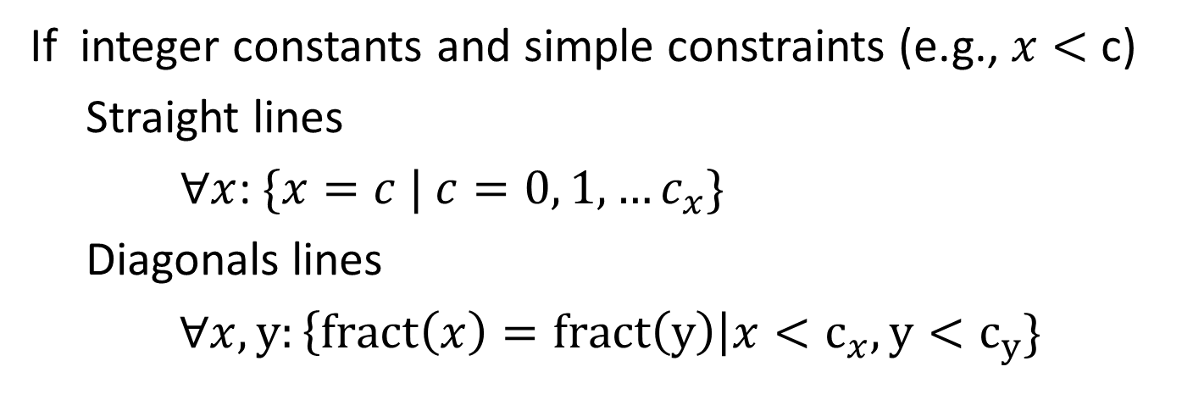
Recap: Region construction
If integer constants and simple constraints (e.g., $x<$ c)
Straight lines
$∀x$: $\{x=c | c=0, 1, …c_{x}\}$
Diagonals lines
$∀x,y:\left\{fract\left(x\right)=fract\left(y\right)\right|x<c_{x}, y<c_{y}\}$
X2 →
x2 < x1 + 2
2
1
0
1
2
3
4
5
X1 →
Notes:
Instead of steps of 1, we can go in steps of GCD
The number of regions grows exponentially in the number of VCs

Slide 41
Recap: Exploring a TA
Trigger0 () [x1,x2]
Trigger0
[false]
[false]
x1=0, x2=0
Trigger1
(x1 >=5) [x1]
Trigger2
Trigger2
() []
Trigger0
Trigger1
Trigger0
δ
Trigger1
Trigger0 () [x1,x2]
[true]
x1=0, x2=0
[false]
x1=0.5, x2=0.5
Trigger1
(x1<5) [x1]
Trigger1 (x1 >= 5) [x1]
Trigger2 {DoSomething}
Trigger1
Trigger2
[true]
δ
Trigger1
(x1 < 5 ) [x1]
[true]
x1=0, x2=0.5
[true]
x1=0.5, x2=0.5
δ
Trigger2 (x2 < 2)
[] {DoSomething}
Trigger2 (x2 > 2)
[] {DoSomethingElse}
[false]
x1=1, x2=1
Notes:
Along with program state, track the values of VCs
From a state
Explore all outgoing transitions
Explore exactly one delay transition
The thing on the right is called a region automata
Reachability is decidable; PSPACE complete
The state space size if a function of the number of regions, which is a function of the number of VCs.

Slide 42
Exploring control programs with TAs
Mapping time-related activity to VCs
Model devices
Construct time regions
Compute equivalent classes for inputs
Explore states
Notes:
The program in not written in terms of VCs
The program sends and receives messages from devices

Slide 43
Mapping to VCs (1/4): Delay measurers
Trigger1: ...
tLast = Now
...
Trigger2: ...
if (Now - tLast < 60)
...
Trigger1:
...
VC_tLast = 0
...
Trigger2:
...
if (VC_tLast < 60)
...
Notes:
All time related variables are effectively VCs
Three types of usage

Slide 44
Mapping to VCs (2/4): Periodic timers
timer1.Period = 600
timer1.Event += Timer1Fired
...
Timer1Fired:
...
VC_timer1 = 0 ...
VC_timer1 == 600:
...
VC_timer1 = 0
Notes:
All time related variables are effectively VCs
Three types of usage

Slide 45
Mapping to VCs (2/4): Delayed actions
Trigger1: ... timer1.Start(600) ...
timer1.Fired:
...
Trigger1: ... VC_timer1 = 0 ...
VC_timer1 == 600:
...
Notes:
All time related variables are effectively VCs
Three types of usage

Slide 46
Mapping to VCs (4/4): Sleep calls
Trigger:
...
Sleep(10)
...
Trigger: ... // pre-sleep actions
VC_sleeper = 0
VC_sleeper == 10:
... // post-sleep actions
Notes:
All time related variables are effectively VCs
Three types of usage

Slide 47
Reducing the number of VCs: Combining periodic timers
timer1.Period = 600 timer1.Event += Timer1Fired timer2.Period = 800 timer2.Event += Timer2Fired
...
Timer1Fired:
...
Timer2Fired:
...
VC_timer = 0 ...
VC_timer == 600:
...
VC_timer == 800:
... VC_timer = 0

Slide 48
Reducing the number of VCs: Combining sleep calls
Trigger:
Act1()
Sleep(5)
Act2()
Sleep(10)
Act3()
Trigger: Act1()
VC_sleeper = 0
sleep_counter = 1;
VC_sleeper == 5:
Act2() VC_sleeper == 15: Act3()
Notes:
We can do this because the two sleeps can never be active at the same time

Slide 49
Modeling devices
Model a device using one of more key value pairs
Motion sensor: Single key with binary value
Dimmer: Single key with values in range [0..99]
Thermostat: Multiple keys
Keys can be notifying or non-notifying
Triggers are used for notifying keys
Queries for values are treated as program inputs
Notes:
The goal is to model externally observable state and actions, not the internal behavior, which can be arbitrarily complex.
Each device is captured by one or more key-value pairs

Slide 50
Limitations of device modeling
Values can change arbitrarily
Key value pairs of a device are independent
Different devices are independent

Slide 51
Constructing time regions
Extract VC constraints using symbolic execution
Construct time regions using the constraints
Trigger0:
tTrigger1 = Now
tTrigger2 = Now
trigger1Seen = false
Trigger1:
if (Now – tTrigger1 < 5)
trigger1Seen = true
tTrigger1 = Now
Trigger2:
if (trigger1Seen)
if (Now – tTrigger2 < 2)
DoSomething()
else
DoSomethingElse()

Slide 52
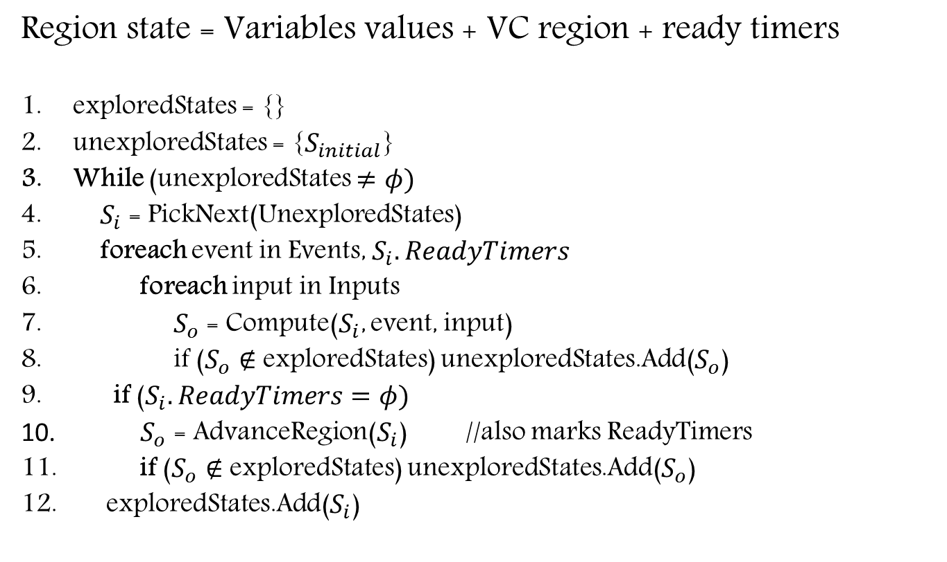
Exploration using TA
Region state = Variables values + VC region + ready timers
exploredStates = {}
unexploredStates = {$S_{initial}$}
While (unexploredStates $≠φ)$
$S_{i}$ = PickNext(UnexploredStates)
foreach event in Events, $S_{i}.ReadyTimers$
foreach input in Inputs
$S_{o}$ = Compute($S_{i}$, event, input)
if ($S_{o}∉$ exploredStates) unexploredStates.Add($S_{o}$)
if ($S_{i}.ReadyTimers=φ)$
$S_{o}$ = AdvanceRegion($S_{i}$) //also marks ReadyTimers
if ($S_{o}∉$ exploredStates) unexploredStates.Add($S_{o}$)
exploredStates.Add($S_{i}$)
Notes:
Assumes instantaneous processing of triggers.
- typically true
- assumed by most other work as well

Slide 53
Optimization: Predicting successor states
Observation: Multiple region states can have identical response to a trigger
Trigger1:
if (x1 < 5)
trigger1Seen = true
x1= 0
Trigger2:
if (trigger1Seen)
if (x2 < 2)
DoSomething()
else
DoSomethingElse()
tTrigger2
2
●
1
●
0
1
2
3
4
5
tTrigger1
Notes:
Same program as before, except that
- I’ve just take out Trigger 0, as it didn’t matter to this example.
- I’ve transformed the program to VC termonology

Slide 54






Optimization: Predicting successor states
Observation: Multiple region states can have identical response to a trigger
Clock personality: region’s evaluation of clock constraints
Same variable values and ready timers
$$S_{1}$$
$$S_{2}$$
Different regions but same personality
Compute
● ● ● ●
● ● ● ●
Predict
Notes:
Same program as before, except that
- I’ve just take out Trigger 0, as it didn’t matter to this example.
- I’ve transformed the program to VC termonology
Different regions can have the same personality
Prediction basically requires appropriate extrapolation of VC values

Slide 55
Optimization: Independent control loops
Observation: Control programs tend to have multiple, independent control loops
Determine independent sets of variables
Explore independent sets independently
Notes:
Independent control loops:
- security loop: locks and alarms
- climate control loop:
- lighting loop

Slide 56
DeLorean
Control program
Safety invariants
Front end
Program with virtualized devices
Clock constraints Input space classes Control loops
Program analyzer
Explorer
Region states Paths

Slide 57
Demo

Slide 58
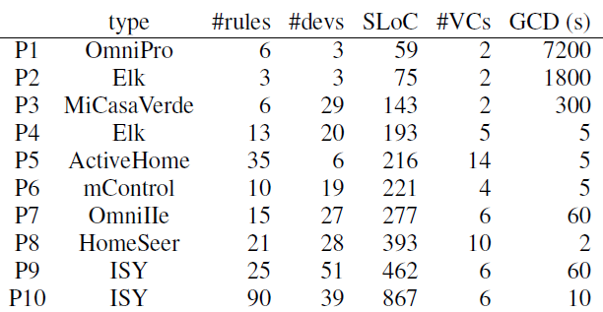
Evaluation on ten real home automation rograms
Notes:
Scripts solicited using a mailing list
Many rules and devices
5+ VCs for most homes, indicating a heavy reliance on time
GCD indicates the granularity at which we explore actions

Slide 59
Example bugs
P9-1: Lights turned on even in the absence of motion
Bug in conditional clause: used OR instead of AND
P9-2: Lights turned off between sunset and 2AM
Interaction between rules that turned lights on and off
P10-1: Dimmer wouldn’t turn on despite motion
No rule to cover a small time window
P10-2: One device in a group behaved differently
Missing reference to the device in one of the rules

Slide 60
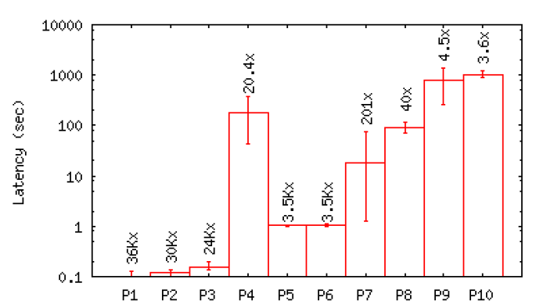
Performance of exploration
Time to “fast forward” the home by one hour
Notes:
8 core 2.5 GHz Intel Xeon PC, 16 GB RAM
Speed-up factor: 3.6 – 36K
P4 is slower despite having fewer SLoC because it has more VCs in its biggest control loop
200K transitions per second

Slide 61
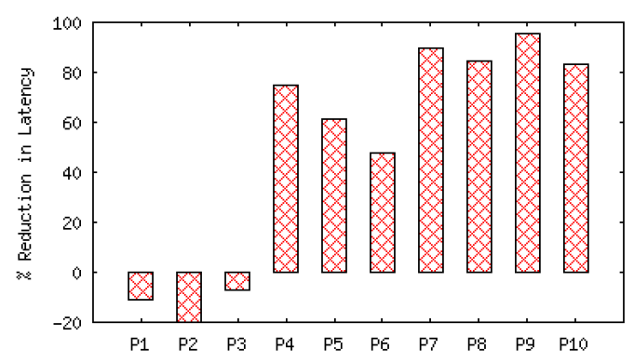
Benefit of successor prediction
Successor prediction yields significant advantage
Notes:
The advantage of successor prediction depends on how often similar states are encountered. If not a lot, it can actually be a disadvantage because of the overhead of looking for them.
In practice, significant benefit for complex programs.

Slide 62
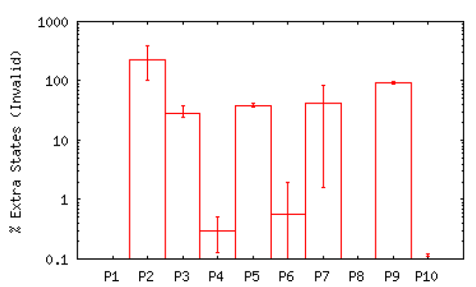
Comparison with untimed model checking
Untimed model checking reaches many invalid states
Notes:
Invalid examples:
- Lights programmed to turn on at specific times such as evenings. They can appear on/off anytime.
- Things supposed to occur in sequence (on key press, open garage door, then close after five minutes). Untimed can predict that the door will be left in open state if it fires the close timer early.

Slide 63
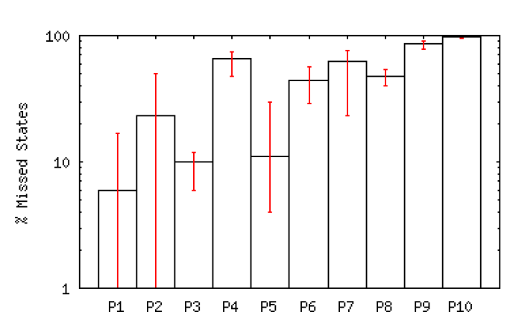
Comparison with randomized testing
Random testing misses many valid states
Notes:
Generated random sequences of events, including delay events.
Same CPU time for exploration as DeLorean.

Slide 64
Exploring OpenFlow programs
 | #devs | SLoC | #VCs | GCD
MAC-Learning Switch (PySwitch) | 2 hosts, 2 sw, 1 ctrl | 128 | >= 6 | 1
Web Server Load Balancer | 3 hosts, 1 sw, 1 ctrl | 1307 | >= 4 | 1
Energy-Efficient Traffic Engineering | 3 hosts, 3 sw, 1 ctrl | 342 | >= 8 | 2

Slide 65
Additional challenges in OF programs
packetIn:
timer = new Timer(5s)
Insert(timer, inPkt.src, inPkt.dst)
Dynamically created VCs
Variable number of VCs along different paths

Slide 66
Open problems
Handling communicating control programs
Exploring all possible topologies

Slide 67
Summary
Control programs are tricky to debug
Interaction between rules
Large space of inputs
Intimate dependence on time
These challenges cab be tacked using
Systematic exploration (model checking)
Symbolic execution to find equivalent input classes
Timed automata based exploration (equivalent times)

