Slide 1
HNI: Human network interaction
Ratul Mahajan
Microsoft Research
@ dub, University of Washington
August, 2011
Notes:
A positive and a negative message. AJ and Jaeyeon convinced me to not go with the negative message.

Slide 2
I am a network systems researcher
Build (or improve) network systems
Build tools to understand complex systems
View system building as the art of balancing technical, economic, and business factors
And off late, human factors too
Notes:
Business factors have become a consideration in the last 10-15 years, inspired by failures of multicast, ipv6, qos, etc.
In the last 2-3 years, I’ve learned human factors matter too.

Slide 3
This talk
Three case studies
Network diagnosis
Network monitoring
Smart homes
Notes:
Make this point using three case studies.

Slide 4
Diagnosis explains faulty behavior
Starts with problem symptoms
Ends at likely cause(s)
File server
Photo viewer
Configuration
Configuration change denies permission
User cannot access a remote folder

Slide 5
Key considerations for diagnostic systems
Rule based
Inference based
Accuracy
Fault coverage
Accuracy: How often the real culprit is identified
Coverage: Fraction of failures covered

Slide 6
NetMedic: A detailed diagnostic system
Focus on small enterprises
Inference based:
Views the network as a dependency graph of fine-grained components (e.g., applications, services)
Produces a ranked list of likely culprit components using statistical and learning techniques
[Detailed diagnosis in enterprise networks, SIGCOMM 2009]

Slide 7
Effectiveness of NetMedic
The real culprit is identified as most likely 80% of the time but not always

Slide 8
Unleashing NetMedic on operators
Key hurdle: Understandability
How to present the analysis to users?
Impacts mean time to recovery
Two sub-problems at the intersection of systems and HCI
Explaining complex analysis
Intuitiveness of analysis
Rule based
Inference based
Accuracy
State of practice
Research activity
Fault coverage

Slide 9
Explaining diagnostic analysis
Presenting the results of statistical analysis
Not much existing work; this uncertainty differs from that of typical scientific data
Underlying assumption: humans can double check analysis if information is presented appropriately
An “HCI issue” that needs to be informed by system structure

Slide 10
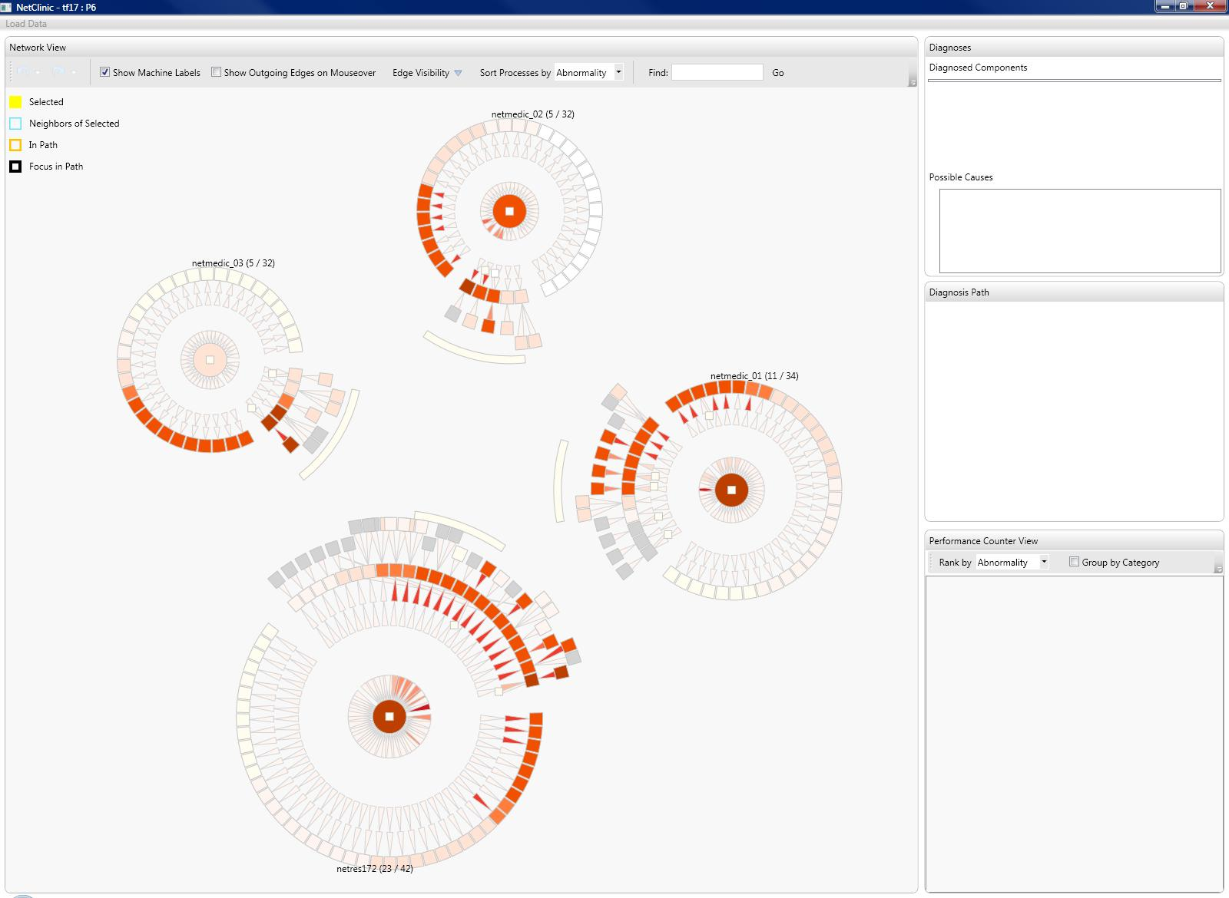
[NetClinic: Interactive Visualization to Enhance Automated Fault Diagnosis in Enterprise Networks , VAST2010]
Notes:
88% of the tasks were done correctly

Slide 11
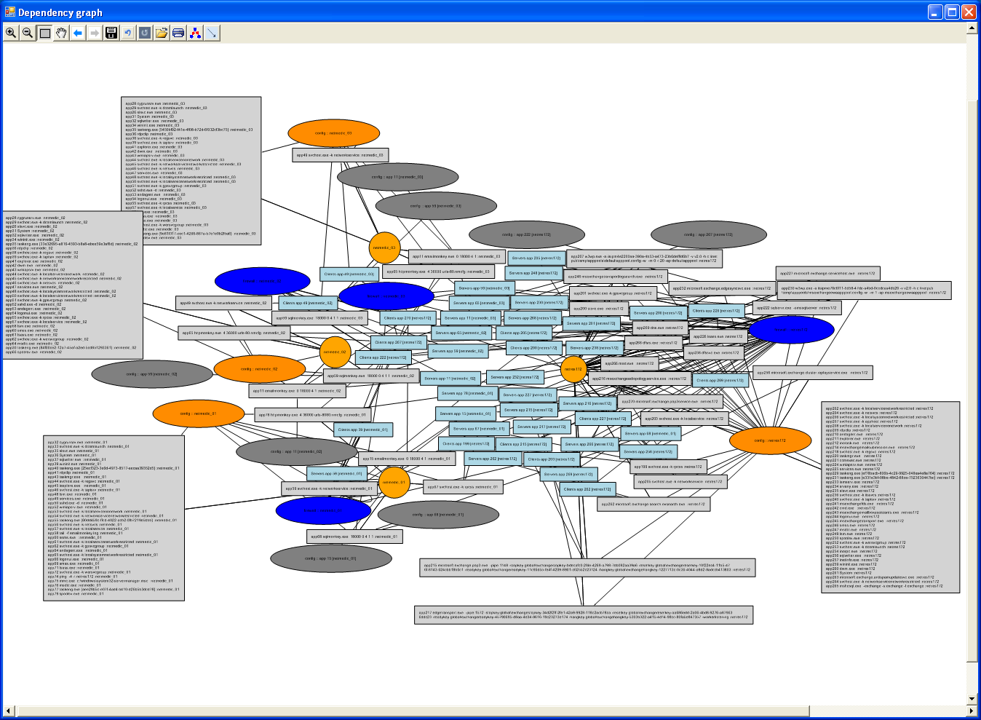

Slide 12
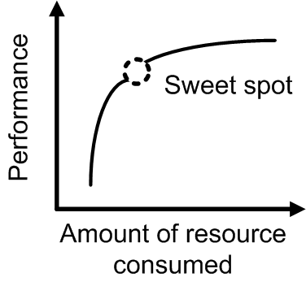
Intuitiveness of analysis
The ability to reason about the system’s analysis
A non-traditional dimension of system effectiveness
Counters the tendency of optimizing the system for incremental accuracy
A “systems issue” that needs to be informed by HCI
Understandability
Accuracy

Slide 13
Intuitiveness of analysis (2)
Goal: Go from mechanical measures to more human centric measures
Example: MoS measure for VoIP
Factors that may be considered
What information is used?
E.g., Local vs. global
What operations are used?
E.g., arithmetic vs. geometric means

Slide 14
Considerations for diagnostic systems
Understandability
Coverage
Accuracy
Coverage
Accuracy

Slide 15





Network Alarm Monitoring and Triage
A large stream of incoming alarms (many per incident)
Alarms grouped by incident and appropriately labeled (e.g., severity, owner)
Alarm triage
Network

Slide 16
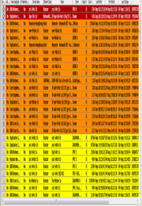




Key considerations for triage systems
CueT
Manual
Accuracy
Pipeline
Full automation
Speed
Notes:
Problems with manual: Tedious, slow, error prone
Problems with full automation: Difficult to keep up-to-date, rarely perfect
Problem with pipeline:
- Inherits problems of manual and full automation
- Introduces a fundamental trade-off
Aggressive rules: suppress too many alarms
Conservative rules: leave too much for operators

Slide 17
CueT: Cooperating machine and human
Use interactive machine learning to automatically learn patterns in operators’ actions
[CueT: Human-Guided Fast and Accurate Network Alarm Triage, CHI 2011]

Slide 18
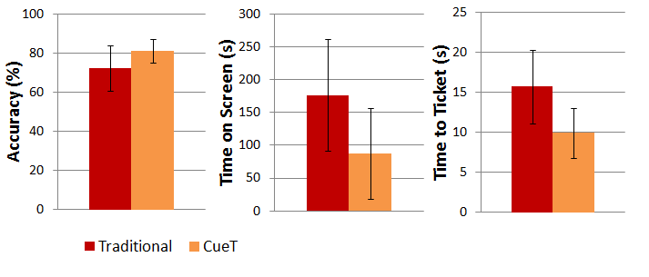
CueT is faster and more accurate
50% speed improvement
10% accuracy improvement
Notes:
And what we found was the CueT lead to large time savings. We measured the time between successive triage actions, and found that CueT lead to a significant improvement in triage speed, with a savings of approximately 37%.

Slide 19
Unleashing CueT on operators
Key hurdle: predictable control
Predictability in system actions and recommendations
Unlearning bad examples
Direct control for special cases

Slide 20
Considerations for network alarm triage
Predictable control
Speed
Accuracy
Speed
Accuracy

Slide 21


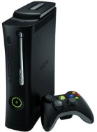

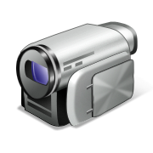
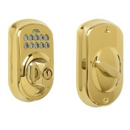

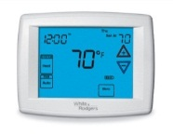
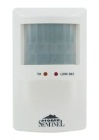
Smart homes
Capability to automate and control multiple, disparate systems within the home [ABI Research]

Slide 22
Why are smart homes not mainstream?
The concept is older than two decades
Commercial systems and research prototypes exist
Initial hypotheses
Cost
Heterogeneity

Slide 23





Study of automated homes
To understand barriers to broad adoption
14 homes with one or more of:
Remote lighting control
Multi-room audio/video systems
Security cameras
Motion detectors
Outsourced
DIY
Inventory
Semi-Structured Interview
Questionnaire
Home Tour
[Home automation in the wild: Challenges and opportunities, CHI 2011]
Notes:
31 people – guru in every house, and 1-2 consumers

Slide 24

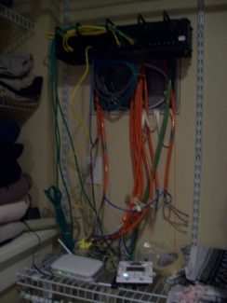
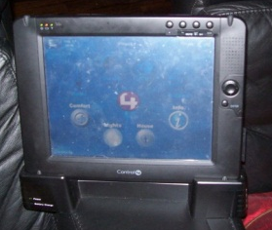
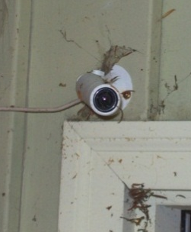
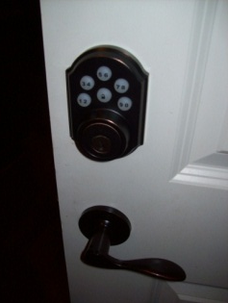
Four barriers to broad adoption
Cost of ownership
Inflexibility
Poor manageability
Difficulty achieving security
Notes:
Cost in terms of time and money:
- Consultant visits not a big factor
- Low perceived value of additional applications
Inflexibility:
- Structural changes
Poor manageability:
- Complex UI
- Iteration required to figure out what worked for them
Security:
- Vulnerability of remote access
- Adding guests on to the wireless network

Slide 25
Some implications for research
Let users incrementally add functionality
While mixing hardware from different vendors
Simplify access control and guest access
Build confidence-building security mechanisms
Theme: Network management for end users
Current techniques are enterprise heavy

Slide 26





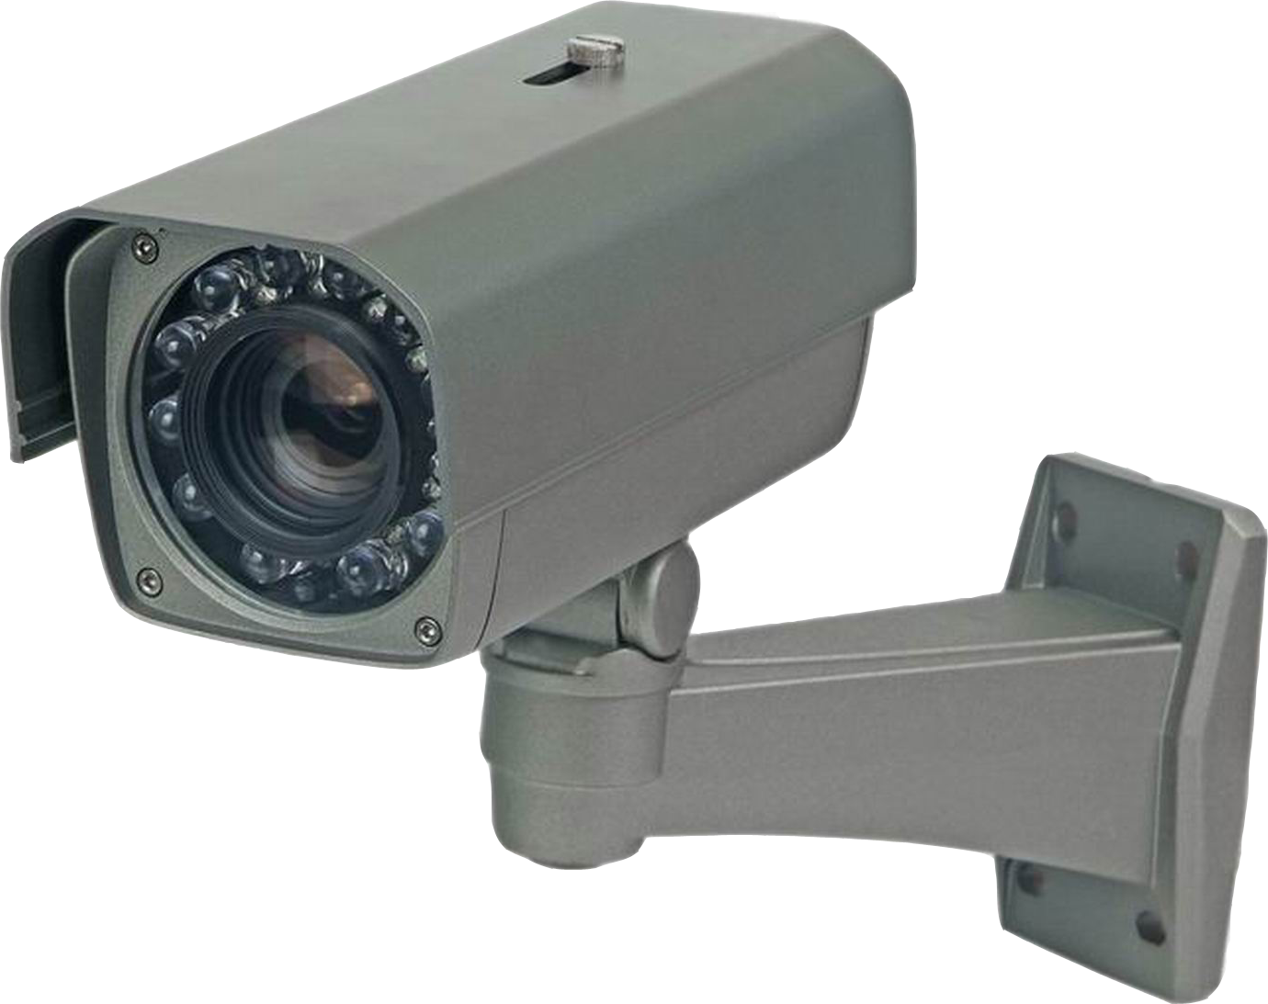





HomeOS: A hub for home technology
HomeStore
Video Rec.
Remote Unlock
Climate
HomeOS
Z-Wave, DLNA, WiFi, etc.
HomeOS logically centralizes all devices in the home
Users interact with HomeOS rather than individual devices
Apps (not users) implement cross-device functionality using simple APIs
HomeStore helps users find compatible devices and apps
[The home needs an operating system (and an app store), HotNets 2010]
Notes:
HomeOS logically centralizes all technology in the home.
Users interact with HomeOS rather than individual devices, which makes them easy to manage.
HomeOS provides applications simple APIs to access these devices.
Cross-device functionality is implemented by applications, not users.
HomeStore simplifies the tasks of finding compatible devices and applications.
This is doable today because:
- most devices are network controllable
- technology around remote control of devices is maturing, for example, through standards such as DLNA, Z-Wave, and ZigBee.

Slide 27
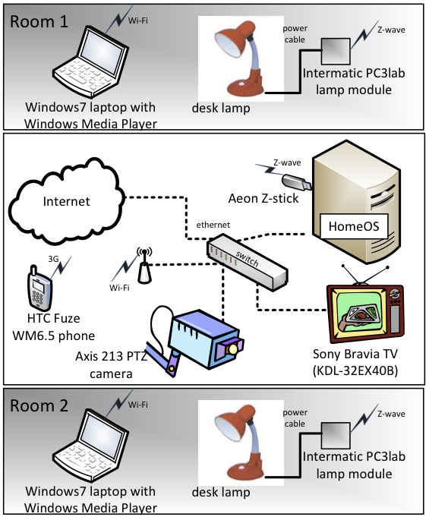
Status
.NET-based software module
~20K lines of C# (~3K kernel)
15 diverse apps (~300 lines per app)
Positive study results
Easy to manage by non-technical users
Easy to develop apps
Small “dogfood” deployment
Academic licensing
What would YOU do?
Notes:
The software module can run on any device that can run .NET framework (e.g., XBox, home server).
The controlled studies of the software show positive results.
Further, validating the software architecture by having academic partners use HomeOS for teaching and research.
Enough interested generated that device vendors have been contacting us to get involved.
What access control primitives are needed?
What apps are interesting to people?
What are the mental models for privacy of sensor data?
How to enable secure data sharing?

Slide 28
Considerations for smart homes
Manageability
Cost
Heterogeneity
Cost
Heterogeneity

Slide 29
HNI: Human network interaction
Humans
Humans
HCI
HNI
Computing systems
Networks are (often loosely) coupled computing devices
Interactions are more complex and challenging
Users are increasingly exposed to the complexity of networks
Human factors can be key to acceptance and effectiveness
Must work with realistic models of network systems

Slide 30
Summary
Human factors can be key to the success of network systems
Their impact on the design can run deep
The complexity of network systems opens up new challenges for HCI research

