Slide 1
Beyond the super-rich and the super-geeks: Smart homes for the rest of us
Ratul Mahajan
Microsoft Research
HomeNets 2010

Slide 2
Smart homes
Capability to automate and control multiple, disparate systems within the home [ABI Research]
Today, only the super rich and super geeks have it

Slide 3


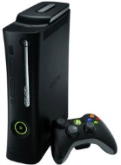




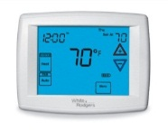

Why don’t you have it?
You have the basic ingredients
But composition is difficult

Slide 4
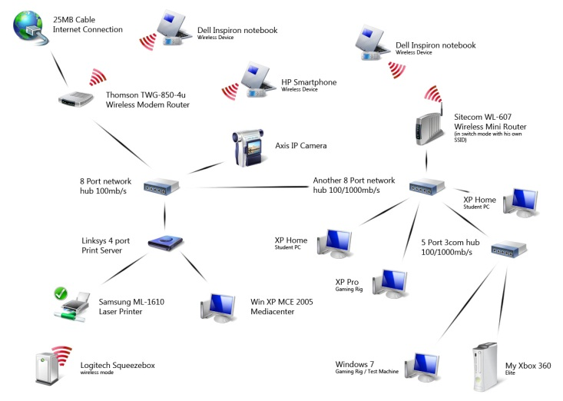
An example home network
Ratemynetworkdiagram.com

Slide 5
Why is device composition in the home hard?
Homes have users, not administrators
Extreme heterogeneity
Low expertise and willingness to manage
Privacy
Rich set of devices
Technical issues mix with human and economic ones
Experimental difficulties

Slide 6









Interoperability is not sufficient
App A
App B
App D
App C

Slide 7
Monolithic systems are hard to extend
Apps A, B, C, ….

Slide 8

An alternative approach: A home-wide operating system
HomeStore
App A
App B
App C
Operating system
“The home needs an operating system (and an app store)” Dixon, Mahajan, Agarwal, Brush, Lee, Saroiu, Bahl, HotNets 2010

Slide 9
Summary
By simplifying device composition, we can bring smart homes to the mainstream
Current approaches fall short
Interoperability alone is insufficient
Monolithic systems are hard to extend and customize
A promising alternative: A home-wide OS

