Slide 1
Effects of Interference on Wireless Mesh Networks: Pathologies and a Preliminary Solution
Yi Li, Lili Qiu, Yin Zhang, Ratul Mahajan Zifei Zhong, Gaurav Deshpande, Eric Rozner University of Texas, Austin Microsoft Research

Slide 2
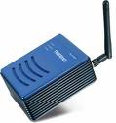

Wireless Mesh Networks
Can enable ubiquitous and cheap broadband access
Witnessing significant research and deployment
But early performance reports are disappointing
Anecdotal evidence suggests that routing is one contributor

Slide 3
This work
Empirically investigate performance issues in current routing method for wireless meshes
Find fundamental pathologies that stem from interference
Develop a routing methodology that systematically accounts for interference
This paper is our first step

Slide 4
Routing and interference modeling in wireless mesh networks
Routing
Measure “link” cost and use least cost paths
Account for interference in rudimentary ways
Nodes can send as much as the MAC layer allows
Analytic interference models
Usually compute asymptotic bounds
Do not usually prescribe routing
Make simplistic assumptions about topology, traffic

Slide 5
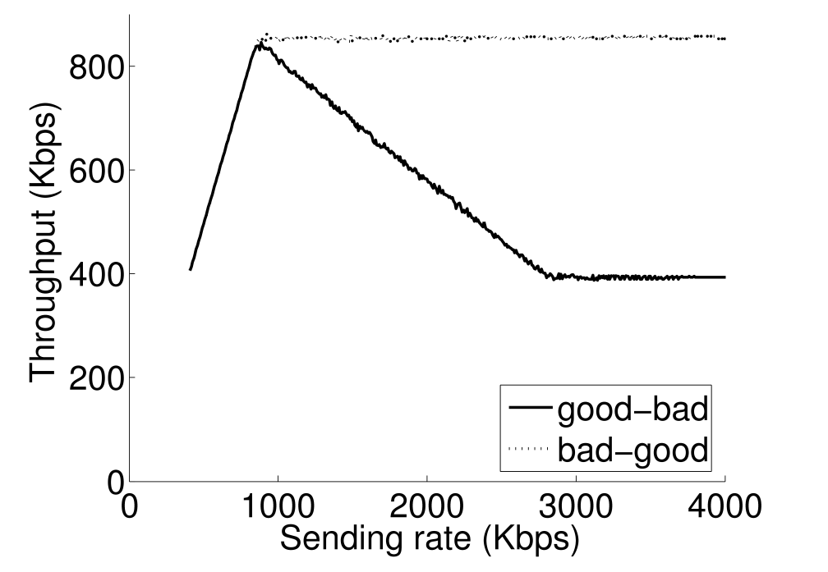
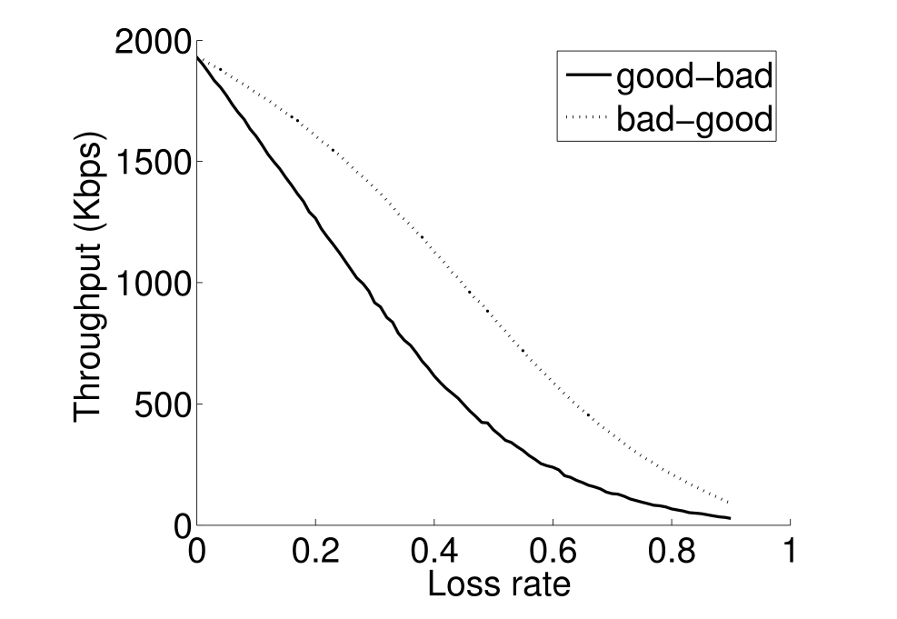
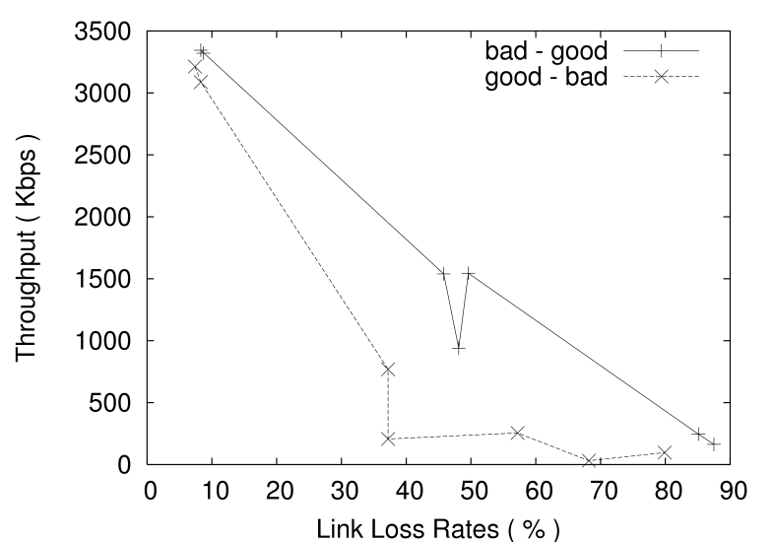
Pathology 1: Severe performance degradation in the absence of rate feedback
Bad
Good
Source
Relay
Sink
Good
Bad
Source
Relay
Sink
Testbed
bad-good
Simulation
bad-good
bad-good
UDP throughput (Kbps)
UDP throughput (Kbps)
UDP throughput (Kbps)
good-bad
good-bad
2x
good-bad
Loss rate on the bad link
Source rate (Kbps)
Loss rate on the bad link

Slide 6
More on Pathology 1
Hard to eliminate in the general case without systematically accounting for interference
Changing MAC allocation, RTS/CTS, or TCP’s congestion response don’t suffice
Occurs in any topology in which the bottleneck is downstream
Even if all links are reliable
S1
R
D
S2

Slide 7
Pathology 2: Poor path selection due to inaccurate quality estimation
No traffic
Fully used
A
B
A
B
Cost measurements ignore sender-side interference
C
D
C
D
ETX = 1
ETX = 1
E
F
E
F
ETX = 1
ETX = 1
A
B
C
D
Adding link costs to get path cost is a simplistic view of intra-flow interference
ETX = 3
A
B
C
D
ETX = 3

Slide 8
Our approach to routing
Goal: assign routing paths and rates to flows while systematically capturing the effects of interference
Divide the problem into two parts
Estimate flow rates that can be supported by a given set routing paths
Search over the space of routing patterns

Slide 9
Model-based flow rate computation
Input: topology, flow demands, routing paths
Output: sending rate of each flow
Capture interference dependencies using an approximate Conflict Graph
Cliques contain links that cannot send together
Compute max-min fair rate of each flow using an iterative water-filling procedure
Saturate one clique at a time
Clique 1
Clique 2
A
B
C
D
AB
BC
CD
E
DE

Slide 10
A (simplified) example
Flow 1, demand=1
Clique 1
Clique 2
AB
BC
CD
A
B
C
D
Flow 1
Flow 2
Flow 1
Flow 3
Flow 2, demand=2
Flow 3, demand=0.5
DE
E
 | Flow demand unmet (met) |  |  | Clique capacity unused (used)
 | Flow 1 | Flow 2 | Flow 3 | Clique 1 | Clique 2
 | 1 (0) | 2 (0) | 0.5 (0) | 1 (0) | 1 (0)
α1 = 33% | 0.67 (0.33) | 1.33 (0.67) | 0.33 (0.17) | 0 (1) | 0.5 (0.5)
α2 = 100% |  |  | 0 (0.5) |  | 0.17 (0.83)

Slide 11
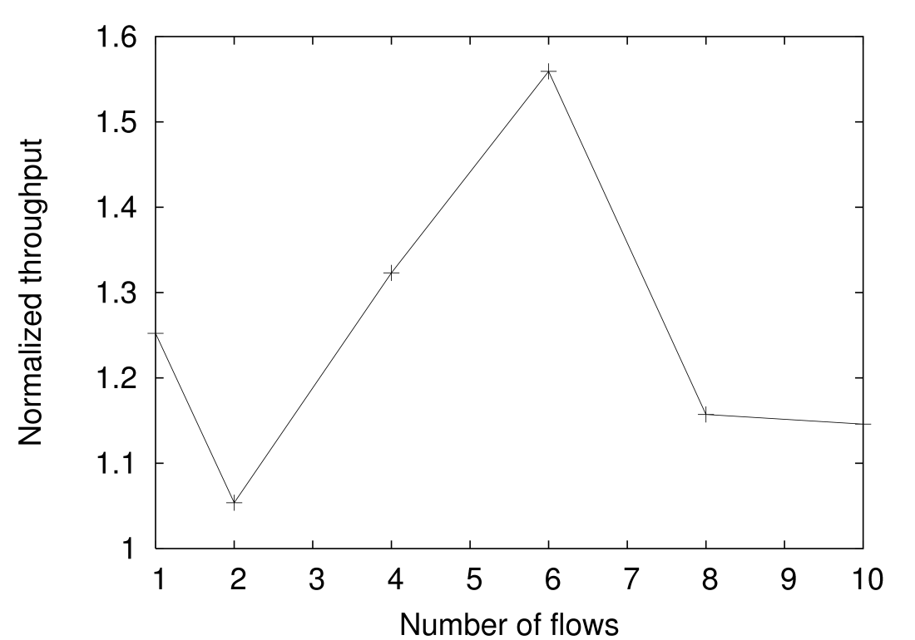
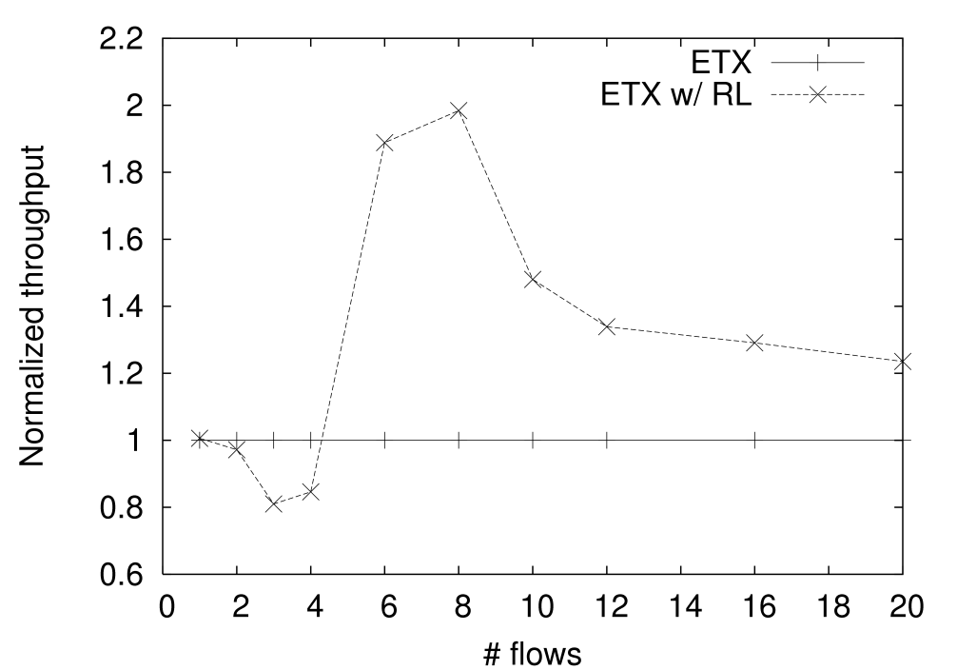
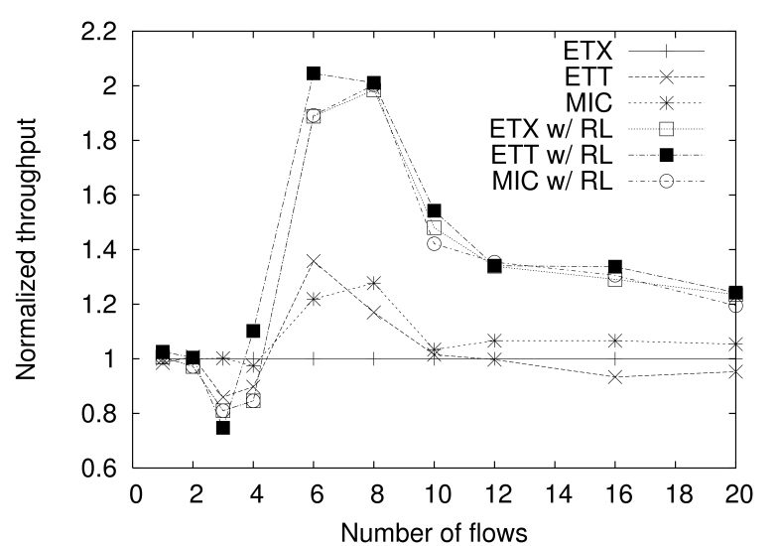
Throughput improvement when flows are limited to the computed rates
With rate-limiting
With rate-limiting
Normalized throughput
Normalized throughput
Without rate-limiting
Number of UDP flows
Number of UDP flows
Testbed (21 nodes)
Simulation (25-node random topology)

Slide 12
Conclusions
Current wireless mesh routing protocols perform poorly in the face of interference
We propose a new model-based approach that systematically accounts for interference
Our flow rate computation method improves throughput by 50-100% in some cases
Future work: search over routing patterns to further improve performance

