Slide 1
Eat all you can in an all-you-can-eat buffet: A case for aggressive resource usage
Ratul Mahajan Jitu Padhye, Ramya Raghavendra, Brian Zill
Microsoft Research

Slide 2


Avoiding hunger
Alice walks into a restaurant
How much to eat to minimize the chance of getting hungry before the next meal?
As much as stomach space allows; or
Based on expected time until next meal

Slide 3
Avoiding packet loss
Bob needs to transmit data over a noisy wireless channel
How much FEC to add to minimize the chance of losing packets?
As much as the available spectrum; or
Based on expected bit error rate

Slide 4
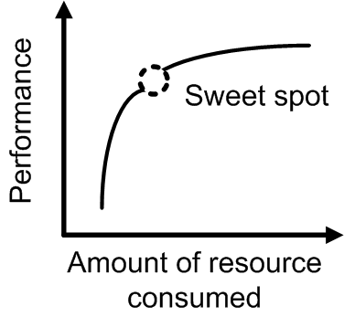
The focus on efficiency in current designs
Operating at the sweet spot tends to be the goal
Low efficiency beyond it
Inappropriate in many scenarios
If the resource is of “use it or lose it” kind
If the sweet spot is hard to determine

Slide 5
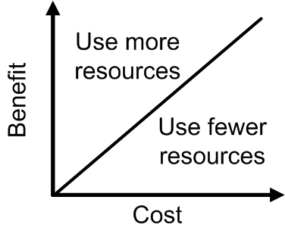
The Buffet principle
Continue using more resources as long as the marginal cost can be driven lower than the marginal benefit
Continue using more resources as long as the marginal cost can be driven lower than the marginal benefit
Key strength: performance limited by available resources, not artificial design choices
Key challenge: the default way to aggressively use resources is often problematic

Slide 6
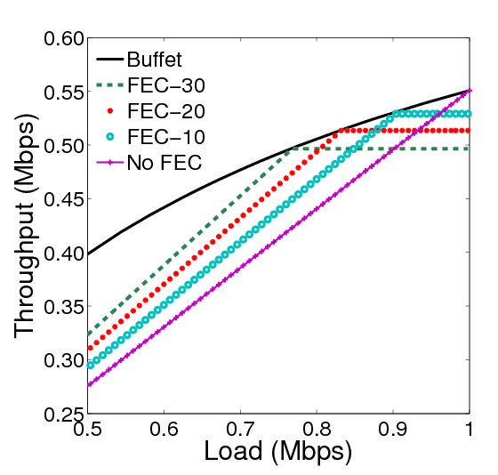
Case: Adding FEC to data transmissions
Current practice: # of FEC bits is independent of load and available spectrum
Buffet: aggressively use available spectrum for FEC bits
Simulation results with 1000-byte packets, 1 Mbps channel, 10⁻⁶ BER

Slide 7

Making Buffet FEC practical
Greedy addition of FEC can hurt with multiple transmitters
Especially for CSMA systems (e.g., WiFi)
Possible solution [under development]
Embed bits in separate packets
Send at low priority
Keep FEC packets small
Data
FEC
Low priority FEC

Slide 8



Case: Erasure coding for lossy paths
Current practice: balance # of coded packets and bandwidth cost
Buffet: aggressively uses all available capacity
Managing the impact of aggressive redundancy
Use priority on packets if router support is available
Transmit only when queue is empty [under development]

Slide 9
More case studies
Mobility updates in ad hoc networks
Must balance freshness of info and bw overhead
Buffet: Aggressively send updates per spare capacity
Prioritization can minimize impact on data transfers
Routing in delay-tolerant networks (DTNs)
Must balance message delivery prob. and fairness
Recent design (RAPID) uses the Buffet principle
A utility-driven framework prevents disproportionate resource usage by some messages

Slide 10
Yet more case studies
Using replication to boost reliability
Across disks within a computer
Use background tasks to manage overhead
Across multiple computers
Use background transfers to manage overhead
Pre-loading binaries into memory
Pre-fetching Web pages into caches
Speculative execution of program branches

Slide 11
Considerations in applying the Buffet principle
What are the challenges?
What resources does it apply to (naturally)?
What are the side-effects?

Slide 12
Challenges in applying the principle
Aggressive resource usage should not detract from productive work
Helpful techniques: explicit or implicit priorities; opportunistic usage; and utility-driven usage
Quantifying the marginal cost and benefit
Must include the impact of side-effects as well
Precise accounting not needed in many situations

Slide 13
Applicable resources
More natural for non-conservable resources
E.g., storage, bandwidth, computation
Feasible for others as well (e.g., battery)
Easier when the resource is not shared with non-Buffet users

Slide 14
Side-effects of aggressive resource use
New bottlenecks or concerns
E.g., disk I/O bw, energy consumption
Increased hardware wear-and-tear
Task completion latency may increase
Performance is now coupled with load

Slide 15
Conclusions
Continue using more resources as long as the marginal cost can be driven lower than the marginal benefit
The Buffet principle advocates aggressive resource usage instead of a singular focus on efficiency
It has the potential to provide the best performance for the level of available resources

