Slide 1
Can you fool me? Towards automatically checking protocol gullibility
Milan Stanojević | Ratul Mahajan
Todd Millstein | Madanlal Musuvathi
UCLA | Microsoft Research

Slide 2
Protocol gullibility
Gullibility
tendency to believe too readily and therefore be easily deceived [thefreedictionary.com]
Protocol gullibility
tendency of the protocol participants to believe too readily and therefore be easily deceived by manipulative participants
The protocol can be subverted without the knowledge of the honest participants

Slide 3





Gullibility of the ECN protocol
ECN receiver can deceive the sender into sending faster [Wetherall 2001]
C=0
C=1
Send slower
Faithful reflection
Congested
C=1
C=0
C=1
Send faster
Incorrect reflection
Congested
C=0

Slide 4
More examples of protocol gullibility
TCP receiver can deceive the sender into sending faster
Three separate manipulation mechanisms [Savage 1999]
Nodes can lie about connectivity in routing protocols
Nodes can refuse to relay packets in multi-hop wireless networks
Several manipulation mechanisms exist for DHTs

Slide 5
Why care about protocol gullibility?
Gullibility is a different form of protocol weakness
≠ bugs
≠ security problems of auth., integrity, and privacy
Manipulation by legitimate participants instead of external agents
Gullible protocols fail to achieve their goal in the presence of manipulation
Modern protocols are regularly used between entities that should not trust each other
Blind trust is foolhardy: hijacked or buggy participants

Slide 6
Our work
Develop methods to automatically uncover protocol gullibility
This paper represents a baby step:
Poses and formalizes the problem
Identifies key challenges and helpful techniques
Implements a preliminary checker

Slide 7
Problem formulation
Two-player game between angelic and demonic components
The angelic component consists of honest participants
Follows the protocol
Non-determinism is allowed
The demonic component consists of manipulators
Not limited by the protocol; can do anything
Collusion is allowed
The protocol is gullible if is there exists a strategy for the demonic component that violates a desirable property

Slide 8
Challenges in determining gullibility
Practical search over demonic strategies
Determining when a strategy succeeds
Dependence on network conditions

Slide 9
Challenge 1: Practical strategy search
The space of demonic strategies
Any bit-pattern can be sent in a packet
2^{^12000} possibilities for a 1500-byte packet
Some strategies may involve packet sequences
Proposed techniques to make search tractable
Consider only the header part of the packet
Consider only syntactically correct packets
Consider limited-history strategies
Exploit independence of header fields
Program analysis (in a few slides)

Slide 10
Challenge 2: Determining when a strategy has been successful
Want to go beyond non-binary properties but hard to predict protocol behavior in arbitrary conditions
E.g., throughput of a TCP receiver
Solution: Compare with reference behavior under the same network conditions
Non-determinism precludes direct one-to-one comparison against reference behavior
E.g., TCP throughput depends on exact packets lost
Solution: Statistical comparison over multiple runs

Slide 11
Challenge 3: Dependence on network conditions
Some strategies succeed only under particular network conditions
E.g., the ECN manipulation has no impact in the absence of congestion
Proposed solution:
Search over the space of network conditions
Assume paths between pairs of participants are independent
Check if the strategy succeeds under any condition

Slide 12
Our preliminary gullibility checker
Checks protocol implementations
Assumes all headers fields are independent
Single-step strategies (no history)
Built on top of MACE [Killian 2005]
Explores angelic non-determinism using simulation
Explores demonic strategies as modifications of the reference implementation itself
Modify outgoing packets (implemented)
Add or drop packets (not yet implemented)

Slide 13
Inputs to the checker
1. Network configuration
2. Properties to be checked
Specified in terms of implementation variables
3. Protocol header format
4. A packet modifier class
Field Type | Default strategies for demonic component
Fixed, CkSum | None
Enum, Range | Try each value, pick at random
SeqNum | Subtract or add a constant
Id | Pick at random
Other | User-specified

Slide 14
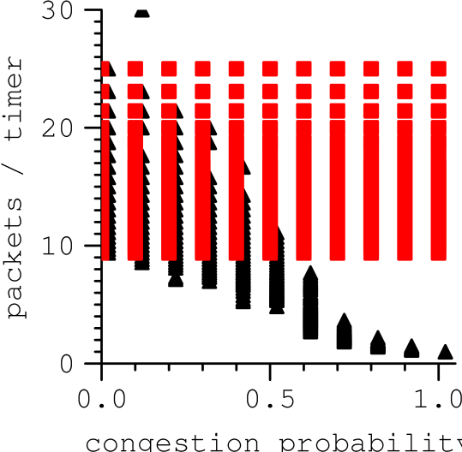
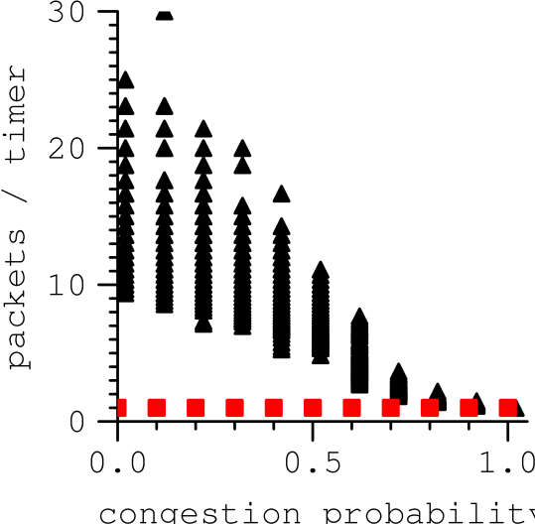
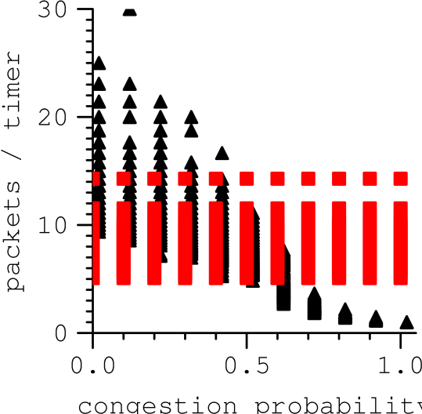
Case study: ECN
We implement a version of the ECN protocol in MACE
Specify throughput as the property to be preserved
Packets / timer
Packets / timer
Manipulative receiver
Reference receiver
Packets / timer
Congestion probability
Congestion probability
Congestion probability
Set bit to 0
Set bit to 1
Set bit randomly

Slide 15
Next: Program analysis to further reduce search space
Infer independent header fields
Infer inputs that are ignored by honest participants
E.g., If (IP.version != 4) ignore;
E.g., If (Ack.SeqNum NOT IN CongWin) ignore;
Infer inputs that impact relevant state variables
E.g., If (Ack.SeqNum > LastSeqNum) pktsSent++;
Hope to leverage work on taint analysis, directed random testing, and symbolic execution

Slide 16
Conclusions and future work
Gullibility is a major vulnerability in modern protocols
Important to develop methods for automatic detection
Our work scratches the surface of the problem
Poses the problem and outlines the challenges
Our preliminary methods show promise
Future work:
Evaluate more complex protocols
Design principles for non-gullibility

