Slide 1
Understanding WiFi-based connectivity from moving vehicles
Ratul Mahajan Microsoft Research
John Zahorjan University of Washington | Brian Zill Microsoft Research

Slide 2
Network access from moving vehicles
Highly attractive, increasing demand
Our long-term goal: Build a network and develop protocols to support vehicles using WiFi
Cheaper and potentially higher throughput than alternatives
Opportune time to consider this challenge
This work: Investigate connectivity characteristics between vehicles and base stations
To understand what applications can be supported and what protocols are suitable

Slide 3
Characterizing V-to-BS connectivity
1. Interested in the basic nature of connectivity provided by the wireless fabric
E.g., packet loss variation with vehicle movement
2. Can the predictability of vehicular paths mitigate the impact of a fast-changing environment?
Deploy a testbed and analyze measurements

Slide 4
Existing work
Either studies what can be done with existing deployments and protocols
Current protocols have high overheads that can be easily removed
Or studies controlled environments
Real environments are very different

Slide 5
VanLAN: Our testbed
Uses campus vans as moving vehicles
Basestations are deployed on roadside buildings
Currently 2 vans, 11 BSes

Slide 6
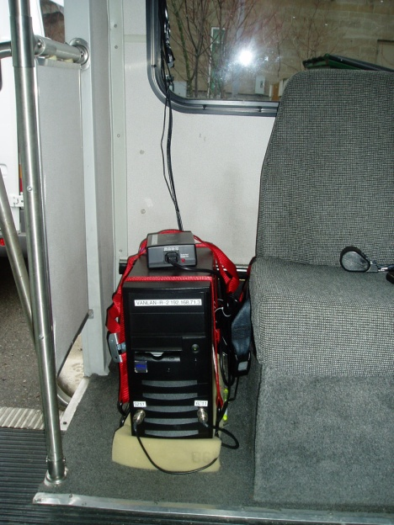
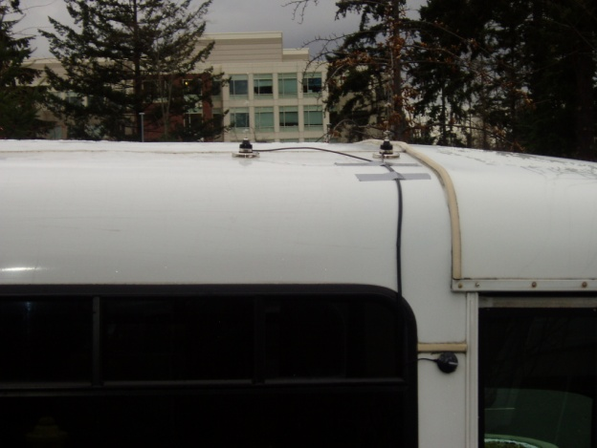
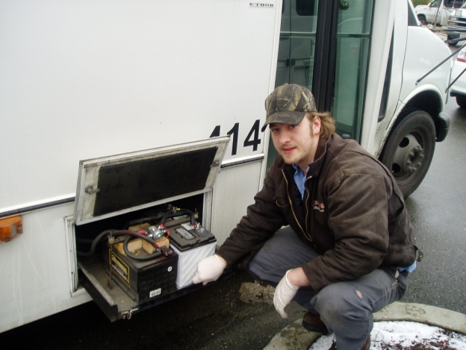
Van deployment

Slide 7
Studying connectivity sessions and disruptions
Define two types of connectivity sessions to a BS:
Meta session: from coming in to going out of range
Mini session: period without disruptions in connectivity
10 beacons per sec
First beacon
Last beacon
No beacon for 2+ secs
Mini session
Gray period
Mini session
Meta session

Slide 8
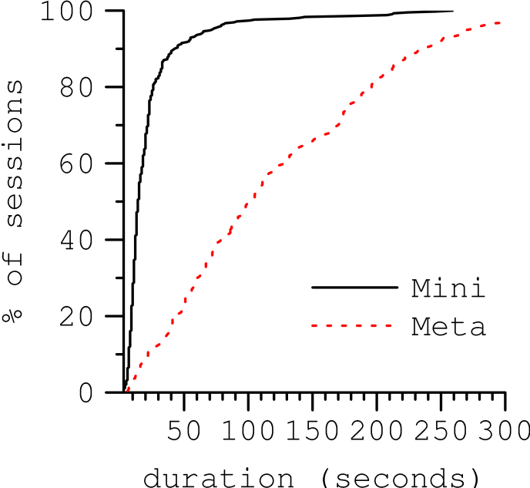
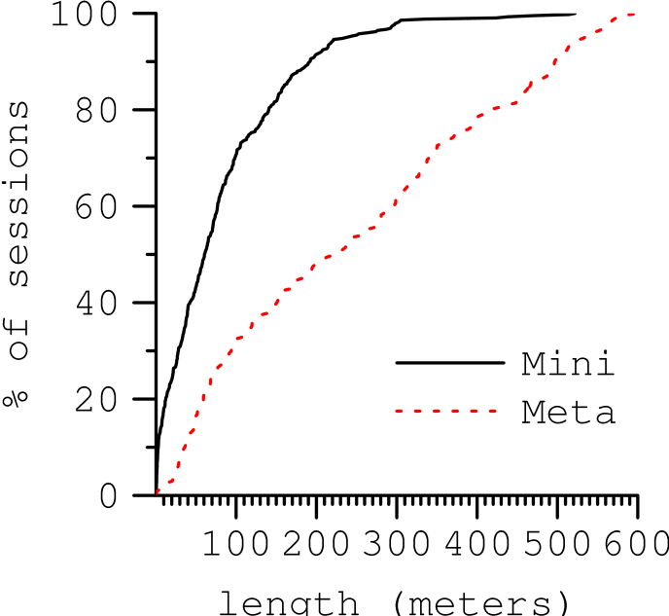
Moving vehicles experience gray periods
Mini sessions
Mini sessions
Meta sessions
% of sessions
Meta sessions
% of sessions
Session duration (s)
Session length (m)
Mini sessions are much shorter than meta sessions

Slide 9
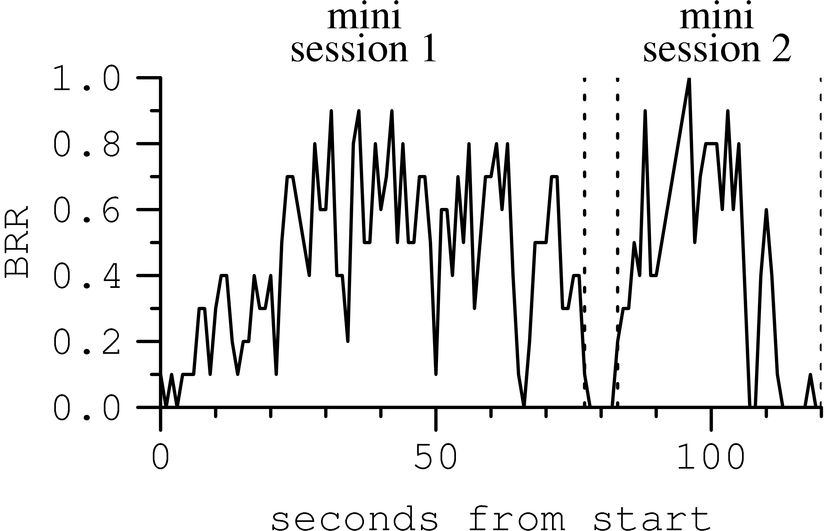
Example gray periods
Entry phase
Production phase
Exit phase
Reception ratio
Seconds from start
Observed behavior does not match earlier observations in controlled environments

Slide 10
Properties of gray periods
Very frequent in our testbed
Most are short but some even longer than 10s
Do not consistently occur at the same location
Hard to predict reliably using online measurements, e.g., of RSSI, reception ratio

Slide 11
Implications of gray periods
Supporting interactive or disruption-sensitive applications is challenging
Current WiFi association and handoff model performs poorly

Slide 12
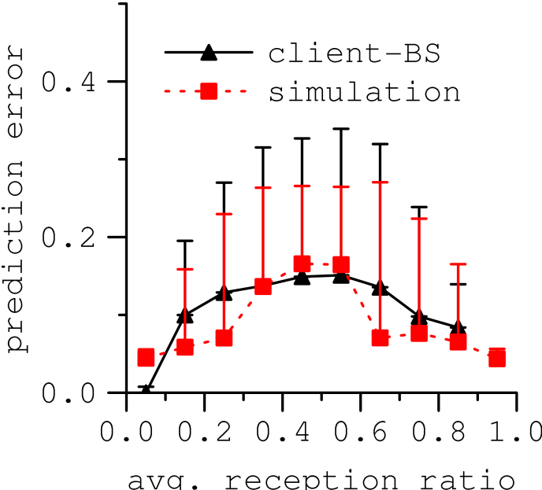
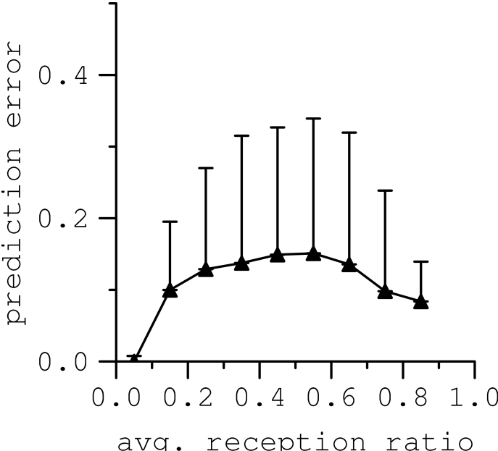
Historical information can help predict performance at a location
Testbed
Simulation
Prediction error in reception ratio
Past reception ratio

Slide 13
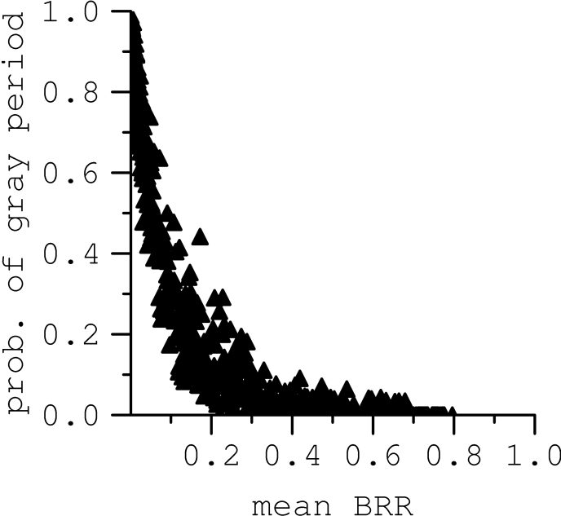
Historical information can also help identify regions prone to gray periods
Prob. of experiencing a gray period
Past reception ratio

Slide 14
Conclusions
Moving vehicles frequently encounter gray periods
Makes it challenging to support some applications
Minimizing disruptions requires new protocols
Predictions based on past performance at a location can help
More information and data at http://research.microsoft.com/vanlan/

