Slide 1
With Thanks
The Networking Research Group, MSR
Esp. Victor Bahl, Srikanth Kandula, Jitu Padhye, Ming Zhang
Advisors and mentors
David Wetherall, Tom Anderson
Sally Floyd, Miguel Castro, Ant Rowstron
Collaborators
Aruna Balasubramanian, Lili Qiu, Charles Reis, Maya Rodrig, Neil Spring, Arun Venkataramani, John Zahorjan, Yin Zhang, ………..
Notes:
Let me end by thanking people that have played a key part in my professional life. Such a list is always incomplete but I figured that I’ll call out some of the people rather than calling out none. My apologies to folks whose names that I missed.
First on the list are my colleagues at the Networking Research Group in MSR. It is a rare privilege to have to so many smart people around who speak the same language and are always willing to act as bullshit detectors. I am particularly thankful to Victor, who always amazes me at his success at shepherding this group, and to Srikanth and Jitu with whom I have worked closely over the last few years.
The stepping stones for my career are the people that have mentored me while I was in graduate school. These include the formidable advising team of David and Tom, who gave me a taste for systems-oriented networking research. Looking back, I am particularly thankful for David’s patience with my dithering in the early years of graduate school and his unique ability to appreciate and bolster both the big picture and the minutest of detail.
I spent 6 months with Sally. It was infectious how personally she took Internet research. I also did an internship with Miguel and Ant; working with them was as much fun as spending time in Cambridge bars.
Finally, my other collaborators have given me great ideas and taught me a lot.

Slide 2

How to build research network systems in your spare time
Ratul Mahajan

Slide 3
This talk
Goal:
Articulate a research method for building network systems
Non-goal:
Building consensus
Notes:
So, when I was invited to give a talk here, I was very pleased for a split second and then immediately started panicking. Holy cow! What am I going to talk about?!
A common thing for speakers to do for such talks is to give an insightful talk on an important topic. But I have no profound insight to share on any topic. So I thought long and hard about what to talk about.
I decided to do something different, and perhaps foolish, for this talk. I decided to try to articulate a method for building research network systems, based on my past mistakes and what I have learned from my collaborators.
The inspiration behind this talk is a paper that I came across early in grad school. This is a paper by the famous economist Hal Varian on how he builds economic models in his spare time. It is a compelling paper and I recommend it if you haven’t read it. Back then, I wished there was something similar for networking research. I see this talk as an opportunity to start a conversation about promising methods for networking research.
My goal is not to build consensus that this is the best way to do networking research or systems research. There are undoubtedly other useful methods and I’d love to hear about them. My hope is simply that some of you will find it useful in your work, as I do in mine.
>> In any case, consensus is a dangerous thing in a scientific field. For instance, whenever I’ve consensus build around talks such as these, it is that the talk was a waste of time. This other kind of consensus scares me too!

Slide 4
Common concerns for research network systems
Do we need another paper on …?
Is this problem important?
Does this solution work?
What is new here?
Why not solve the problem this other (simpler) way?
Do these represent flaws in the research process or communication?
Notes:
To give you some context for why I chose to do this, I had the misfortune of serving on several conference and workshop PCs this year.
A common set of complaints kept cropping up for research systems being proposed by those papers. These went like ….
For many of these papers, the authors had clearly put in a lot of work and they definitely contained some good ideas. By the way, I am not immune and many of my own papers too have gotten similar reviews.
That got me thinking: is the dominant cause of these sentiments that we are not communicating our results as well as we should or does this represent a flaw in the research process.
This is a hard question to answer in general and I wouldn’t attempt an answer except to note that as authors we often feel that concerns like these can be addressed by better writing because the reviewers didn’t get it. While good writing certainly helps and should always be a goal, at the end of the day the writing reflects thinking and experiences, which are the results of the process you undertake. So, perhaps our research process is to blame as well.
But I did begin to wonder and what the research process should be, and can it even be articulated? By a research process, I don’t mean merely a bag of do’s and don’ts but a somewhat more systematic step-by-step description of the process. Knowing the sequence of steps is important because the earlier steps are supposed to save you from making poor investments of time, which you then might be forced to paper over using writing.
Then, perhaps naively, I decided to articulate a method based on my past mistakes and what I have learned from people that I have worked with. This talk is my first attempt at describing a research method for building systems. I’ll focus on building systems because much of my work falls in that category but I am hoping that some of what I am about to say applies to other types of networking research as well.
For those of you who are experienced researchers, many of the things that I am about to say will undoubtedly appear obvious. I am hoping that you’ll point out important things that I have missed and things that you disagree with. I would also like to encourage you to articulate your own method. Perhaps we can then convince keshav to do a series in CCR.

Slide 5
A method for building research network systems
0. Pick the domain carefully
Know the problem well before you build
Debate several solution ideas
Have a core idea to what you build
When building, start small and then embellish
Make it real
Notes:
Here is a potential method that I have found to work well. By necessity, this is a simplification of what actually happens. In reality, there is a lot of back and forth. But I think these steps capture the process pretty well.
The time you spend increases in successive steps, but the earlier steps are more important as the success of the latter ones hinges on them.
The zero-th step is picking a domain or an area that you want to attend to. This is a step that may or may not have to go through, depending on whether you already have a target domain. I tend to switch domains on a regular basis because I run out of ideas, and thus for me, this is a conscious exercise.
By the time you pick a domain, you probably have some idea of what you want to do there. But it is not time yet to start designing and building your system. First, you must get to know the problem better. The goal here is to find a technical problem, solving which will significantly improve the state of the world, for instance, by reducing cost, improving performance, or enabling new functionality. If you already know the problem, the goal of this effort is to confirm if the problem is real. Without this measurement exercise, you run the risk of solving a problem that does not really exist.
Suppose you know the problem that you are about to solve, it is still not time to start building it. You should consider several solution ideas and debate them to gain clarity on the design space and identify the core idea or two around which you are going to build the system. It is important to be able to articulate this idea. This is important because a major goal for a research system is to validate a research hypothesis such as this idea can solve this problem in this domain. If you just build the system without articulating the central ideas, the resulting system has less future value.
Its now time to start building the system to solve that problem. It helps to start small by implementing your core idea and add complexity only as needed to make it practical. This way you’ll ensure that only needed complexity is added.
The final step is to try to make it real. This will often require you to step outside network systems research or research at all. But it is critical to making your ideas a reality.
In the rest of this talk, I’ll describe these steps in more detail. In describing this method, I’ll draw on my experiences and use anecdotes based on my own work. This is not because it is the best work ever, but only because I was there while it was being done.
By the way, I would like to point out that having a research method does not mean that there is no role for intuition, creativity, luck, and hard work. No, those factors are absolutely necessary for success. The purpose that any such articulation serves is to that it helps you focus, avoid common mistakes, and move along faster in the process. Think of it as best practices.

Slide 6


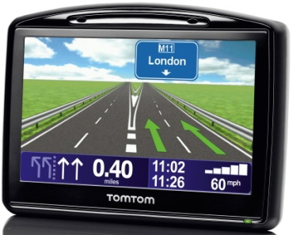
Picking a domain
Be wary of the hot trends
Observe the world for changes
Workload, technology trends, concerns
New technologies
Government regulations
Prefer underexplored domains
Serendipitous matches
Large enterprises
Small enterprises
Notes:
When picking a domain, a critical factor that goes without saying is of course that it should be something of interest to you. If inter-domain routing is not your cup of tea, or espresso since we are in Italy, do not even think of picking that as a research area.
But the question is what beyond that? In trying to find a domain, I look out for the following.
First, I am wary of hot new trends in the field. These days those appear to be social networks and data centers. If enough smart people are already working on it, unless you have a cool new insight or perspective going in, your time and energy is probably best spent elsewhere. Plus, if you are a graduate student, you’ll graduate with 10 other people who have worked in the same area. This happened to me, by the way. In retrospect, my choice of thesis topic was not that inspired.
A more promising method is to look for opportunities elsewhere.
The first is to observe the world for changes. The fault lines created by such changes represent promising avenues for systems research into how to best accommodate or leverage those changes. T
These changes could be changes in workloads, technology trends, or even new concerns such as energy. Some of the very successful research projects have been driven by such observations. This includes the two awards papers at this year’s SOSP. As another example, my recent work on vehicular networks is driven by the observation of increasing demand for connectivity from moving vehicles. I want to understand how to enable that connectivity in a cheap and reliable manner.
Another kind of change to look out for is adoption or availability of new technologies. For instance, the availability of software defined radios engendered a whole bunch of research activity. A similar thing is happening with programmable directional antennae.
Yet another kind of change is expected changes that we tend to look less at is government regulation. Examples of such changing regulation today are those around net neutrality and privacy.
A second strategy is to prefer domains that are underexplored. These underexplored domains could exist just because they have not been on other people’s radars, because folks have not figured out how to do systems research for those domains, or because people presume that the problems in that domain have been solved by solutions in related domains. Question such premises.
One of my recent projects focused on diagnosing faults in small enterprise networks. We started that because we realized that those networks had not been studied before, perhaps because people thought that any solution designed for large enterprises will automatically work in the case of small enterprise. We found that to not be true. Studying those networks gave us a very different perspective on the design of diagnostic systems, a perspective that we found later was useful for large enterprises as well.
A final one is to look out for serendipitous matches. This could happen, for instance, if you got access to some unique data that lets you study a system that few people have studies before. If you read about a cool new technique or tool, ask yourself what else is it good for. This can also happen for internal tools. The tools you developed could be useful in a different context.
For instance, Rocketfuel, an ISP topology discovery system that I built, happened because I realized that a tool that I had developed as part of a routing misconfiguration study could be more effectively used for a different purpose.

Slide 7
A method for building research network systems
0. Pick the domain carefully
Know the problem well before you build
Debate several solution ideas
Have a core idea to what you build
When building, start small and then embellish
Make it real

Slide 8
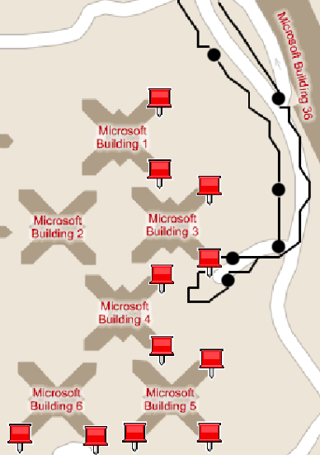
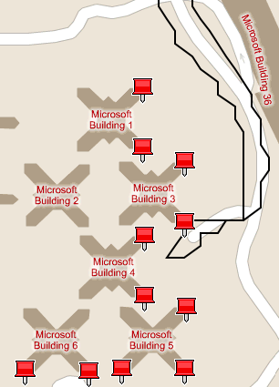
1. Knowing the problem
Papers alone are rarely a good source
Scrutinize (e.g., measure, survey)
verb, to look over closely
Use imagination to guide what and how to scrutinize
Do not imagine the problem!
Disruptions
Single BS
Multiple BSes
Notes:
Having picked a domain does not mean that you have picked a problem to work on. But hopefully, you’ll have some idea of the problem you want to solve in that domain. If all you know is that you want to work on data centers, you probably didn’t do a good job of picking a domain; go back to step 0.
Before trying to solve what I think is a potential problem, I try to frame it more concretely. Framing the problem means identifying what exact weakness in the status quo I am trying to address, and what the benefits of solving that problem might be. For instance, if you want to work on data center scalability, you must first understand the scalability bottlenecks, the workload, and any characteristics that you can leverage.
This is an exercise that you must do yourself. Because in trying to frame problems, I find the papers in that domain written by other people to not be a good source. If an author has outlined the exact problem for you, and has not solved it themselves, the chances are that the problem is either not important or very hard to solve. If it is too hard, you need additional insights or perspectives that cannot be obtained by just reading that paper.
Instead, you must measure. I use the term measurement loosely, to mean the act of estimating or carefully appraising the situation. The goal is to get a concrete understanding of the real issues.
In this process, use your imagination to guide what to measure and how to measure it. Never, ever let imagination alone or hearsay frame the problem for you. I have been surprised many times that I take this process seriously. Things that I think are problems turn out to not be problems at all after I measure them.
For instance, for my work on vehicular Internet access using WiFi, I went in with the hypothesis that current WiFi handoff methods in which clients talk to only one AP at a time will lose a lot of packets compared to handoff methods that use multiple APs at the same time. When I measured it, it turns out that difference was less than 20%. At which point, I figured that the problem is not worth solving. Further analysis showed that the real problem with using only one AP was something else: that it was hard to support interactive traffic. While bad periods were infrequent, they lasted longer. This difference between the two handoff strategies was 7x. Boy, was I glad that I did my own measurements before going off to solve the wrong problem.

Slide 9
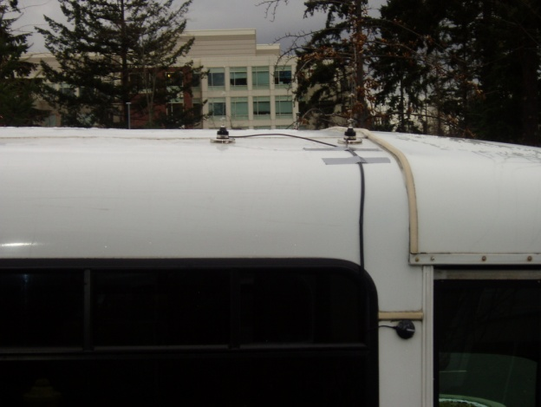
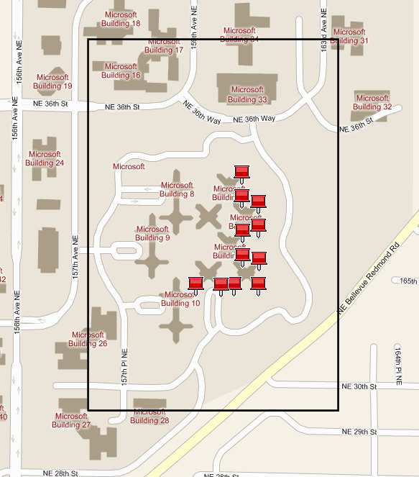
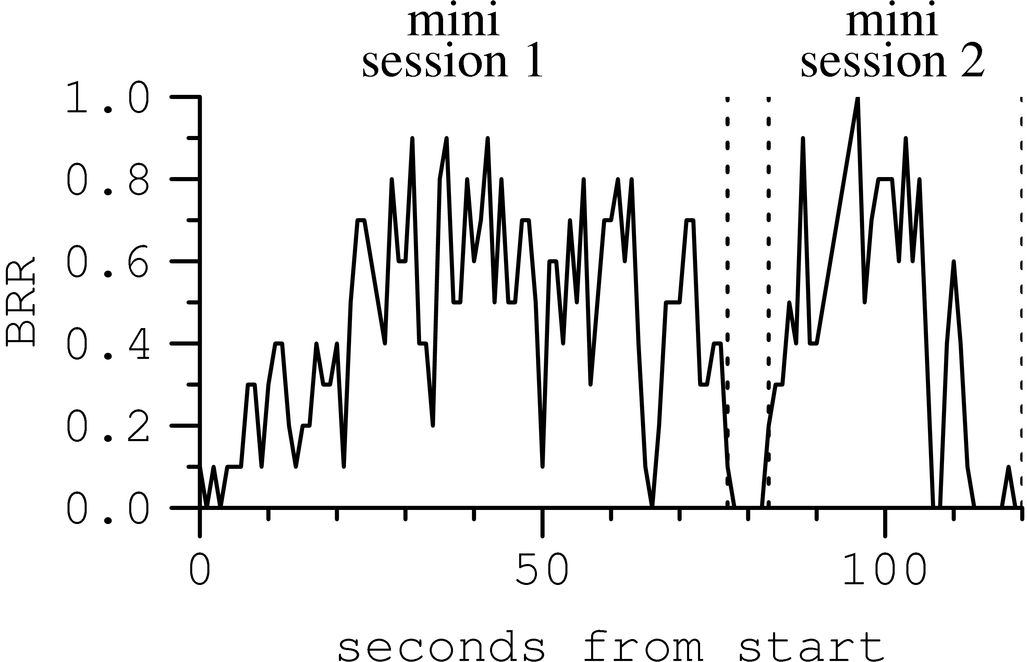
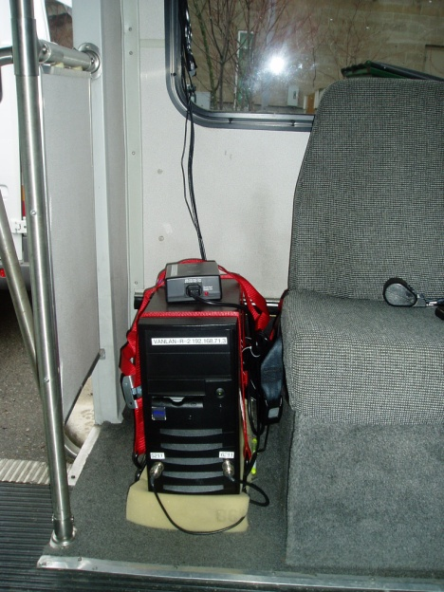
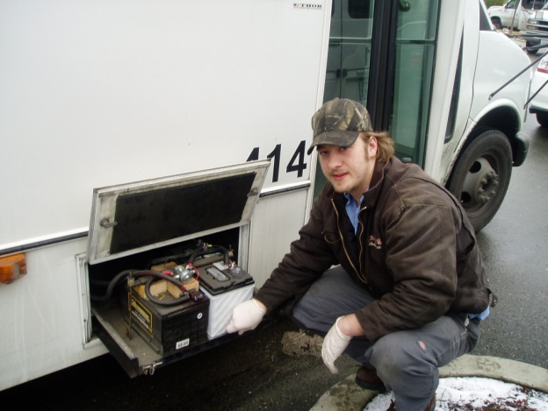
Some scrutiny how-to's
Be open to unconventional approaches
Conduct your own as far as possible
As realistic a setting as possible
Project into the future and go (only) for big gains
Entry phase
Production phase
Exit phase
Reception ratio
Seconds from start
Client-BS connectivity pattern in a realistic setting did not match observations in controlled environments
VanLAN
Notes:
A few words on how to conduct measurements.
If you are trying to solve hard problems, the chances are measurements will not be easy. Here, it helps to be open to unconventional measurement approaches that go beyond running scripts on computers to probe things.
Such approaches include, but are not limited to, setting up your own testbeds, digging through market research data, social engineering, reading through trouble tickets, and even back-of-the-envelop calculations.
In my recent work on network diagnosis, I read through 100s of trouble tickets to understand what problems the operators were having. In an earlier work, against the good advice of my advisors, I spammed network operators wholesale so I could separate intentional network changes from unintentional misconfigurations. These approaches came in handy when the conventional methods failed.
A second piece of advice is to conduct your own measurements as far as possible, even if you need to measure what others have measured before. This is worth the effort even if takes a long time and there is no substitute for it. In my vehicular WiFi work, this meant going through a six-month period setting up a testbed before I could do any real work.
Conducting your own measurements has two benefits:
First, you’ll likely find something that others missed either because you are lucky or because your measurements harness is different from others. Remember the misconception that I had about using one versus multiple APs, that was based on reading other papers.
Second, you’ll get to know the space at a visceral, intuitive level that will not happen from reading other people’s papers.
A third advice is to have as realistic a setting as possible when you measure. Again, for instance, in the vehicular WiFi work, because my testbed was more realistic that earlier measurements, I found the environment to be quite different. Earlier work in controlled settings showed that the time that a client is connected to an AP can be neatly divided into three phases, entry and exit phases with poor connectivity, and a production phase with good connectivity. In my measurements, I found that the reality was a lot more complex and such cleanly separable phases could not be found.
Similarly, in trying to build a network diagnosis for small enterprises, it was critical for us to get the operators’ perspective. That is how we realized that existing systems are not likely to help those operators.
A final thing that you should do with your measurements before settling on a problem to solve is that you should project your data into the future. If some problem is going to go away in a few years – think Moore’s law, for instance – it is probably not worth solving. It is after all going to take time for your solution to come to market.
Also, if the projected gains are small, the problem is not worth solving because there is going to be an overhead to deploying your solution and its real instantiations will eat into some of the gain. What is a worthwhile gain, however, depends on the domain. If you are talking about performance of data exchanges, 10-20% improvements are probably not worth it. 10-20% reduction in cost of running a network are probably well worth it.

Slide 10
Output of well-done scrutiny
Primary:
Identification of real issues and non-issues
An estimate of the benefit before you commit fully
Detailed insight
E.g., domain characteristics that you can leverage
Secondary:
Sets up evaluation for later
Risk reduction in publishing
Notes:
There are many benefits to well-done measurements that makes the effort worth it. The primary ones are that you would have identified real issues and non-issues.
By having done these yourself, you would have also obtained detailed insights into the domain and the problem you are about to focus on. You may also have uncovered important aspects of the domain that will help with eventual solution. E.g., if you find locality in web requests, caching becomes a possibility. Similarly, if you have elephants and mice in traffic, managing elephants alone might be sufficient for traffic engineering. Insights such as these are hard to have without good measurements and they go a long way in making your design exercise a success.
There are secondary benefits as well. One is that this exercise tells you how to evaluate your design. Your design should have solved the issues that you just identifies.
Another secondary benefit is that I find this exercise to be a great strategy for risk reduction. You can probably publish these measurements independently if a lot came out of it. Even if a lot did not, including them in your eventual paper will make the paper stronger and the problem you are addressing more convincing to the readers.

Slide 11
A method for building research network systems
0. Pick the domain carefully
Know the problem well before you build
Debate several solution ideas
Have a core idea to what you build
When building, start small and then embellish
Make it real
Notes:
At this point, you know well the problem that you are about to solve.
You may even have an idea or two about how to solve it, and you may be itching to get started with implementing your idea.
But it is still not time to start implementing it. Instead, at this point you should take a problem-centric view and consider as many solution ideas as possible and not just the ones that are your own. This helps you not be blind sided by your own brilliant ideas and lose out on other, perhaps better, solutions. Finding out later that other solutions work just as well or better is much costlier. Your idea may still be valuable, but perhaps not as good for the problem you want to solve.
There are two steps to this step. First, you assemble a list of possible solution ideas and then you compare them.

Slide 12

Fishing for solution ideas
Filter your problem to its crux
Can you express it as a puzzle?
Make connections to related problems
CS and beyond
Get exposed to many solution concepts
Talk to people (don’t worry about theft)
Read broadly
?
?
Bradley.chattablogs.com
Notes:
To assemble a list of possible solution ideas, I first try to filter the problem to its crux, removing any detail that I consider to not be critical, which enables me to focus on the core of the problem. These extraneous details may be related to, for instance, how exactly the solution might be implemented. There will be time to figure that out later. A good goal is to abstract it enough to a level of a puzzle that you can describe to people who are not in the area.
Once you have this puzzle in hand, look at it from different perspectives. What if you did this? What if that happened? What if you modified it thus? What if this constraint was missing or imposed?
Another useful activity, once you have this abstract problem, is to make connections to similar problems. Where else such a problem might arise? Do not restrict yourself to systems literature, or even CS literature, or academic literature at all.
For instance, when I was designing a win-win routing protocol for competitive yet cooperative ISPs, the underlying idea came from a description I had read years ago in a trashy magazine about how to divide jointly-held property among a couple after a divorce. This division method had the nice property that it incented each partner to reveal their true relative valuation for individual objects. I was looking for this property in my solution. In another work, I had to draw upon techniques from removing sampling biases in surveys of illegal drug users and MRI machines.
In trying to make this connections, of course, having a vivid imagination helps but that is a gift over which we have no control over, at least in the short term. What you can do, however, is leverage those around you. If you have abstracted your problem enough, you’ll be able to describe it to others, even those outside of your area. This has a tremendous benefit. First, they might give you pointers to related problem. But more often what happens, they poke at the problem in a way that is different than what you were able to. Because they are not familiar with the constraints of your environment, they’d ask questions like: why don’t you do this? Instead of discounting such suggestions as impractical, think about them carefully. What if you did that? Are you running against something fundamental or it is something that can be worked around.
And oh, by the way, do not worry about other people stealing your problem. Chances are that they are not interested in doing that. And even if they were, remember that you have a head start because you have all those insights from your measurement effort.
The other thing that helps me is reading broadly to get exposed to various solution concepts. You should read even if you think it is a bad paper. Your goal is not to judge the paper, but let the ideas in that paper mingle with yours and get exposed to various ways of looking at the problem.
Keep reading even if your head hurts. It is hurting probably because your brain cannot categorize and group all the stuff you are reading about. In time, with conscious and subconscious thinking, it will eventually.
There are different schools of thought on whether you should read other people’s ideas before developing your own. Varian discourages that. I find it hard to think in vacuum. I find that more ideas are generated as I get exposed to other ideas.
Also, in all this, it is critical that you set aside some time to think and digest. This should be a time with minimal distractions. For me, its when I am in the shower, riding the bus to and from work, and when I am in bed trying to sleep. There is too much going on at other times. It could be different times for you but do think without distractions. If you are disciplined enough, you could set aside an hour a day to just ponder over the problem at hand.

Slide 13

Idea triage
Set up an idea racetrack
Compare relative strengths
Focus on the essence
Give others’ ideas a fair shake
“Not invented here” is not a disqualifying criterion
Helps to have an “adversary”
Answer new measurement questions that arise
Notes:
At this point, you have a bag of ideas that could solve the problem at hand. Be sure to have in this bag even non-technical solutions to the problem. For instance, if you are working on relieving congestion, over provisioning is a possible solution.
The goal of the triage is to identify the promising one around which you’ll build your system.
I think of doing this by setting up an idea racetrack on which different ideas compete. This race track could be entirely in your head. It does help to write things down, however.
You should begin identifying the relative strengths and weaknesses of each idea, and start discounting those that have show stopping weaknesses.
This comparison can sometimes be a subjective exercise, depending on your own taste and experiences. For instance, if you are packet switching kind of a guys, you may find nothing redeeming about circuit switching. But this comparison is still helpful as it forces you to make explicit why you are discounting each possible idea.
In this comparison, you should focus on the essence. Try hard to make each idea work, even those that are not yours. Do not discount existing ideas on issues that are surmountable.
A common problem is authors dismissing techniques simply because they were not invented in your setting. Know why a given technique does not work, independent of where it came from.
In this exercise, it helps immensely to work with someone closely, so you can take opposing ends of various arguments. If you are like me, it is hard to argue very strongly against yourself. Working with someone makes this both fun and productive. That is part of the reason I enjoy working with others.
In a recent project, Srikanth and I went at each other for a few weeks. There was stalemate, and we ended up including both ideas in the paper, but with a deeper appreciation of what was going on than what would have been possible had one of us given up too soon.

Slide 14
Output of the triage exercise
A promising solution idea (or two)
Core of the system that you are about to build
Simple to express
Clarity on the design space
Reframing of the problem
Classification of your own terms
Notes:
The triage exercise has a few outputs.
A clear one is that you would have narrowed down to one or two promising ideas that are worth pursuing. This idea will be the core of the system that you are about to build.
I cannot stress enough the importance of making explicit what the core idea behind your system is that makes it work. Systems are complex, and someone a few years down the line who is solving a similar problem should be able to tell what the key idea was behind your system, independent of the context in which your built and evaluated the idea. You should help them by separating the meat from the gravy.
A good property you should be looking in the winning idea is conceptual simplicity. That does not necessarily mean that it is simple to implement, though that is a definite plus. You should be able to explain it to non-systems folks and it should make sense to them.
For instance, you could say that we probabilistically relay overheard packets to boost communication reliability of wireless transmissions, or that we leverage locality in p2p workloads to reduce the transit traffic for ISPs.
Another important outcome is that you will get much greater clarity into the design space. This by itself makes the triage exercise well worth it, even if you come out of it with the same solution idea that you went in with. If you are new to this domain, you were probably overwhelmed with all that you read. You’ll now have a much clearer understanding of what is going on.
Two other things typically happen. First, you’ll realize that you are solving a narrower problem than you set out to solve. That is, you’ll realize that your idea works in a narrower set of operating circumstances than you originally imagined. For instance, you might realize that your solution ideas are most effective when network delays are low, or there is stability in the traffic or topology, or wireless nodes can overhear each other frequently, or whatever. Without looking at competing solution ideas for the same problem, it is sometimes hard to get that understanding.
It is important to realize these assumptions and list them explicitly. When people complain that your solution does not work, it is because they are thinking of corner cases where it does not work and you have not made it clear that it does not work under those corner cases.
Have you ever read a paper with a set of design goals and then the solution, and wondered how the solution exactly matched the design criteria, as if the design criteria was made to fit the solution. Chances are that is exactly what happened. The authors figured out what design goal their solution idea meets.
A second thing that happens is that you are able to classify past work on your terms. That is, identify one or two axis of classification along which you are unique. This makes it easy to explain to people how you are different. The triage exercise makes me realize what those axis should be.
For instance, in my work on diagnosis, we realized that a big difference between our approach and past work was that we were maintaining the health of network entities as multi-dimensional variables. After explaining why this mattered, this made it easy to explain how we were different and why our approach does better at the problem we were solving.

Slide 15
A method for building research network systems
0. Pick the domain carefully
Know the problem well before you build
Debate several solution ideas
Have a core idea to what you build
When building, start small and then embellish
Make it real

Slide 16
Building the system
Start small
Quickly check if the idea works at all
Consider using controlled experimental platforms first
Hardcode certain factors
Then embellish as needed to make it work
If it does not work as expected:
Figure out why
Return to idea generation with the newfound knowledge
Notes:
You are now ready to start building the system.
The key here is to start small. Do not immediately roll out the whole thing. Your goal should be to check as quickly as possible if your solution idea works in limited settings. If it does not work in those settings, it is probably not going to work in more realistic situations. The idea is to hit failures before making too much of a time investment.
In some cases, if the actual experimental platform is hard to control or too variable, consider using more controlled experimental platforms first. These could be simulation, emulation, or even a separate controlled testbed.
In the vehicular WiFi work that we did, we used simulation before we rolled out the protocol to the buses. That helped us debug quite a few issues in our system. The extra time invested in making the simulations work was way less than the time it would have taken us to resolve those issues when running on the buses. Similarly, for the network diagnostic work, we first did all the development on a separate, controlled testbed before testing it in the live environment.
What also helps in having a more controlled setting is to hardcode some of the environmental factors.
As you build confidence that the system is working as expected, you make it more real. As you do that, additional complications will arise, that you must discover and resolve.

Slide 17
Evaluating your system
Does it work?
How does it compare to the state of art?
Why/when does it work?
Do its assumptions hold in practice?
What are the benefits (or costs) of its complexity (or simplifications)?
Notes:
What you should evaluate about the system you just built depends very much on the system but I always try to ask the following questions …

Slide 18
A method for building research network systems
0. Pick the domain carefully
Know the problem well before you build
Debate several solution ideas
Have a core idea to what you build
When building, start small and then embellish
Make it real

Slide 19
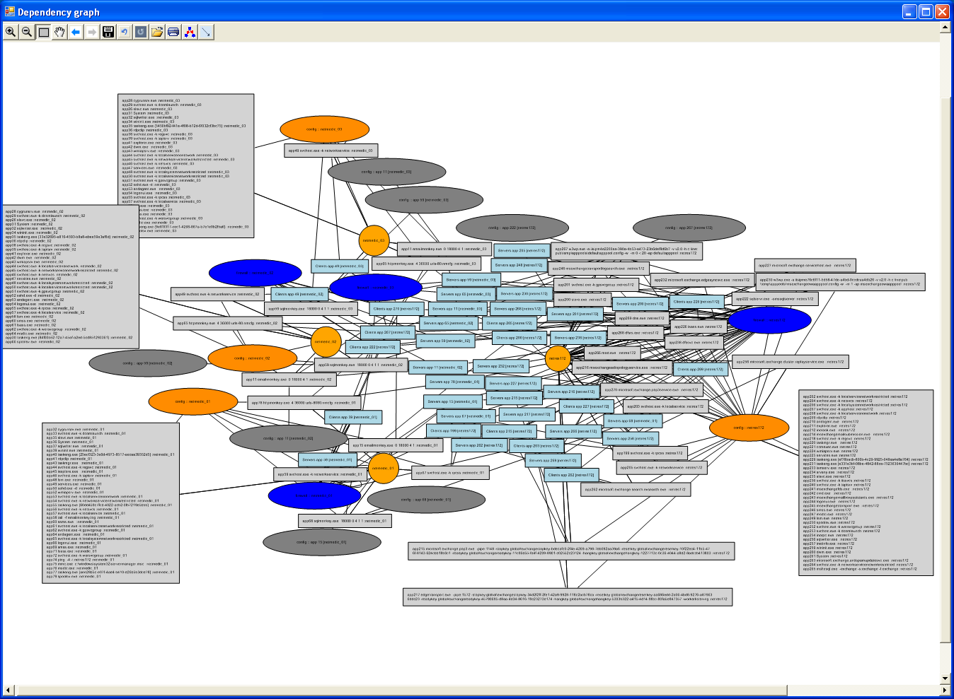
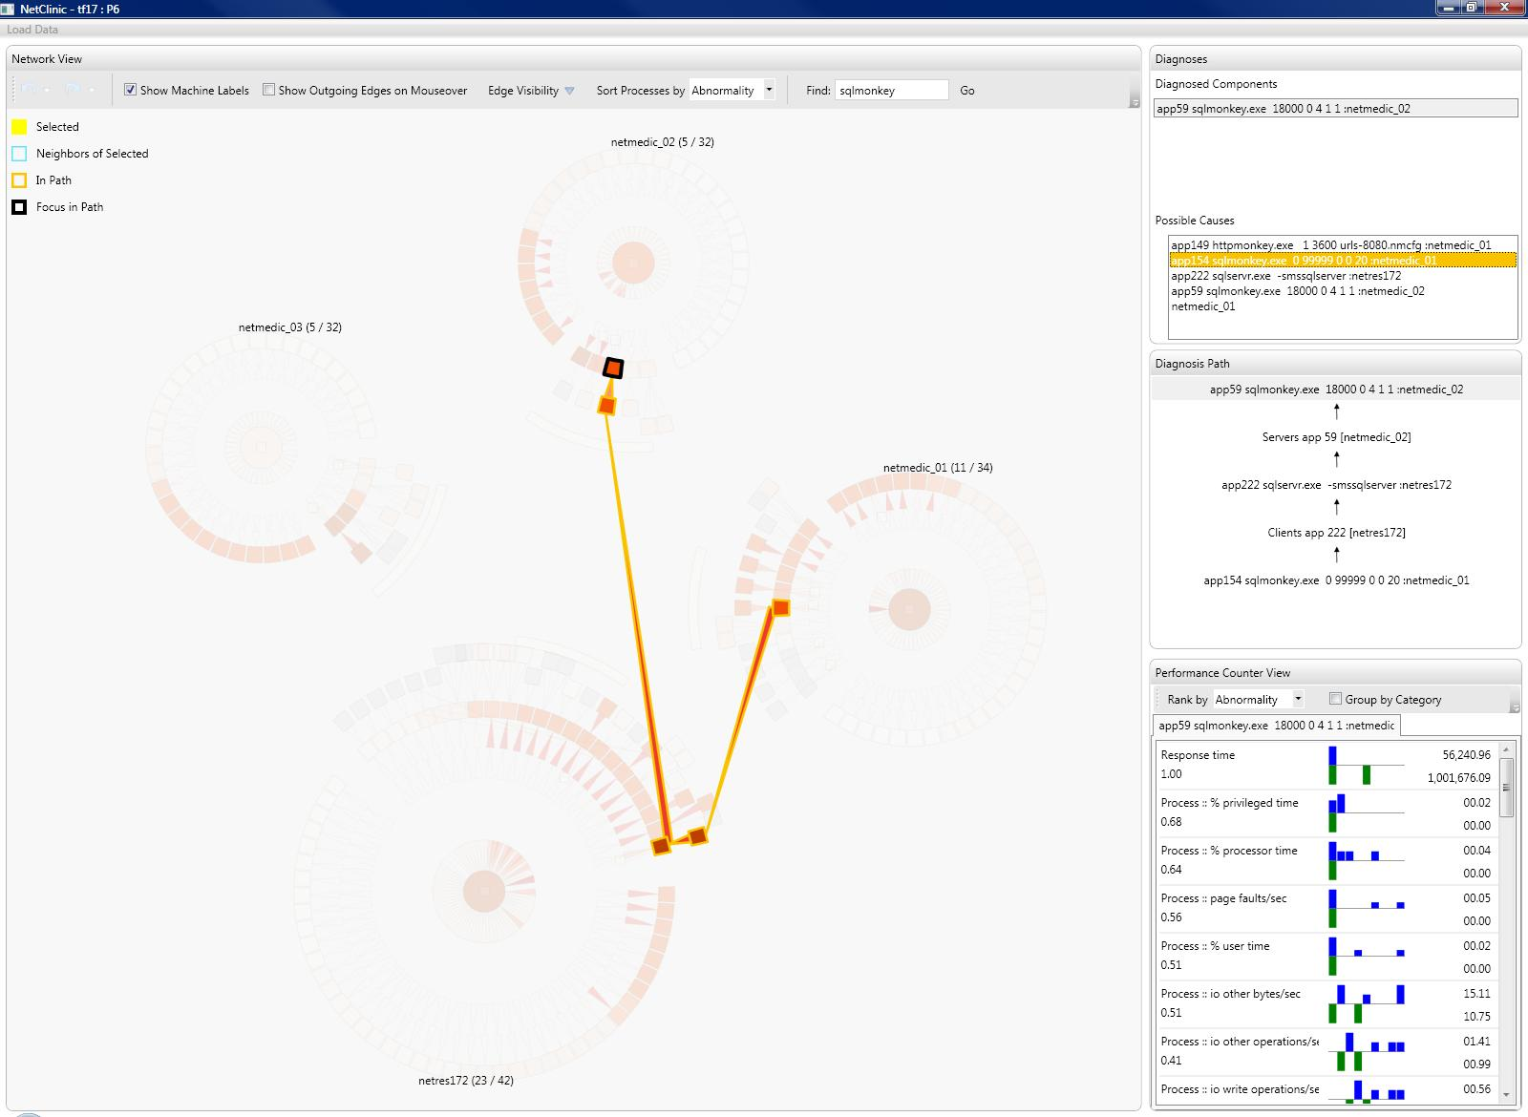
Making it real
Identify the impediments to making your work go beyond the paper
Release data, code
Deploy (e.g., on PlanetLab)
Talk to practitioners, technology transfer
More research, perhaps in other areas
Often takes you outside your traditional systems researcher role but well worth it
Notes:
Finally, you completed your research and wrote a nice paper about it. Are you done? No! It is up to you to make your research go further. Ask yourself what the big impediments are to making your work live past the paper you just wrote. There are a range of things you can do.
Release data that you gathered and the code you wrote. You should not look at releasing data and code as an altruistic activity. It is beneficial to you as well. It makes your work more visible than it would be without it. In the year after we released Rocketfuel data, there were 3 papers, that is roughly 10% of the conference program, published in the next SIGCOMM that used that data. And guess what, all of these papers helped spread the word about our work.
Another method is to talk to practitioners and try to transfer the technology you just built. I’ll admit that this is an incredibly frustrating exercise. I went through this some as a grad student and now more so as a researcher at Microsoft. You will learn, perhaps to your surprise, that good technology is not the sole criteria for success in this space. There are a whole bunch of other factors, many of which you have no control over. But it is great to know about them, so you have a slightly better chance of succeeding the next time around.
Sometimes looking at making your research real present up new research opportunities. Often, these secondary research problems are broader and more fundamental. You will not stumble upon them if you weren’t worrying about making your original research real.
A couple of years ago, I built a system called Netdiff that was supposed to compare the network path performance of backbone ISPs. In worrying about making that system real, I feared that its results were suspect because of sampling biases. It turns out that this problem is shared by many path measurement studies. I recently published a follow-on paper that describes the first set of techniques to reduce sampling biases in network path measurements.
Sometimes, you will hit research problems in other areas as well. For a recent inference-based diagnostic system that I built, I realized that it will never be adopted unless we could figure out a way to explain the analysis results to operators. It turns out that showing the results of complex statistical analysis to humans is an open problem in the HCI world. It needs to be addressed before many of the inference-based diagnostic systems, which our community works on, and not just the system we designed, can be made real. Along with HCI researchers, we recently submitted a paper to CHI describing an interface that makes it easy for humans to verify statistical analysis. This was an educational experience along many levels. It also alerted me to a basic weakness in systems whose output must be consumed by humans. We need to figure out a way to factor into the design of such systems the cost for a human to verify its operation. Without that, we may end up making those systems arbitrarily complex for incremental gains in accuracy.
Activities required to make your work real often take you outside what you might think of as traditional systems researcher’s role. And there is of course an opportunity cost to them. In the time it takes to do these, you could be doing more research. But time spent on these activities is well worth it. You already spent so much time in doing the original research; might as well spend some more to make it real. These activities will amplify your current research and greatly benefit your future research.

Slide 20
How does this method help address those common concerns?
Do we need another paper on …?
Pick the domain carefully
Know the problem before you build
Is this problem important?
Debate several solution ideas
Does this solution work?
What is new here?
When building, start small and then embellish
Why not solve the problem this other (simpler) way?
Make it real

Slide 21
Summary
Good research processes help avoid common mistakes and improve efficiency
As a community, we should openly share what works well and what doesn’t
One process:
0. Pick the domain carefully
1. Know the problem well before you build
2. Debate several solution ideas
Have a core idea to what you build
3. When building, start small and then embellish
4. Make it real

