Slide 1
A simple coordination mechanism for interdomain routing
Ratul Mahajan*
David Wetherall
Tom Anderson
University of Washington
(*now @ Microsoft Research)

Slide 2
The nature of Internet routing today
Within a contractual framework, ISPs select paths that are best for themselves
Potential downsides
higher BW provisioning
requires manual tweaking to fix egregious problems
inefficient end-to-end paths

Slide 3
An alternative approach: coordinated routing
ISPs have joint control
path selection is based on the preferences of both ISPs
Potential benefits
lower BW provisioning
no egregious cases that need manual tweaking
efficient end-to-end paths
  basis for interdomain QoS

Slide 4
Exisiting mechanisms cannot implement coordinated routing
Route optimization boxes help (stub) ISPs pick better routes from those available
MEDs implement receiver’s preferences
Without MEDs
With MEDs
D [1]
D [3]
D [11]

Slide 5
What makes for a good coordination mechanism?
MEDs have some nice properties
ISPs can express their own metrics
ISPs are not required to disclose sensitive info.
lightweight
requires only pairwise contracts
Provides joint control and benefits all ISPs

Slide 6
Our solution: Wiser
1
7
D [1]
D
2
D [3]
3
S
1
11
D [11]
Operates in a lowest-cost routing framework
downstream ISPs advertise their cost
upstream ISPs select paths based on both their own and received costs

Slide 7
Problems with vanilla lowest-cost routing
ISP costs are incomparable
Can be easily gamed

Slide 8
Cost normalization
1
0.7
10
7
3
2
2
30
11
1
7.3
110
Normalize costs such that both ISPs have “equal say”

Slide 9
Bounds on cost usage
7
0.7
2/3.3
2
2
1
7.3
7.3/3.3
Downstreams log cost usage of the upstream ISPs
Compute the ratio of avg. cost of paths used and announced
Contractually stipulate a bound on the ratio

Slide 10

Wiser in action
c3 = c1^{l} + internal path cost
←D, {OG}, c3
O
c1^{l}
c3^{l}
←D, {OG}, c4
←D, {G}, c1
c4^{l}
S
G
B
←D, {G}, c2
c5^{l}
D
←D, {YG}, c5
c2^{l}
Y
Convert incoming costs using the normalization factor
Add internal costs while propagating routes
Announce costs in routing messages
Select paths based on local and received costs

Slide 11
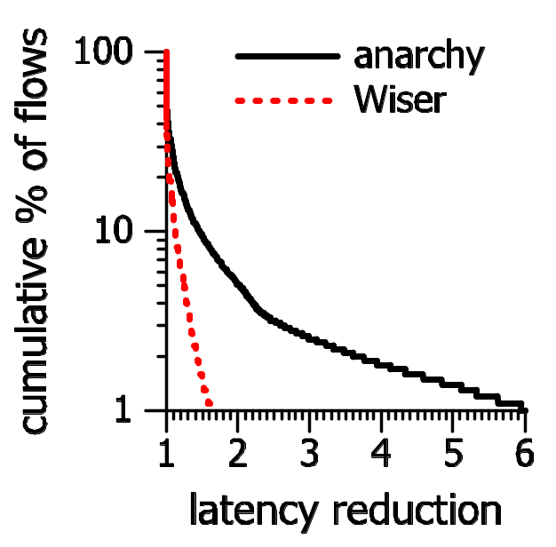
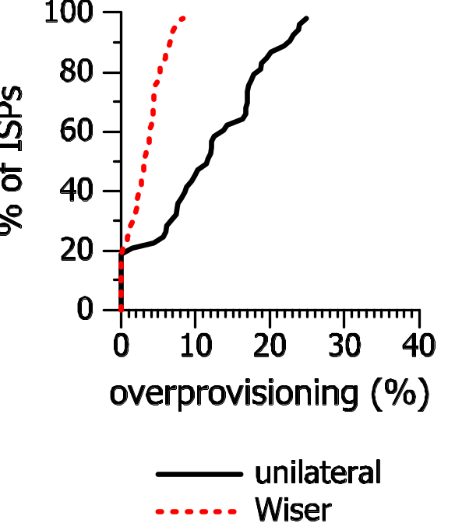
Example results
BGP
Wiser
cumulative % of flows
cumulative % of ISPs
BGP
Wiser
overprovisioning (%)
relative to stable load
path length inflation
relative to optimal
Wiser requires lower bandwidth provisioning
Wiser produces shorter paths
Significant benefit in the tail

Slide 12
Implementation
XORP prototype
Simple, backward-compatible extensions to BGP
  embed costs in non-transitive BGP communities
  border routers jointly compute normalization factors and log cost usage
  a slightly modified BGP decision process
Benefits even the first two ISPs that deploy it

Slide 13
Summary
Wiser is a simple mechanism to coordinate interdomain routing
  may lower provisioning, reduce manual tweaking, produce efficient paths, and help with interdomain QoS
Feedback: <ratul@cs.washington.edu>
Details/code: http://www.cs.washington.edu/research/networking/
negotiation/

