Slide 1

Detailed and understandable network diagnosis
Ratul Mahajan
With Srikanth Kandula, Bongshin Lee, Zhicheng Liu (GaTech), Patrick Verkaik (UCSD), Sharad Agarwal, Jitu Padhye, Victor Bahl

Slide 2
Network diagnosis explains faulty behavior
Starts with problem symptoms and ends at likely culprits
File server
Photo viewer
Configuration
User cannot access a remote folder
Configuration change denies permission
Notes:
None of us are strangers to network faults.
Modern networks have many components that interact in complex ways.
When something fails, diagnosing the fault, that is, explaining what went wrong can be a very frustrating experience for users and operators alike.

Slide 3

Current landscape of network diagnosis systems
Big enterprises
Large ISPs
Small enterprises
Network size
?
Notes:
As a result, network diagnosis has been the subject of much research and commercial activity.
One way to characterize this activity is through the lens of network size. On one end you have big networks with thousands of computers, such as those that belong to large ISPs or enterprises. On the other end you have small networks with tens of computers, such those inside homes and small enterprises. And of course, this is a spectrum rather than a dichotomy.
It turns out that most of the research and commercial activity has focused on one end of the spectrum. And little work has focused on the small network end.
Our work aims to correct this imbalance.

Slide 4

Why study small enterprise networks separately?
Big enterprises
Large ISPs
Small enterprises
Less sophisticated admins
Less rich connectivity
Many shared components
IIS, SQL, Exchange, …
Notes:
Now, you might wonder why small networks deserve special attention. Presumably, if a problem has been addressed in the more complex case of large networks, wouldn’t it automatically apply to the simpler case of small networks?
That turns out to be a wrong presumption because of qualitative differences between the two extremes.
- The small networks have less sophisticated admins that need more precise information from the diagnostic tools.
- The small enterprise networks also have less rich connectivity and have many shared components. For instance, a small enterprise might have only one subnet and one server machine that hosts a range of application servers. In contrast, a large enterprises tend to have many subnets, switches, and dedicated application servers. This richness of connectivity is exploited by diagnostic approaches for large enterprise networks.
These differences mean that techniques designed for large networks may not directly translate to small networks.
Its with these observations that we started our work.

Slide 5
Our work
Uncovers the need for detailed and understandable diagnosis
Develops NetMedic for detailed diagnosis
Diagnoses application faults without application knowledge
Develops NetClinic for explaining diagnostic analysis
Notes:
We show that they need detailed diagnosis. I will explain what I mean by that and why systems designed for large networks are incapable of it.
We then build NetMedic, a system for detailed diagnosis. A key feature of netmedic is that is able to diagnose application-specific failures in a way that does not require application knowledge.
So lets get started.

Slide 6

Understanding problems in small enterprises
Symptoms, root causes
100+ cases
Notes:
We characterize problems inside small enterprise networks using support transcripts from an unnamed company that provides technical support to small enterprises. Operators of small enterprises contact this company over e-mail or over the phone and describe the symptoms of their problems. The support person helps them debug the network and identify the root causes of the problem.
We got transcripts for an entire month. We randomly selected a small sample and read them. This enabled us to understand in detail what was going on in each of these instances.
After discarding cases that were incomplete or contained non-faults we were left with 150 cases. We classify these cases based on their symptoms and root causes.

Slide 7


And the survey says …..
Symptom
App-specific | 60 %
Failed initialization | 13 %
Poor performance | 10 %
Hang or crash | 10 %
Unreachability | 7 %
Identified cause
Non-app config (e.g., firewall) | 30 %
Software/driver bug | 21 %
App config | 19 %
Overload | 4 %
Hardware fault | 2 %
Unknown | 25 %
Handle app-specific
as well as generic faults
Identify culprits at a fine granularity
Detailed diagnosis
Notes:
This slides shows the overall categorization of symptoms and root causes. I’ll describe a couple of example faults in two slides. I don’t have time to go through the individual categories, so I will focus on the main points that I took away from this analysis.
Focusing on the symptoms, we see that they are all over the place from unreachability to crashes to poor performance.
The biggest one, however, is app-specific faults such as error codes or certain features not working. Unlike other generic faults, with app-specific faults, the application appears functional when observed superficially. But a detailed view of its operation reveals the faults.
The implication for the diagnostic system is that it should be able to handle both application-specific and generic faults.
Now, focusing on the identified causes, we again see a range of them, from configuration to buggy processes to overload.
One interesting aspect that we find in the logs is that the operators often knew which machine had the fault. But they needed help figuring out what aspect of the machine was faulty.
This implies that we should identify culprits at a fine granularity.
It is the combination of these two properties that we call detailed diagnosis, for lack of a better word.

Slide 8
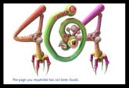
Example problem 1: Server misconfig
Browser
Web server
Server config
Browser

Slide 9
Example problem 2: Buggy client
SQL client C1
SQL server
Requests
SQL client C2

Slide 10

Example problem 3: Client misconfig
config
Outlook
Exchange server
config
Outlook
Notes:
The third problem concerned email.

Slide 11
Current formulations sacrifice detail (to scale)
Dependency graph based formulations (e.g., Sherlock [SIGCOMM2007])
Model the network as a dependency graph at a coarse level
Simple dependency model
Notes:
There are several approaches to building a diagnostic system. The paper discusses why we prefer dependency graphs based approach. The short version is that unlike signature-based approaches such an approach is capable of diagnosing a wider range of failures.
That is the reason that dependency graph based solutions have been proposed for large networks. A recent example being Sherlock. But the dependency graph formulation that current solutions, Sherlock as well as others, use are incapable of detailed diagnosis.
Current formulations model the network at a coarse level, for instance, at the level of machines. They then construct a dependency graph such as this one. A dependency edge means that the destination of the edge relies on the source for correct operation.
- The health of a node in the dependency graph is modeled using a single abstract variable. This simplifications treats all kinds of sicknesses as equivalent.
But the model of this dependency is a simple one. There are two simplifications:
- First, whenever a node is deemed unhealthy, it is assumed that it will make its dependent components unhealthy regardless of the nature of the sickness.
- Second, the dependency graph itself is simple in that does not allow for cycles, by which nodes are mutually dependent on each other. So, in this example, a sick client cannot make the server sick.
Once you see unhealthy nodes in the network, the goal of the diagnosis is to identify a small number of nodes whose sickness can explain all unhealthy nodes in the network.

Slide 12

Example problem 1: Server misconfig
Browser
Web server
Server config
Browser
The network model is too coarse in current formulations
Notes:
I’ll next explain using the same two example problems why this formulation cannot provide detailed diagnosis. I stress, however, this does not imply that the formulation is fundamentally broken. It’s just that it was designed for different environments and not for small enterprise networks.
…………
This degree of resolution may suffice in large enterprise networks that have dedicated servers, but will not be very useful for small enterprise operators.

Slide 13
Example problem 2: Buggy client
SQL client C1
SQL server
Requests
SQL client C2
The dependency model is too simple in current formulations

Slide 14
Example problem 3: Client misconfig
config
Outlook
Exchange server
config
Outlook
The failure model is too simple in current formulations

Slide 15
A formulation for detailed diagnosis
% CPU time
IO bytes/sec
Connections/sec
404 errors/sec
SQL client C1
Dependency graph of
fine-grained components
Component state is a
multi-dimensional vector
Exch.svr
IIS svr
SQL svr
SQL client C2
IIS config
Process
OS
Config
Notes:
Designing point solutions for the problems that I just described and other problems in our logs is easy. What is hard is having a common framework that can diagnose a wide range of the observed faults. Our goal is to design such a framework.
Towards that goal, we formulate detailed diagnosis as an inference problem that faithfully captures the dependencies and interactions in the network.
1. We model the network as a dependency graph of fine-grained components such as processes, OS, and various configuration entries.
This detailed modeling is necessary if we are to identify culprits at a fine granularity.
These components depend on each other as you might expect. For instance, a process depends on its OS and configuration of the application it is running. It also depends on the other processes that it communicates with.
2. We represent component state as a multi-dimensional vector. Each dimension captures some aspect of the component’s behavior. For instance, a process’s state might include these variables. Some are application-independent, and some are application-specific. Including application-specific variables in the states lets us observe application specific faults.
This multi-dimensional view of component state allows for components to impact other components based on their state. For example, a process might impact its machine when it is unhealthy in a way that consumes a lot of CPU but not when it observes too many connection failures.
I’d like to add that the rich view of component state needed for our formulation is already exposed by modern operating systems and applications. Our prototype uses the windows counter framework, but I believe similar information can be gleaned in unix-based Oses.

Slide 16
The goal of diagnosis
Identify likely culprits for components of interest
Without using semantics of state variables
➔ No application knowledge
C1
Svr
C2
Process
OS
Config
Notes:
The goal in this formulation is to identify likely culprits that are responsible for the sickness of the component that we want to diagnose.
This culprit is impacting the component of interest, possibly through a series of other components in the dependency graph.
- So, if C2 impacts C1 through Svr, we want to identify C2 as the culprit when we diagnose C1.
The basic primitive required for identifying such culprits is estimating when a component is impacting its neighbor. Once we have that information, we can use that to connect culprits to components of interest using a series of high impact edges.
Estimating when a component is impacting its neighbor is hard because whether components impact their neighbors depends on their state and we do not know a priori in which states a component impacts its neighbor.
One way to make that impact estimation is to use the semantics of state variables themselves. For instance, if the variable corresponding to received error codes in a client processes state is high, the chances are that the server is currently impacting the client.
Using the semantics of state variables is intractable.
- For starters, there can be too many variables. The IIS server process, for instance, exports over a 100 state variables.
- What is more problematic is that the semantics are application dependent. Different applications processes export different state variables, and inferring impact based on them will require embedding deep application knowledge into the diagnostic system.
Because small enterprise networks run a range of applications, embedding knowledge of all possible applications is intractable.

Slide 17
Using joint historical behavior to estimate impact
d_{n}ª | d_{n}^{b} | d_{n}^{c}
. | . | .
. | . | .
. | . | .
. | . | .
. | . | .
d₁ª | d₁^{b} | d₁^{c}
s_{n}ª | s_{n}^{b} | s_{n}^{c} | s_{n}^{d}
. | . | . | .
. | . | . | .
. | . | . | .
. | . | . | .
. | . | . | .
s₁ª | s₁^{b} | s₁^{c} | s₁^{d}
How “similar” on average states of D are at those times
Identify time periods when state of S was “similar”
D
S
d₀ª | d₀^{b} | d₀^{c}
s₀ª | s₀^{b} | s₀^{c} | s₀^{d}
Request rate (low)
Response time (high)
C1
H
Svr
Request rate (high)
H
Request rate (high)
Response time (high)
C2
L
Notes:
We thus devised a technique that estimates impact without using the semantics of state variables. The key insight is that we can use the joint historical behavior of the two components.
Suppose we want to know if S is impacting D. Let the current states of S be S0 and D be D0, as shown.
- We look for historical periods in time where the state of S was similar to S0. State similarity is a measure of how close the values are for individual variables.
- We then check how similar on average the states of D are to D0.
The intuition behind this approach is simple. If every time S gets into a state similar to S0, D gets into a state similar to D0, the chances are high that S is currently impacting D. If on the other hand, D’s state is usually dissimilar when S gets into state S0, then the chances are that S is not impacting D.
If S is in a state that was not seen before we conservatively estimate the impact to be high.
Lets see how this approach helps in this example that is based on the buggy SQL client example. Let these be the state variables of the three components. In the parenthesis, I show the current state of those variables.
- The impact from Svr to C1 will be estimated as high if every time svr has a high request rate, C1 has a high response time along with a normal request rate
- The impact from C2 to Svr will be high if C2 was never observed to have a high request rate in the past.
Thus, we get a high impact path from C2 to C1 through the Server, without having to interpret what those variables mean.
- At the same time, our technique will correctly estimate that the impact from Svr to C2 is low if every time svr had a high request rate, C2 did not necessarily have a high request rate.
This ability to correctly infer low impact turns out to be critical because it lets us more easily pick out the correct high impact path.

Slide 18
Robust impact estimation
Ignore state variables that represent redundant info
Place higher weight on state variables likely related to fault being diagnosed
Ignore state variables irrelevant to interaction with neighbor
Account for aggregate relationships among state variables of neighboring components
Account for disparate ranges of state variables
Notes:
The paper describes in detail how we implement this technique in a manner that is robust to components having a large number of state variables with arbitrary properties.
I’ll summarize a couple of things that we do.
While computing state similarity, we ignore state variables that represent information that is redundant to other information in the state. For instance, state of the OS may contain both memory used and memory available. Ignoring redundant dimensions produces a more representative measure of state similarity.
- we automatically infer which variables represent redundant information
We also place a higher weight on state variables that are likely related to fault being diagnoses. Such variables are identified as those that currently have statistically abnormal values. For instance, when a fault is related to high CPU usage the state variables impacted by CPU usage will more likely be abnormal.
- placing higher weight on such variables when computing state similarity lets us focus state similarity on variables that are currently more important

Slide 19
Ranking likely culprits
0.8
Path weight
Global impact
B
A
0.8
A
A
0.8
A
0.8
0.2
0.2
C
D
A
0.8
B
A
1.8
B
C
C
B
0.8
C
A
2.6
C
B
A
A
0.2
D
A
0.4
D
A
D
Notes:
The edge weights help by

Slide 20
Implementation of NetMedic
Monitor components
Diagnose
edge impact
path impact
Target components
Diagnosis time
Reference time
Component states
Ranked list of likely culprits
Notes:
The implementation of NetMedic has two parts.
One part monitors various components and periodically logs their state.
The other part is responsible for diagnosis. It takes as input the log of components states, the component of interest, the time period to diagnose, and the time period to use as reference.
It produces a list of likely culprits that is ranked from most likely to least likely.
The idea is that the operator can look at the top few culprit in the list and decide which one is the real culprit based on the states of components.

Slide 21

Evaluation setup
IIS, SQL, Exchange, …
.
.
.
#components | ~1000
#dimensions per component (avg) | 35
10 actively used desktops
Diverse set of faults observed in the logs
Notes:
We evaluated netmedic in a setting that mimics a small enterprise network.
We set up a server machine that hosted multiple, unmodified application servers. As client machines we use desktops of our colleagues that have all the noise and bursty activity that you expect from actively used desktops. On these desktops we ran custom client processes that communicated with the server.
To give you a sense of the detail in which we observe this network, this 11-machine network has roughly 1000 components and there are 35 state variables per component on average.
Into this network, we injected 10 diverse set of faults that we observed in our logs. We measure the effectiveness of netmedic using the rank assigned to the actual culprit. The best case value of this rank is 1.

Slide 22
NetMedic assigns low ranks to actual culprits
Notes:
We see that netmedic does quite well. For 80% of faults, netmedic infers the actual culprit as the most likely one. The ranks of the remaining 20% are low as well.
In contrast a diagnostic scheme modeled after current coarse formulations does poorly. This formulations uses a single state variable as an abstract measure of overall component health and used that variable to decide if a component is impacting its neighbor.

Slide 23
NetMedic handles concurrent faults well
2 simultaneous faults
Notes:
This graph shows that NetMedic can handle well even the more challenging case of concurrent faults. In this experiment, we injected two simultaneous faults and measure the ability of netmedic to identify actualy culprits starting from the respective symptoms.

Slide 24
Other empirical results
Netmedic needs a modest amount (~60 mins) of history
The key to effectiveness is correctly identifying many low impact edges
It compares favorably with a method that understands variable semantics
Notes:
There are other results in the paper that I do not have time to discuss.
We show that netmedic requires only a modest amount of history. The experiments I showed in previous slides used only an hour’s worth of history.
We also show that even though netmedic does not know the semantics of state variables, it compares favorably to a method that understands variable semantics.

Slide 25
Unleashing (systems like) NetMedic on admins
How to present the analysis results?
Need human verification
(Fundamental?) trade-off between coverage and accuracy
Rule based
Inference based
Accuracy
State of the practice
Research
activity
Fault coverage
Notes:
So, in our research cocoons, we were pretty pleased with how well NetMedic was performing. We started talking to various people inside and outside Microsoft, including a few field engineers.
We quickly learned that we had a new problem at our hand. We didn’t know how to present the results of NetMedic to admins. The central problem was that the system could sometimes be wrong, which meant that the admins should be able to verify its output before acting on it. This is not an easy task because the eventual output is the result of a series of complicated computations. It is also complicated by our focus on small enterprise networks that tend to have less sophisticated admins.
We also realized that this problem is not unique to NetMedic but is shared by all inference based diagnostic systems. In general, there appears to be a trade-off between accuracy and the fraction of faults covered by a diagnostic system. This trade-off appears to be fundamental, though no one has proved it to my knowledge.
The research and commercial worlds currently seem split on this trade-off. Most deployed diagnostic systems that I am aware of use a rule-based approach. In this approach, rules or signatures encode common faults. An accurate diagnosis is provided when these faults occur but nothing is done for the remaining faults. This approach tends to cover a small subset of the faults. Because of this, much recent research has been exploring an inference-based approach. This approach covers a wider range of faults but is less accurate.
I find that engineers are very skeptical about this approach because they do not want to output possibly incorrect results that their users cannot verify. They thus feel more comfortable with rule-based approaches.
In our work, we have begun exploring if we can improve the understandability of inference-based systems, in an effort to improve the chances of them being adopted.

Slide 26
The understandability challenge
Admins should be able to verify the correctness of the analysis
Identify culprits themselves if analysis is incorrect
Two sub-problems at the intersection with HCI
Visualizing complex analysis (NetClinic)
Intuitiveness of analysis (ongoing work)
Notes:
So, what we mean by understandability is simple. That admins should be able to ……..
I see this problem as having two components, both of which are at the intersection of systems and HCI. The first one is visualizing complex analysis. In this sense, this task can be bucketed into the growing field of visual analytics. But the focus of existing work in visual analytics is on compact representation of large amounts of data, not so much on providing users an ability to verify sophisticated analysis. We have developed a system called NetClinic that I’ll describe next.
The second one is if there is a way to modify the analysis itself such that its more intuitive and easy to explain. This problem is more speculative and subject of ongoing work. I’ll share my thoughts on it.

Slide 27
NetClinic: Visualizing diagnostic analysis
Underlying assumption: Admins can verify analysis if information is presented appropriately
They have expert, out-of-band information
Views diagnosis as multi-level analysis
Makes results at all levels accessible on top of a semantic graph layout
Allows top-down and bottom-up navigation across levels while retaining context

Slide 28
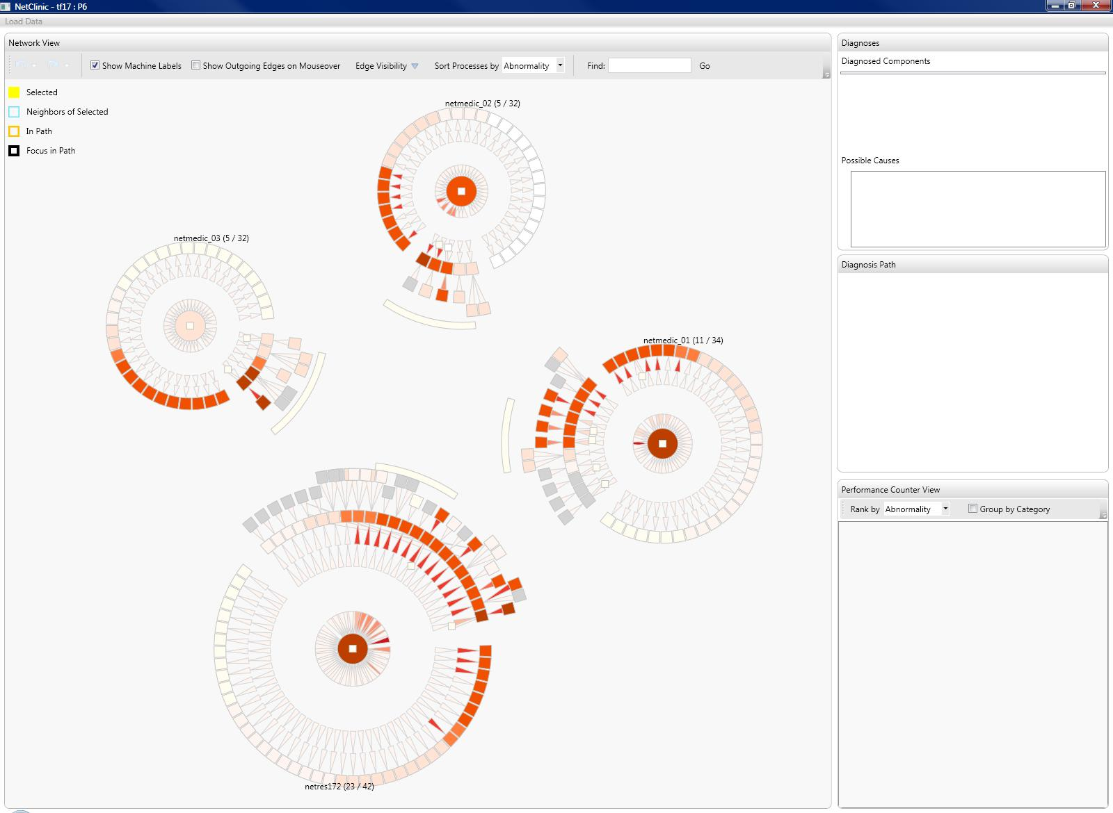

Slide 29
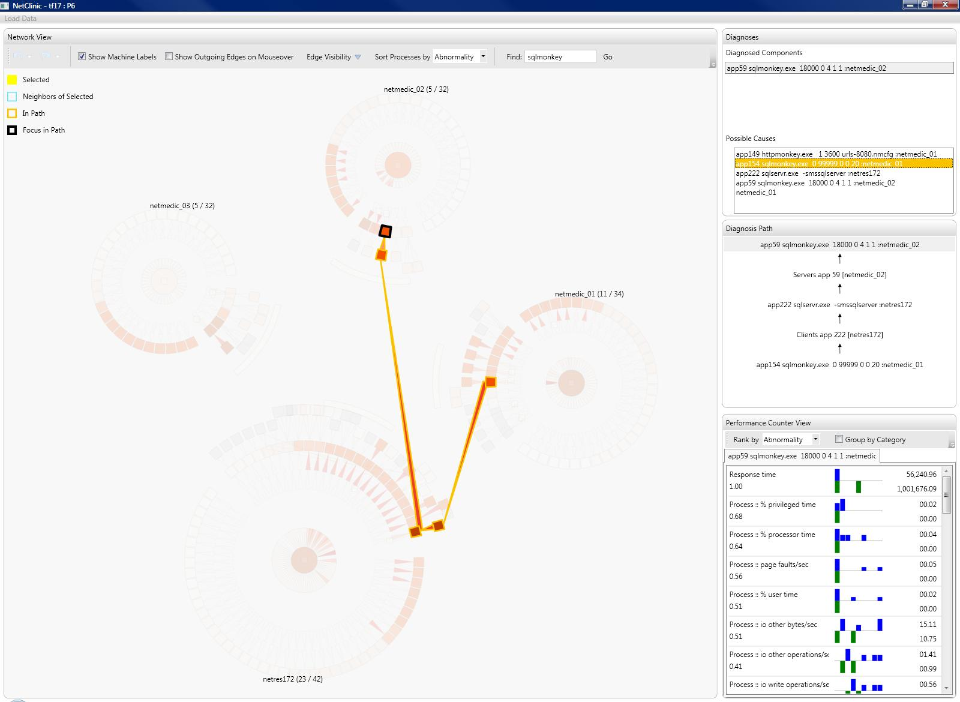

Slide 30
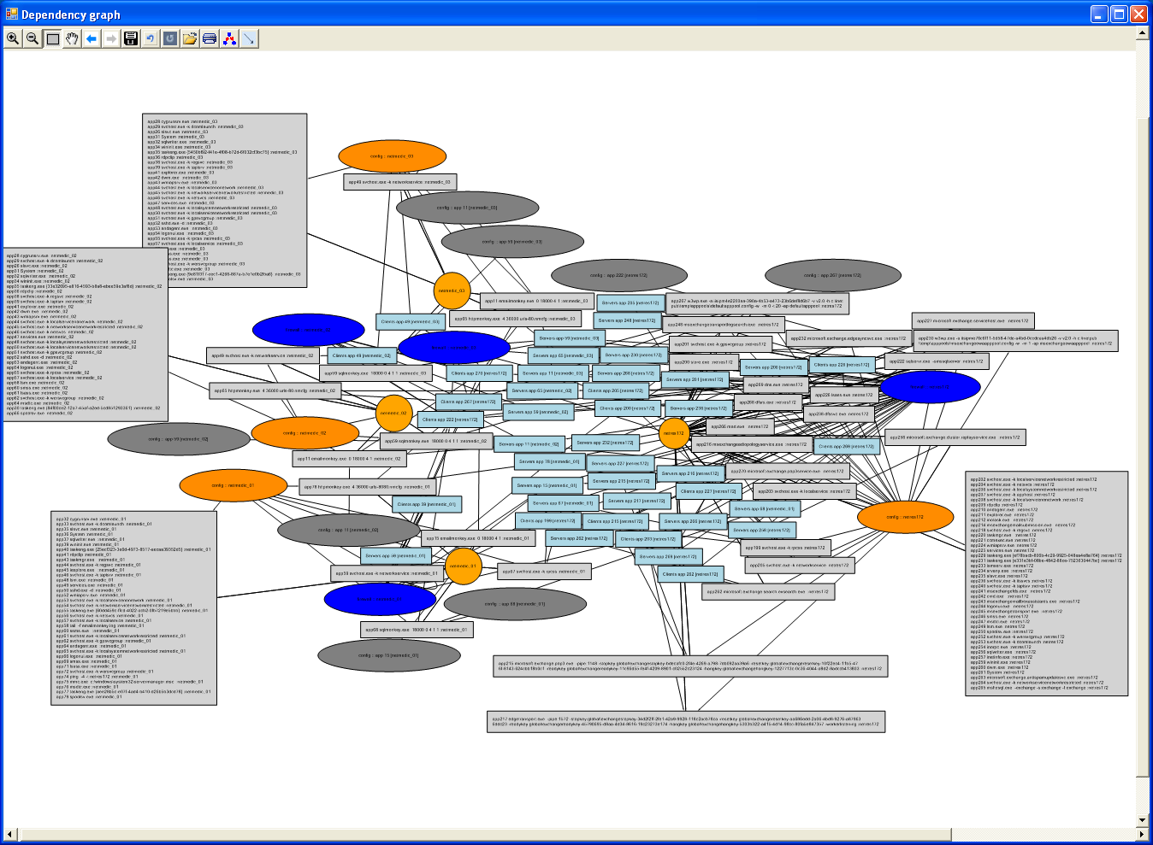

Slide 31
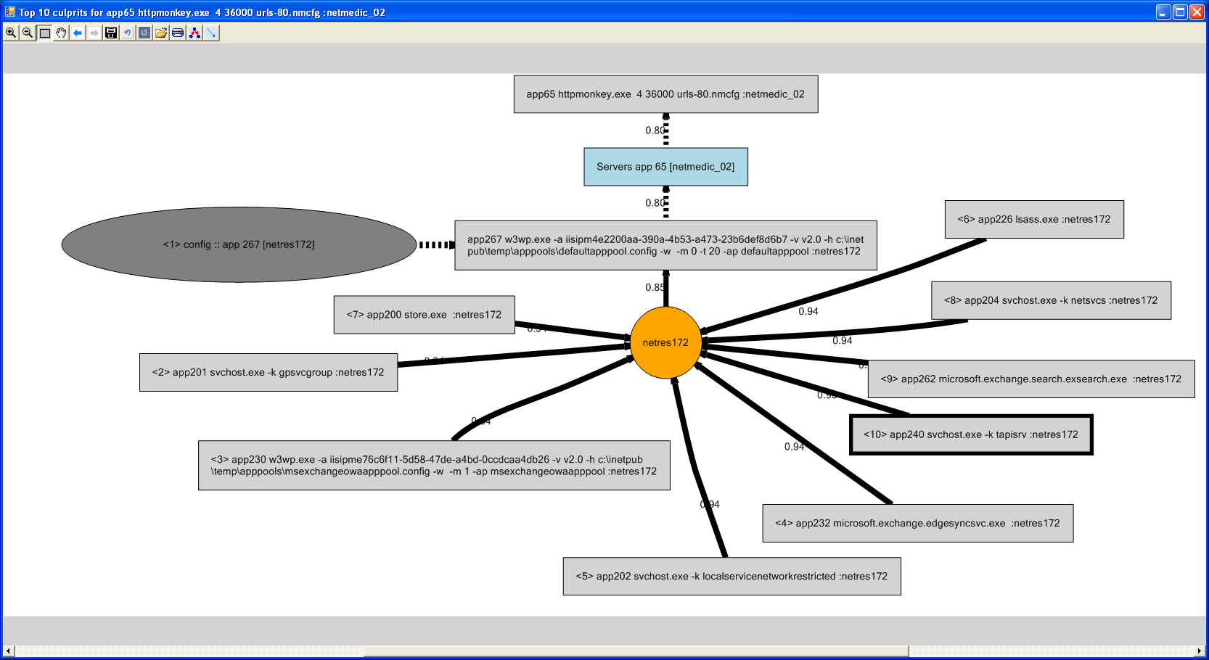

Slide 32
NetClinic user study
11 participants with knowledge of computer networks but not of NetMedic
Given 3 diagnostic tasks each after training
88% task completion rate
Uncovered a rich mix of user strategies that the visualization must support

Slide 33
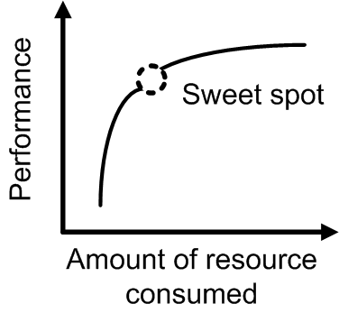
Intuitiveness of analysis
What if you could modify the analysis itself to make it more accessible to humans?
Counters the tendency to “optimize” for incremental gains in accuracy
Understandability
Accuracy
Notes:
A non-traditional dimension of system effectiveness

Slide 34
Intuitiveness of analysis (2)
Goal: Go from mechanical measures to more human centric measures
Example: MoS measure for VoIP
Factors to consider
What information is used? E.g., Local vs. global
What operations are used? E.g., Arithmetic vs. geometric means

Slide 35
Conclusions
Thinking small (networks) can provide new perspectives
Understandability
Accuracy
Accuracy
Accuracy
Coverage
Detail
Coverage
Coverage
Detail
NetMedic enables detailed diagnosis in enterprise networks w/o application knowledge
NetClinic enables admins to understand and verify complex diagnostic analyses
Notes:
To conclude, I described a system called NetMedic to enable detailed diagnosis in small enterprise networks.
- NetMedic can diagnose application specific faults without application knowledge
More broadly, our work makes the case that small enterprise networks deserve more attention because solutions designed for large enterprises may not be effective this setting.
Through this work, we learned another reason to study small networks. Large network methods are designed with scalability as a first order concern. Small networks let us put scalability concerns to one side and ask how we might address some of the harder challenges related to network diagnosis. Very different solutions emerge from this perspective. This investigation is one of the directions where we are headed.

